Slide 1
Identify IP Addresses via Fine-Tuned AI Models
https://github.com/frankwxu/digital-forensics-lab/tree/main/AI4Forensics/IP_Identifier_Fine_Tuning
Notes:
https://github.com/openai/openai-cookbook/blob/main/examples/Fine-tuned_classification.ipynb

Slide 2
Overview
IP addresses as digital forensic evidence
Background
Problem
Proposed approach
Introduction to object identification with AI
Object classification
Fine-tunning
Identify IP Addresses via Fine-tuned Models
Data processing, training, testing, and validation
Summary

Slide 3
IP addresses as digital forensic evidence

Slide 4
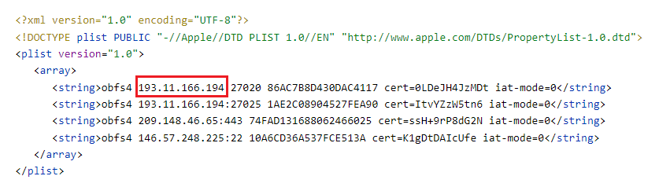
Motivation
Mobile devices contain multiple configuration files
e.g., xxx.plist (an iOS configuration file)
A configuration file contains lots of potential digital evidence
IP of a server, Geolocation, Name, Address,
port number
Notes:
<?xml version="1.0" encoding="UTF-8"?> <!DOCTYPE plist PUBLIC "-//Apple//DTD PLIST 1.0//EN" "http://www.apple.com/DTDs/PropertyList-1.0.dtd"> <plist version="1.0"> <array> <string>obfs4 193.11.166.194:27020 86AC7B8D430DAC4117 cert=0LDeJH4JzMDt iat-mode=0</string> <string>obfs4 193.11.166.194:27025 1AE2C08904527FEA90 cert=ItvYZzW5tn6 iat-mode=0</string> <string>obfs4 209.148.46.65:443 74FAD131688062466025 cert=ssH+9rP8dG2N iat-mode=0</string> <string>obfs4 146.57.248.225:22 10A6CD36A537FCE513A cert=K1gDtDAIcUfe iat-mode=0</string> </array> </plist>

Slide 5
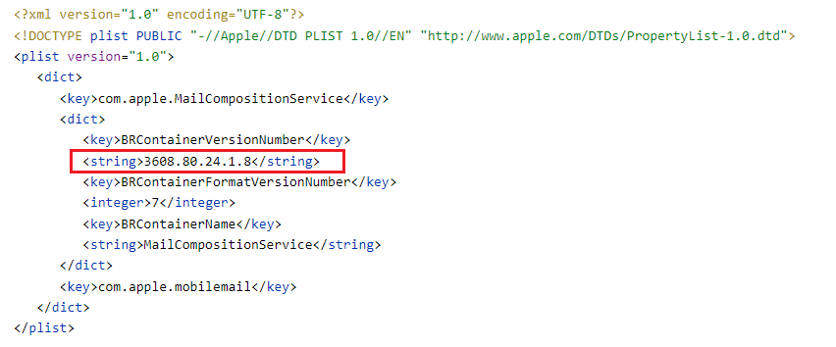
Problem
Identifying the correct IP address is not an easy task. Why?
Not the correct IP, it is the container’s version number!
Notes:
<?xml version="1.0" encoding="UTF-8"?>
<!DOCTYPE plist PUBLIC "-//Apple//DTD PLIST 1.0//EN" "http://www.apple.com/DTDs/PropertyList-1.0.dtd">
<plist version="1.0">
<dict>
<key>com.apple.MailCompositionService</key>
<dict>
<key>BRContainerVersionNumber</key>
<string>3608.80.24.1.8</string>
<key>BRContainerFormatVersionNumber</key>
<integer>7</integer>
<key>BRContainerName</key>
<string>MailCompositionService</string>
</dict>
<key>com.apple.mobilemail</key>
</dict>
</plist>

Slide 6
Goal
Utilizing AI techniques to identify correct IP addresses from iOS configuration files.
Fine-tuning pre-trained language models
pre-trained language models are provided by openAI
Note
Other approaches may solve the problem, e.g., regular expression

Slide 7
Approach
Use regular expressions to identify possible IPs
Inputs: a text line from a configuration file contains all possible IPs
output: all possible IPs (positive or negative)
false positives are included intentionally
Utilize OpenAI language model to identify if the IP is correct
Binary classification
Inputs: the text line + IPs identified with regular expression
Output: the possible IP a real IP or not (positive or negative)

Slide 8
Introduction to Object Identification with AI

Slide 9




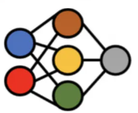
How does AI identify if a fruit is an apple?
Input Dataset
Training Process
This is an apple.
This is not an apple.
Model
Trained Model
Label/Truth/Annotation
It is an apple
Testing Process
Test Data
Trained Model

Slide 10
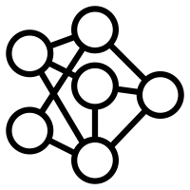



Fine-tuning a model to identify objects
Trained Model
Fine-Tuning Process
Classifier
Fine-tuned Model
Additional Domain Specific Data
Testing Process
It is valid IP
Test Data
Fine-tuned Model

Slide 11
Identify IP Addresses via Fine-tuned Models

Slide 12
Approach
Prepare a dataset
Train a specified model
Test a fine-tuned model
Evaluate model performance
Understand confusion matrix

Slide 13
A. Preparing a dataset

Slide 14


training dataset (80%)
preprocessing
test dataset (20%)
Prepare Dataset Overview
Should be training/validation/test. We simplify the data

Slide 15
Preparing dataset steps
Label IP addresses in a single line
Convert the single line with the label to prompt-completion pair
Save multiple prompt-completion pairs to a file (.jsonl)
i.e., JSON Lines text
e.g., dataset.jsonl (openAI format)
Split dataset.jsonl to training and testing datasets

Slide 16
1. Label IP addresses (positive or negative)
,
# | Text Line | IP from Regx | Label (Truth)
1 | <string>obfs4 193.11.166.194:27025 1AE2C08904527FEA90 cert=ItvYZzW5tn6 iat-mode=0</string> | 93.11.166.194 | Positive
2 | <string>3608.80.24.1.8</string> | 80.24.1.8 | Negative
We included IP from regular expression to help us to label (pos or neg) the IP address
False Positive: because it is a container version, not an IP address

Slide 17
2. Convert the single line
Convert the single line with the label to prompt-completion pair
Key words
{"prompt": "prompt text", "completion": “ ideal generated text"}
,
# | Text Line | IP from Regx | Label
1 | <string>obfs4 193.11.166.194:27025 1AE2C08904527FEA90 cert=ItvYZzW5tn6 iat-mode=0</string> | 193.11.166.194 | Positive

Slide 18
Best practice for prompt-completion formatting
{"prompt": "prompt text ->", “completion": “_xxx \n"}
Each prompt should end with a fixed separator
The separator informs the model when the prompt ends and the completion begins.
The separator should not appear elsewhere in any prompt.
\n\n###\n\n, ->
Each completion should start with a whitespace
Model tokenization tokenizes most words with a preceding whitespace.
Each completion should end with a fixed stop sequence
inform the model when the completion ends.
A stop sequence could be any other token that does not appear in any completion.
\n, ###, END

Slide 19
prompt-completion pair example with the best practice
,
# | Text Line | IP from Regx | Label
1 | <string>obfs4 193.11.166.194:27025 1AE2C08904527FEA90 cert=ItvYZzW5tn6 iat-mode=0</string> | 93.11.166.194 | Positive
Convert to a prompt-completion pair
added new annotation
{
"prompt": " <string>obfs4 193.11.166.194:27025 1AE2C08904527FEA90 cert=ItvYZzW5tn6 iat-mode=0</string>
; 193.11.166.194 ->",
"completion": “ Positive END“
}
a fixed separator
a white space
END: optional stop sequence

Slide 20
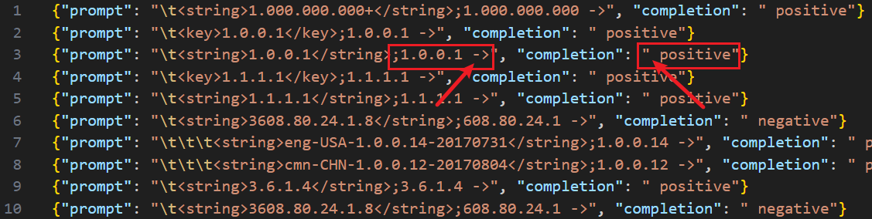
3. Save multiple p&c pairs to a file (dataset.jsonl)
we don’t use a stop token

Slide 21
4. Split dataset.jsonl to training and test datasets
dataset_train.jsonl
dataset_test.jsonl

Slide 22
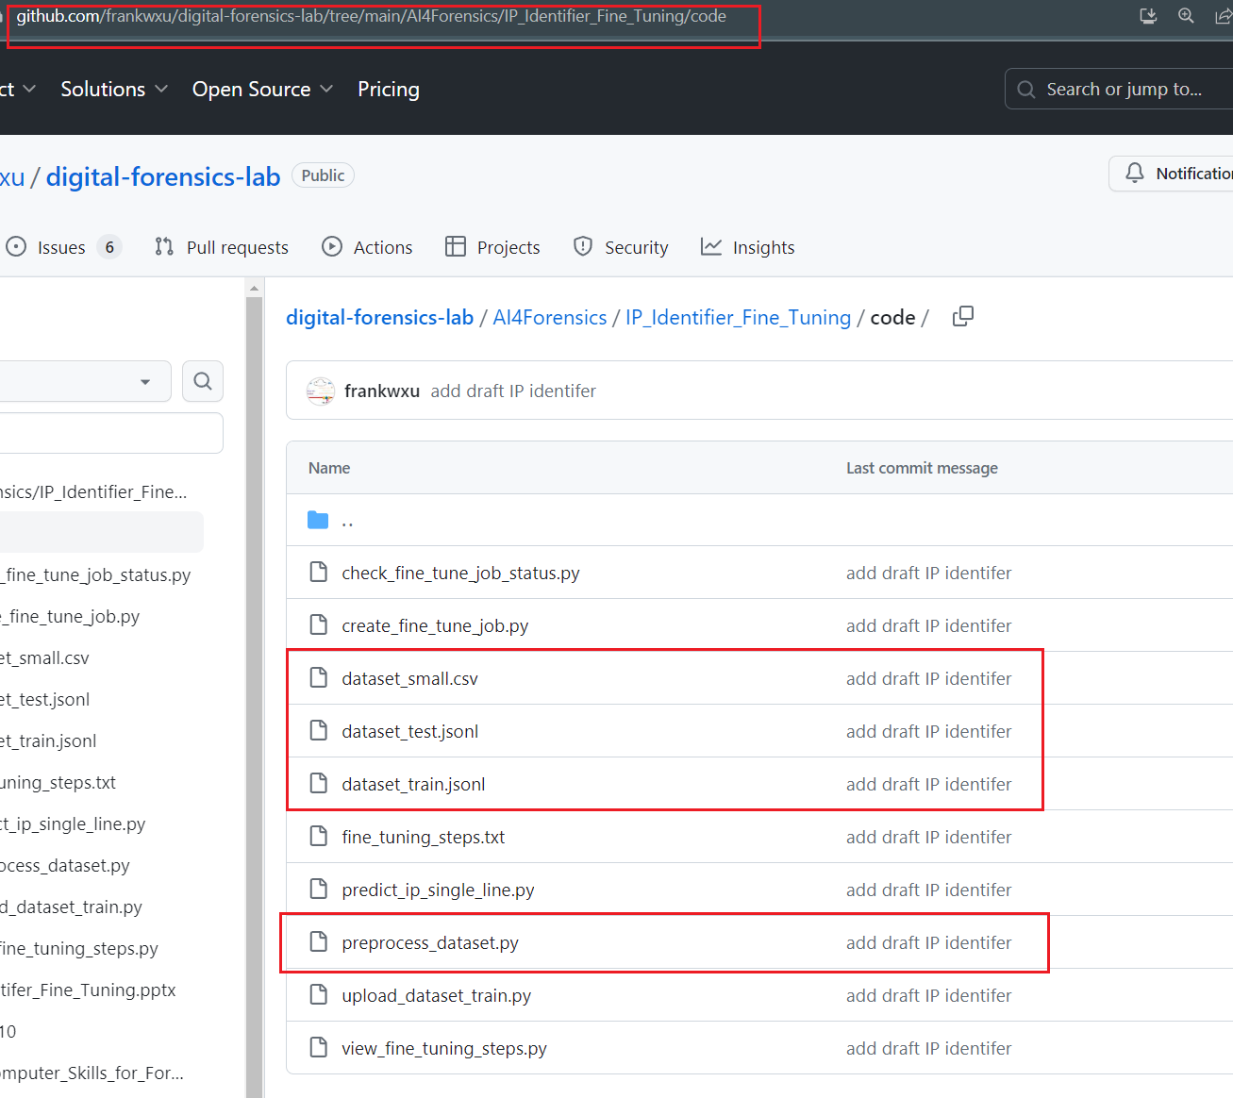

https://github.com/frankwxu/digital-forensics-lab/tree/main/AI4Forensics/IP_Identifier_Fine_Tuning/code
Input labeled dataset
Output of the preprocessing
Preprocess input dataset

Slide 23
B. Train a specified model

Slide 24


Training steps
3. check job info
4. view training progress
1. Upload a training dataset
2. Create a fine-tunning job
openAI trains
Training dataset
job ID
fine-tuned model ID
file ID

Slide 25
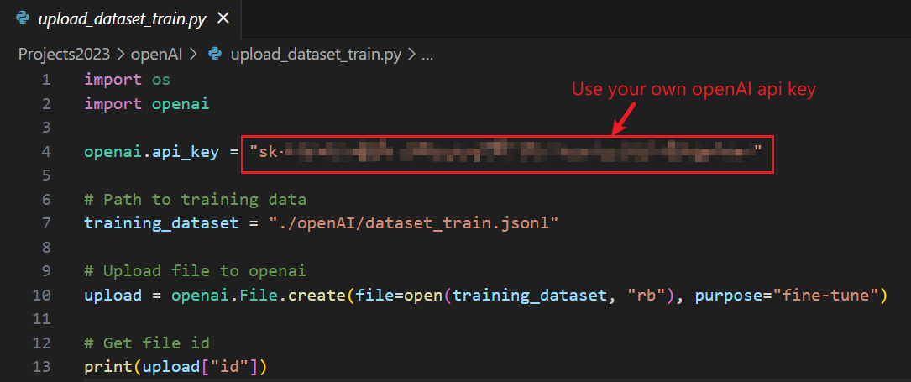
1. Upload the training dataset to openAI
https://raw.githubusercontent.com/frankwxu/digital-forensics-lab/main/AI4Forensics/IP_Identifier_Fine_Tuning/code/upload_dataset_train.py
pip install --upgrade openai
Execution results which shows the uploaded dataset ID
uploaded file ID
Notes:
file-1kZdBPJtBAHOehkHuhc8z5N1
pip install --upgrade openai

Slide 26
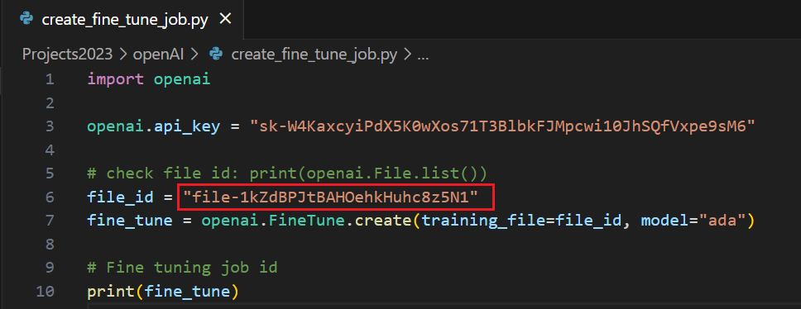
2. Create a fine-tuning job
https://raw.githubusercontent.com/frankwxu/digital-forensics-lab/main/AI4Forensics/IP_Identifier_Fine_Tuning/code/create_fine_tune_job.py
Creates a job that fine-tunes a specified model from a given dataset
Input: file (id) that contains the training data
output: fine-tune job object with ID

Slide 27
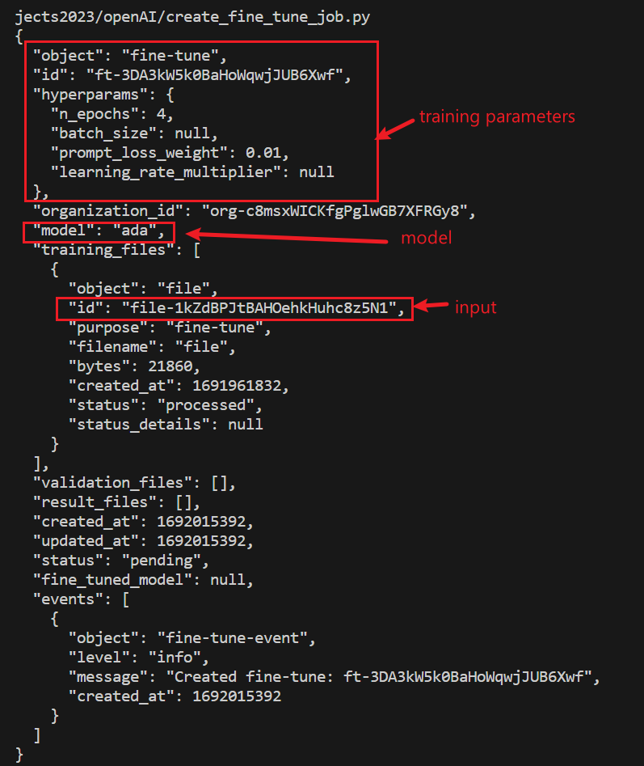
Output: Fine-tune object description
fine-tuning job ID
job status
Notes:
{
"object": "fine-tune",
"id": "ft-3DA3kW5k0BaHoWqwjJUB6Xwf",
"hyperparams": {
"n_epochs": 4,
"batch_size": null,
"prompt_loss_weight": 0.01,
"learning_rate_multiplier": null
},
"organization_id": "org-c8msxWICKfgPglwGB7XFRGy8",
"model": "ada",
"training_files": [
{
"object": "file",
"id": "file-1kZdBPJtBAHOehkHuhc8z5N1",
"purpose": "fine-tune",
"filename": "file",
"bytes": 21860,
"created_at": 1691961832,
"status": "processed",
"status_details": null
}
],
"validation_files": [],
"result_files": [],
"created_at": 1692015392,
"updated_at": 1692015392,
"status": "pending",
"fine_tuned_model": null,
"events": [
{
"object": "fine-tune-event",
"level": "info",
"message": "Created fine-tune: ft-3DA3kW5k0BaHoWqwjJUB6Xwf",
"created_at": 1692015392
}
]
}

Slide 28
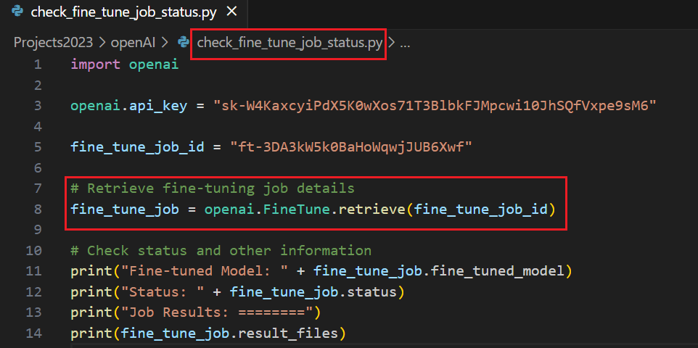
3. Check fine-tune job info (model, status, progress)
https://raw.githubusercontent.com/frankwxu/digital-forensics-lab/main/AI4Forensics/IP_Identifier_Fine_Tuning/code/check_fine_tune_job_status.py
Train model, training status, and training process information
Input: fine-tune job (id)
output: fine-tune job info
output 1: fine-tune model
output 2: fine-tune status
output 3: fine-tune progress file info
Notes:
Fine-tuned Model: ada:ft-university-of-baltimore-2023-08-14-12-39-06
Status: succeeded
Job Results: ========
[<File file id=file-ngHRotibSy82Mr55IjsPP2uK at 0x1c1873fa7c0> JSON: {
"object": "file",
"id": "file-ngHRotibSy82Mr55IjsPP2uK",
"purpose": "fine-tune-results",
"filename": "compiled_results.csv",
"bytes": 31134,
"created_at": 1692016747,
"status": "processed",
"status_details": null
}]

Slide 29
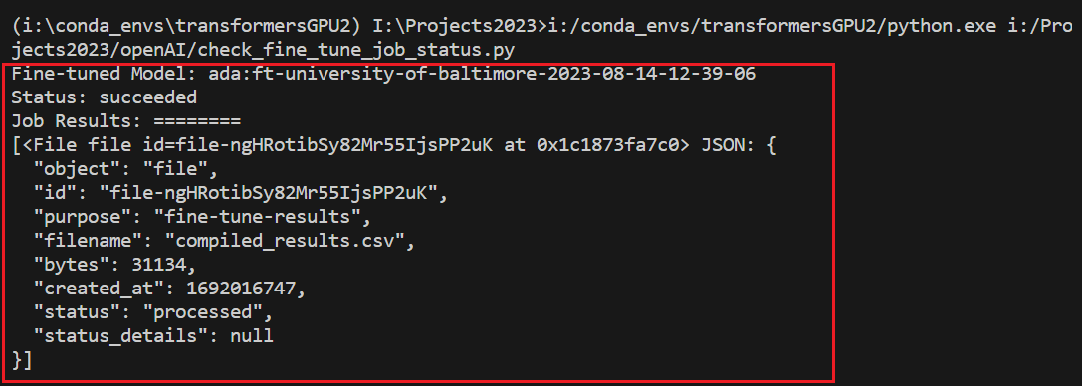
Outputs: (1) model: ada:ft-university-of-baltimore-2023-08-14-12-39-06
(2) fine-tune steps: "file-ngHRotibSy82Mr55IjsPP2uK”
training completed!
we can view fine-tune steps, e.g., training_loss
Notes:
Fine-tuned Model: ada:ft-university-of-baltimore-2023-08-14-12-39-06
Status: succeeded
Job Results: ========
[<File file id=file-ngHRotibSy82Mr55IjsPP2uK at 0x1c1873fa7c0> JSON: {
"object": "file",
"id": "file-ngHRotibSy82Mr55IjsPP2uK",
"purpose": "fine-tune-results",
"filename": "compiled_results.csv",
"bytes": 31134,
"created_at": 1692016747,
"status": "processed",
"status_details": null
}]

Slide 30
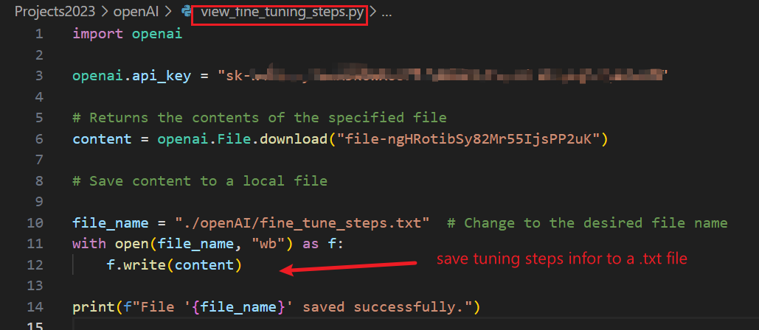
4. View fine-tuning progress information
https://raw.githubusercontent.com/frankwxu/digital-forensics-lab/main/AI4Forensics/IP_Identifier_Fine_Tuning/code/view_fine_tuning_steps.py
Download fine-tunning steps information
Input: file (id) that saves the training progress info

Slide 31
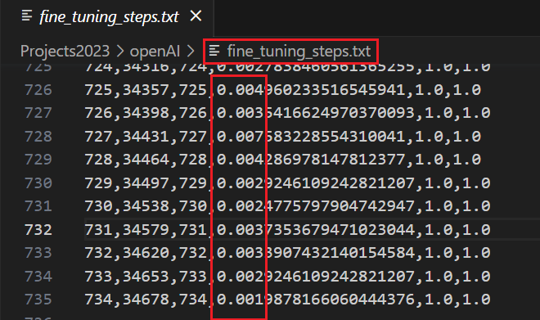
Running result
View fine-tuning steps information
training_loss should decrease

Slide 32
C. Test a fine-tuned model

Slide 33
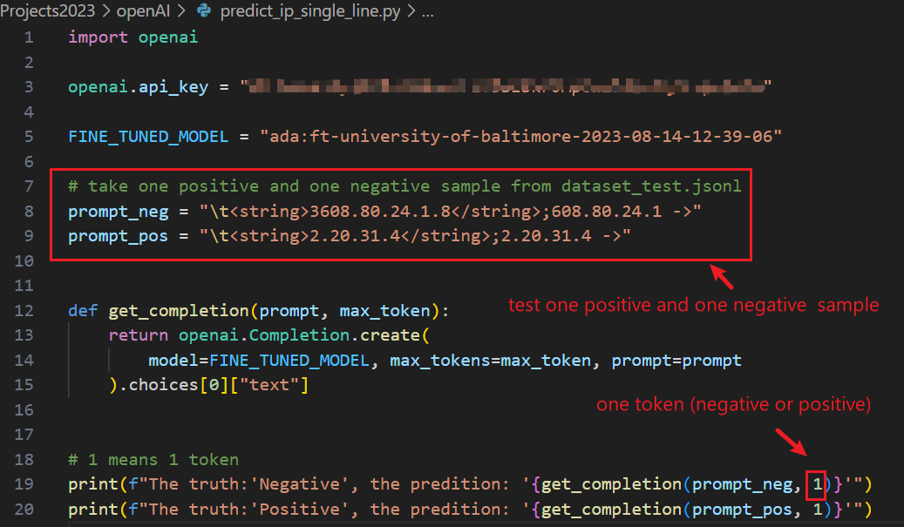
Identify IP from a single text line
https://raw.githubusercontent.com/frankwxu/digital-forensics-lab/main/AI4Forensics/IP_Identifier_Fine_Tuning/code/predict_ip_single_line.py
Only test one negative and one positive samples
Input: trained model (ID)

Slide 34
Execution results

Slide 35
D. Evaluate model performance

Slide 36
Goal
Evaluate the fine-tuned model performance on the provided validation set
dataset_test.jsonl
We use the testing dataset as the validation set for the demonstration purpose

Slide 37
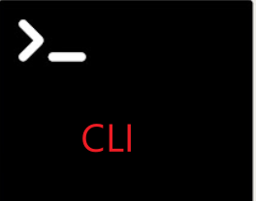



training dataset (80%)
test dataset (20%)
1. Run command line
2. Download the accuracy of each training step
3. Show or visualization accuracy

Slide 38
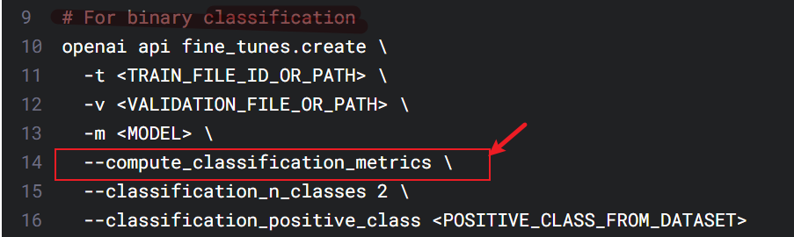
classification/accuracy
classification/precision
classification/recall
classification/f{beta}
classification/auroc - AUROC
classification/auprc - AUPRC
1. One Windows CLI
save the above classification performance data to a result file

Slide 39
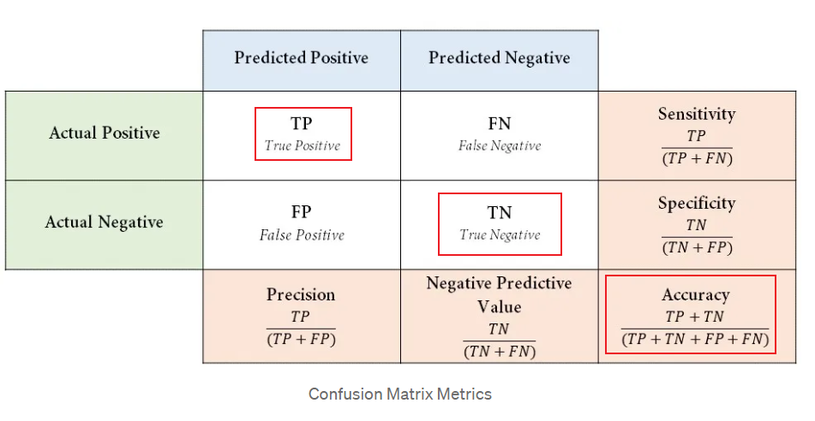
https://medium.com/@danyal.wainstein1/understanding-the-confusion-matrix-b9bc45ba2679

Slide 40
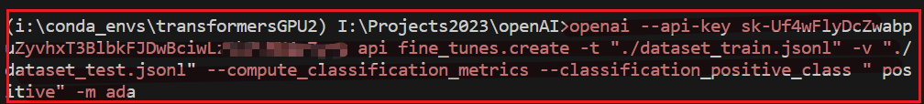
The CLI to evaluate our trained model
openai --api-key sk-Uf4wFlyDcZwabpuZyvhxT3BlbkFJDwBciwLz1hBcxxxx
api fine_tunes.create
-t "./dataset_train.jsonl"
-v "./dataset_test.jsonl"
--compute_classification_metrics
--classification_positive_class " positive"
-m ada

Slide 41
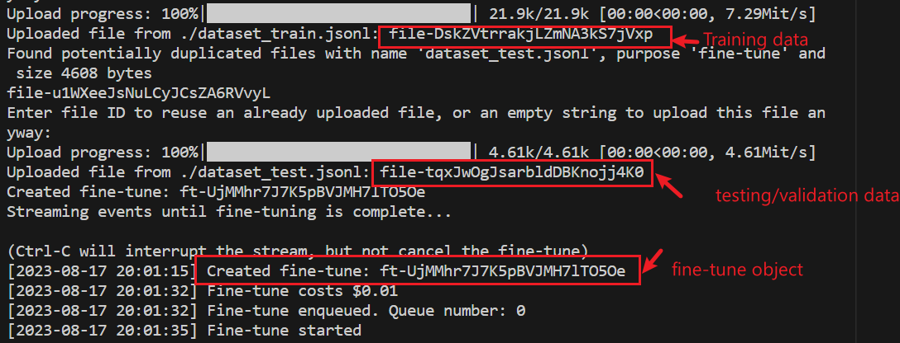
Execution information
(job id)
ft-UjMMhr7J7K5pBVJMH7lTO5Oe
Notes:
Upload progress: 100%|█████████████████████████████| 21.9k/21.9k [00:00<00:00, 7.29Mit/s]
Uploaded file from ./dataset_train.jsonl: file-DskZVtrrakjLZmNA3kS7jVxp
Found potentially duplicated files with name 'dataset_test.jsonl', purpose 'fine-tune' and size 4608 bytes
file-u1WXeeJsNuLCyJCsZA6RVvyL
Enter file ID to reuse an already uploaded file, or an empty string to upload this file anyway:
Upload progress: 100%|█████████████████████████████| 4.61k/4.61k [00:00<00:00, 4.61Mit/s]
Uploaded file from ./dataset_test.jsonl: file-tqxJwOgJsarbldDBKnojj4K0
Created fine-tune: ft-UjMMhr7J7K5pBVJMH7lTO5Oe
Streaming events until fine-tuning is complete...
(Ctrl-C will interrupt the stream, but not cancel the fine-tune)
[2023-08-17 20:01:15] Created fine-tune: ft-UjMMhr7J7K5pBVJMH7lTO5Oe
[2023-08-17 20:01:32] Fine-tune costs $0.01
[2023-08-17 20:01:32] Fine-tune enqueued. Queue number: 0
[2023-08-17 20:01:35] Fine-tune started

Slide 42
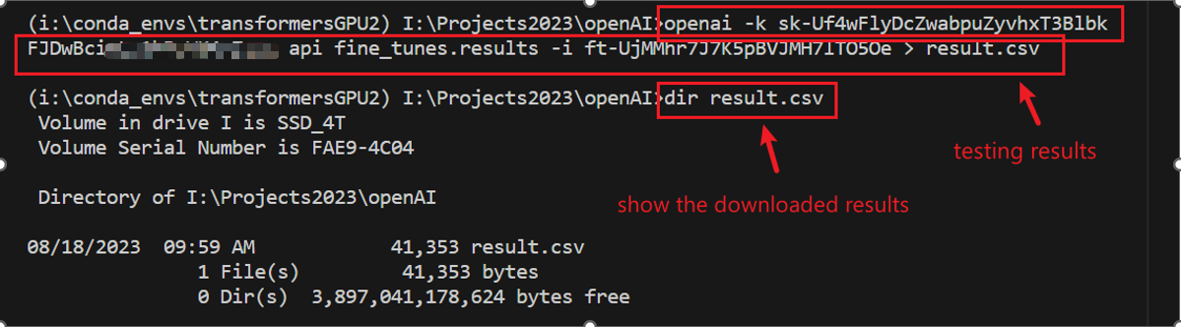
2. Download the fine-tuned (based on job id) metrics of each training step to a text file for further analysis
Notes:
openai -k sk-Uf4wFlyDcZwabpuZyvhxT3BlbkFJDwBciwLz1xxxxx api fine_tunes.results -i ft-UjMMhr7J7K5pBVJMH7lTO5Oe > result.csv

Slide 43
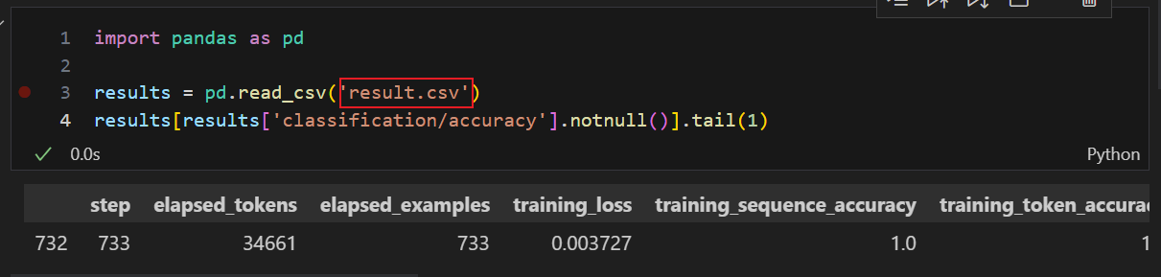
https://raw.githubusercontent.com/frankwxu/digital-forensics-lab/main/AI4Forensics/compute_classification_metrics/ipynb
3. Read metrics accuracy information using pandas
Notes:
import pandas as pd
results = pd.read_csv('result.csv')
results[results['classification/accuracy'].notnull()].tail(1)

Slide 44
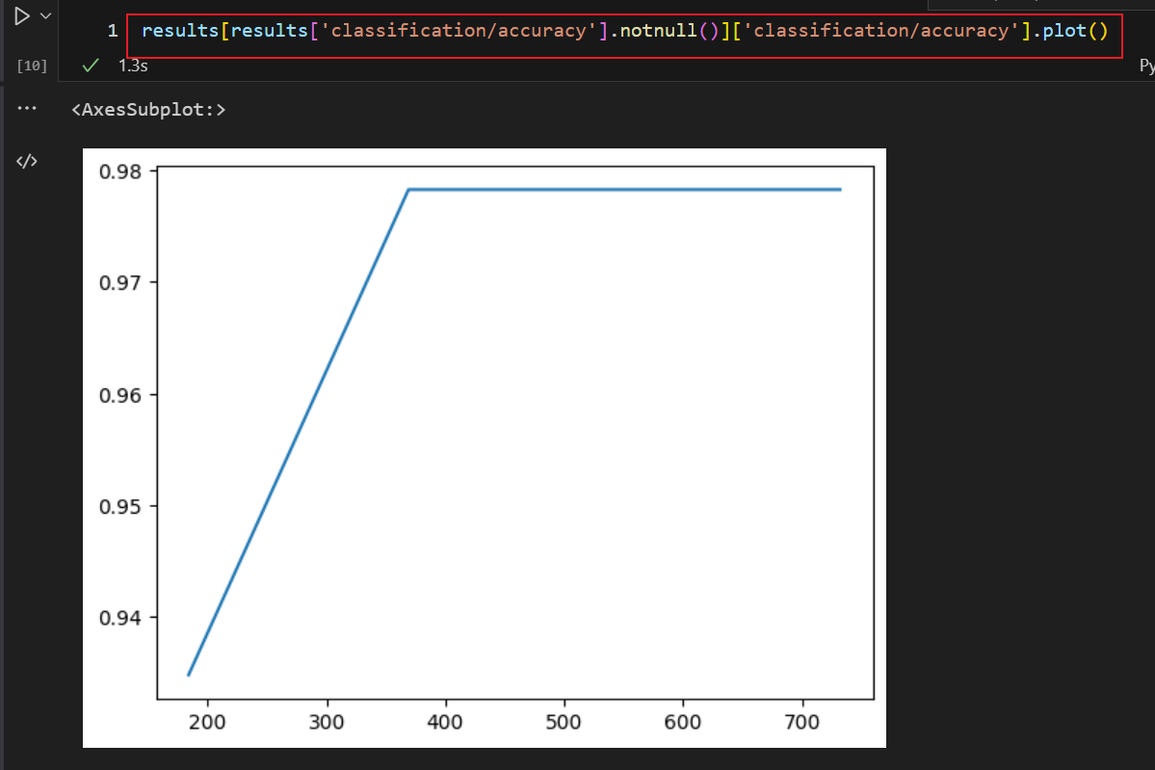
How accuracy increases with training steps

Slide 45
E. Understand confusion matrix

Slide 46
Goal
Understand the possible predicted results using a trained model
Definition of a confusion matrix
Use sklearn library to compute the confusion matrix
Test a larger dataset with the confusion matrix

Slide 47
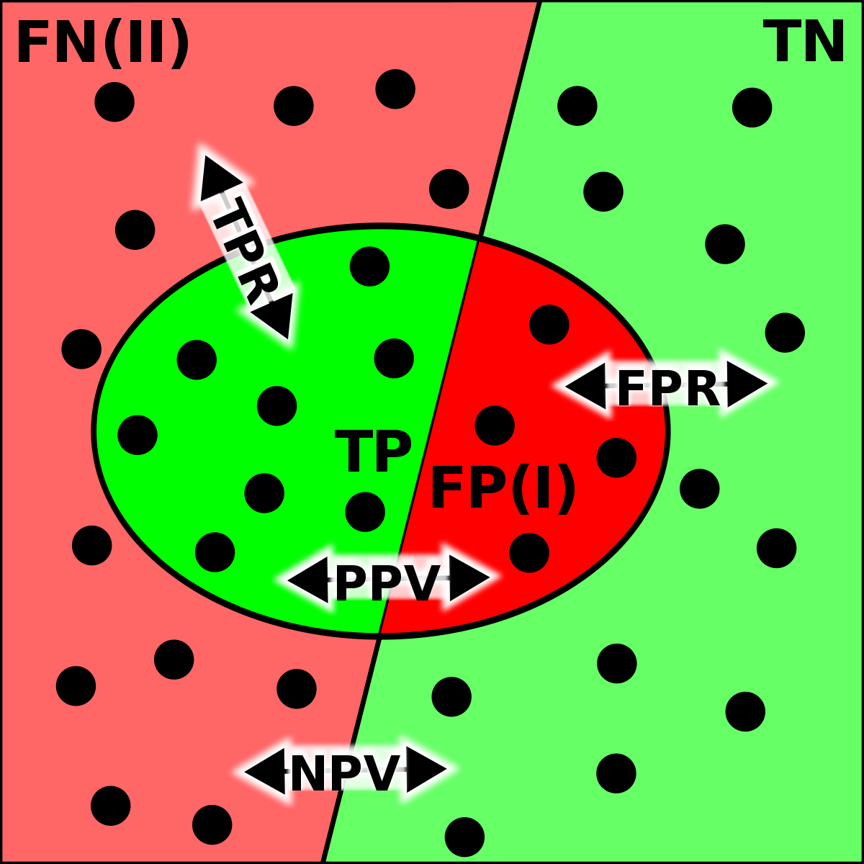
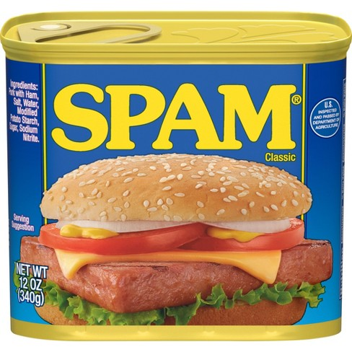

Possible predicted result using a trained model
a positive value is predicted as positive
a positive value is predicted as negative
 |  | Predicted Value
 |  | Positive | Negative
Actual Value | Positive | True Positive (TP) | False Negative (FN)
 | Negative | False Positive (FP) | True Negative (TN)
Actual | Predicted
 |  | TN
 |  | FP
 |  | TP
 |  | FN
For Binary Classification
Visualize TP/FN/TN/FP
a negative value is predicted as positive
a negative value is predicted as negative
Notes:
https://towardsdatascience.com/confusion-matrix-clearly-explained-fee63614dc7

Slide 48


Confusion Matrix
A confusion matrix is a table
The table displays the # of TP, TN, FP, and FN
# are produced by the model on the test dataset.
We use a confusion matrix to calculate many metrics
accuracy, recall, precision, f1 score
to evaluate the performance of a classification model.
 |  | Predicted Value
 |  | Positive | Negative
Actual Value | Positive | # True Positive (TP) | # False Negative (FN)
 | Negative | # False Positive(FP) | # True Negative (TN)
# TP
# TN
Accuracy= -------------------------------------------------
# TP
# TN
# FN
# FP

Slide 49
Why accuracy is biased?
Imbalance dataset problem: cheat the model and return all negative
…
…
Positive (10)
Negative (90)
 |  | Predicted Value
 |  | Positive | Negative
Actual Value | Positive | # TP (0) | # FN (10)
 | Negative | # FP (0) | # TN (90)
# TP
# TN
Accuracy= ------------------------------------------------- =0+90/100= 90%
# TP
# TN
# FN
# FP
90% might seem very high. However, this model does a poor job (TP=0) of identifying "Spam" emails (which is likely the more critical task). In this example, accuracy is biased because it doesn't reflect the model's poor performance on the minority class, "Spam."
Predicated results of 100 test

Slide 50
Precision
Precision is the ratio of correct positive predictions to the total positive predictions.
High precision indicates that the model makes positive predictions only when it's confident and correct,
Low precision suggests that the model often makes mistakes by incorrectly labeling negative cases as positive.
 |  | Predicted Value
 |  | Positive | Negative
Actual Value | Positive | # True Positive (TP) | # False Negative (FN)
 | Negative | # False Positive(FP) | # True Negative (TN)
# TP
Precision= --------------------------------
# TP
# FP
important to minimize: misdiagnosing a healthy patient as having a disease can lead to unnecessary stress and treatment

Slide 51
Recall
Recall tells us how many of the actual positive cases we were able to predict correctly with the trained model.
High recall indicates that the model is effective at finding the majority of the positive cases but may have a higher false positive rate,
Low recall suggests that the model misses a significant portion of positive cases.
important to minimize: missing a medical diagnosis/security vulnerability/forensic evidence causes problems
 |  | Predicted Value
 |  | Positive | Negative
Actual Value | Positive | # True Positive (TP) | # False Negative (FN)
 | Negative | # False Positive(FP) | # True Negative (TN)
# TP
Recall= --------------------------------
# TP
# FN

Slide 52
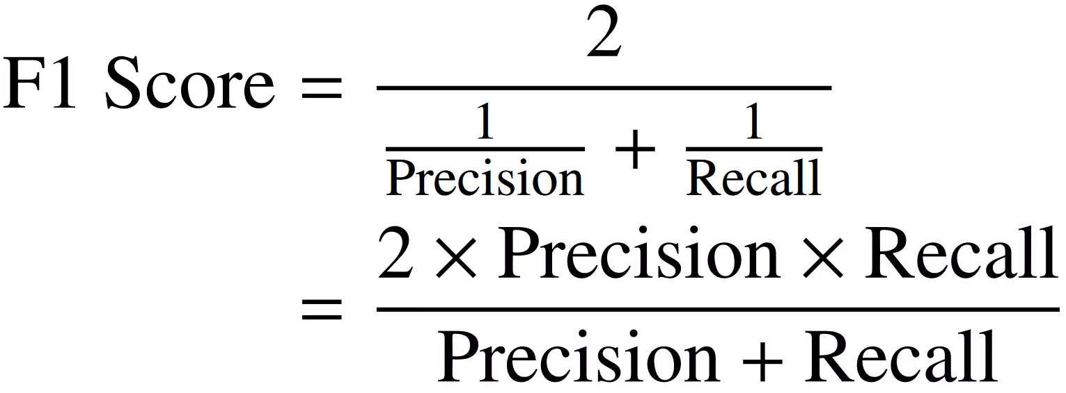
F1-Score
A higher F1-score indicates a model that has a good balance between precision and recall
can make accurate positive predictions while also capturing most of the positive cases.
It is maximum when Precision is equal to Recall.
F1-score is particularly useful in situations where both precision and recall are important

Slide 53
Example: A model prediction looks like this
# | Actual | Predicted | Actual | Predicted
1 |  |  | 0 | 0 | TN
2 |  |  | 0 | 1 | FP
3 |  |  | 1 | 1 | TP
4 |  |  | 1 | 0 | FN
5 |  |  | 0 | 0 | TN
6 |  |  | 0 | 1 | FP
7 |  |  | 0 | 1 | FP
8 |  |  | 0 | 0 | TN
9 |  |  | 0 | 0 | TN
10 |  |  | 1 | 1 | TP
 |  | Predicted Value
 |  | Positive | Negative
Actual Value | Positive | # TP (2) | # FN (1) | 3
 | Negative | # FP (3) | # TN (4) | 7
 |  | 5 | 5
Confusion Matrix

Slide 54
Confusion Matrix
 |  | Predicted Value
 |  | Positive | Negative
Actual Value | Positive | # TP (2) | # FN (1) | 3
 | Negative | # FP (3) | # TN (4) | 7
 |  | 5 | 5
Evaluation Metrics | Formular | %
Precision | TP/(TP+FP) | 2/(2+3)=40%
Recall | TP/(TP+FN) | 2/(2+1)=67%
Accuracy | (TP+TN)/Total | 6/10 =60%
F1-scores | 2*(Precision*recall)/(Precision + Recall) | 50%

Slide 55
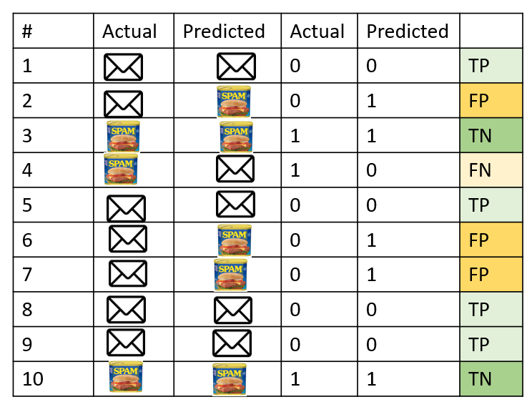

Calculate confusion matrix using sklearn

Slide 56
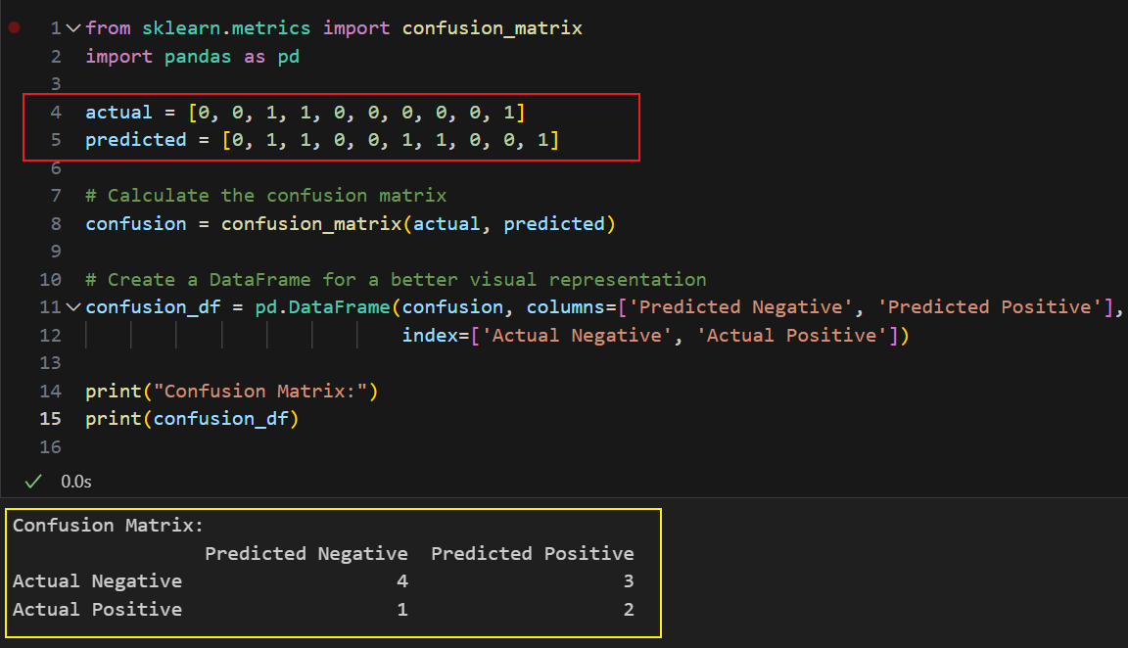
Calculate the Confusion Matrix with the results of a spam classification model
https://raw.githubusercontent.com/frankwxu/digital-forensics-lab/main/AI4Forensics/IP_Identifier_Fine_Tuning/Calculate_Confusion_Matrix/code/confusion_matrix_tutorial.ipynb
Notes:
from sklearn.metrics import confusion_matrix
import pandas as pd
actual = [0, 0, 1, 1, 0, 0, 0, 0, 0, 1]
predicted = [0, 1, 1, 0, 0, 1, 1, 0, 0, 1]
# Calculate the confusion matrix
confusion = confusion_matrix(actual, predicted)
# Create a DataFrame for a better visual representation
confusion_df = pd.DataFrame(confusion, columns=['Predicted Negative', 'Predicted Positive'],
index=['Actual Negative', 'Actual Positive'])
print("Confusion Matrix:")
print(confusion_df)

Slide 57
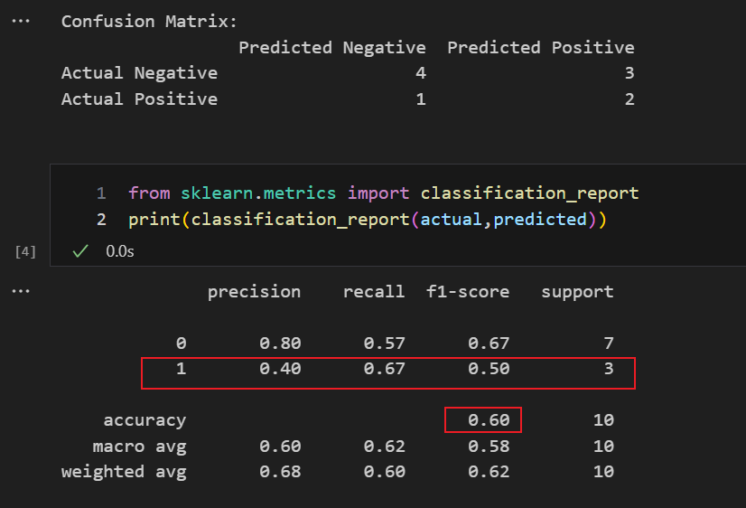
Generate classification report

Slide 58
Summary 1
Fine-tuning refers to the process of taking a pre-trained model and further training it on a smaller, domain-specific dataset to adapt it to a specific task or domain.
The pre-trained model has already learned general patterns and features from a large dataset, often resulting in better initial performance than training from scratch.

Slide 59
Summary 2
Select a Pre-trained Model:
Prepare Domain-specific Data:
Fine-tuning:
Adjust Hyperparameters:
Evaluation and Iteration:
Deployment

Slide 60
Practice

Slide 61
Goal
Apply the same fine-tunning approach to identify if an IP address is correct. The only difference is we will provide a larger dataset
Training set size = 400
Correct IP (Positive) = 265
Incorrect IP (Negative) = 135

Slide 62
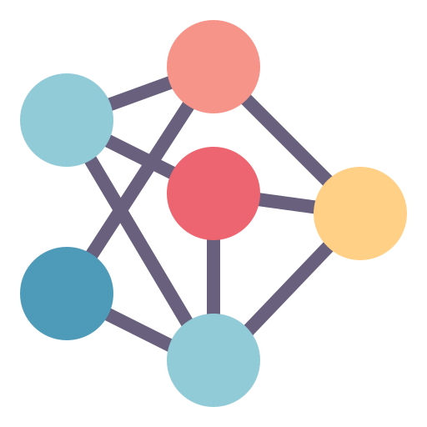

Step 1: Fine-tune an AI model
Training Dataset
Dataset Size =400
Fine Tuning
Fined-tuned model id =
ada:ft-personal-2023-09-21-17-xx-xx
AI Model = ada

Slide 63
Step 2: Testing
Test dataset size: 100
Correct IP (Positive) = 67
Incorrect IP (Negative) = 33
Testing Dataset
Predicted Result
Predicting
Fined-tuned model id =
ada:ft-personal-2023-09-21-17-xx-xx

Slide 64
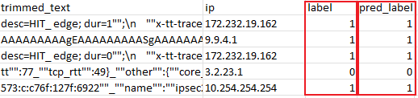
Step 3: Evaluate a fine-tuned model
Predicted label
Predicted
Predicted Result
 | Positive | Negative
Positive | 66 | 1
Negative | 0 | 33
Calculate confusion matrix
Actual
Actual Label
Confusion Matrix

Slide 65
Step 4: Computing evaluation metrics
Precision = TP / (TP + FP) = 66 / (66 + 0) = 1
Recall = TP / (TP + FN) = 66 / (66 + 1) = 0.98507
Accuracy = 99/100
F1 scores = 2 * (Precision * Recall) / (Precision + Recall)
= 2 x (1 * 0.98507) / (1 + 0.98507)
= 1.97014 / 1.98507 = 0.99248

Slide 66
Appendix
set up openAI api key

Slide 67
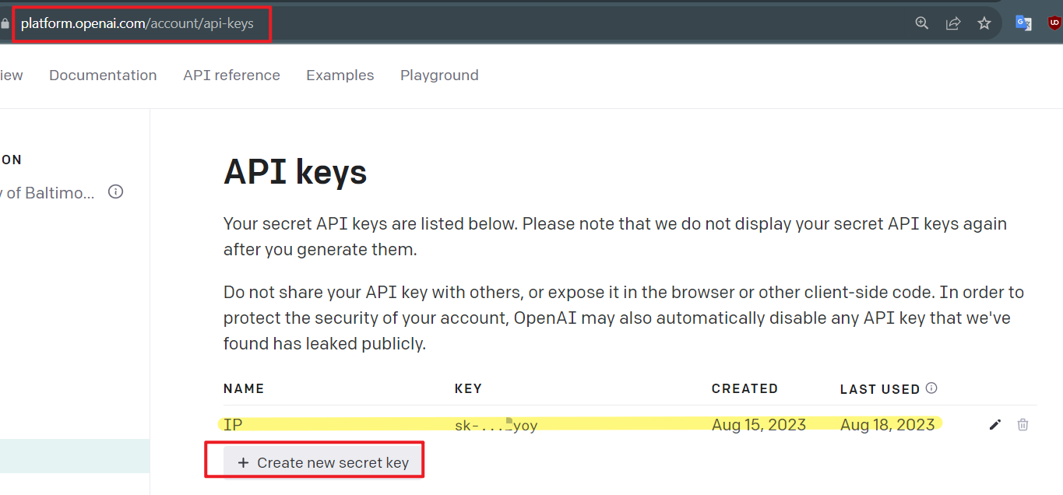
Set up API keys

Slide 68
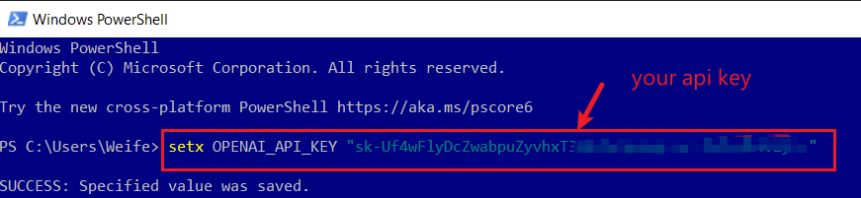
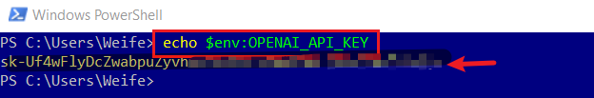
set up openAI api keys in Windows
Notes:
setx OPENAI_API_KEY "sk-Uf4wFlyDcZwabpuZyvhxT3BlbkFJ….“
echo $env:OPENAI_API_KEY
https://github.com/openai/openai-cookbook/blob/main/examples/Fine-tuned_classification.ipynb

Slide 69
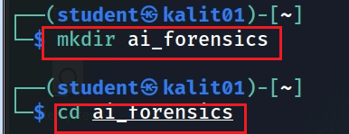
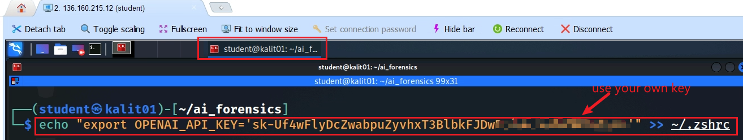

set up openAI api keys in Linux
Notes:
echo "export OPENAI_API_KEY='sk-Uf4wFlyDcZwabpuZyvhxT3BlbkFJDwBciwLz1hBcWK4vZ'" >> ~/.zshrc
source ~/.zshrc
echo $OPENAI_API_KEY

Slide 70
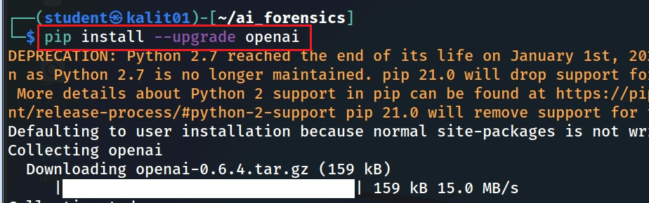
install openAI library

Slide 71
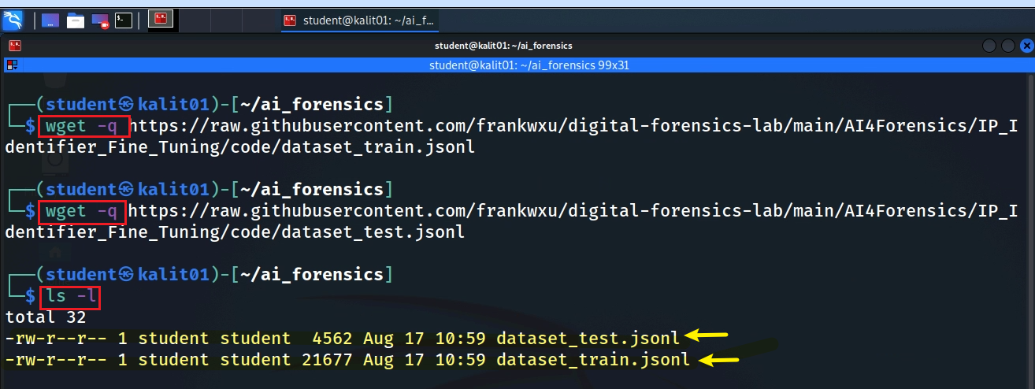
Download files in Linux
Notes:
wget –q https://raw.githubusercontent.com/frankwxu/digital-forensics-lab/main/AI4Forensics/IP_Identifier_Fine_Tuning/code/dataset_train.jsonl
wget –q https://raw.githubusercontent.com/frankwxu/digital-forensics-lab/main/AI4Forensics/IP_Identifier_Fine_Tuning/code/dataset_test.jsonl

