Slide 1













FACE RECOGNITION ATTENDANCE SYSTEM
TEAM-11

Slide 2
SECOND REVIEW
TEAM MEMBERS
LOGESHWARAN V V (2118125)
SEDHU RAM P (2118138)
SRIDHAR E (2118145)
TAMIZHARASU M (2118L10)
PROJECT GUIDE
DR.R.DEVI M.Tech.,PhD.,

Slide 3
INDEX
PROBLEM STATEMENT
EXISTING SYSTEM
QUERY FROM PREVIOUS REVIEW
[ why client-server application is built?
why svm is used and why is it better than cnn in this context? ]
PROPOSED SYSTEM FLOWCHART
MODULES
REFERENCES

Slide 4
PROBLEM STATEMENT
Current attendance systems, relying on manual methods like paper-based records and outdated technologies such as punch cards or RFID tags, are prone to significant inefficiencies. These methods are often error-prone and can be easily manipulated, leading to inaccuracies.ID cards or RFID tags can be lost, damaged, or misused by others. This results in unreliable attendance tracking and frequent data inaccuracies. An efficient, automated solution is needed to address these limitations.

Slide 5
EXISTING SYSTEM
Attendance System | Advantages | Disadvantages
Manual Attendance Marking | Simplicity: No need for special equipment, only pen and paper. Customizable: Easily adapted to various attendance policies. | Error-prone: High risk of human error or tampering (proxy attendance).
Fingerprint-based | Highly Accurate: Unique fingerprint ensures authenticity. Fast: Quick scanning process. | Hygiene Issues: Frequent contact with devices can lead to hygiene concerns. False Negatives: Dirty or wet fingers can cause false rejections. Expensive: Requires specialized equipment for scanning and software integration. Proxy Attendance: Making fake fingerprint leads to false entries.

Slide 6
EXISTING SYSTEM
Attendance System | Advantages | Disadvantages
Facial Recognition | Contactless: No physical contact required, making it hygienic. | Environmental Limitations: Poor lighting or extreme angles may affect recognition. Privacy Concerns: Storing facial data raises privacy and security issues. False Positives/Negatives: Can have difficulty distinguishing between similar faces or detecting masks/hats.
Iris/Retina Scan | Highly Secure: Iris or retina patterns are more unique than fingerprints. Contactless: Eliminates hygiene concerns. | Expensive: Requires advanced, costly hardware. User Discomfort: Some users may find it uncomfortable to scan their eyes.

Slide 7
EXISTING SYSTEM
Attendance System | Advantages | Disadvantages
Card Swipe (RFID based) | Easy to Implement: Simple setup process. Reliable: Can handle a large number of users with minimal error. | Lost or Damaged Cards: Users may lose their RFID cards, and they can be easily damaged. Proxy Attendance: Cards can be shared, leading to buddy punching.
QR Code-based Attendance | Easy to Implement: Users only need a smartphone and a QR code scanner. Contactless: No physical contact, making it hygienic. Low Cost: No need for specialized hardware except a smartphone camera. | Dependence on Smartphones: Users without smartphones are excluded. Cheating: QR codes can be shared or replicated. Slower for Large Groups: Scanning QR codes for large groups can take time.

Slide 8
Query from previous review:
Why client-server application is build?
A client-server application is built for centralized data management, efficient processing, and secure handling of tasks. It allows for scalable, remote access while offloading heavy computations to the server, ensuring better performance and easier maintenance. Only need browser to access the application without any additional installation.

Slide 9
Query from previous review:
Why is SVM used, and why is it better than CNN in this context?
Efficiency: SVMs are computationally less expensive compared to Convolutional Neural Networks (CNNs). CNNs require large datasets and powerful hardware (like GPUs) for training.
Training Time: SVMs are faster to train on embeddings compared to CNNs, which require multiple layers and training epochs to learn from raw images. This makes SVMs more practical for smaller-scale or real-time applications.

Slide 10
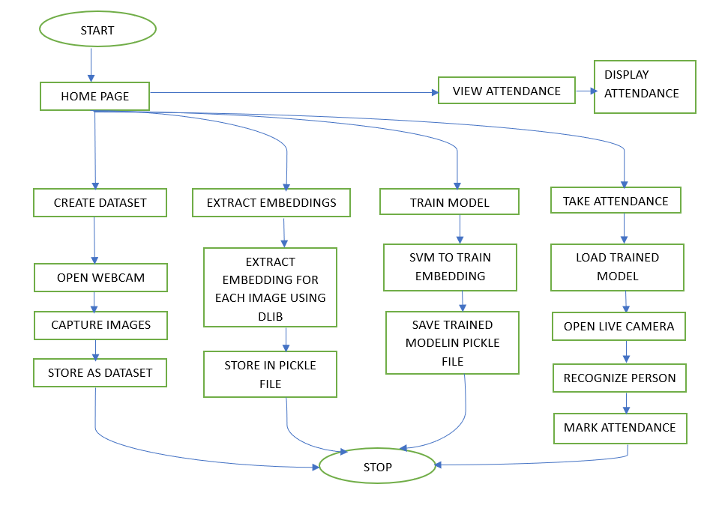
PROPOSED SYSTEM FLOWCHART

Slide 11
MODULES
Dataset Creation
Preprocessing and Embedding Extraction
Model Training
Live Face Recognition
Attendance Logging
Attendance View

Slide 12
1. Dataset Creation STATUS:COMPLETED
Purpose:
To collect and store face images of individuals for training the face recognition model.
Components:
Webcam or camera for image capture.
Open cv for processing images.
Haar cascade in OpenCV to detect the frontal face.
Key Deliverables:
50 images per individual, stored in folders named after each person.
Successfully created and organized dataset for future use in recognition.
Dependencies:
Functional webcam.
Proper directory structure to store captured images.

Slide 13
2. Preprocessing and Embedding Extraction STATUS:COMPLETED
Purpose:
To extract facial embeddings from the images, which are used to train the face recognition model.
Components:
Pretrained dlib model for face landmark predictor, embedding extraction.
Key Deliverables:
128-dimensional facial embeddings for each face in the dataset.
A pickle file containing the extracted embeddings and associated names.
Dependencies:
Pre-trained Dlib models.
Properly formatted dataset images from the "Dataset Creation" module.

Slide 14
3. Model Training STATUS : ONGOING
Purpose:
To train a Support Vector Machine (SVM) classifier that can recognize faces based on the extracted embeddings.
Components:
SVM classifier with a linear kernel.
Label encoder for encoding names.
Facial embeddings and names as input data.
Key Deliverables:
A trained SVM model capable of predicting individuals based on facial embeddings.Pickle files for both the trained model and the label encoder.
Dependencies:
Preprocessed embeddings from the "Preprocessing and Embedding Extraction" module.
A sufficient number of distinct faces in the dataset for accurate training.

Slide 15
4. Live Face Recognition STATUS : ONGOING
Purpose:
To recognize individuals in real-time using live video feed and mark their attendance.
Components:
Webcam for live video streaming.
Face embedding extraction using dlib and SVM classification for recognition.
Key Deliverables:
Real-time recognition of faces with confidence scores.
Dependencies:
A functional webcam for video input.
Trained SVM model and label encoder from the "Model Training" module.
Sufficient lighting and clear camera view for accurate detection.

Slide 16
5. Attendance Logging STATUS : COMPLETED
Purpose:
To log the names of recognized individuals along with timestamps into a MySQL database for attendance tracking.
Components:
MySQL database to store attendance records.
Key Deliverables:
Attendance records with names and timestamps stored in the database.
Dependencies:
Successful recognition of faces from the "Live Face Recognition" module.
Active connection to the MySQL database.
Timestamping mechanism to log the time of recognition.

Slide 17
6. Attendance View STATUS:COMPLETED
Purpose:
To provide an interface for viewing logged attendance records, including names and timestamps.
Components:
UI to display attendance data.
SQL queries to fetch attendance records from the database.
Key Deliverables:
A webpage displaying all attendance records with names and timestamps.
Dependencies:
MySQL database with attendance data from the "Attendance Logging" module.
Proper SQL queries for data retrieval.
Access to the web interface for viewing the records.

Slide 18
ALGORITHMS USED:
Face Detection : Haar Cascade Algorithm in Open cv, Dlib
Face Shape Predictor : Dlib’s 68 Landmark Predictor
Face Embedding Extraction : Dlib’s ResNet-based Face RecognitionModel
Face Recognition : Support Vector Machine (SVM) Classifier
Database : MYSQL
Backend : Python flask
Frontend : HTML,CSS,JS

Slide 19
REFERENCES:
1.Muhammad Haikal Mohd Kamil, Norliza Zaini, Lucyantie Mazalan, Afiq Harith Ahamad – 2023 “Online attendance system based on facial recognition with face mask detection”[Springer]
2.Priyanka Manke,Mohammed Hamza Siddiqui,Himanshu Pednekar, Pawan Sakat, Qureshi Abdul Qadir-2024 “Facial Recognition-Based Attendance System”[ResearchGate]
3.Andre Budiman, Fabiana, Ricky Aryatama Yaputera, Said Achmad, Aditya Kurniawan – 2023 “Student attendance with face recognition (LBPH or CNN)”[ELSEVIER]
4.Aditya UmalkarShivang Singh ManhasImazChandiwalaNarendra Bhagat​ -2023” Face Recognition Based Attendance System Using Real Time Data “[IJCRT]
5.Ashish Kumar Shukla, Archana Shukla, Raghvendra Singh-2023” Automatic attendance system based on CNN–LSTM and face recognition”[IJIT]

Slide 20
REFERENCES:
6.Kamal G. Oladele , Edidiong J. Iseh , Jamal O. Oladele , Pawan R. Bhaladhare-2024” AI-Based Face Recognition Attendance System”[IJIRMPS]
7.Olufemi S. Ojo , Mayowa O. Oyediran , Babatunde J. Bamgbade ID , Abidemi Emmanuel Adeniyi ID , Godwin Nse Ebong ID, and Sunday Adeola Ajagbe – 2023” Development of an Improved Convolutional Neural Network for an Automated Face-Based University Attendance System”[PARADIGM Plus]
8. Ahmad S. Lateef , Mohammed Y. Kamil -2023 “Face Recognition-Based Automatic Attendance System in a Smart Classroom “[IJEEE]

Slide 21
Thank you

