Slide 1
FINAL REVIEW
A Fuzzy Logic Approach for Trust Score Evaluation in Cloud Service Providers

Slide 2
TEAM MEMBERS
LOGESHWARAN VV(71772118125)
SEDHU RAM P(71772118138)
SRIDHAR E(71772118145)
TAMIZHARASU M(71772118L10)
PROJECT GUIDE
Dr. R. DEVI, M.Tech., Ph.D.,

Slide 3
PROBLEM STAEMENT
Cloud computing introduces security challenges as data and services are managed by third-party providers. Evaluating the trustworthiness of Cloud Service Providers (CSPs) is crucial to ensure data security, privacy, and reliability. This project proposes trust evaluation model that uses a fuzzy inference system to compute trust scores based on vulnerability assessments. The model enhances cloud security and aids in informed CSP selection.

Slide 4
EXISTING SYSTEM
1. Agreement-based / SLA-based Trust Models
Trust is built on Service Level Agreements (SLAs) between Cloud Service Providers (CSPs) and users.
These models monitor service performance and Quality of Service (QoS) compliance.
Objective trust is determined based on contract fulfillment.
2. Certificate-based Trust Models
Uses certificates, trust tickets (TTs), and endorsement keys issued by certificate authorities.
Security certificates for cloud software, platforms, and infrastructure help establish trust.
Ensures authenticity and compliance of cloud services.

Slide 5
EXISTING SYSTEM
3. Feedback-based Trust Models
Collects customer feedback and ratings on CSPs.
Trust scores are computed based on user experiences and security evaluations.
Relies on user opinions but may be prone to biased or fake reviews.
4. Domain-based Trust Models
Divides the cloud into autonomous trust domains (intra-domain and inter-domain trust).
Uses direct and recommended trust tables to assess CSP reliability.
Suitable for multi-cloud and federated cloud environments.

Slide 6
EXISTING SYSTEM
5. Prediction-based Trust Models
Uses advanced techniques like social network analysis (SNA), fuzzy theory, and probability theory to predict trust levels.
Focuses on selecting trustworthy services based on historical data and analytics.
Helps in adaptive trust management for cloud services.
6. Reputation-based Trust Models
Assesses CSPs based on historical records, experience, and third-party reports.
Reputation scores help users identify reliable cloud services.
Provides an additional trust metric beyond direct interactions.

Slide 7
PROPOSED SYSTEM
The proposed system introduces a Fuzzy Inference System (FIS) for evaluating the trustworthiness of Cloud Service Providers (CSPs).
Unlike traditional mathematical models or manual evaluation techniques, the proposed fuzzy logic-based trust assessment model offers an automated, efficient, and more accurate trust computation system.
This system assists Cloud Service Users (CSUs) in selecting the most reliable CSP by analyzing various trust parameters such as Security, Privacy, Performance, Dynamicity, and Data Integrity.

Slide 8
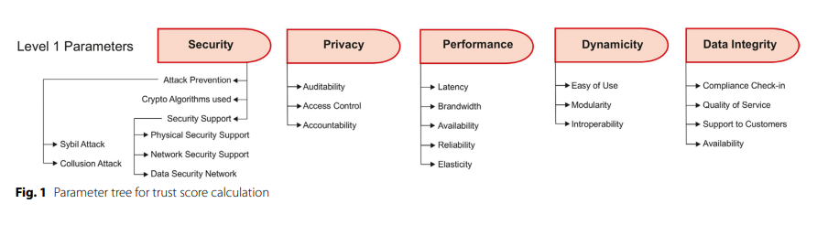
Data Collection
Trust parameter values are gathered through:
Vulnerability Assessment Tests
User Feedback
Efficiency Measurements

Slide 9
1. Vulnerability Assessment Tests (Security & Privacy)
These parameters are usually evaluated using automated security tools, penetration testing, and compliance audits:
Security
i. Attack Prevention
A Sybil attack is a security threat where an attacker creates many fake identities or nodes within a network. These fake identities act like real users or devices, allowing the attacker to gain more control or influence than they should. This can weaken the trust, and overall security of the network.
A collusion attack in the context of cloud computing occurs when multiple malicious parties, such as cloud service users or even cloud service providers, work together in a coordinated manner to compromise security, exploit vulnerabilities, or bypass access controls.

Slide 10
ii. Crypto Algorithms Used
In the evaluation of cloud service providers, cryptographic strength is a vital component of the security trust parameter. The effectiveness of a cryptographic algorithm is measured based on key size, resistance to attacks, performance, and adoption in industry standards.
iii. Security Support
a) Physical security support refers to the measures and practices a cloud service provider (or data center) implements to protect hardware, software, networks, and data from physical actions and events that could cause serious loss or damage.
b) Network security in cloud computing refers to the set of policies, configurations, and technologies deployed to protect cloud infrastructure from unauthorized access, breaches, DDoS attacks, and internal misuse.
c) Data Security Support in Cloud refers to the implementation and enforcement of security mechanisms that ensure confidentiality, integrity, and availability of data stored, processed, and transmitted within cloud environments. It involves the use of advanced cryptographic techniques.

Slide 11
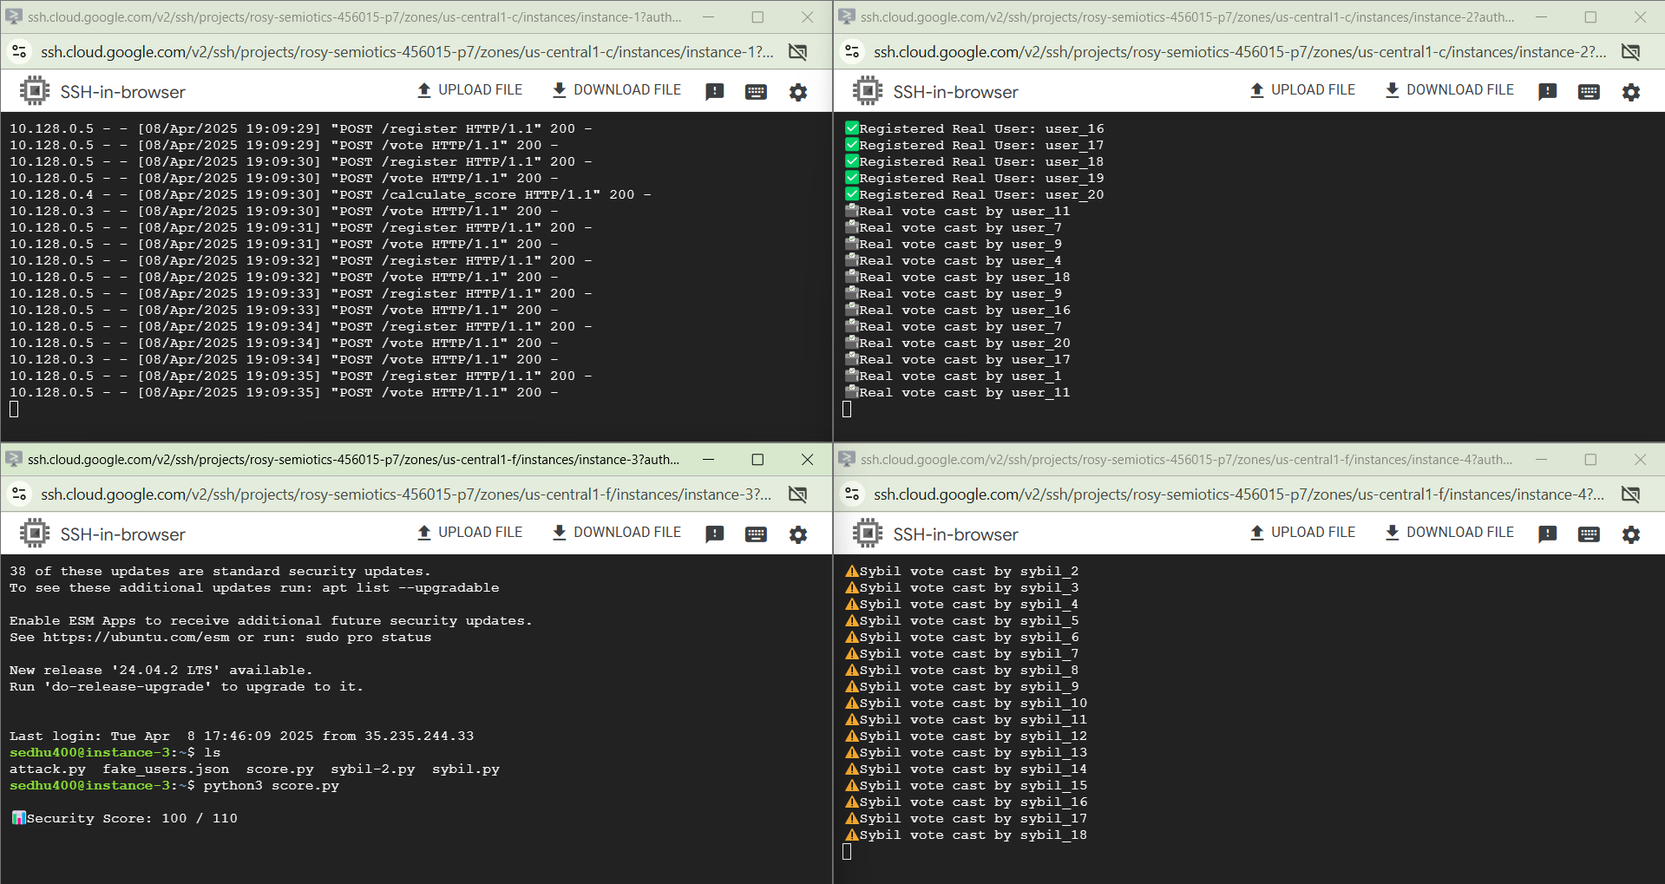
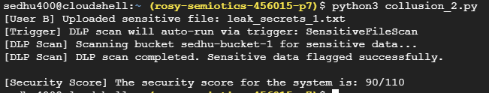
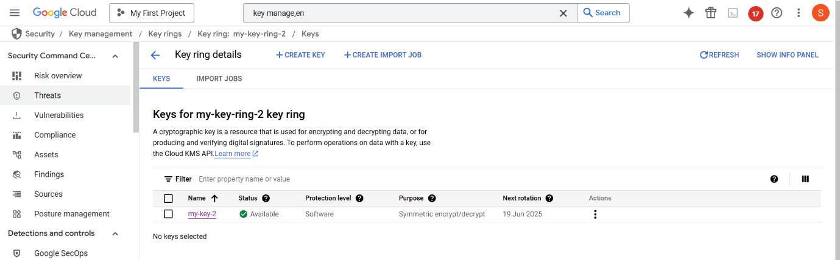
Collision Attack
Sybil Attack
Crypto-Algorithm used

Slide 12
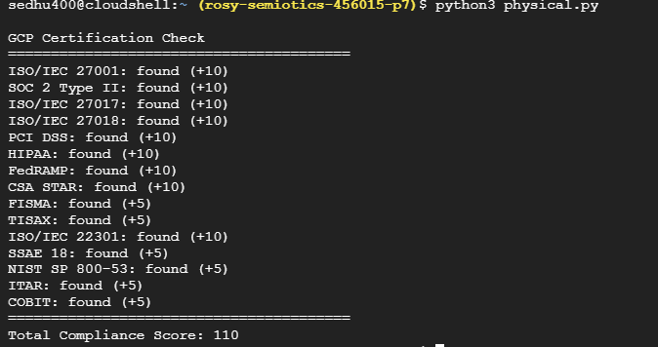
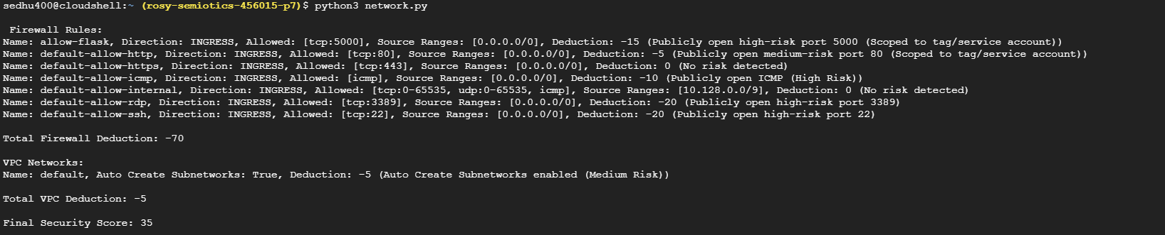
Data Security
Physical Security
Network Security

Slide 13
Privacy
i. Auditability
Auditability in cloud computing means being able to track and review all user and service actions clearly and reliably. By using audit logs and risk scores, it becomes easier to spot issues like unauthorized access or misconfigurations.
ii. Access Control
Access Control is a fundamental mechanism in ensuring data privacy in cloud environments. It regulates who can access what information and under what conditions, minimizing unauthorized access to sensitive resources
iii. Accountability
In Accountability, Billing is an essential aspect which trackes resource usage and apply charges accordingly. Accountability in cloud computing also encompasses responsibility for actions, transparency in operations, and adherence to security, privacy, and compliance standards.

Slide 14
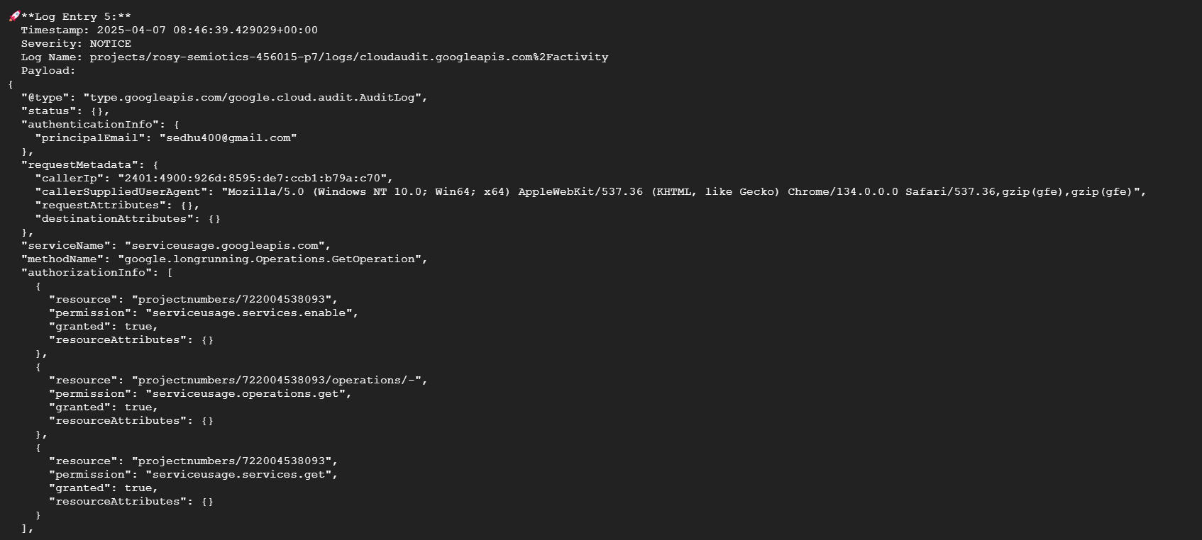
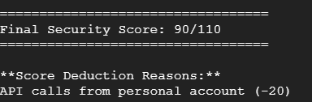
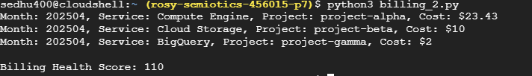
Access control
Auditability
Accountability

Slide 15
2. User Feedback (Dynamicity & Data Integrity)
These parameters are often assessed through user surveys, satisfaction ratings, and direct feedback mechanisms:
Dynamicity
i. Ease of Use
It refers to the simplicity with which users can interact with and adapt to the dynamic nature of cloud computing environments.
ii. Modularity
Modularity in cloud computing refers to a design approach that enables individual components of a system to be added, removed, upgraded, or reconfigured independently, without disrupting the overall functionality of the system.
iii. Interoperability
It refers to the ability of dynamically changing cloud services and components to seamlessly interact, integrate, and function across different platforms, technologies, and service providers.

Slide 16
Data Integrity
Support to Customers
It refers to the cloud service provider’s ability to assist users in ensuring their data remains accurate, consistent, and secure throughout its lifecycle.
Quality of Service
It refers to the ability of a cloud system to maintain high standards of data accuracy, consistency, and reliability throughout its lifecycle from storage and processing to transmission.
Compliance Check-in
It ensures that data in the cloud meets predefined policies, standards, and regulations like GDPR, HIPAA, or ISO. It helps maintain data integrity by verifying that all operations comply with legal and industry guidelines.

Slide 17
3. Efficiency Measurements (Performance & Availability)
These are measured through system performance monitoring, benchmarks, and service-level agreement (SLA) compliance:
Performance and data-integrity
Latency
Latency refers to the time delay it takes for a data packet to travel from one point to another in a network, such as from a client (e.g., a user's device) to a server (e.g., a virtual machine in the cloud) and back. It is usually measured in milliseconds (ms) and is an important factor in determining the responsiveness and performance of a system or network.
Bandwidth
Bandwidth in cloud computing refers to the maximum rate of data transfer across a network path. It is a crucial Quality of Service (QoS) metric that determines how quickly data can move between a client and a cloud service provider (CSP).

Slide 18
iii. Reliability
Reliability in cloud computing refers to the consistency and dependability of a cloud service provider (CSP) in delivering services without failure or degradation over time.
iv. Elasticity
Elasticity in cloud computing refers to the ability of a system to automatically adapt to workload changes by provisioning or de-provisioning resources in real-time to match demand. It ensures optimal resource utilization, cost-efficiency, and consistent performance without manual intervention.
v. Availability
Availability in cloud computing refers to the proportion of time that a cloud service is operational and accessible to users within a specified period.

Slide 19
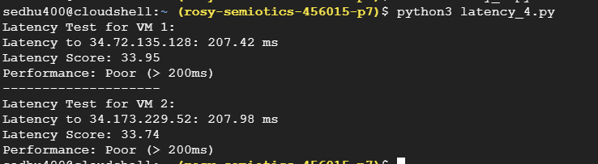
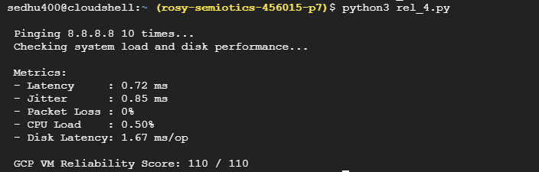
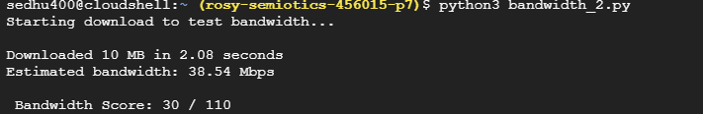
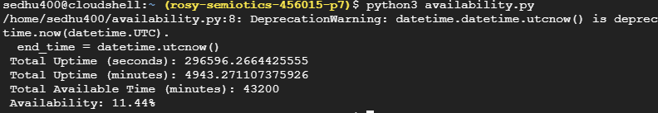
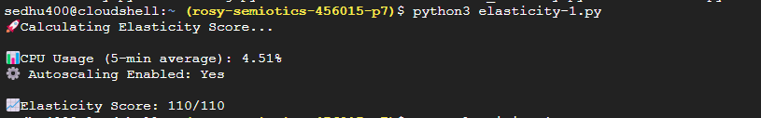
Latency
Reliability
Bandwidth
Availability
Elasticity

Slide 20
Fuzzy Inference System (FIS)
The proposed fuzzy logic-based trust evaluation model consists of four main components:
Fuzzifier: Converts crisp input values (e.g., security level, performance score) into fuzzy values.
Inference Engine: Applies fuzzy logic rules to generate fuzzy trust evaluations.
Defuzzifier: Converts the fuzzy trust values into a final crisp trust score.
Knowledge Base: Stores fuzzy rules and membership functions to map input variables to output trust scores.

Slide 21
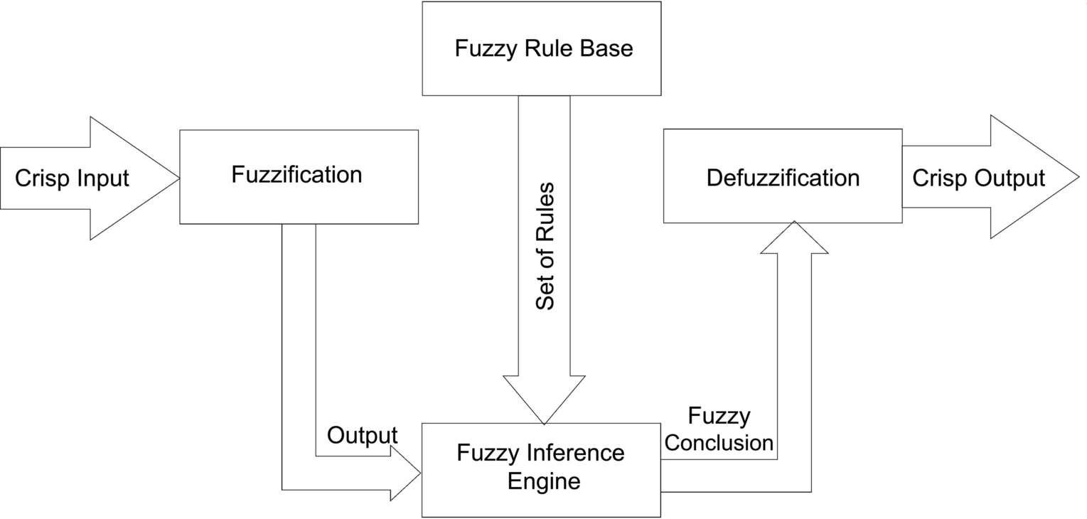
Working of Fuzzy Inference System (FIS)

Slide 22
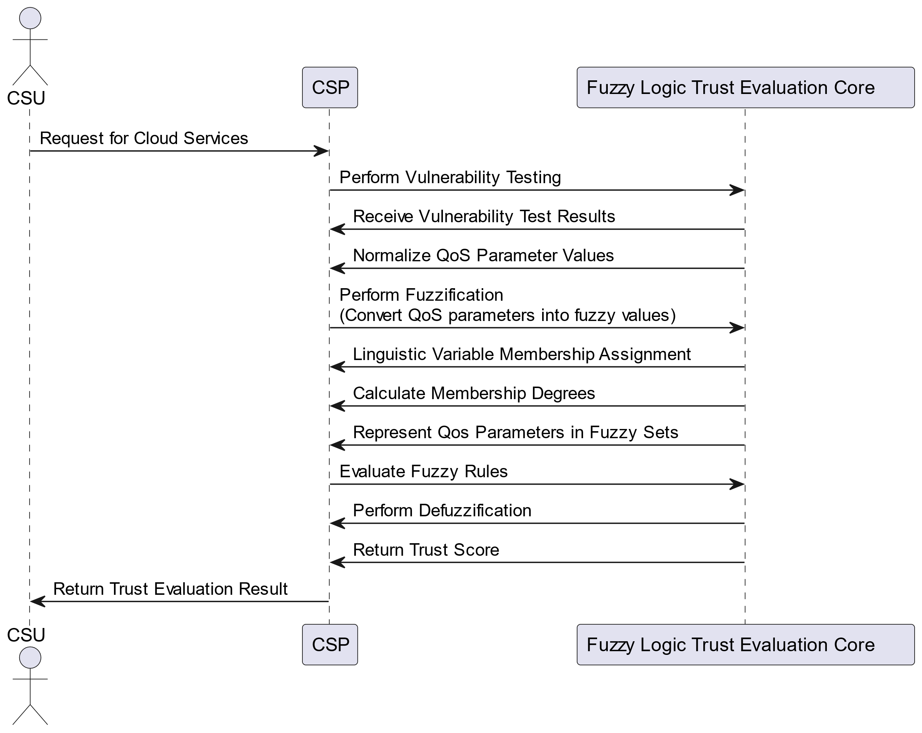
SEQUENCE DIAGRAM

Slide 23
Trust Score Calculation
1. Define Trust Parameters
Identify key trust factors influencing CSP trustworthiness.
Examples: Security, Privacy, Performance, Data Integrity, Dynamicity.
2. Assign Linguistic Variables
Convert trust parameters into linguistic terms.
Example: Low, Medium, High or Very Low, Low, Medium, High, Very High.
3. Define Membership Functions
Define mathematical representations for linguistic variables.
Common types: Triangular, Trapezoidal, Gaussian functions.
4. Construct Rule Base
Develop IF-THEN rules to determine trust relationships.
Example:
IF Security is High AND Performance is High, THEN Trust is High.

Slide 24
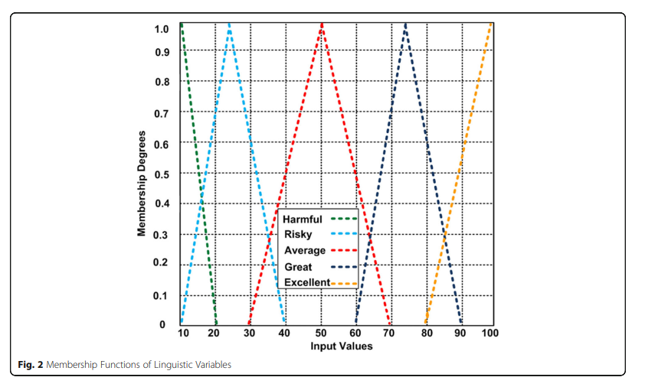

Slide 25
Trust Score Calculation
5. Fuzzification
Convert crisp input values into fuzzy values using membership functions.
Example: A security score of 80% may be classified as "High" with 0.8 membership.
6. Inference Engine Processing
Apply fuzzy inference rules to compute fuzzy trust output.
Utilize Mamdani or Sugeno Fuzzy Inference System (FIS).
7. Defuzzification
Convert fuzzy output back into a crisp trust score.
Common method: Centroid approach.
8. Final Trust Score Computation
Aggregate trust factors to compute the final trust score.
Used for Cloud Service Provider (CSP) selection based on trust evaluation.

Slide 26
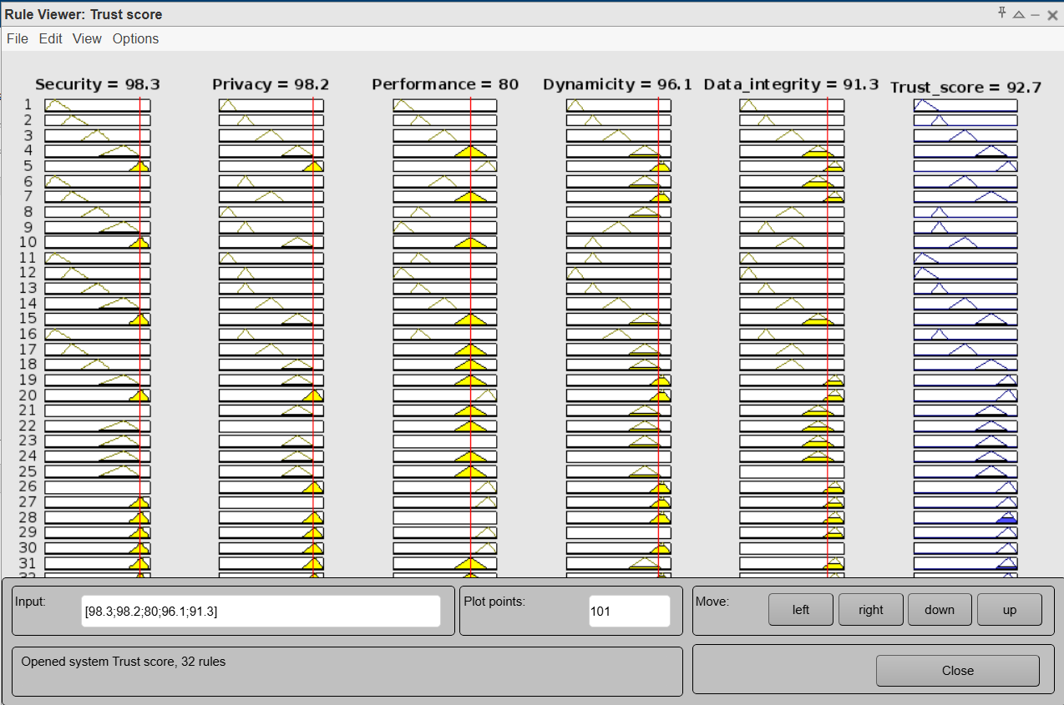
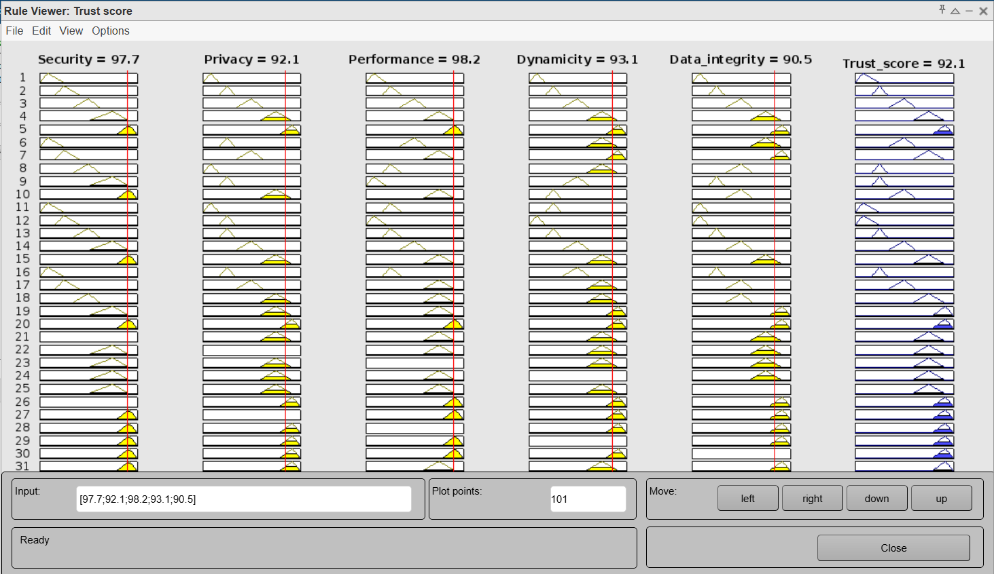
Results
Trust score in GCP
Trust score in AWS

Slide 27
REFERENCES
[1] Jomina John, K. John Singh, 2024, “Trust value evaluation of cloud service providers using fuzzy inference based analytical process”, Nature.com/scientific reports, Article number: 18028.
[2] Jomina John, K. John Singh, 2024, “Predictive digital twin driven trust model for cloud service providers with Fuzzy inferred trust score calculation”, Springer Open/Journal of Cloud Computing 13, Article number: 134.
[3] Syed Rizvi, John Mitchell, Abdul Razaque, Mohammad R. Rizvi and Iyonna Williams, 2020, “A fuzzy inference system (FIS) to evaluate the security readiness of cloud service providers”, Springer Open/Journal of Cloud Computing 9, Article number: 42.
[4] Vijay Kumar Damera, A Nagesh, M Nagaratna, 2020, “Trust Evaluation Models For Cloud Computing”, International Journal Of Scientific & Technology Research, Vol.No. 9, Issue 02.
[5] Yubiao Wang, Junhao Wen, Xibin Wang, Bamei Tao, Wei Zhou, 2019, “A Cloud Service Trust Evaluation Model Based on Combining Weights and Gray Correlation Analysis”, Hindawi, Vol. 2019, Article ID 2437062, 11 pages.
[6] Ming Yang, Rong Jiang, JiaWang, BinGui, Leijin Long, 2024, “Assessment of cloud service trusted state based on fuzzy entropy and Markov chain”, Nature.com/scientific reports 14, Article number: 30026.
[7] Mohammad Faiz, A. K. Daniel, 2024, “A multi‑criteria cloud selection model based on fuzzy logic technique for QoS”, Springer, Vol.No. 15, pp. 687–704.
[8] Mihan Hosseinnezhad, Mohammad Abdollahi Azgomi, Mohammad Reza Ebrahimi Dishabi, 2024, “A probabilistic trust model for cloud services using Bayesian networks”, Springer, Vol.No. 28, pp. 509–526.
[9] Doaa Trabay, Azezza Asem, Hazem M. El Bakry, Ibrahim El-Henawy, 2021, “A Trust Evaluation System for Cloud Environment”, Mansoura Journal For Computers and Information Sciences(MJCIS),Vol. 17, No. 1.
[10] Anand Kumar Mishra, Mayur Rahul, C.S. Raghuvanshi, 2023, “A Trust-based framework for the assessment of security in cloud computing environment”, ResMilitaris, ,Vol. 13, No. 1.
[11] Ihab Razzaq Sekhi, Hadeel Abdah, Karoly Nehez, 2024, “Reliable and Cost‑Effective Fuzzy‑Based Cloud Broker”, Springer, Vol.No.13, Article number 10.
[12] Rajanpreet Kaur Chahal, Sarbjeet Singh, 2017, “Fuzzy Rule-Based Expert System for Determining Trustworthiness of Cloud Service Providers”, Springer, Vol.No. 19, pp. 338–354.
[13] Alagumani Selvaraj, Subashini Sundararajan, 2017, “Evidence-Based Trust Evaluation System for Cloud Services Using Fuzzy Logic”, Springer, Vol.No. 19, pp. 329–337.

Slide 28
Thank you!

