Slide 1


Design Thinking & Innovation
Idea Showcase Presentation
Review - I
FACULTY MENTOR
TEAM
Name: [ Ms . AZHAGURAMYAA]
Team Name / Batch No: [ TEAM AQUA ]
Year & Dept / Section: [ II YEAR-CYBER SECURITY ]
Designation: [HEAD OF THE DEPARTMENT ]
Members: 1. [ NISHANTH.K -25SY042 ]
Department: [CYBER SECURITY ]
2. [ SRIDHARAN.R — 25SY050]
Notes:
Introduce the team and the mentor. Keep this to 30 seconds.

Slide 2



Empathy & Problem statement
A 60-second recap from Empathy Talk — do not re-present the whole empathy stage.
OUR USER
THEIR TOP PAIN POINT
WHAT WE VALIDATED
A daily commuter/driver, aged 25–45, who visits crowded malls, hospitals, colleges, airports, railway stations and office buildings. Met at a mall/hospital parking lot during peak hours.
Drivers waste several minutes circling crowded parking lots searching for a vacant slot, with no way to know availability before entering.
We observed drivers circling repeatedly during peak hours; interviews confirmed there is no real-time way to check slot availability before entering.
PROBLEM STATEMENT
Drivers/commuters needs a way to know parking slot availability in real time before entering crowded areas because manual monitoring wastes time and fuel, and increases traffic congestion and pollution.
HOW MIGHT WE
How might we help drivers to quickly find and access a vacant parking slot so that time, fuel and frustration are reduced and parking space utilization improves ?
Notes:
This slide only recaps. Everything after this is new work from the Ideate stage.

Slide 3


Solution
Smart IoT-Based Parking System
A real-time, sensor-based parking guidance system for drivers in crowded public and commercial spaces, cutting search time and congestion.
Finding a vacant parking space in crowded areas such as shopping malls, colleges, hospitals, airports, and railway stations is a major challenge. Drivers often spend several minutes searching for an available spot, leading to traffic congestion, fuel wastage, air pollution and frustration. Traditional parking systems rely on manual monitoring and give no real-time information about availability, resulting in inefficient use of space. To solve this, we propose a Smart Parking System using IoT technology. Ultrasonic sensors (HC-SR04) detect whether each slot is occupied or vacant, and a microcontroller (Arduino Uno / ESP8266 / ESP32) processes this data and displays it in real time on an LCD and a mobile/web app.
The system also controls the entry gate using a servo motor, letting it open automatically once availability is confirmed. By showing drivers exactly where a free slot is before they enter, the system reduces the time spent searching, cuts unnecessary fuel consumption and congestion, and helps parking administrators monitor occupancy without manual effort. It is a low-cost, scalable solution suitable for malls, hospitals, colleges, airports, railway stations and office buildings alike.
Notes:
This is the slide reviewers remember. Say the pitch line out loud, clearly.

Slide 4

Concept Sketch / Block diagram
A hand-drawn sketch is perfectly acceptable — clarity matters more than polish and AI generated Images.
CONCEPT SKETCH / BLOCK DIAGRAM
1
Paste your sketch/ block diagram of the solution here.
4
Notes:
Four frames: problem → user meets solution → user uses it → outcome.

Slide 5
Storyboard
Tell it as a short story — their day before your solution, and the day after it. No sketching needed.
BEFORE — A DAY IN THEIR LIFE TODAY
Ravi drives to the mall for a quick errand. He circles the parking lot for 10 minutes, sees no signboard telling him which floor has space, and finally parks illegally near the exit out of frustration — making him late and stressed before he even starts his task.
AFTER — A DAY WITH OUR SOLUTION
Ravi checks the mall’s parking app before he arrives and sees three vacant slots on Level 2. The gate opens automatically as he enters, the LCD board confirms the exact free slot, and he parks in under a minute — calm, on time, and stress-free.
Notes:
Read the BEFORE story aloud first, then the AFTER story. Use real details from your field visit — names, times, what the person actually said. A story full of [ blanks ] or generic phrases shows the team never met a real user.

Slide 6
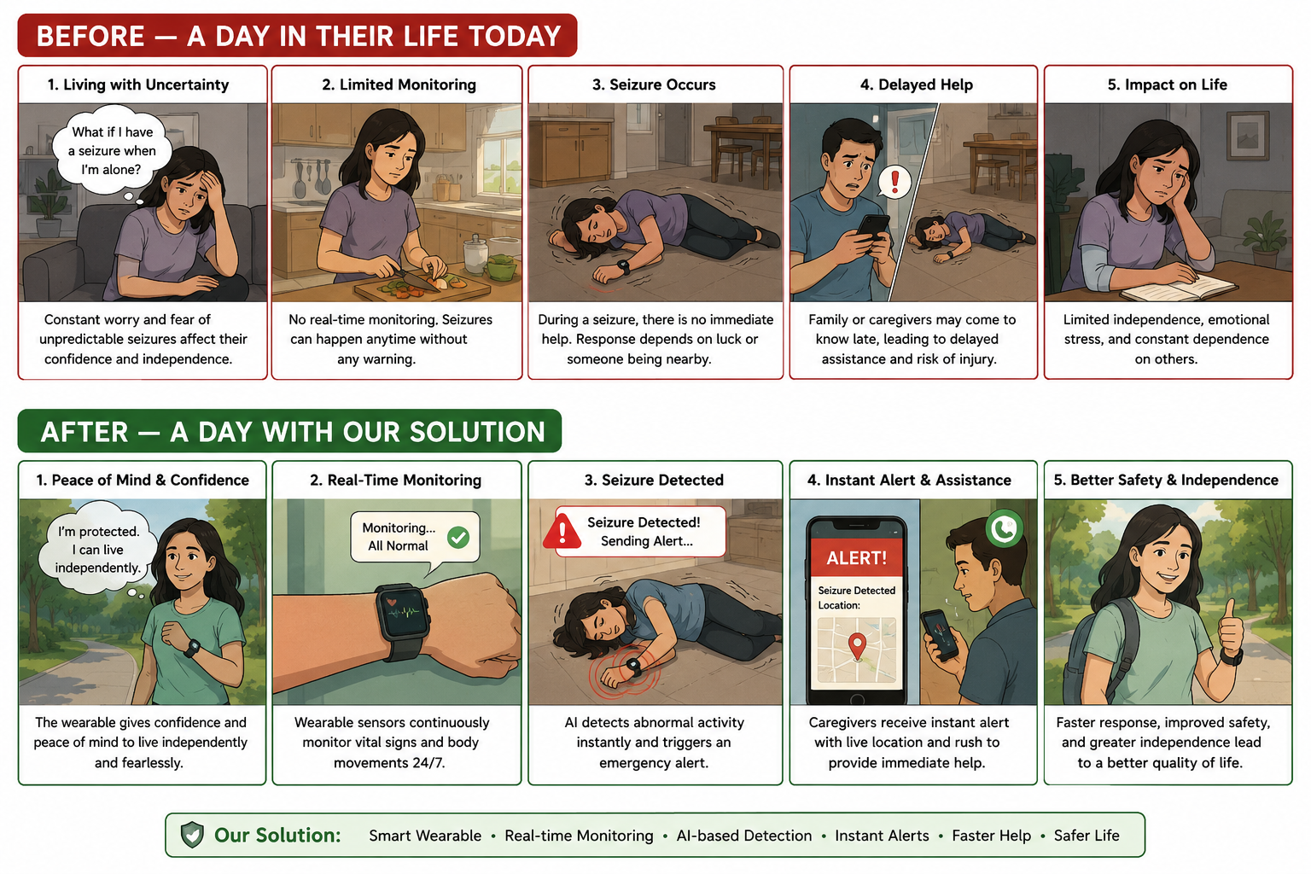
Storyboard – SAMPLE (Don’t Use this Slide for your presentation)
Notes:
Read the BEFORE story aloud first, then the AFTER story. Use real details from your field visit — names, times, what the person actually said. A story full of [ blanks ] or generic phrases shows the team never met a real user.

Slide 7

From Pain Point to Feature
Prove the idea came from empathy — every pain point must meet a feature.
PAIN POINT (from Empathy Map)
OUR FEATURE THAT SOLVES IT
“I circled the parking lot times and still couldn’t find an empty slot.”
Ultrasonic sensors detect every slot in real time and guide the driver straight to a vacant one.
“I don’t know if there’s space inside before I even enter.”
LCD/app display shows live vacancy count before entry, so drivers only come in when a slot is free.
“Manual checking by staff is slow and inconsistent.”
Microcontroller-based automated monitoring replaces manual checks, updating occupancy instantly.
“I waste fuel and get frustrated searching for parking.”
Automated servo-controlled gate plus real-time guidance cuts search time, fuel use and frustration.
Notes:
If a feature has no matching pain point, it is a feature you invented — drop it.

Slide 8


Existing Works
Carry the alternatives from your Problem Statement Canvas and show the gap you fill. Slides can be added for more content
WHAT USERS DO TODAY
WHY IT FALLS SHORT
WHAT WE DO DIFFERENTLY
Manually circling the parking lot looking for an empty slot
Time-consuming and increases traffic congestion
Real-time, slot-level occupancy detection using ultrasonic sensors
Asking security guards/attendants for directions
Guards give inconsistent or delayed information
Live LCD/app display showing exact vacancy before entry
Using generic navigation apps that don’t show slot-level data
Apps show the lot’s location, not real-time slot availability
Automated gate control integrated with the sensing system
OUR ONE-LINE DIFFERENTIATOR
Unlike existing options, our solution gives drivers real-time, slot-level parking availability instead of guesswork, saving time and fuel while reducing congestion.
Notes:
Novelty is a scoring criterion. Be specific about the gap.

Slide 9

Feasibility Analysis
An honest feasibility check — reviewers respect a team that knows its limits.
TECHNOLOGY / MATERIALS
SKILLS WE HAVE
Basic embedded programming (Arduino/ESP), circuit design, sensor interfacing
RISKS & ASSUMPTIONS
Ultrasonic sensors (HC-SR04), microcontroller (Arduino Uno / ESP8266 / ESP32), servo motor, LCD display, Wi-Fi module, mobile/web app
1
Sensor accuracy may vary with lighting/weather conditions
Calibrate sensors and test under different conditions
2
Network issues could delay real-time updates
SKILLS WE NEED
Keep the local LCD display as a backup and use a reliable Wi-Fi module
Mobile/web app development, IoT cloud integration
3
Scaling to large parking lots may need more sensors
Start with a pilot of a few slots and design the system modularly
Notes:
Naming a risk is a strength, not a weakness.

Slide 10
Cost Estimate & Bill of Materials
A rough costing is enough at this stage — show you have thought about money. Add or Remove rows.
S. No. | Item / Component | Qty | Unit Cost (₹) | Total (₹)
1 | HC-SR04 Ultrasonic Sensor | 6 | 100 | 600
2 | Arduino Uno / ESP32 Board | 1 | 700 | 700
3 | Servo Motor (SG90) | 1 | 150 | 150
4 | LED Lights(Green&Red) | 4 | 50 | 200
5 | Wi-Fi Module (ESP8266) | 1 | 300 | 300
6 | Wires, breadboard, power supply & misc. | 1 set | 550 | 550
TOTAL ESTIMATED COST |  |  |  | ₹ 2,500
Notes:
Approximate figures are fine. Show the thinking, not precision.

Slide 11


Impact & SDG Mapping
WHO BENEFITS
MEASURABLE IMPACT
Drivers/commuters at malls, hospitals, colleges, airports, railway stations and offices
Parking administrators and the environment, through reduced emissions
Saves approximately 5–10 minutes per visit spent searching for parking
Reduces unnecessary fuel consumption and related emissions from idle circling
Always include units.
UN SUSTAINABLE DEVELOPMENT GOALS
1 No Poverty
2 Zero Hunger
3 Good Health
4 Quality Education
5 Gender Equality
6 Clean Water
7 Clean Energy
8 Decent Work
9 Industry & Innovation
10 Reduced Inequalities
11 Sustainable Cities
12 Responsible Consumption
13 Climate Action
14 Life Below Water
15 Life on Land
16 Peace & Justice
17 Partnerships
Our solution maps to SDG [ 11 ] because it reduces traffic congestion and fuel wastage by helping vehicles find parking quickly, making urban infrastructure more sustainable
Notes:
Pick one primary SDG. Two at most. Do not tick every box.

Slide 12
Team Contribution
Every member should be able to speak to their part.
Member Name | Roll No. | Role in the Team | Contribution to Ideation | Next Task
[ NISHANTH.K ] | [ 25SY042 ] | [ e.g., research lead ] | [ what they did in this stage ] | [ next ]
[ SRIDHARAN.R ] | [ 25SY050 ] | [ e.g., research lead ] | [ what they did in this stage ] | [ next ]
[ Name ] | [ Roll No ] | [ e.g., research lead ] | [ what they did in this stage ] | [ next ]
Notes:
Team work is a scored criterion. Everyone should speak at least once.

Slide 13
Roadmap
What happens between today and the Prototype review. - Sample
STEP 1
STEP 3
Finalise design
Build first version
Finalize sensor layout & circuit design — Week 1
Assemble and program the prototype with test slots — Week 3–4
1
2
3
4
STEP 2
STEP 4
Source materials
Test with the user
Procure sensors, microcontroller, servo motor & display — Week 2
Test in a mock parking area with real users & refine — Week 5
WHAT WE NEED HELP WITH
Guidance, CoE/ lab access, and mentor guidance on IoT cloud integration and mobile app development
Notes:
End with a clear ask. Mentors can only help if you name what you need.

Slide 14
Thank You!
Questions, feedback & ideas are always welcome.
Sri Eshwar College of Engineering
Sri Eshwar Innovation Studio · Coimbatore | Tamilnadu

