Slide 1
AEROCADASTRAL AI
Transforming Drone Vision into Smart Land Records
AI-assisted urban parcel mapping • Geospatial intelligence • Human-verified land records
SMART INDIA HACKATHON | SIH26012
React + Express + Python + PostGIS
AEROCADASTRAL AI • SIH26012 • PROTOTYPE
1

Slide 2
Problem Statement
Urban land administration needs reliable, up-to-date spatial records.
• Manual digitisation of drone and aerial imagery is time-consuming.
• Buildings, roads and parcel features must be converted into usable GIS geometries.
• Reviewers need transparent tools to correct AI outputs before they enter a land-record workflow.
• Prototype objective: shorten the imagery-to-review cycle while keeping human verification central.
AEROCADASTRAL AI • SIH26012 • PROTOTYPE
2

Slide 3
Proposed Solution
An end-to-end workflow from drone imagery to reviewable geospatial features.
• Upload drone imagery, including georeferenced GeoTIFF orthomosaics.
• Run AI-assisted segmentation for visible classes such as buildings and roads.
• Convert detected masks to vector polygons and preserve georeferencing where metadata is valid.
• Create clearly labelled heuristic parcel candidates for manual review.
• Edit, approve or reject features and export structured GIS records.
AEROCADASTRAL AI • SIH26012 • PROTOTYPE
3

Slide 4
Key Features
A demonstrable prototype, not just a static dashboard.
• Interactive React + Leaflet map with drawing and geometry-edit tools.
• Python inference service using a pretrained SegFormer model.
• GeoTIFF CRS / affine-transform processing and GeoJSON export.
• Human verification states: pending, approved and rejected.
• Statistics dashboard, CSV / GeoJSON exports and an SIH summary report.
• Optional PostgreSQL + PostGIS persistence and spatial index.
AEROCADASTRAL AI • SIH26012 • PROTOTYPE
4

Slide 5
System Architecture
Three application layers with an optional spatial database.
• Frontend: React + Vite + Leaflet for upload, map editing, review and exports.
• Backend: Express API for uploads, feature CRUD, statistics and routing to AI service.
• AI service: FastAPI + PyTorch + Rasterio + OpenCV + Shapely.
• Data: GeoJSON interchange and optional PostgreSQL / PostGIS storage.
• Refer to the accompanying architecture diagram for service and data flow.
AEROCADASTRAL AI • SIH26012 • PROTOTYPE
5

Slide 6
AI & Geospatial Workflow
Image understanding and map alignment are separate, testable steps.
• Validate image format and file size; for GeoTIFF, read CRS and affine transform.
• Run pretrained semantic segmentation and post-process masks into polygon candidates.
• Transform pixel coordinates into geographic coordinates only when valid georeferencing is available.
• Display confidence and review status where available; preserve source and candidate metadata.
• Export geometry and attributes for GIS inspection.
AEROCADASTRAL AI • SIH26012 • PROTOTYPE
6

Slide 7
Human Verification & Trust
AI supports reviewers; it does not certify ownership.
• Map operators inspect polygons and edit geometry against authoritative reference layers.
• Reviewers approve or reject each feature; changes can be saved to PostGIS when configured.
• Keep provenance, confidence, status and candidate source visible.
• Never treat heuristic parcel proposals as legal property boundaries.
• Use cadastral records, survey control and qualified review before operational use.
AEROCADASTRAL AI • SIH26012 • PROTOTYPE
7

Slide 8
Technology Stack
Preserve the existing React + Express + Python architecture.
• React / Vite / Leaflet / Leaflet-Geoman — user interface and map editing.
• Node.js / Express / Multer — APIs and upload workflow.
• Python / FastAPI / PyTorch / SegFormer — model inference.
• Rasterio / PyProj / OpenCV / Shapely — geospatial and vector processing.
• PostgreSQL / PostGIS — optional persistent spatial storage.
AEROCADASTRAL AI • SIH26012 • PROTOTYPE
8

Slide 9
Demo Plan
A repeatable 5–7 minute demonstration.
• 1. Open dashboard and explain sample records are illustrative.
• 2. Upload a GeoTIFF with a known CRS and affine transform.
• 3. Run AI analysis; show overlay, extracted features and the candidate notice.
• 4. Open Map Explorer and edit a polygon using the map controls.
• 5. Approve one feature and reject another in Parcel Review.
• 6. Show statistics, then export GeoJSON, CSV and the SIH report.
• 7. Explain limitations and how authoritative cadastral references validate results.
AEROCADASTRAL AI • SIH26012 • PROTOTYPE
9

Slide 10
Validation & Evaluation
Measure quality rather than claiming accuracy without evidence.
• Detection: precision, recall and F1 against labelled imagery.
• Geometry: IoU / intersection-over-union and boundary displacement against reference polygons.
• Georeferencing: compare known control points and coordinate residuals.
• Workflow: processing time, reviewer correction time and proportion of candidates accepted.
• Robustness: test multiple image resolutions, shadows, occlusion and varied urban layouts.
AEROCADASTRAL AI • SIH26012 • PROTOTYPE
10

Slide 11
Roadmap & Impact
Move from prototype to a validated land-record assistance workflow.
• Phase 1: validate the demo pipeline on representative georeferenced imagery.
• Phase 2: curate a cadastral-specific labelled dataset and fine-tune segmentation models.
• Phase 3: integrate authoritative parcel and survey reference layers.
• Phase 4: add role-based review, audit trail, project management and deployment hardening.
• Expected benefit to evaluate: faster initial digitisation with traceable human review.
AEROCADASTRAL AI • SIH26012 • PROTOTYPE
11

Slide 12
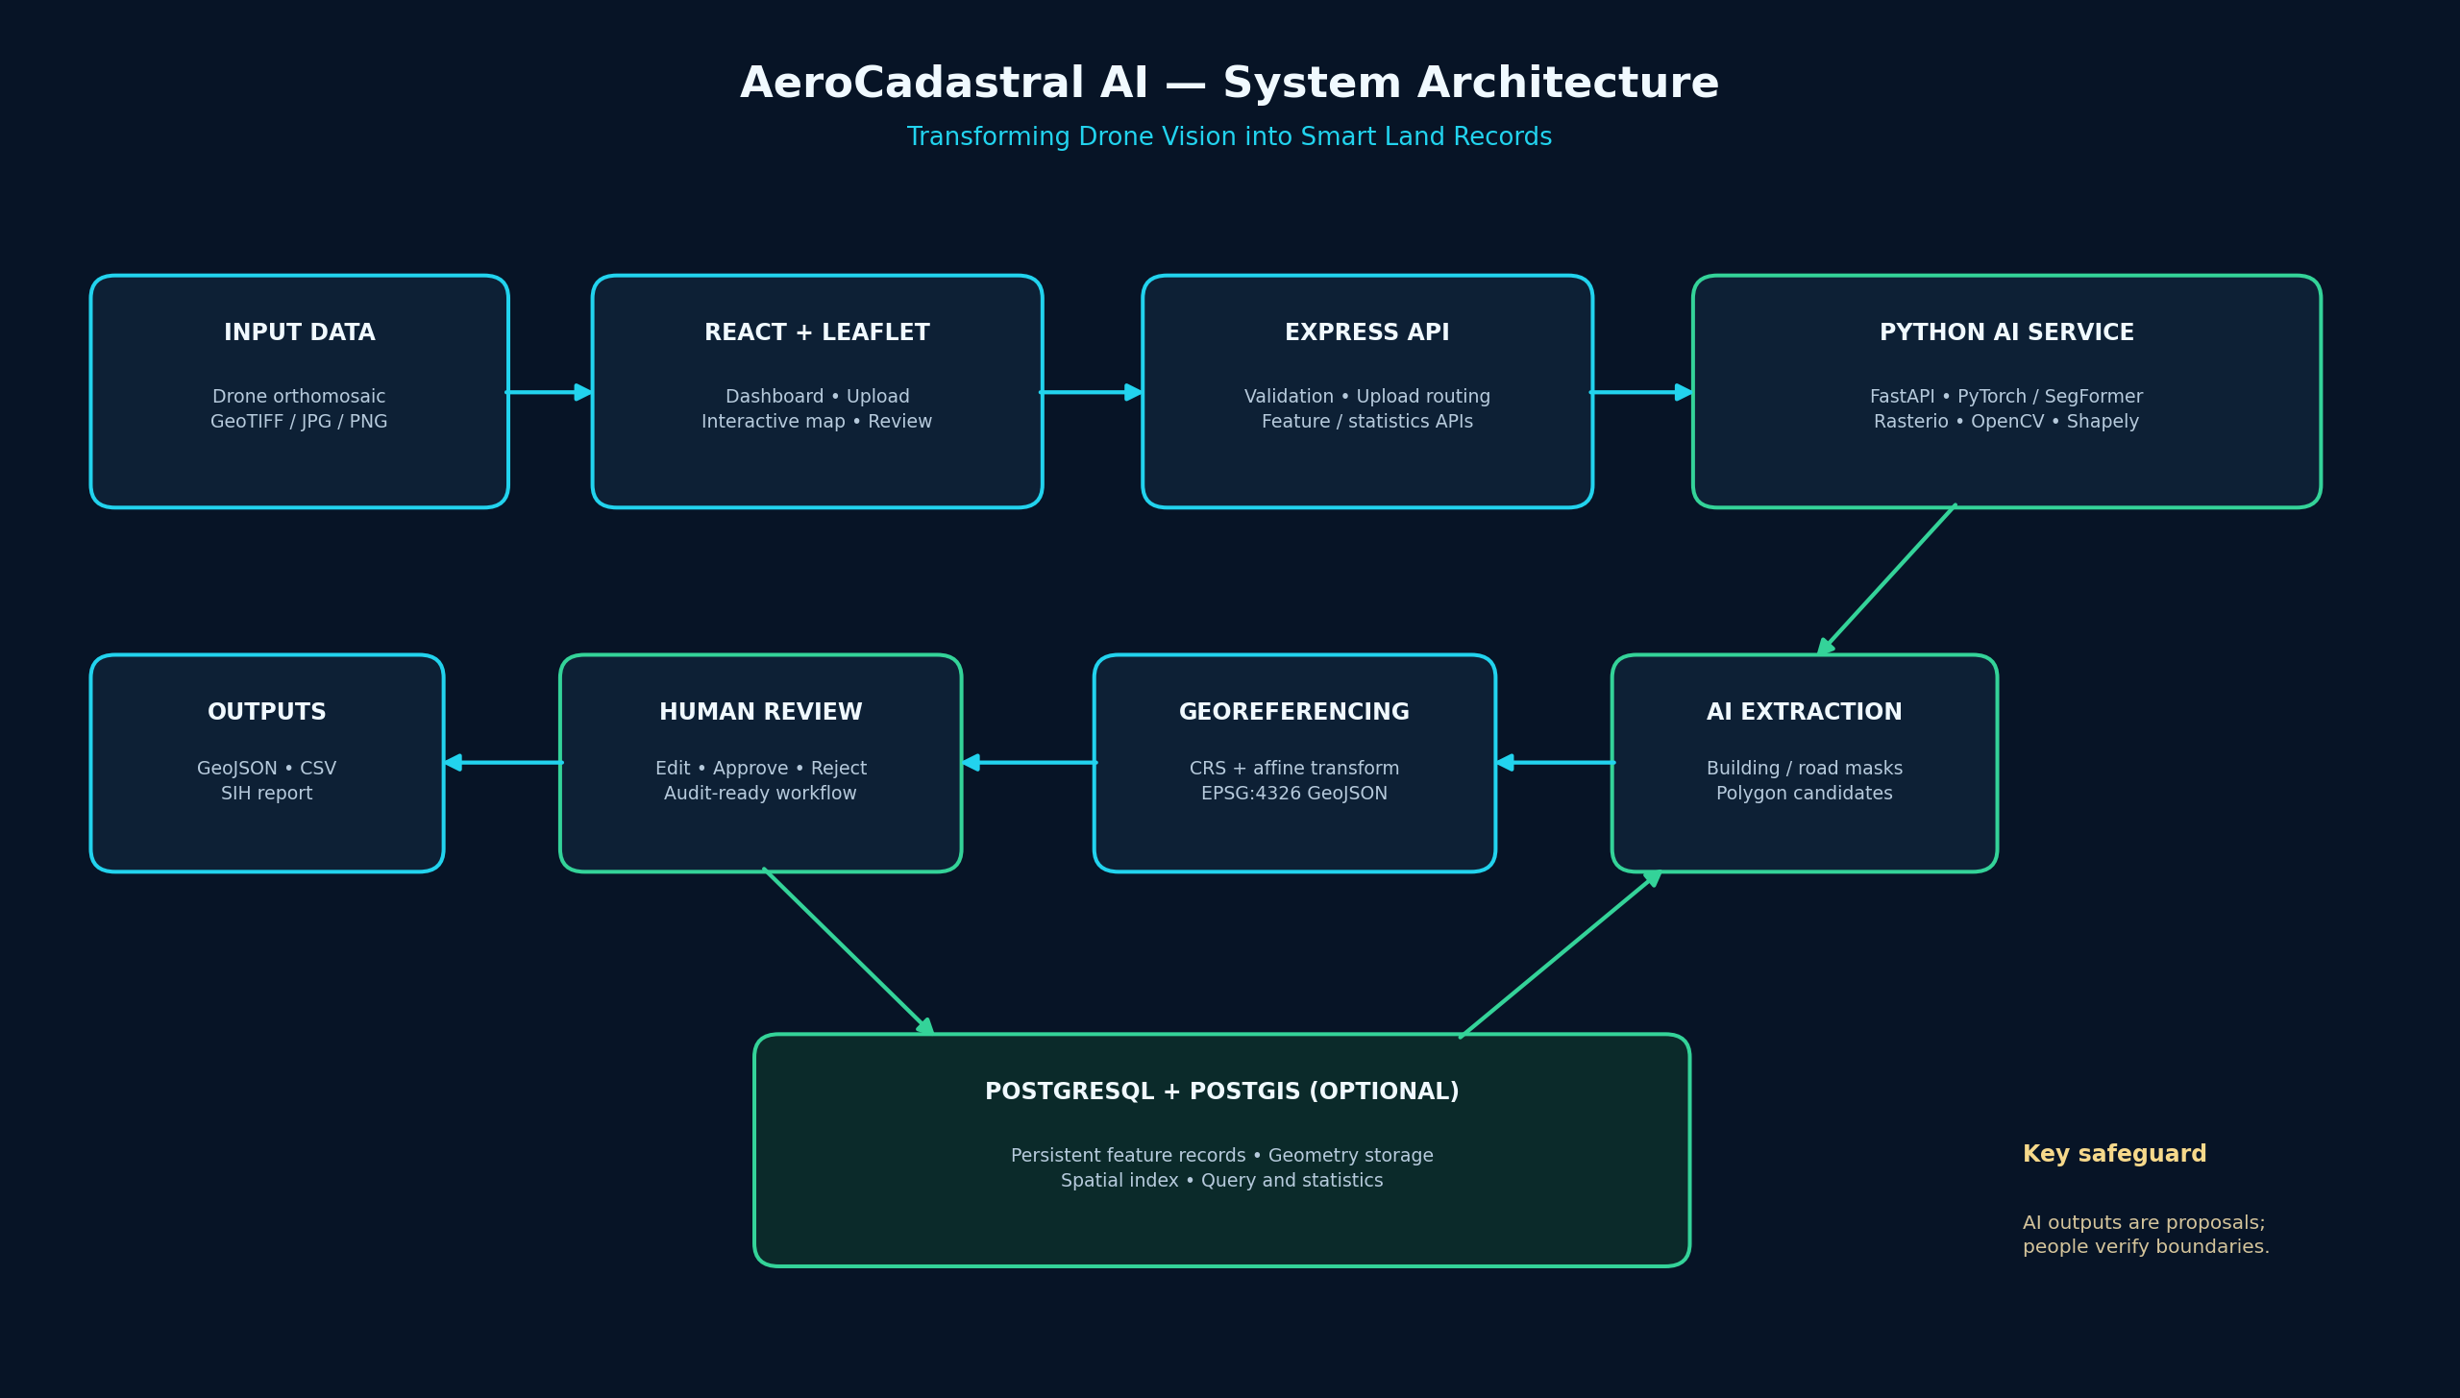
Architecture Diagram
Application and geospatial data flow
AEROCADASTRAL AI • SIH26012 • PROTOTYPE
12

