Slide 1
Analysis of Audience Engagement and Growth Trends
Data Analysis Report
Generated on 2025-03-21

Slide 2
Key Insights
The program is experiencing a consistent year-over-year decline in audience engagement, with all data points showing negative YOY growth percentages ranging from -3.7% to -34.6%.
Despite the long-term decline, there are positive short-term audience trends, with 4 out of 5 data points showing positive weekly growth, suggesting potential for audience recovery if these short-term gains can be sustained.
The audience metrics show significant volatility week-to-week, with growth percentages ranging from -15.56% to +63.04%, indicating inconsistent viewer engagement that could benefit from more strategic content scheduling or promotion.
Current audience metrics generally outperform recent averages (4-week and 8-week) but consistently underperform compared to year-ago numbers, highlighting a concerning long-term trend despite short-term improvements.
The identical values between National AA and Coverage AA metrics across all data points suggest these measurements are capturing the same audience or using the same methodology for this particular program.

Slide 3
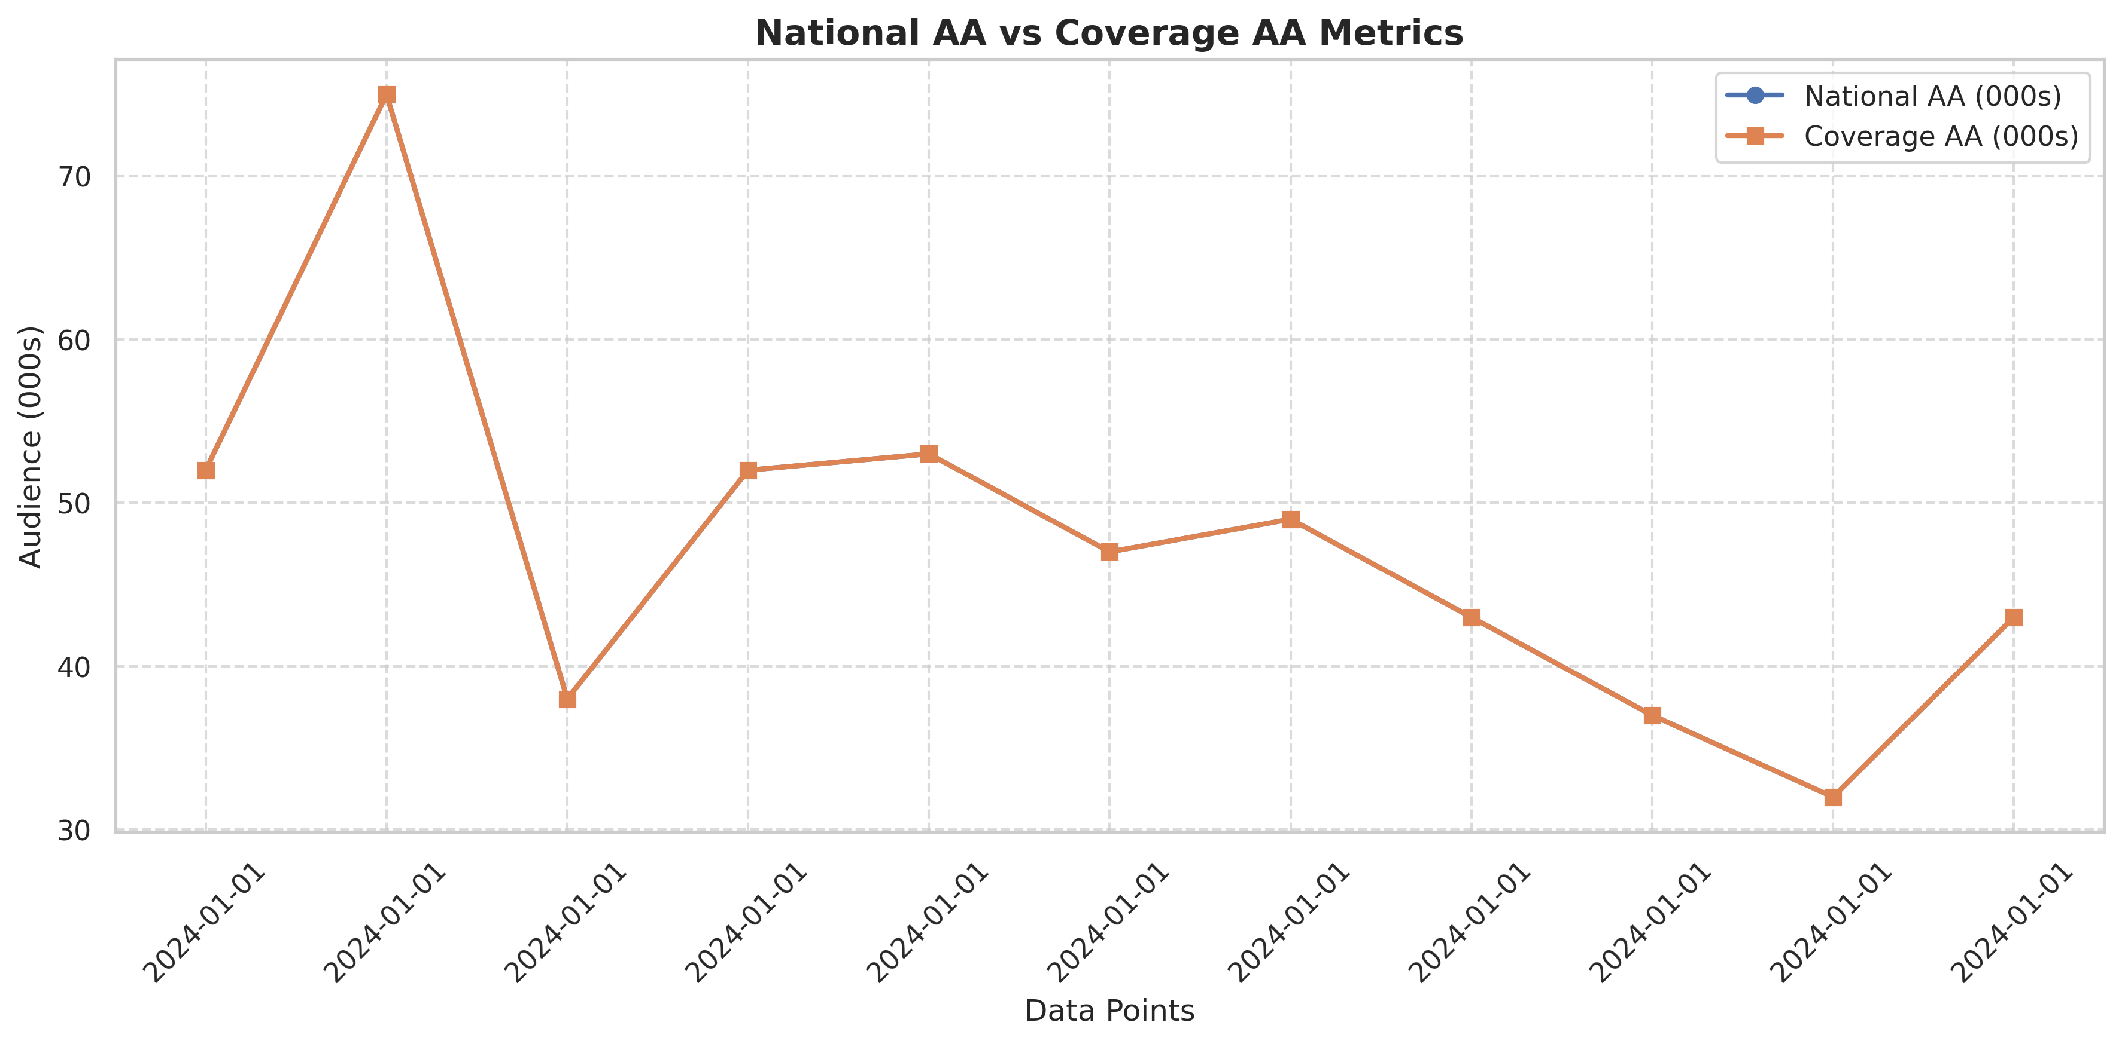
Comparison of National AA and Coverage AA metrics over time
Analysis
• The National AA and Coverage AA metrics show identical values across all data points, suggesting they are measuring the same audience or are calculated using the same methodology for this particular dataset.
• There is significant variability in audience numbers across different dates, with a notable peak in the second data point reaching 75,000 viewers.
• The audience metrics show no clear upward or downward trend over the time period, indicating fluctuating viewership rather than consistent growth or decline.

Slide 4
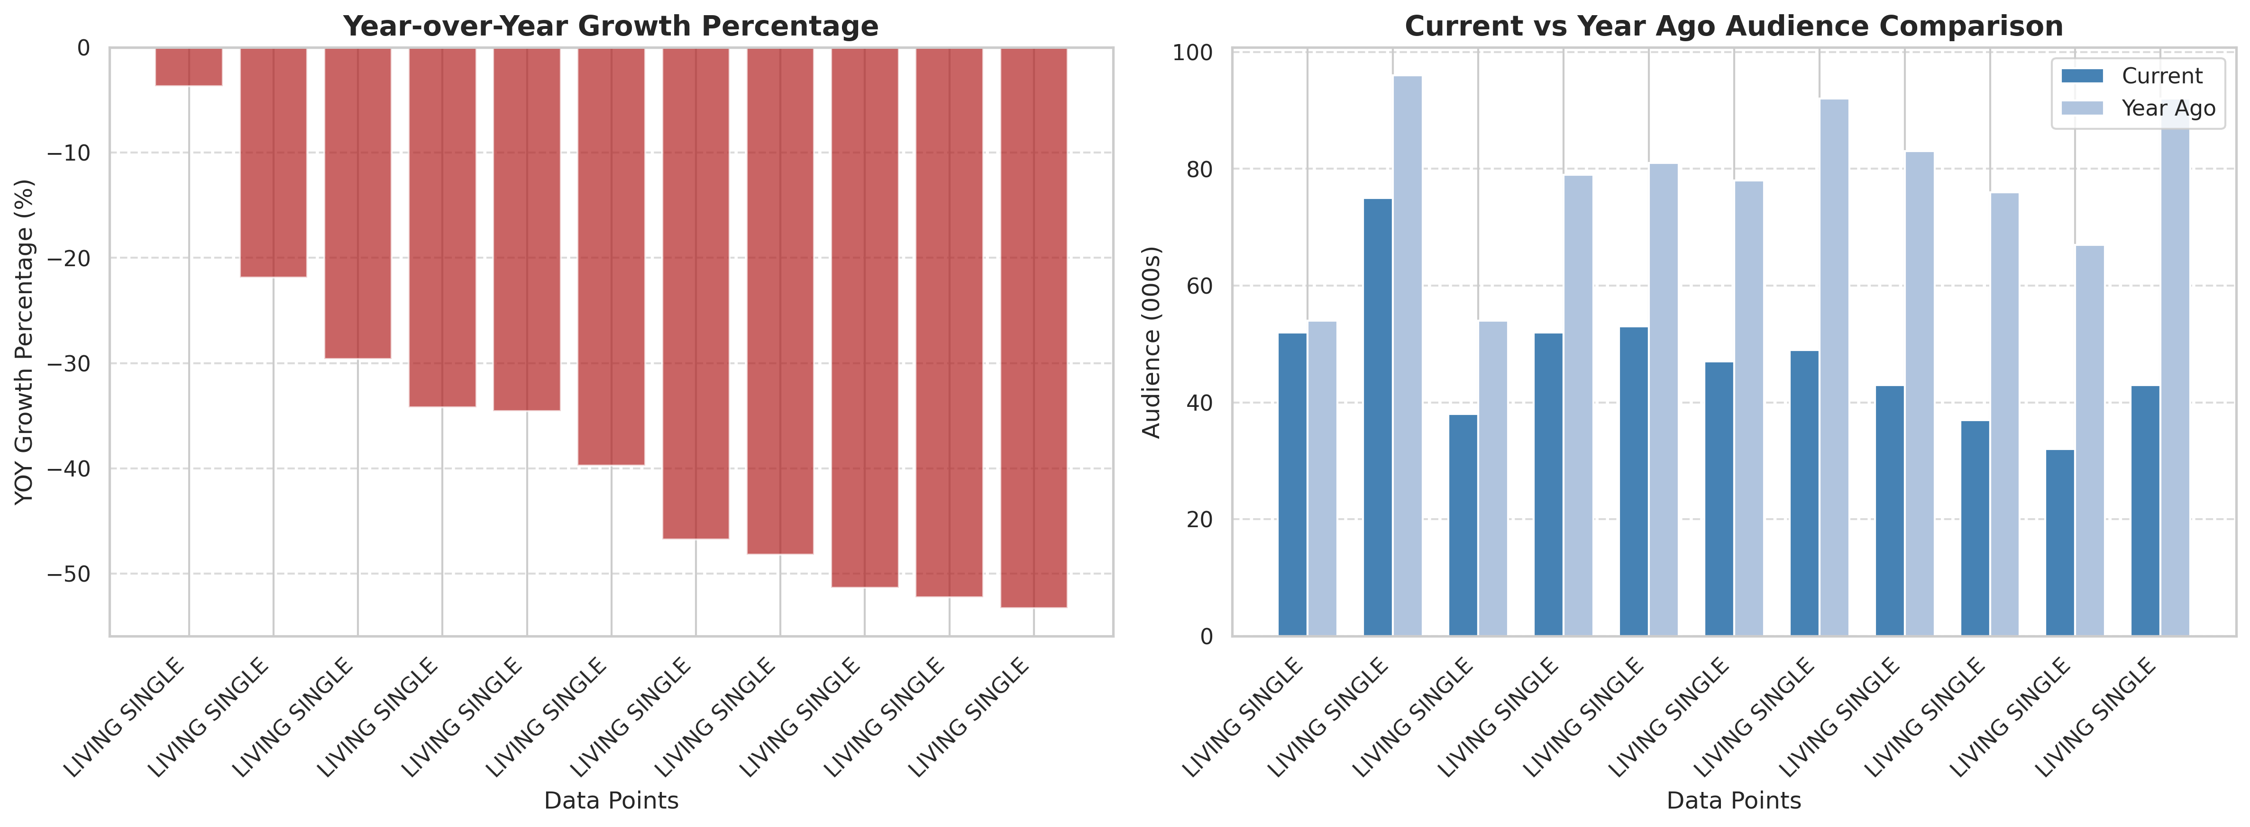
Year-over-Year Growth Analysis
Analysis
• All data points show negative Year-over-Year growth percentages, indicating a consistent decline in audience compared to the previous year, with decreases ranging from approximately -3.7% to -34.6%.
• The comparison between current and year-ago audience numbers visually confirms this decline, with the 'Year Ago' bars consistently taller than the 'Current' bars across all data points.
• The most significant YOY audience decline appears in the later data points, suggesting an accelerating loss of viewership compared to the previous year.

Slide 5
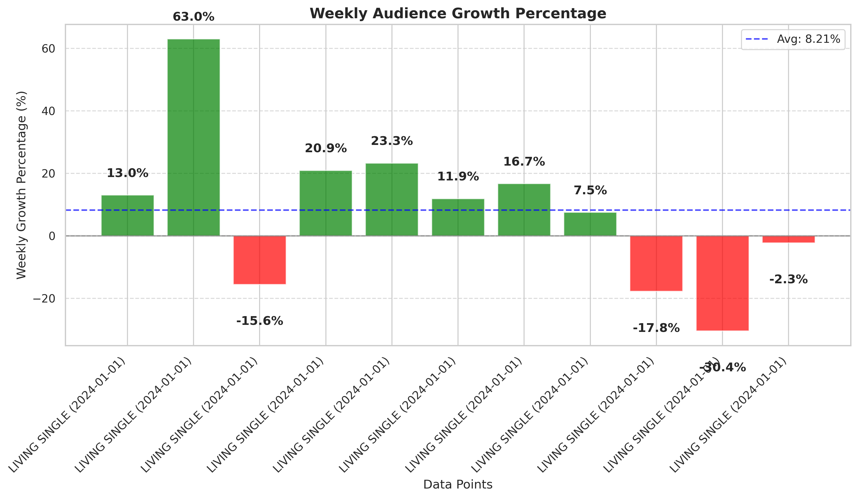
Weekly Growth Analysis and Patterns
Analysis
• Weekly growth patterns show significant volatility, with growth percentages ranging from -15.56% to +63.04%, indicating inconsistent week-to-week audience engagement.
• Most data points (4 out of 5) show positive weekly growth, suggesting short-term audience gains despite the longer-term YOY decline observed in the previous visualization.
• The second data point shows an exceptional weekly growth of 63.04%, representing a significant audience spike that could be related to special content, promotion, or external factors affecting viewership.

Slide 6
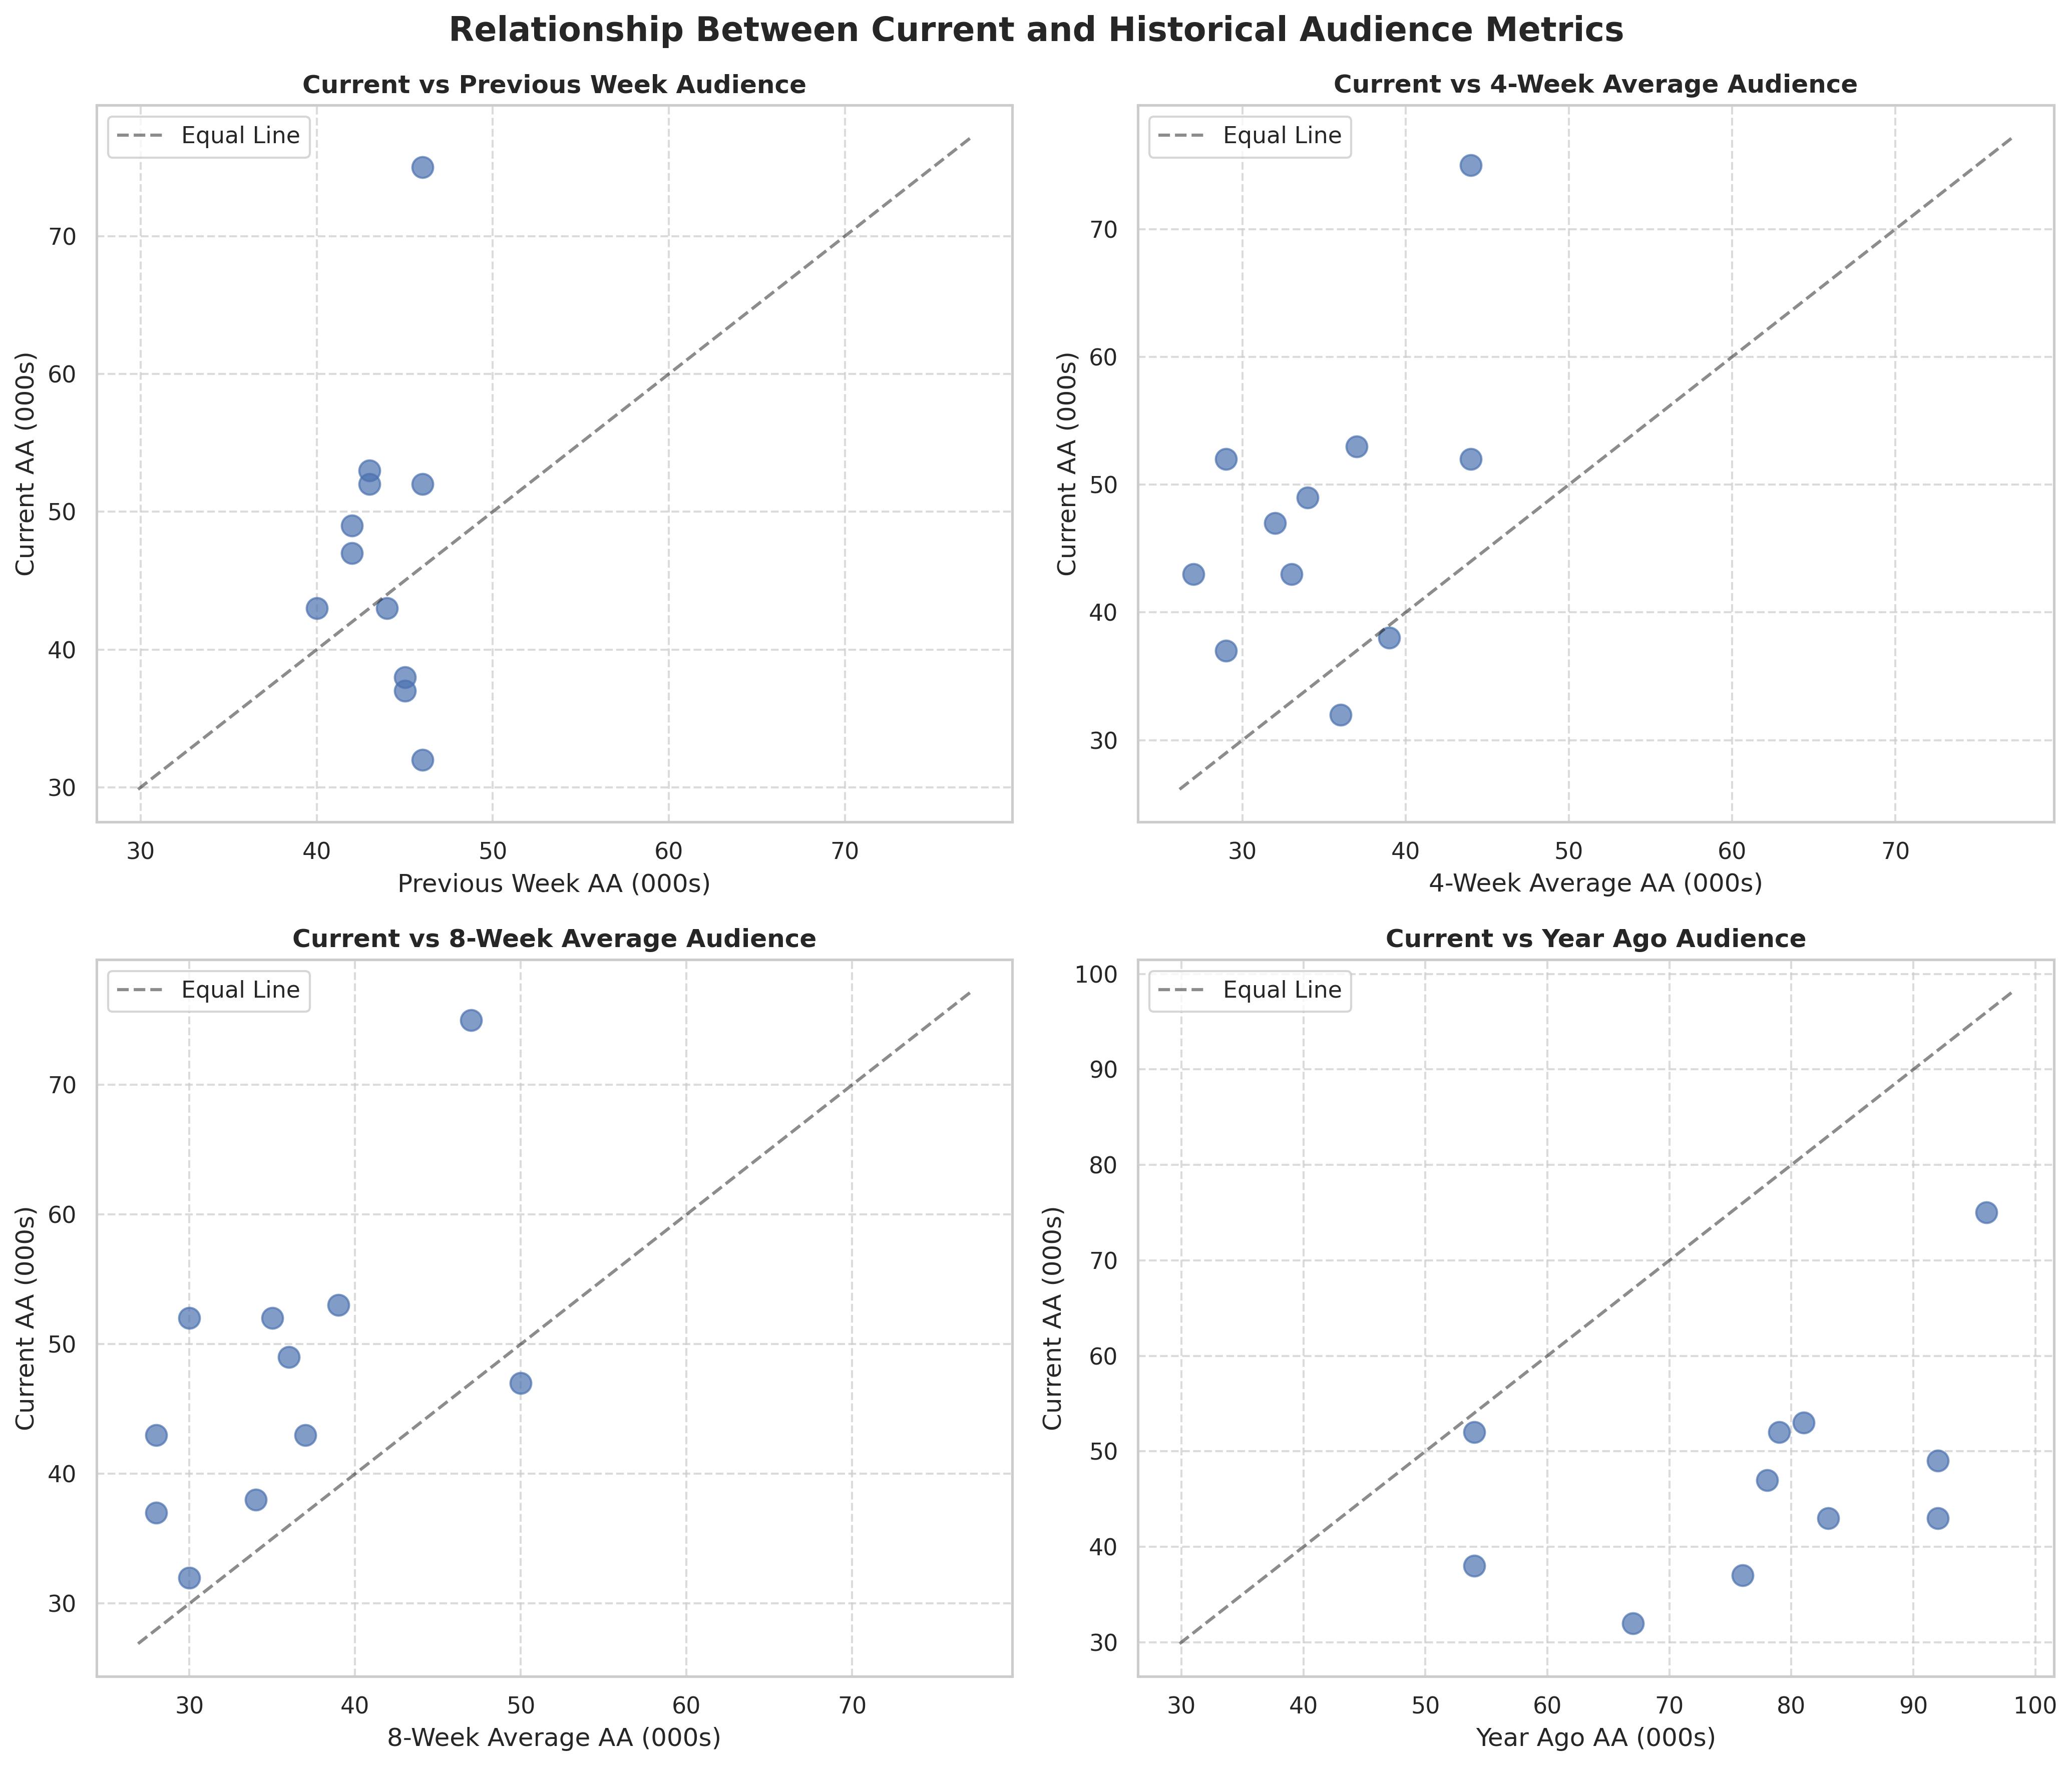
Correlation between Current Metrics and Historical Performance
Analysis
• The scatter plots reveal that current audience metrics generally outperform recent averages (4-week and 8-week), with most points appearing above the reference line, indicating short-term audience growth.
• However, when comparing current metrics to year-ago performance, all points fall below the reference line, confirming the consistent year-over-year audience decline observed earlier.
• The relationship between current and previous week metrics shows the most variability, reflecting the weekly fluctuations in audience engagement that don't follow a consistent pattern.

Slide 7
Thank You

