Slide 1
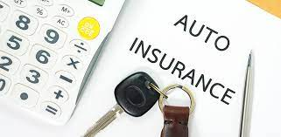
Automobile Insurance Fraudulent Claim
Detection Using Machine Learning

Slide 2
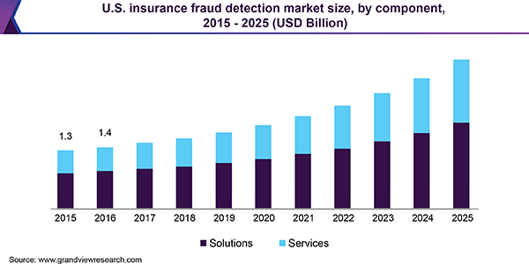
INTRODUCTION
Insurance fraud isn’t a new thing, many kinds of research had been made, to determine the causes which take us back to 1945 and state these occur majorly for the financial benefit.
There is a significant rise in the number of fraudulent claims occurring year by year in the automobile insurance industry.
The global insurance fraud detection market size was valued at USD 4.1 billion in 2018 and is expected to register a CAGR of 13.7% from 2019 to 2025
Source : GRAND VIEW RESEARCH

Slide 3
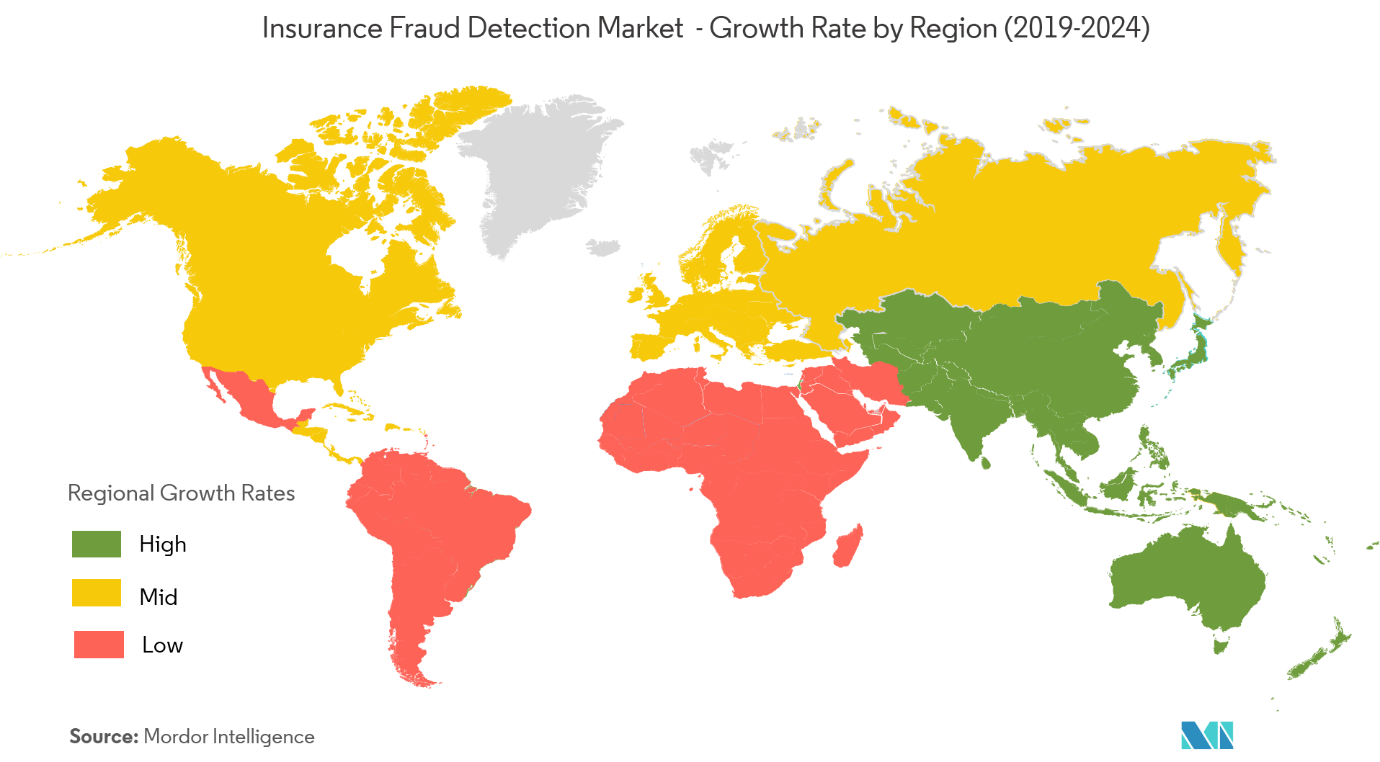
We can see there is a lot of scope and the fraud detection market growth rate in the countries.
Seeing this we can understand how big problem is this and required.
Source: mordorintelligence

Slide 4
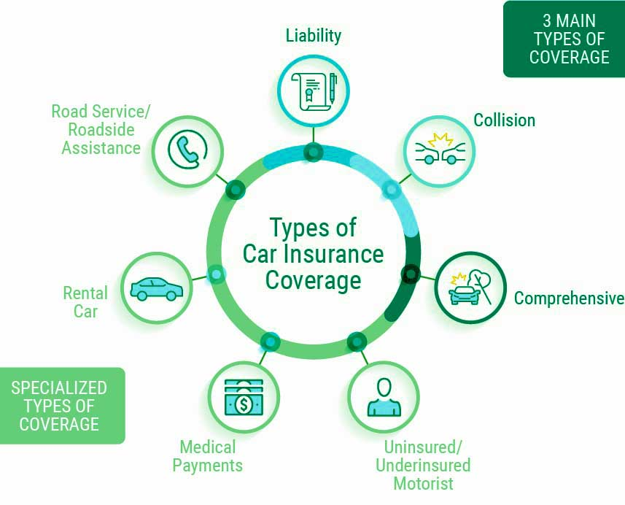
BACKGROUND
Automobile insurance is one of the sub domains in insurance industry.
There are different types of components and policies in this industry which are liable to cover the damages occurred to vehicle/ medical bills for persons caused due to accident.
Taking advantage of the coverages provided by the company, few people are using this for their own benefits by doing fraudulent claims, i.e. claiming the amount even there is their mistake or done intentionally or when they are not entitled to get benefits as per the company policies.

Slide 5
LITERATURE REVIEW
Automobile Insurance Industry is one of the several other insurance industries. In this industry, the user will do insurance for his vehicle. The vehicle may be bikes, cars, trucks, etc. Based on the vehicle, vehicle cost, and the option chosen to get covered in case of an accident, the premium amount will vary. Also, they need to reinsure their vehicle every year, while reinsuring the cost of the vehicle will be depreciated as per norms and the sum valued for insurance will be the same.
Some stats about automobile insurance:
Countrywide in USA, the automobile insurance expenditure rose from $1,059.41 in 2018 to $1,070.47 in 2019 which is 1.0 percent. This is the data according to the National Association of Insurance Commissioners. As per the data of the 2019 report, the average expenditure was highest in Louisiana, followed by Michigan and New York.

Slide 6
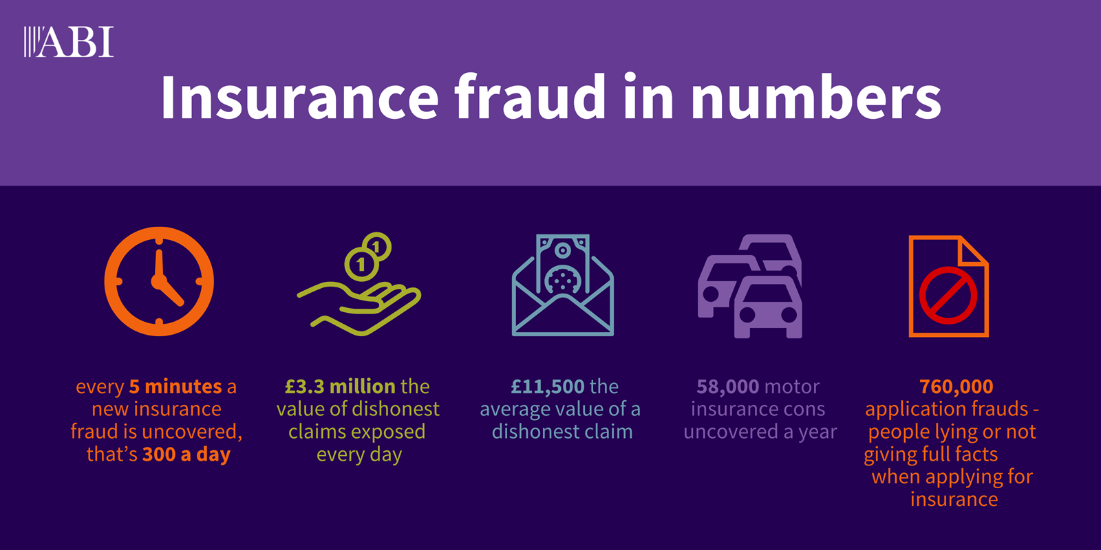
PROBLEM STATEMENT
There is an increase in the cost of insurance globally and it is compounded by the
advent of fraud, of which insurance claims fraud makes up a substantial portion.
These fraudulent claims are a big problem for the companies providing insurance.
Source: ABI

Slide 7
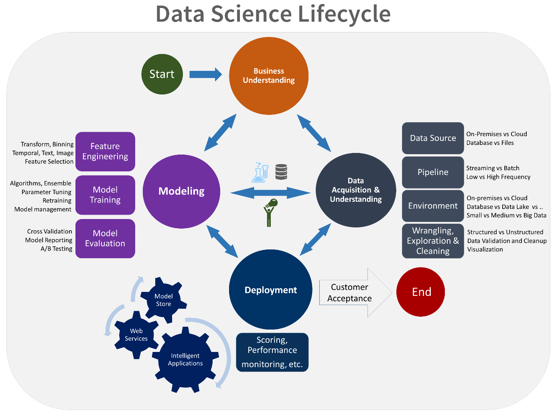
METHODOLOGY
We are going to use the advancement of technology to overcome the problem with better way, such that there will be a lot of cost-cutting and time saving to the company from the traditional way of detecting the fraudulent claim.
Utilising the existing data in the company, we use the data science to our favour to solve the problem.
We will take the required data
Pre-process the data, get some insights
We will build the model to predict whether the claim is fraudulent or not.
We will use classification models for this purpose.
This built model can be used for predicting the future claims.

Slide 8
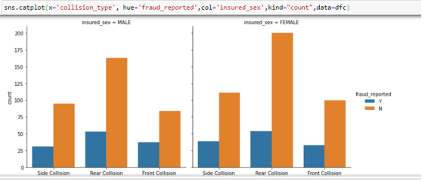
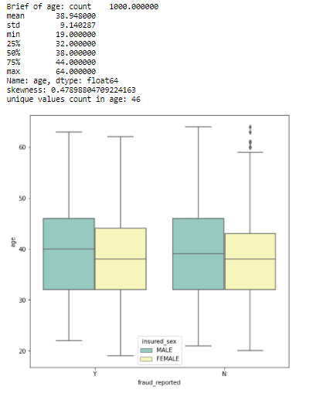
RESULTS & DISCUSSION
We observed more accidents and claims are made by females.
Comparatively the fraudulent claims % is not related with gender.
The age of persons committed fraudulent claims.
Age Range : Male – 22 to 64; Female – 18 to 62
Male : 50 percentile of them are less than 40 years.
Female: 50 percentile of them are less than 38 years.

Slide 9
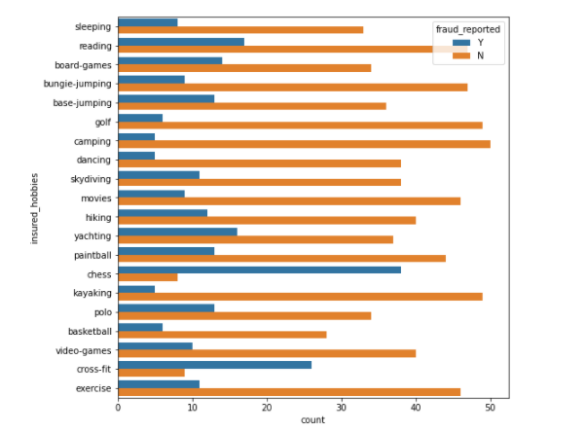
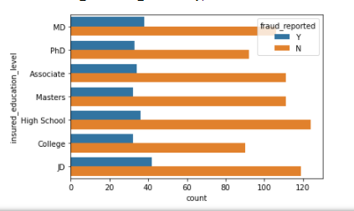
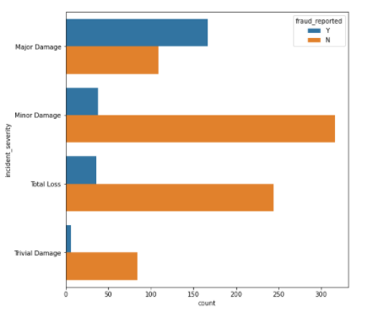
We can see people having chess as the hobby had done more fraudulent claims.
Basing their study, claims done by college students are more fraudulent.
The claims which are made as heavy damage are fraudulent.

Slide 10
Model | F1 score | Cross-validation | Difference
Logistic Regression | 81 | 74.5 | 6.5
Decision Tree Classifier | 85 | 84.9 | 0.1
Random Forest Classifier | 91 | 87 | 4
Gradient Boosting Classifier | 91 | 88 | 3
K Neighbors Classifier | 72 | 73 | 1
SVC | 89 | 84.5 | 4.5
Above table gives performance of the various Machine Learning models used to predict the fraudulent claims.
Decision tree model is having the least difference compared to all models.
However based on the confusion matrix we considered Random Forest classifier model as the best model and performed the tuning on this model.

Slide 11
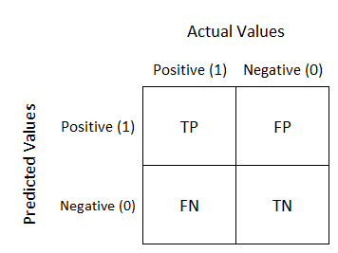
Exploring the model results
Random Forest Model
Our model is saying 10 members as not fraud where they are actually frauds.
15
In our business case we need less FN (False Negative).
Decision Tree is considered as the best model and tuned for improving accuracy.
The model accuracy improved to 90% from 92% by tuning
10

Slide 12
CONCLUSION
Finally, as per our main objective and the data science project life cycle steps, we understood the business problem, collected the data cleaned, observed the underlying trends, and built the machine learning models with various algorithms. Their performance is compared, the best model is selected and still, we tuned the model to improve its accuracy. The model we made gives the output with an accuracy of 92%.

