Slide 1
Capstone Project
CE-11 Group 4
Card-Based Payment System
27 December 2025
Team Members:
Ryan Nguyen
Marlon Prudencio
Sridhar Maroju
Sreedevi Voruganri

Slide 2
Project Objectives
Build a secure application using AWS
Implement DevOps and CI/CD Pipeline with Infrastructure as Code

Slide 3
Overview
Card-Based Payment System
Back-end by AWS
  Create Profile
  Add card to profile
  Top-up
  Deduct
  View card transactions
Front-end by Angular

Slide 4
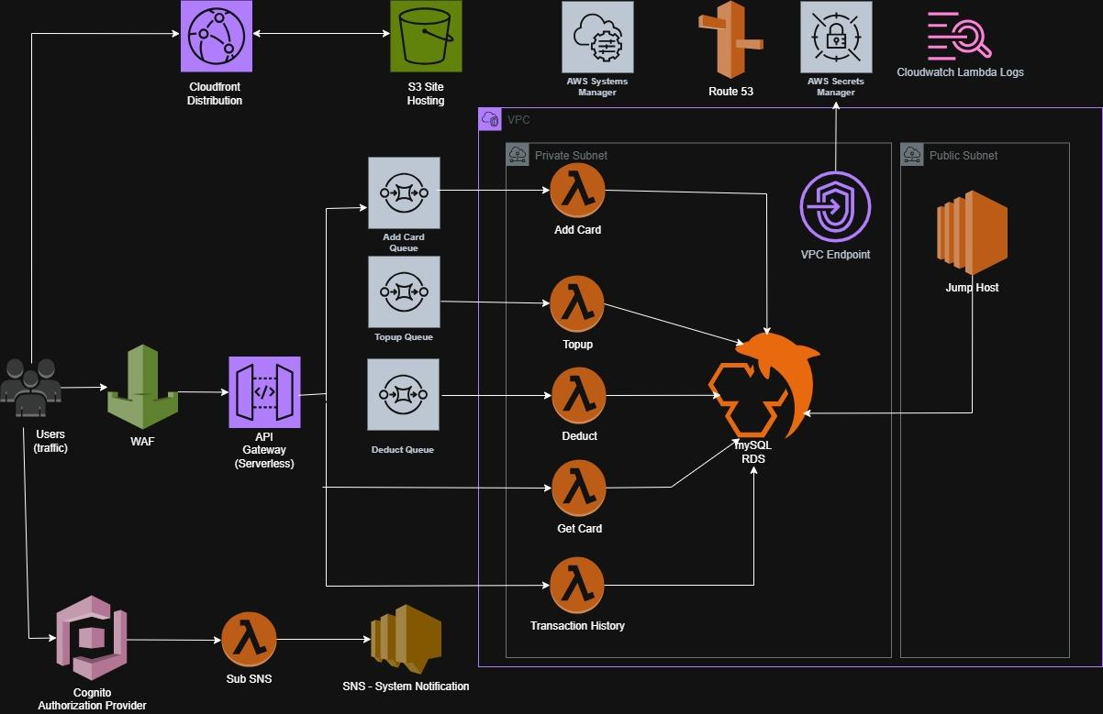
System Architecture

Slide 5
CI/CD Pipeline (DevOps)
2 branches (long live) for GitHub Repo
  Main branch for Production Environment
  Dev branch for Development Environment
  Using Terraform Workspace to create AWS resources and manage the environments
Main and Dev branches in the main repo are protected
Changes introduced by pull requests for code review before merge to base branch
3 Github Workflows:
  CI runs on push and pull requests
  CD runs on “workflow_dispatch”
  DESTROY runs on “workflow_dispatch”

Slide 6
CI/CD Pipeline (DevOps) - cont’d
Main Repository:
RyanNguyen1808/CapstoneProject_Group4_Infra
Run CD Workflow to deploy to Prod
Main (Prod)
Pull request,
Merge
Merge
Dev (Stage)
Development Repositories
MPrudencio33 / CapstoneProject_Group4_Infra
Sreedevi123i / CapstoneProject_Group4_Infra
sridharmaroju / CapstoneProject_Group4_Infra
fork
push
sync fork
push
Main (Dev)
Pull request,
Merge
Dev
branch
push
new feature 1
branch
push
new feature 2

Slide 7
CI/CD Pipeline (DevOps) - cont’d
Illustration of deployment from dev to prod
New Feature: Include a column ‘Balance’ in the display of Transaction History
Steps:
In the development environment / repository (created by forking from the main (upstream) repository):
Create a new branch from the dev branch in the dev (“origin”) repo
$ git checkout -b feature/balance
Push the feature/balance to the origin repo
$ git add .
$ git commit -m “add feature/balance branch”
$ git push origin feature/balance
In the development repo in Github, run the CD workflow for the feature/balance branch. This will create the resources (for the development environment) in AWS.
Using the AWS Console, open the lambda function ce11-capstone-group4-get-TransHist-api-sandbox-mprudencio33
In the Code Source, update the SQL statement to get the Balance from CARDS table by joining to the TRANSACTIONS table using the CARD_ID
Steps cont’d:
6. Push the feature/balance branch to the origin repository..
7. Create a Pull Request for the dev branch in the origin repository,
review the changes and then do a merge of the dev branch to the
main branch.
8. Run the CD workflow for the Main branch.
9. Go the application portal and go to the Transaction History menu/tab
and enter a valid card id to see if the Balance value is now displayed
for each of the transactions.
In the production environment / repository:
10. Create a pull request for the dev branch, review the changes and
then do a merge of the dev branch to the main branch
12. Run the CD workflow for the ‘main’ branch to deploy the new
feature in production environment.

Slide 8
Enhancements
Move to Aurora to achieve Serverless
Deploy into 2 separate regions (Active – Passive) to increase Fault Tolerance and High Availability
Add notification when SQS Messages not successfully processed

