Slide 1
An Introduction to
Machine Learning and
Natural Language Processing
Tools
Vivek Srikumar, Mark Sammons
(Some slides from Nick Rizzolo)

Slide 2
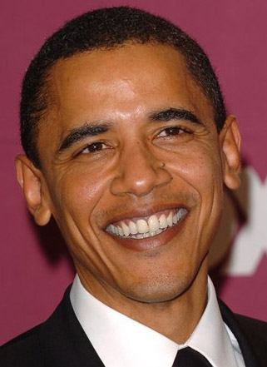
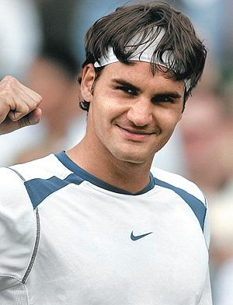
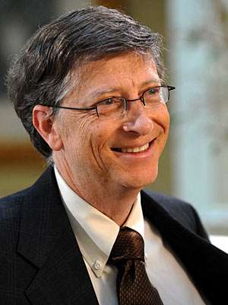
The Famous People Classifier
f( ) = Politician
f( ) = Athlete
f( ) = Corporate Mogul

Slide 3
Outline
An Overview of NLP Resources
Our NLP Application: The Fame classifier
The Curator
Edison
Learning Based Java
Putting everything together

Slide 4
An overview of NLP resources
What can NLP do for me?

Slide 5
NLP resources (An incomplete list)
Cognitive Computation Group resources
  Tokenization/Sentence Splitting
  Part Of Speech
  Chunking
  Named Entity Recognition
  Coreference
  Semantic Role Labeling
Others
  Stanford parser and dependencies
  Charniak Parser
Page <number>

Slide 6
Tokenization and Sentence Segmentation
Given a document, find the sentence and token boundaries
The police chased Mr. Smith of Pink Forest, Fla. all the way to Bethesda, where he lived. Smith had escaped after a shoot-out at his workplace, Machinery Inc.
Why?
  Word counts may be important features
  Words may themselves be the object you want to classify
  “lived.” and “lived” should give the same information
  different analyses need to align if you want to leverage multiple annotators from different sources/tasks
Page <number>
Notes:
How hard can it be?
Periods, spaces, and capitalization all give strong cues, but are still ambiguous

Slide 7
Part of Speech (POS)
Allows simple abstraction for pattern detection
Disambiguate a target, e.g.
“make (a cake)” vs. “make (of car)”
Specify more abstract patterns,
e.g. Noun Phrase: ( DT JJ* NN )
Specify context in abstract way
  e.g. “DT boy VBX” for “actions boys do”
  This expression will catch “a boy cried”, “some boy ran”, …
POS | DT | NN | VBD | PP | DT | JJ | NN
Word | The | boy | stood | on | the | burning | deck
POS | DT | NN | VBD | PP | DT | JJ | NN
Word | A | boy | rode | on | a | red | bicycle
Page <number>

Slide 8
Chunking
Identifies phrase-level constituents in sentences
  [NP Boris] [ADVP regretfully] [VP told] [NP his wife]
  [SBAR that] [NP their child] [VP could not attend] [NP night school] [PP without] [NP permission] .
Useful for filtering: identify e.g. only noun phrases, or only verb phrases
  Groups modifiers with heads
  Useful for e.g. Mention Detection
Used as source of features, e.g. distance (abstracts away determiners, adjectives, for example), sequence,…
  More efficient to compute than full syntactic parse
  Applications in e.g. Information Extraction – getting (simple) information about concepts of interest from text documents
Page <number>

Slide 9
Named Entity Recognition
Identifies and classifies strings of characters representing proper nouns
[PER Neil A. Armstrong] , the 38-year-old civilian commander, radioed to earth and the mission control room here: “[LOC Houston] , [ORG Tranquility] Base here; the Eagle has landed."
Useful for filtering documents
  “I need to find news articles about organizations in which Bill Gates might be involved…”
Disambiguate tokens: “Chicago” (team) vs. “Chicago” (city)
Source of abstract features
  E.g. “Verbs that appear with entities that are Organizations”
  E.g. “Documents that have a high proportion of Organizations”
Page <number>

Slide 10
Coreference
Identify all phrases that refer to each entity of interest – i.e., group mentions of concepts
[Neil A. Armstrong] , [the 38-year-old civilian commander], radioed to [earth]. [He] said the famous words, “[the Eagle] has landed”."
The Named Entity recognizer only gets us part-way…
…if we ask, “what actions did Neil Armstrong perform?”, we will miss many instances (e.g. “He said…”)
Coreference resolver abstracts over different ways of referring to the same person
  Useful in feature extraction, information extraction
Page <number>

Slide 11
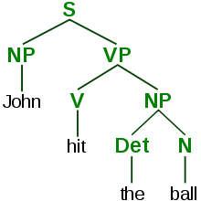
Parsers
Identify the grammatical structure of a sentence
object
subject
modifier
John
hit
the
ball
Dependency parse
Parsers reveal the grammatical relationships between words and phrases
Full parse

Slide 12
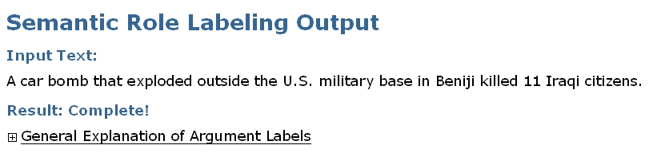
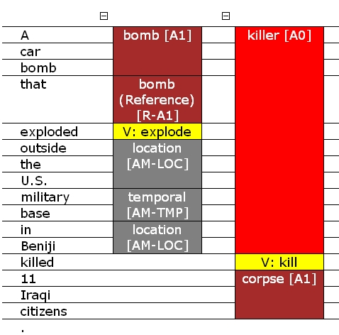
Semantic Role Labeler
SRL reveals relations and arguments in the sentence (where relations are expressed as verbs)
Cannot abstract over variability of expressing the relations – e.g. kill vs. murder vs. slay…
Page <number>

Slide 13
The fame classifier
Enough NLP. Let’s make our $$$ with the

Slide 14
The Famous People Classifier
f( ) = Politician
f( ) = Athlete
f( ) = Corporate Mogul

Slide 15
The NLP version of the fame classifier
All sentences in the news, which the string Barack Obama occurs
Represented
by
All sentences in the news, which the string Roger Federer occurs
All sentences in the news, which the string Bill Gates occurs

Slide 16
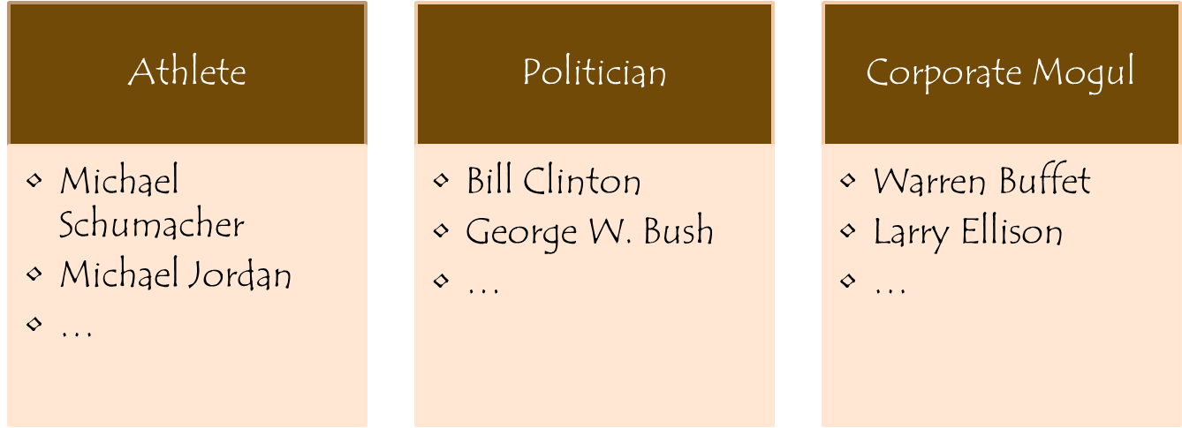
Our goal
Find famous athletes, corporate moguls and politicians

Slide 17
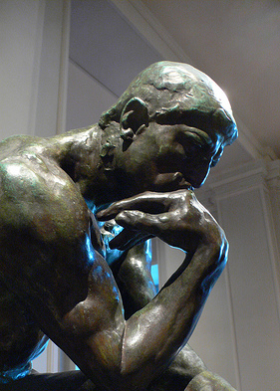
Let’s brainstorm
What NLP resources could we use for this task?
  Remember, we start off with just raw text from a news website

Slide 18
One solution
Let us label entities using features defined on mentions
Identify mentions using the named entity recognizer
Define features based on the words, parts of speech and dependency trees
Train a classifier
All sentences in the news, which the string Barack Obama occurs

Slide 19





Where to get it: Machine Learning
Feature
Functions
Data
→ “politics”
Learning Algorithm
→ “sports”
→ “business”

Slide 20


A second look at the solution
Identify mentions using the named entity recognizer
Define features based on the words, parts of speech and dependency trees
Train a classifier
University of Illinois
Sentence and Word Splitter
Part-of-speech Tagger
Named Entity Recognizer
Stanford University
Dependency Parser
(and the NLP pipeline)
These tools can be downloaded from the websites.
Are we done? If not, what’s missing?

Slide 21

We need to put the pieces together

Slide 22
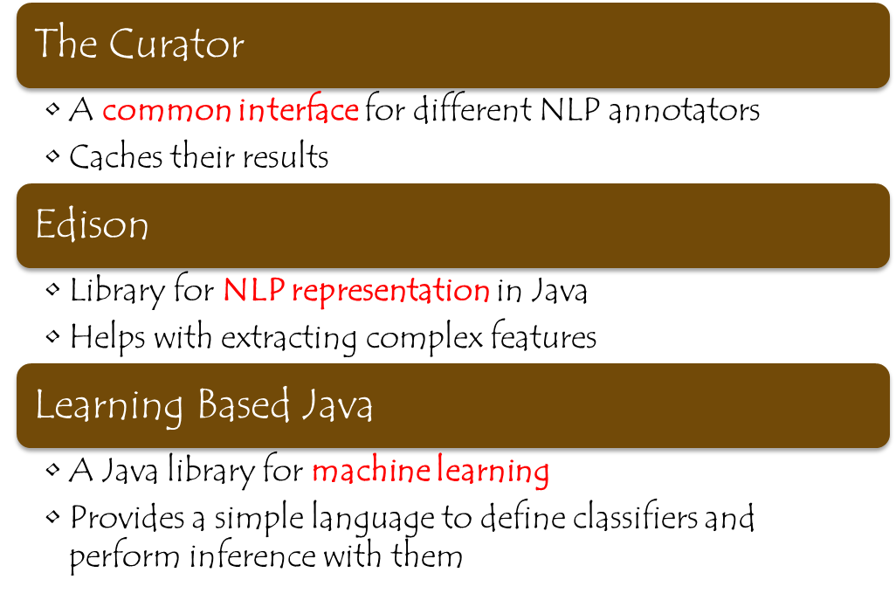
The infrastructure

Slide 23
The infrastructure
Each infrastructure module has specific interfaces that the user is expected to use
The Curator specifies the interface for accessing annotations from the NLP tools
Edison fixes the representation for the NLP annotation
Learning Based Java requires training data to be presented to it using an interface called Parser

Slide 24
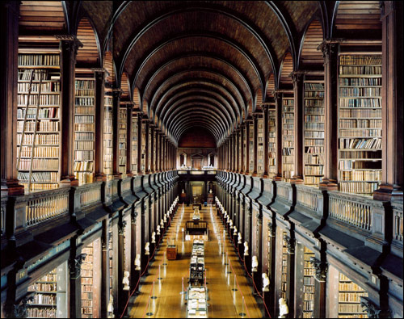
Curator
A place where NLP annotations live

Slide 25
Big NLP
NLP tools are quite sophisticated
The more complex, the bigger the memory requirement
  NER: 1G; Coref: 1G; SRL: 4G ….
If you use tools from different sources, they may be…
  In different languages
  Using different data structures
If you run a lot of experiments on a single corpus, it would be nice to cache the results
  …and for your colleagues, nice if they can access that cache.
Curator is our solution to these problems.
Page <number>

Slide 26


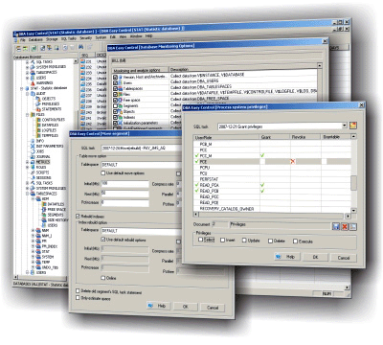
Curator
NER
Curator
SRL
POS, Chunker
Cache
Page <number>

Slide 27
What does the Curator give you?
Supports distributed NLP resources
  Central point of contact
  Single set of interfaces
  Code generation in many programming languages (using Thrift)
Programmatic interface
  Defines set of common data structures used for interaction
Caches processed data
Enables highly configurable NLP pipeline
Overhead:
Annotation is all at the level of character offsets: Normalization/mapping to token level required
Need to wrap tools to provide requisite data structures
Page <number>

Slide 28
Getting Started With the Curator
http://cogcomp.cs.illinois.edu/curator
Installation:
  Download the curator package and uncompress the archive
  Run bootstrap.sh
The default installation comes with the following annotators (Illinois, unless mentioned):
  Sentence splitter and tokenizer
  POS tagger
  Shallow Parser
  Named Entity Recognizer
  Coreference resolution system
  Stanford parser

Slide 29
Basic Concept
Different NLP annotations can be defined in terms of a few simple data structures:
  Record: A big container to store all annotations of a text
  Span: A span of text (defined in terms of characters) along with a label (A single token, or a single POS tag)
  Labeling: A collection of Spans (POS tags for the text)
  Trees and Forests (Parse trees)
  Clustering: A collection of Labelings (Co-reference)
Go here for more information:
http://cogcomp.cs.illinois.edu/trac/wiki/CuratorDataStructures

Slide 30
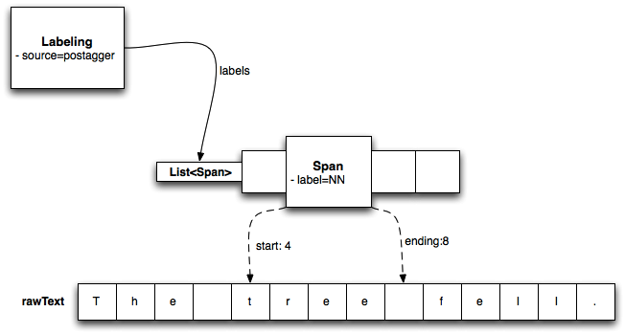
Example of a Labeling
The tree fell.

Slide 31

Edison
Representing NLP objects and extracting features

Slide 32
Edison
An NLP data representation and feature extraction library
Helps manage and use different annotations of text
Doesn’t the Curator do everything we need?
  Curator is a service that abstracts away different annotators
  Edison is a Curator client
  And more…

Slide 33
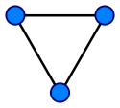
Representation of NLP annotations
All NLP annotations are called Views
A View is just a labeled directed graph
  Nodes are labeled collections of tokens, called Constituents
  Labeled edges between nodes are called Relations
All Views related to some text are contained in a TextAnnotation

Slide 34
Example of Views: Part of speech
A tree fell
Part of speech view is a degenerate graph
  No edges because there are no relations
  This kind of View is represented by a subclass called TokenLabelView
Note that constituents are token based, not character based
constituents
A
DT
tree
NN
fell
VBD

Slide 35
Example of Views: Shallow Parse
A tree fell
Shallow parse view is also a degenerate graph
  No edges because there are no relations
  This kind of View is represented by a subclass called SpanLabelView
constituents
A tree
Noun Phrase
fell
Verb Phrase

Slide 36
Example of Views: DependencyTree
A tree fell
A subclass of View called TreeView
Relations
mod
subj
A
tree
fell
Constituents

Slide 37
More about Views
View represents a generic graph of Constituents and Relations
Its subclasses denote specializations suited to specific structures
  TokenLabelView
  SpanLabelView
  TreeView
  PredicateArgumentView
  CoreferenceView
Each view allows us to query its constituents
  Useful for defining features!

Slide 38
Features
Complex features using this library
Examples
  POS tag for a token
  All POS tags within a span
  All tokens within a span that have a specific POS tag
  All chunks contained within a parse constituent
  All chunks contained in the largest NP that covers a token
  All co-referring mentions to chunks contained in the largest NP that covers this token
  All incoming dependency edges to a constituent
Enables quick feature engineering

Slide 39
Getting started with Edison
http://cogcomp.cs.uiuc.edu/software/edison
How to use Edison:
  Download the latest version of Edison and its dependencies from the website
  Add all the jars to your project
  ????
  Profit
A Maven repository is also available. See the edison page for more details

Slide 40
Demo 1
Basic Edison example, where we will
  Create a TextAnnotation object from raw text
  Add a few views from the curator
  Print them on the terminal
  http://cogcomp.cs.uiuc.edu/software/edison/FirstCuratorExample.html

Slide 41
Demo 2
Second Edison example, where we will
  Create a TextAnnotation object from raw text
  Add a few views from the curator
  Print all the constituents in the named entity view

Slide 42
Let’s recall our goal
Let us label entities using features defined on mentions
Identify mentions using the named entity recognizer
Define features based on the words, parts of speech and dependency trees
Train a classifier
All sentences in the news, which the string Barack Obama occurs

Slide 43
Demo 3
Reading the Fame classifier data and adding views
Feature functions
  What would be good features for the fame classification task?
The US President Barack Obama said that he ….
President Barack Obama recently visited France.
Features for Barack Obama
US: 1
President: 2
said: 1
visited: 1
France: 1

Slide 44
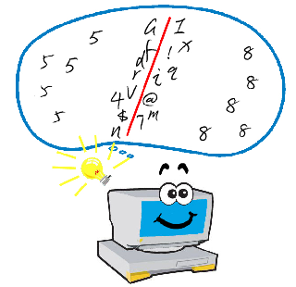
Learning Based Java
Writing classifiers

Slide 45
What is Learning Based Java?
A modeling language for learning and inference
Supports
  Programming using learned models
  High level specification of features and constraints between classifiers
  Inference with constraints
The learning operator
  Classifiers are functions defined in terms of data
  Learning happens at compile time

Slide 46
What does LBJ do for you?
Abstracts away the feature representation, learning and inference
Allows you to write learning based programs
Application developers can reason about the application at hand

Slide 47
Our application
Curator and Edison
Feature
Functions
Data
→ “politics”
Learning Algorithm
→ “sports”
→ “business”
Learning Based Java

Slide 48
Demo 4
The fame classifier itself
  The features
  The classifier
  Compiling to train the classifier

Slide 49
The Fame classifier
Putting the pieces together

Slide 50
Recall our solution
Let us label entities using features defined on mentions
Identify mentions using the named entity recognizer
Define features based on the words, parts of speech and dependency trees
Train a classifier
All sentences in the news, which the string Barack Obama occurs

Slide 51
The infrastructure
Curator
  Provides access to the POS tagger, NER and the Stanford Dependency parser
  Caches all annotations
Edison
  NLP representation in our program
  Feature extraction
Learning Based Java
  The machine learning

Slide 52

Final demo
Let’s see this in action

Slide 53
Links
Cogcomp Software:
  http://cogcomp.cs.illinois.edu/page/software
Support:
illinois-ml-nlp-users@cs.uiuc.edu
Download the slides and the code from
http://cogcomp.cs.illinois.edu/page/tutorial.201008

Slide 54
Running the test code on a Unix Machine
Step 1: Train the classifier
$ ./compileLBJ entityFame.lbj
Step 2: Compile the other java files with
$ ant
Step 3: Test the classifier:
$ ./test.sh data/test

