Slide 1
Transport Model for Commuter Trips
Mock-up for Bangalore as part of Fields of View task
Presentation for Academics
Sridhar Raman

Slide 2
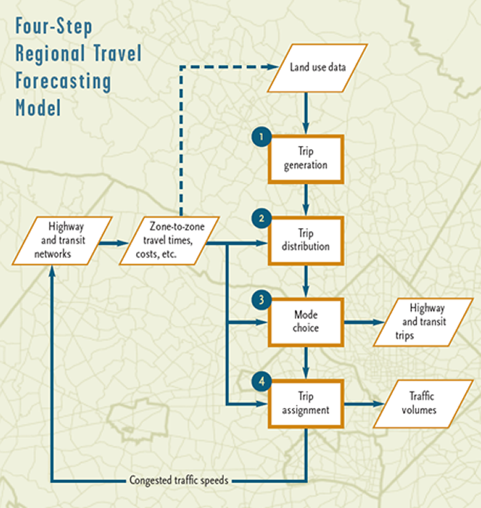
Model Description
Four-step Transport Model for Forecasting
Trip Generation
Trip Distribution
Mode Choice
Route Assignment
Focusing on workers commuting from home to work location
Model base scenario and compare with:
better public transport accessibility
traffic disincentivisation measures
Aim is to understand how transport plans that can help:
increase active travel (public transport, walking, cycling, etc.)
reduce traffic congestion (lesser non-mass transport trips)

Slide 3



Scenario 1: Base Scenaro - Specification
Looks at current challenges with different modes
Ignores vehicle ownership
Model result determines by “ease of mode”

Slide 4
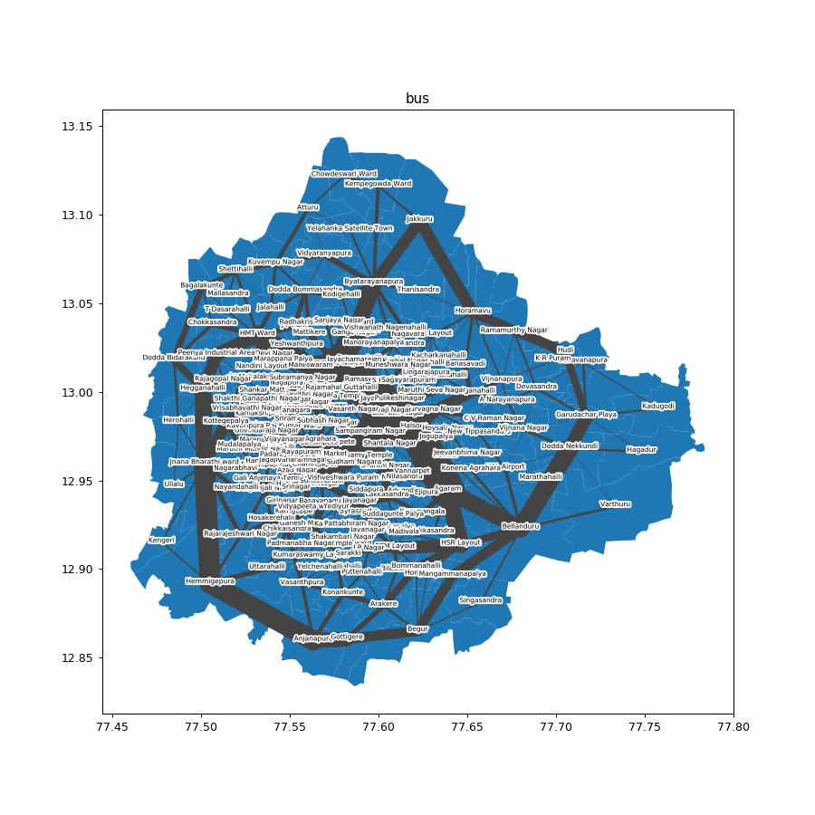

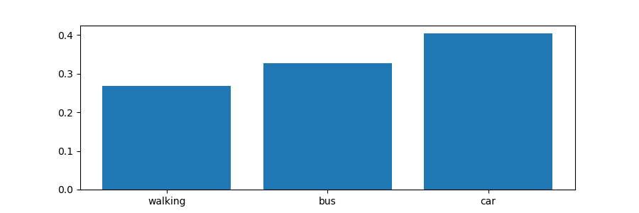

Scenario 1: Base Scenaro - Results
Modal split (below) shows preference linked to ease
Unsustainable, as resources required for satisfyind demand unavailable

Slide 5

Scenario 2: Flat Fare for Public Transport - Specification
Currently, public transport fares in Bangalore are dynamic (i.e. dependent on distance)
This scenario looks at a flat fare (e.g. Rs. 10)
Trade-off between potential increase in ridership vs operation costs of transportation system

Slide 6
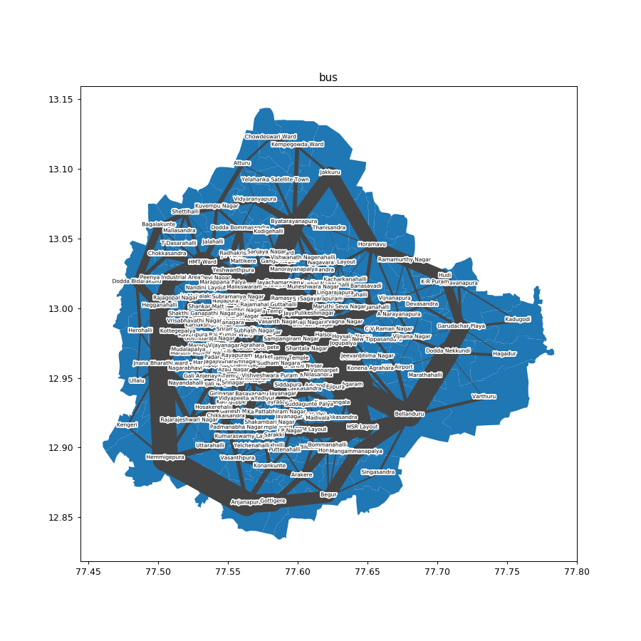
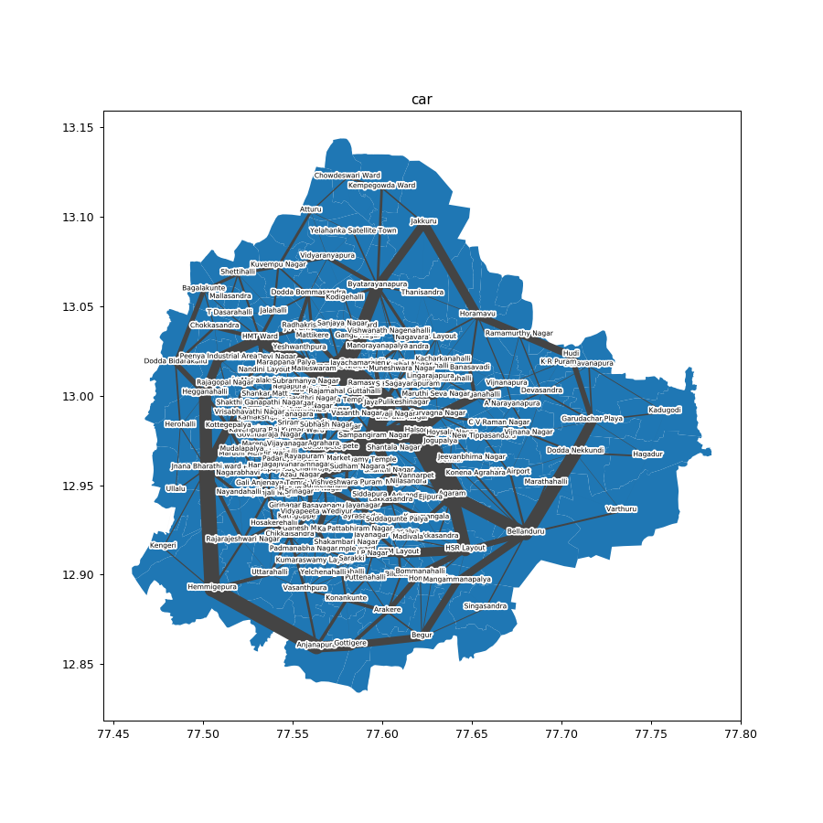

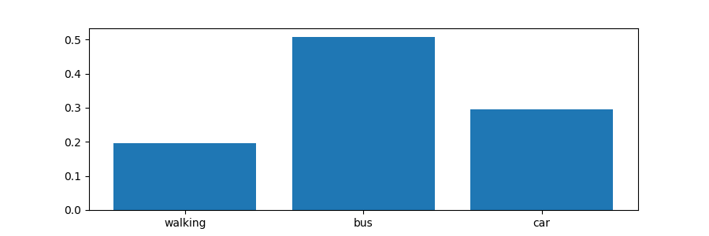
Scenario 2: Flat Fare for Public Transport - Results
Modal split (below) shows huge uptake of buses
Also, reduction in car trips adds an advantage to existing trade-offs
Results seem to indicate reduction in walking as well, but this doesn’t take into account the ”walking” mode as part of “bus” modal choice

Slide 7

Scenario 3: Congestion Pricing - Description
As seen in Base Scenario, cost of usage for “car” mode in the network is low
This scenario looks at “congestion pricing”, i.e. additional charges on cars for entering certain zones/wards
Flat congestion charge (not linked to distance)

Slide 8



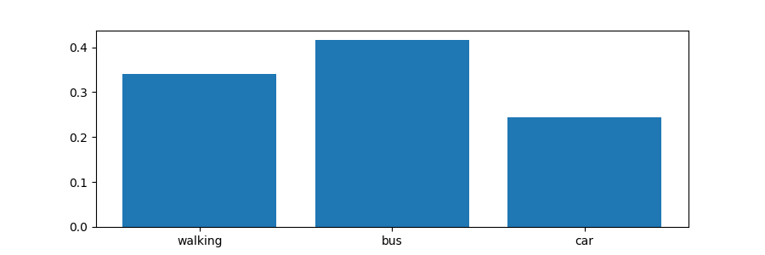
Scenario 3: Congestion Pricing - Results
Modal split (below) shows increase in walking and bus trips
Obvious reduction in car trips adds an advantage to existing trade-offs
Reduction in car trips is more compared to Scenario 2, could be linked to difference between short and long distance trips

Slide 9
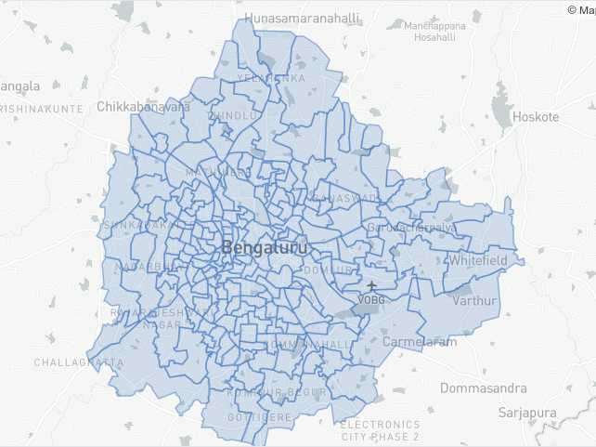
DATA: LINKS, ASSUMPTIONS
SUPPLY
Bangalore ward data, sourced from shapefiles provided by BBMP
DEMAND
Commuter Home Locations
available from Census data
validation done with average % of working population at district level
Commuter Work Locations
not easily available
assumed a normal distribution extrapolated from other countries’ data

Slide 10
FUTURE ROADMAP
Build an agent-based model to identify possible emergent phenomena
Utility function based on distance, time and external costs (fares, etc.)
Identify wards with high throughput of traffic and model “congestion pricing” on only those zones
Assignment of routes for each mode based on road network
Factor in vehicle ownership and other demographics details to better model trips and mode choice
Link modes, trips with environmental factors to better understand air quality, noise, etc.

Slide 11
THANK YOU

