Slide 1

RETAIL ANALYTICS PROJECT
Retail Sales Analytics Using
Excel, SQL, Python & Power BI
Submitted by :
S.Sripriyadharshini
Presented By
Course :
Data Analytics
Organization :
Vinsup Skill Academy
Notes:
1

Slide 2
Project Overview
What This Project Does
Objectives
This project analyzes retail sales data to understand sales performance, customer behavior, product performance, and revenue trends. The project follows an end-to-end analytics process from data cleaning to dashboard creation.
1
Analyze sales performance
2
Identify top customers
3
Monitor inventory and products
4
Segment customers
End-to-End Analytics Flow
Data Cleaning → Storage → Analysis → Visualization
5
Build an interactive Power BI dashboard
2
Notes:
2

Slide 3
Tools & Technologies
E
Excel
S
SQL
Data Cleaning & Preparation
Data Storage & Querying
P
Python
B
Power BI
EDA & Customer Segmentation
Dashboard & Visualization
3
Notes:
3

Slide 4
Project Workflow
0
1
2
3
4
Excel
SQL
Python
Power BI
• Missing values
• Create tables
• EDA
• Interactive dashboard
Raw
Dataset
→
→
→
→
• Duplicate removal
• Import data
• RFM analysis
• Business insights
• SQL queries
• Segmentation
4
Notes:
4

Slide 5
Standardized column names
Removed duplicate records
E
Handled missing values
Converted data types
Excel Data
Cleaning
Calculated Total Price
Created Pivot Tables
Exported cleaned CSV files
5
Notes:
5

Slide 6
Setup
Created database tables
Imported CSV files
S
Performed joins
Key Queries Built
Sales by Store
Top Selling Products
SQL Database
Management
Customer Purchase Summary
Staff Performance Analysis
Stock Alert Query
6
Notes:
6

Slide 7
Loaded data from SQL
Performed Exploratory Data Analysis
P
Generated statistical summaries
Calculated RFM values
Python
Analysis
Applied Customer Segmentation
Exported results back to SQL
7
Notes:
7

Slide 8
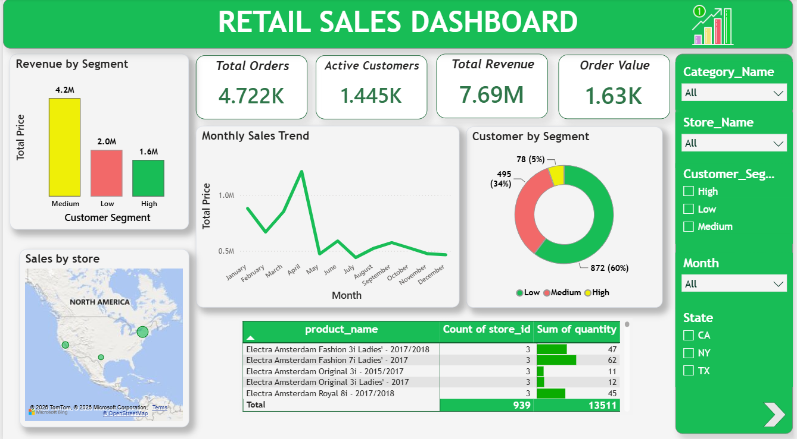
Retail Sales Dashboard
Dashboard Includes
Total Orders
Active Customers
Total Revenue
Average Order Value
Revenue by Segment
Sales by Store
Monthly Sales Trend
Customer Segmentation
Product Sales Table
Interactive Filters
8
Notes:
8

Slide 9
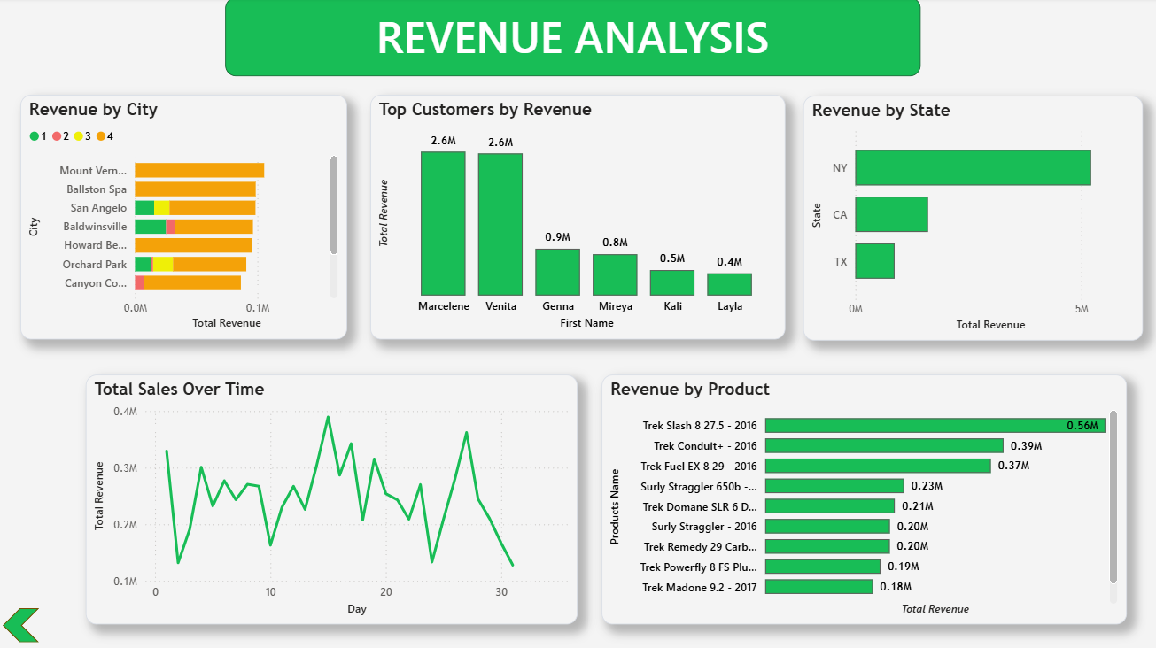
Revenue Analysis Dashboard
Visualizations
Revenue by City
Revenue by State
Revenue by Product
Top Customers
Monthly Sales Trend
9
Notes:
9

Slide 10
Business Insights
7.69M
4.72K
1.45K
1.63K
Total Revenue
Total Orders
Active Customers
Avg. Order Value
Medium customer segment generated the highest revenue.
New York recorded the highest revenue.
A few customers contributed a significant share of total revenue.
Some bicycle products performed exceptionally well.
Monthly sales showed noticeable fluctuations.
10
Notes:
10

Slide 11
Conclusion
Successfully completed an end-to-end retail analytics project.
✓
Improved data quality using Excel.
✓
Extracted business insights using SQL and Python.
✓
Developed an interactive Power BI dashboard.
✓
The dashboard supports better decision-making through real-time business insights.
✓
11
Notes:
11

Slide 12
Thank You
Notes:
12

