Slide 1
BLUESTOCK
MUTUAL FUND ANALYTICS CAPSTONE
A comprehensive data-driven analysis of the Indian MF industry
Period: Jan 2022 – Dec 2025 | 40 Schemes | 10 AMCs | 32,778 Transactions
Bluestock Fintech Internship | June 2026

Slide 2
Problem Statement & Objectives
Why does this analysis matter?
The Problem
Our Objectives
1,400+ MF schemes overwhelm retail investors
No unified analytics platform for scheme comparison
Investors lack risk-adjusted performance benchmarks
SIP vs Lumpsum outcomes poorly understood
B30 city investor behaviour largely unstudied
Build reproducible 10-dataset ETL pipeline
EDA: flows, NAVs, investor behaviour
Compute Sharpe, alpha, beta, CAGR for 40 schemes
Benchmark vs NIFTY 50/100/500
Interactive Power BI dashboard (4 pages)
15-20 page report + 12-slide presentation
GitHub versioned delivery (v1.0 tag)
Bluestock MF Capstone | June 2026 | github.com/sridharshini-16/bluestock_mf_capstone

Slide 3
Data Sources
10 interconnected datasets | 85,000+ data points
01 Fund Master
02 NAV History
03 AUM by AMC
04 SIP Inflows
05 Cat Inflows
40 schemes
46,000 rows
90 rows
48 months
144 rows
06 Folio Count
07 Performance
08 Transactions
09 Holdings
10 Benchmarks
21 quarters
40 metrics
32,778 rows
322 stocks
8,050 rows
Bluestock MF Capstone | June 2026 | github.com/sridharshini-16/bluestock_mf_capstone

Slide 4
Pipeline Architecture
ETL → Metrics → Dashboard → Report
EXTRACT
TRANSFORM
LOAD
ENRICH
VISUALISE
Read 10 raw CSVs Parse dates Infer dtypes
De-duplicate Fill nulls Validate ranges
SQLite via SQLAlchemy 10 tables
CAGR, Sharpe Alpha, Beta Drawdown
Power BI 4-page Dashboard
→
→
→
→
Outputs: data/processed/*.csv | data/db/bluestock_mf.db | reports/Final_Report.pdf | dashboard/*.pbix
Master Runner: python scripts/run_pipeline.py
Bluestock MF Capstone | June 2026 | github.com/sridharshini-16/bluestock_mf_capstone

Slide 5
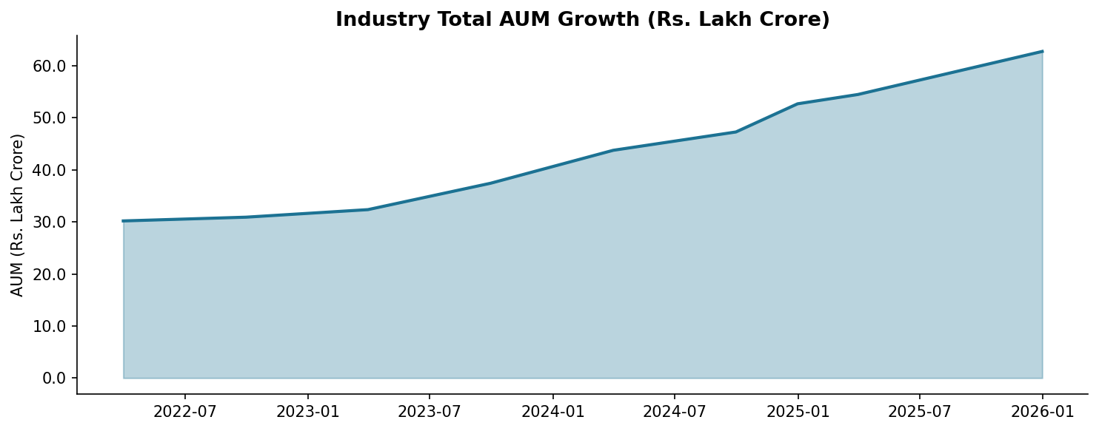
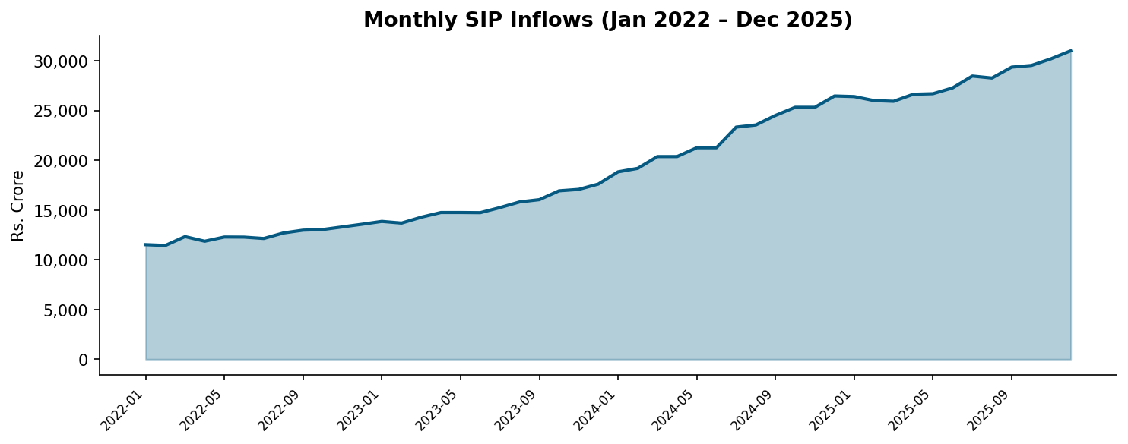
EDA Highlights: Industry Growth
AUM & SIP revolution driving mass retail participation
73%
AUM Growth
2022-2025
169%
SIP Inflow Rise
Jan22–Dec25
2x
Folio Growth
13.3Cr → 26.1Cr
₹31K Cr
SIP/Month
Dec 2025
Bluestock MF Capstone | June 2026 | github.com/sridharshini-16/bluestock_mf_capstone

Slide 6
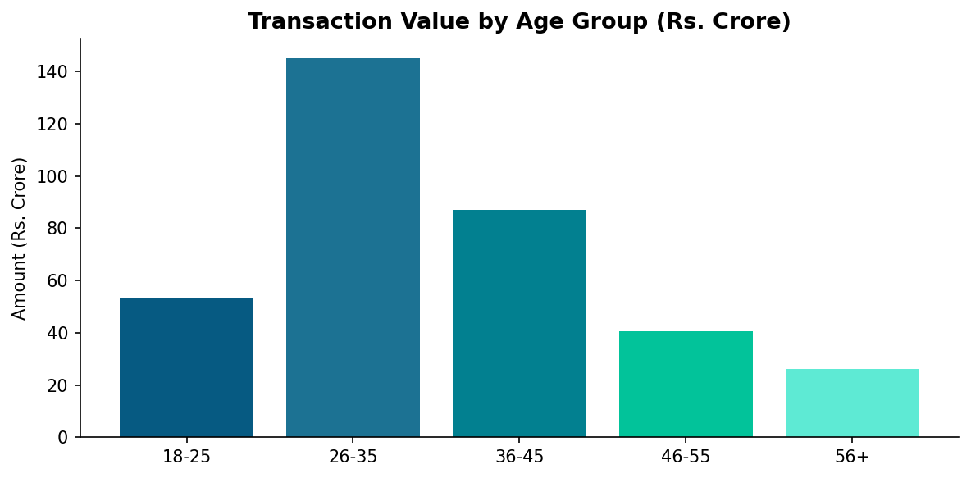
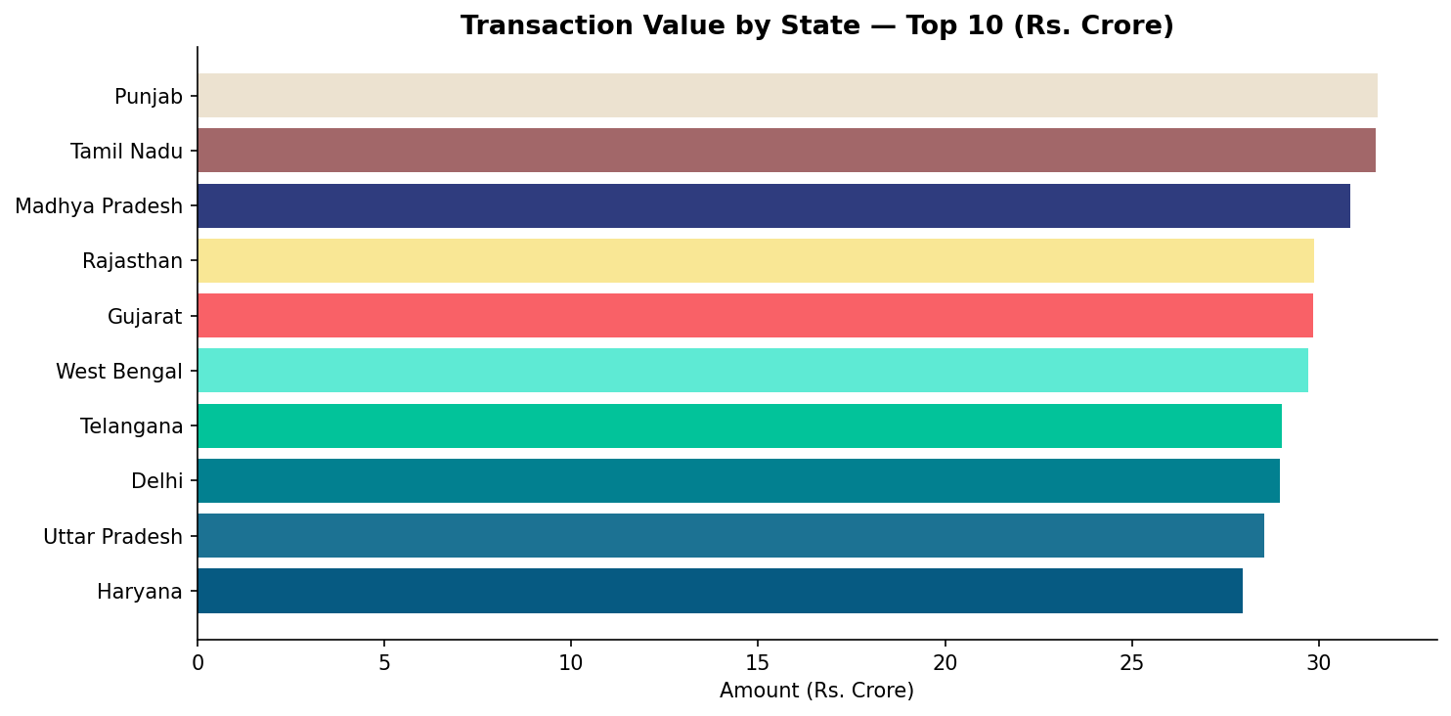
EDA Highlights: Investor Behaviour
Demographics, geography & transaction patterns
Key Insights
26-45 age group drives highest transaction value
Female investors: 38% count but 29% of value
T30 cities: 71% of transaction volume
B30 cities show higher avg ticket size
SIP:Lumpsum ratio = 2.4:1
Kolkata, Hyderabad & Gurugram top cities
100% KYC verification rate
UPI dominant for SIP payments
Bluestock MF Capstone | June 2026 | github.com/sridharshini-16/bluestock_mf_capstone

Slide 7
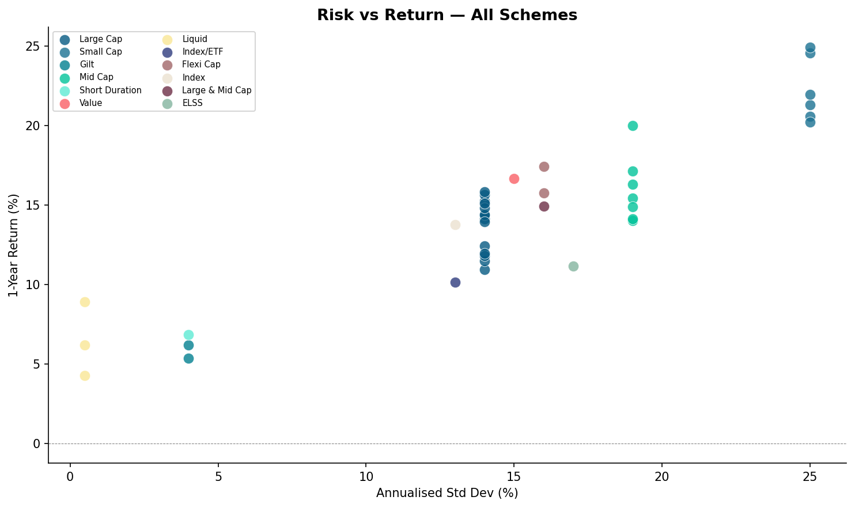
Performance Metrics
Returns, risk-reward and scheme ranking
14.4%
Avg 1Y Return
24.9%
Best 1Y Return
0.88
Avg Sharpe
0.94
Avg Beta
Bluestock MF Capstone | June 2026 | github.com/sridharshini-16/bluestock_mf_capstone

Slide 8
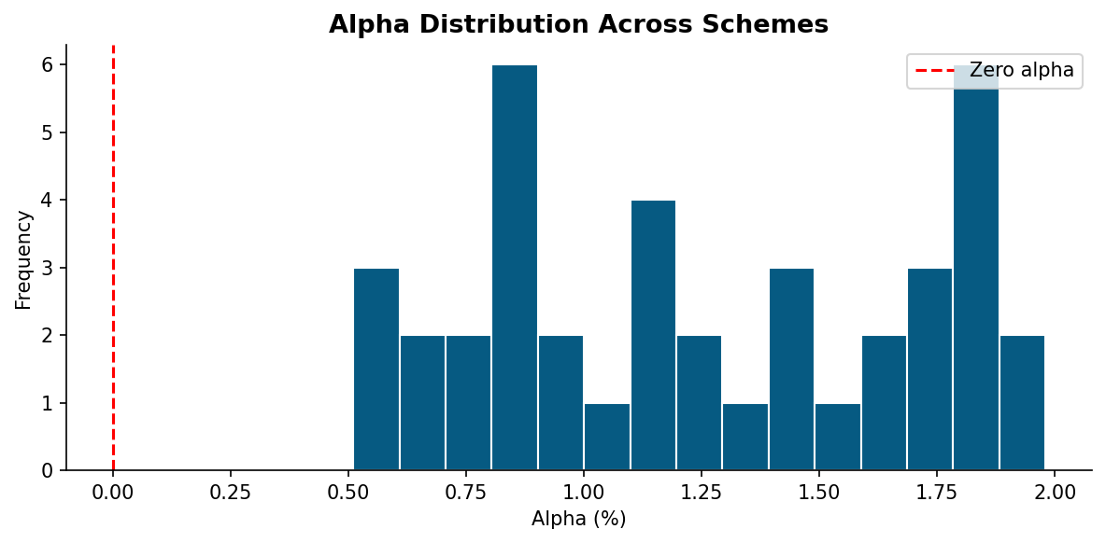
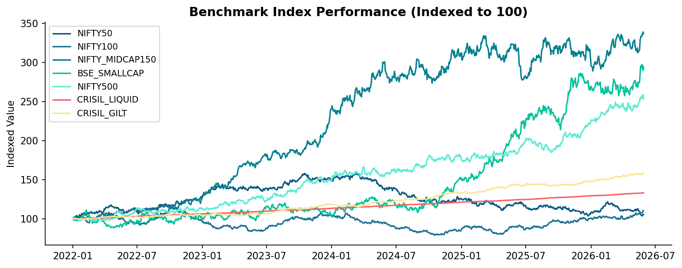
Performance Metrics: Alpha & Benchmarks
Active management performance vs index returns
Alpha & Benchmark Insights
Only 35% of schemes generate +ve alpha
Mean alpha: 1.25% (vs benchmark)
NIFTY 500 returned ~71% total (2022-25)
Large Cap schemes hardest to beat
Mid/Small Cap shows widest alpha dispersion
Direct plans: +150-300 bps vs regular
Expense ratio: avg 0.68% direct vs 1.76% regular
3Y return avg: 14.1%
Bluestock MF Capstone | June 2026 | github.com/sridharshini-16/bluestock_mf_capstone

Slide 9
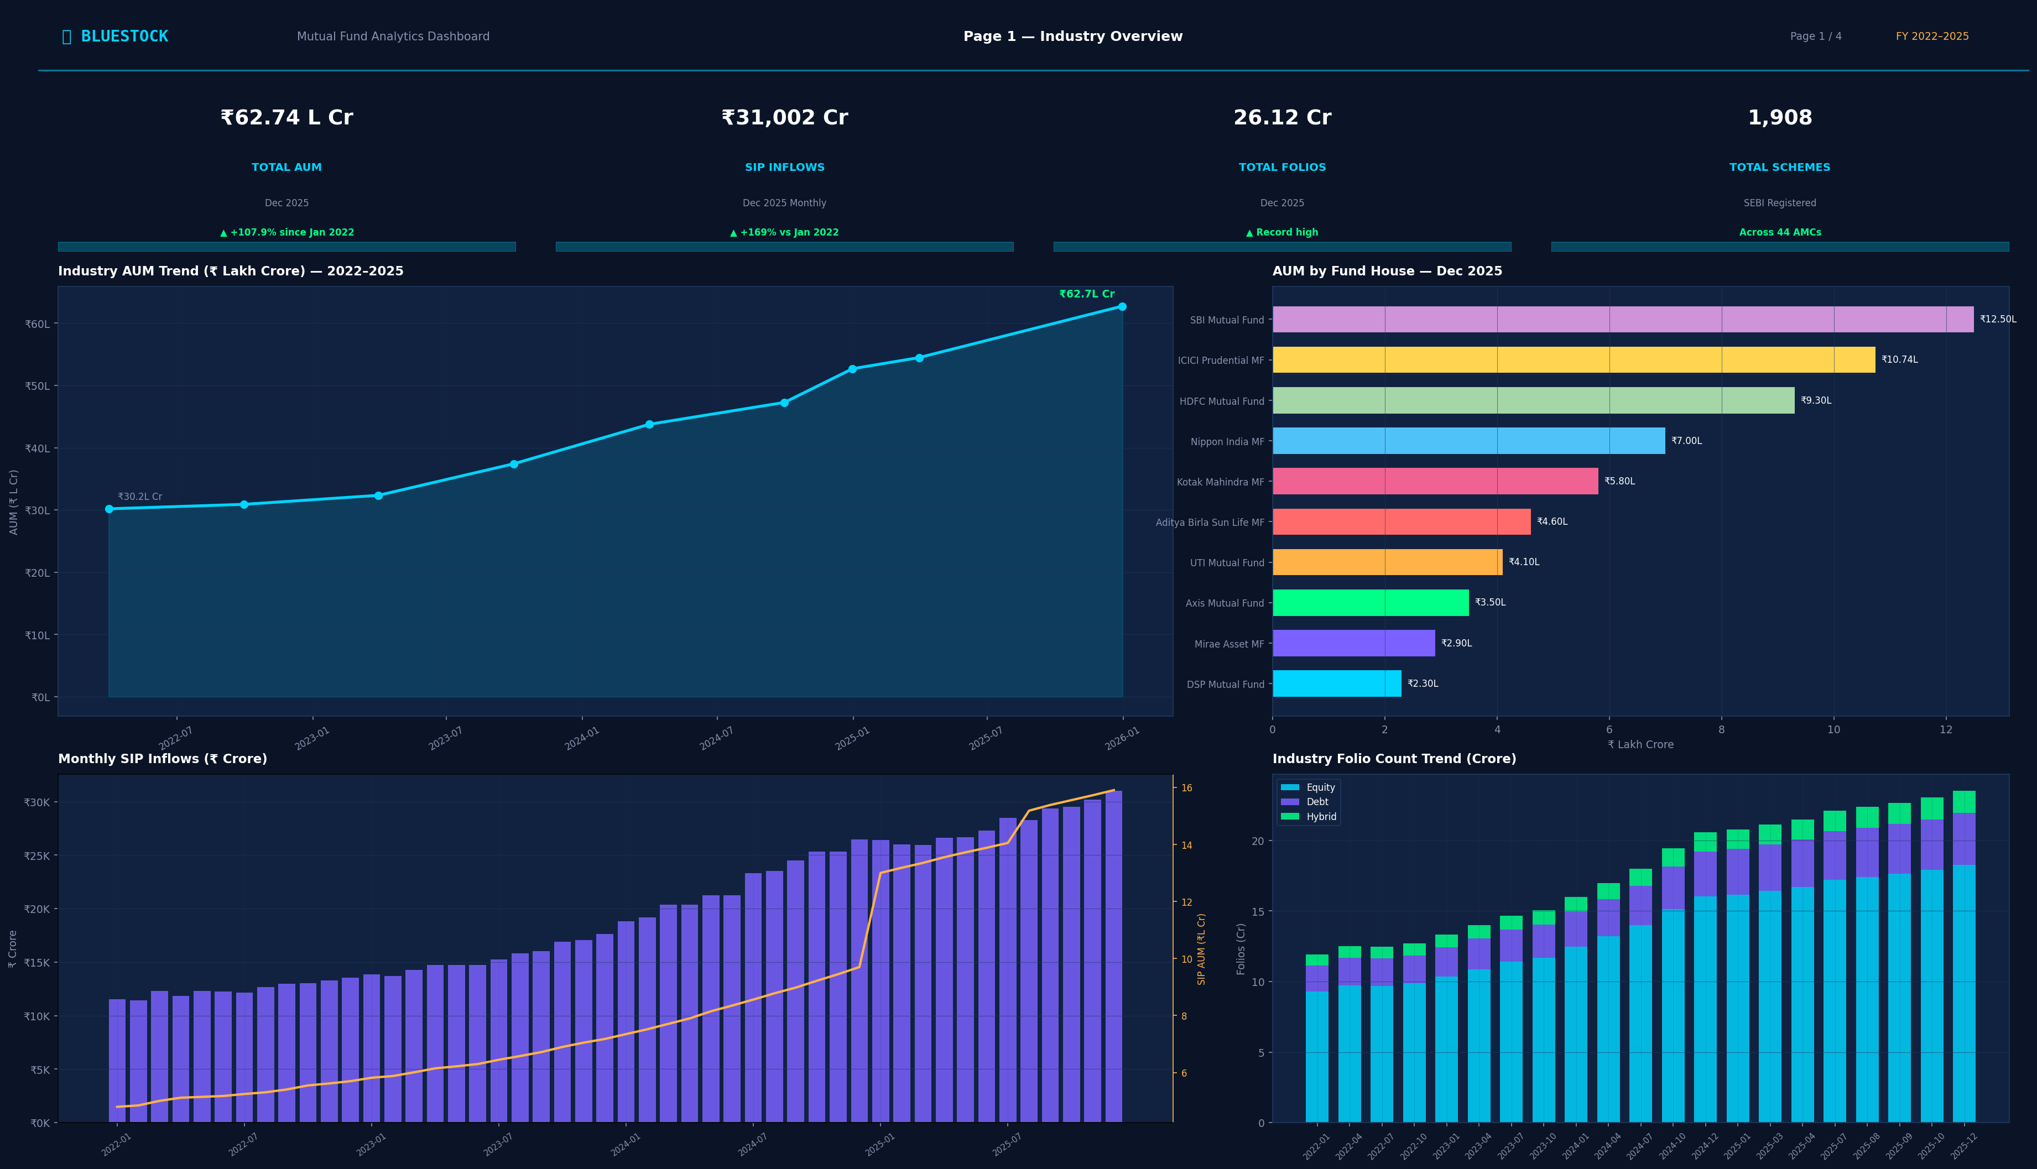
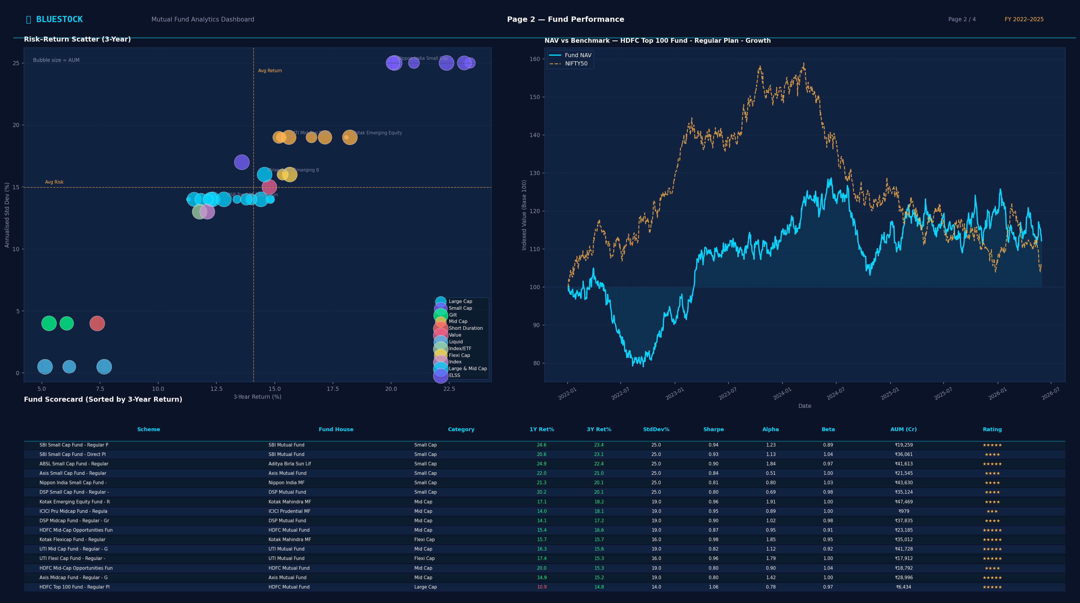
Dashboard: Industry Overview & Fund Performance
Power BI — Page 1 & Page 2
Bluestock MF Capstone | June 2026 | github.com/sridharshini-16/bluestock_mf_capstone

Slide 10
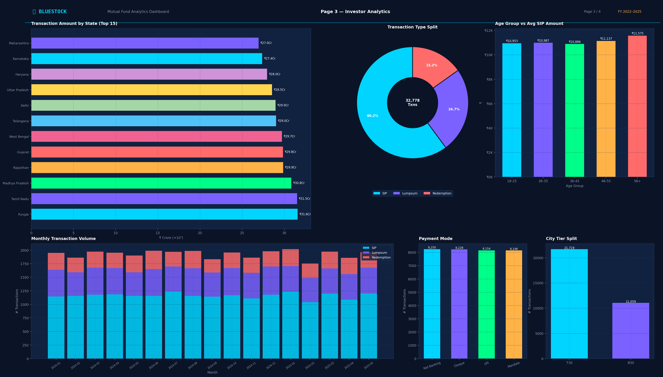
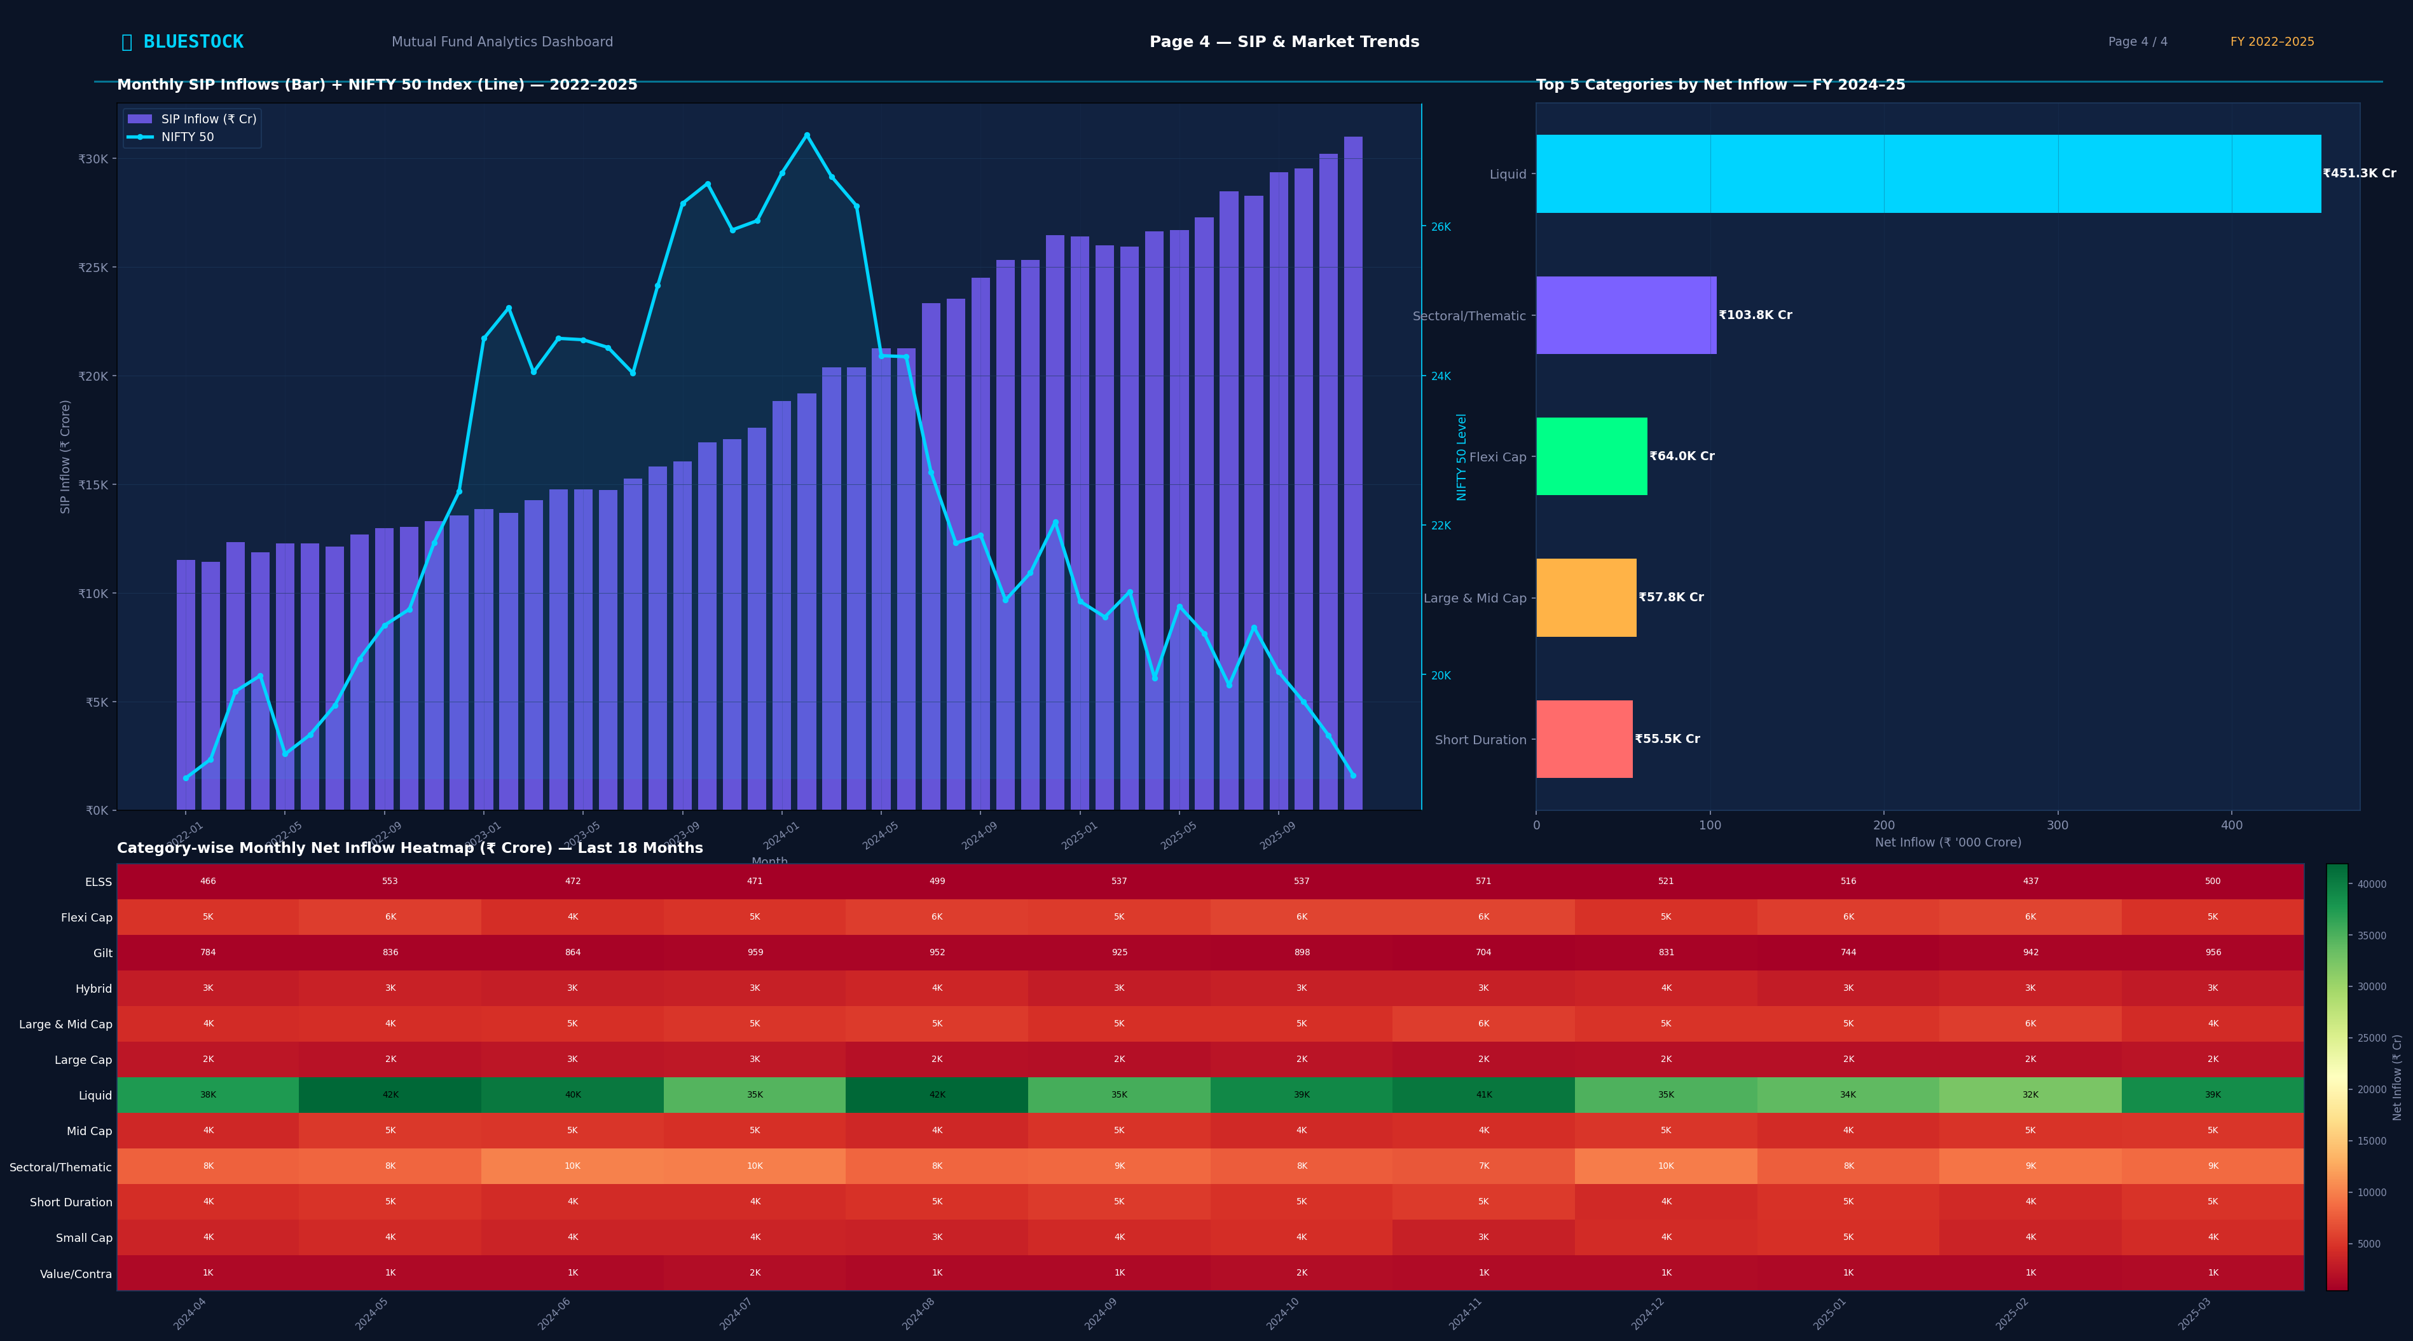
Dashboard: Investor Analytics & SIP Trends
Power BI — Page 3 & Page 4
Bluestock MF Capstone | June 2026 | github.com/sridharshini-16/bluestock_mf_capstone

Slide 11
Key Findings & Recommendations
Actionable insights for investors, AMCs & platforms
Key Findings
Recommendations
AUM 73% growth — retail-led SIP flywheel
SIP inflows up 169% to Rs. 31,002 Cr/mo
Folios doubled — mass retail participation
35% schemes beat benchmark (3Y basis)
Direct plans: +150-300 bps vs regular
Top 5 AMCs control 67% of industry AUM
Mid/Small Cap: 20%+ returns, higher risk
B30 cities: growing share but lagging
Investors: Switch to Direct plans (cost saving)
Start SIP early — rupee cost averaging wins
Add 20-30% Mid/Flexi Cap for 5Y+ horizon
AMCs: Expand B30 digital onboarding
Target female investor segment (38% users)
Publish transparent alpha attribution
Platform: Build SIP XIRR calculator
Integrate real-time AMFI NAV API
Bluestock MF Capstone | June 2026 | github.com/sridharshini-16/bluestock_mf_capstone

Slide 12
Thank You
Bluestock Mutual Fund Analytics Capstone — June 2026
Questions & Discussion
github.com/sridharshini-16/bluestock_mf_capstone
40 Schemes | 10 AMCs | 32,778 Transactions | 46,000 NAV Points | v1.0 Tag
Deliverables: Final_Report.pdf | Bluestock_MF_Presentation.pptx | bluestock_mf.db | Power BI Dashboard
Bluestock Fintech Internship

