Slide 1
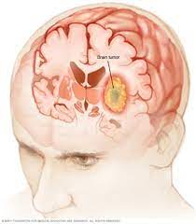
BRAIN TUMOR DETECTION
TEAM MEMBERS:-
2110030071 - SRAVYA
2110030131 – NANDINI
2110030273 – SAI DEEKSHITHA
2110030378 - SRIDIVYA

Slide 2
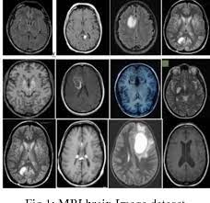
ABSTRACT:
INTRODUCTION
PROBLEM STATEMENT
PROJECT CONCEPT
INNOVATION
FEASIBILITY
CONCLUSION

Slide 3
INTRODUCTION:
Brain tumor is a serious disease, and the number of people who are dying due to brain tumors are increasing. Manual tumor diagnosis from magnetic resonance images (MRIs) is a time consuming process and is insufficient for accurately detecting, localizing, and classifying the tumor type.
Our objectives include:
Developing a robust CNN-based framework for identifying various lung diseases.
Assessing performance across diverse datasets.

Slide 4
PROBLEM STATEMENT: IDENTIFICATION OF Brain Tumor using cnn(vgg16).
OBJECTIVE:
To develop a model capable of
classifying Brain images into diseased
or non-diseased categories using the
VGG16 convolutional neural network
architecture.
Image name | Brain Tumor Identification
y1.jpg | Yes
no1 | No
y10.jpg | Yes

Slide 5
Survey
Brain tumor is a serious disease in which an abnormal growth of tissue inside the brain can disrupt proper brain function.
The National Brain Tumor Foundation (NBTF) reported that the number of people in developed countries who have died due to brain tumors has increased by 300% over the last three decades.

Slide 6
The most common Brain Tumorsinclude:
Gliomas: Arising from glial cells, the most prevalent type being astrocytomas, oligodendrogliomas, and ependymomas.
Meningiomas: Derived from the meninges, the protective layers surrounding the brain and spinal cord.
Pituitary adenomas: Typically benign tumors originating from the pituitary gland.
Schwannomas: Developing from Schwann cells, usually found in cranial or peripheral nerves.
Medulloblastomas: Primarily affecting children, these tumors arise in the cerebellum.
Craniopharyngiomas: Slow-growing tumors located near the pituitary gland and hypothalamus.

Slide 7
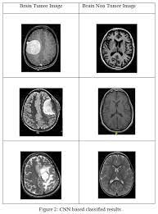
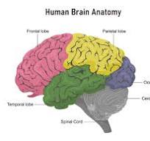
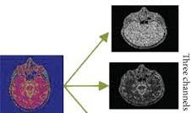
color image RGB image Segmentation RGB detection

Slide 8
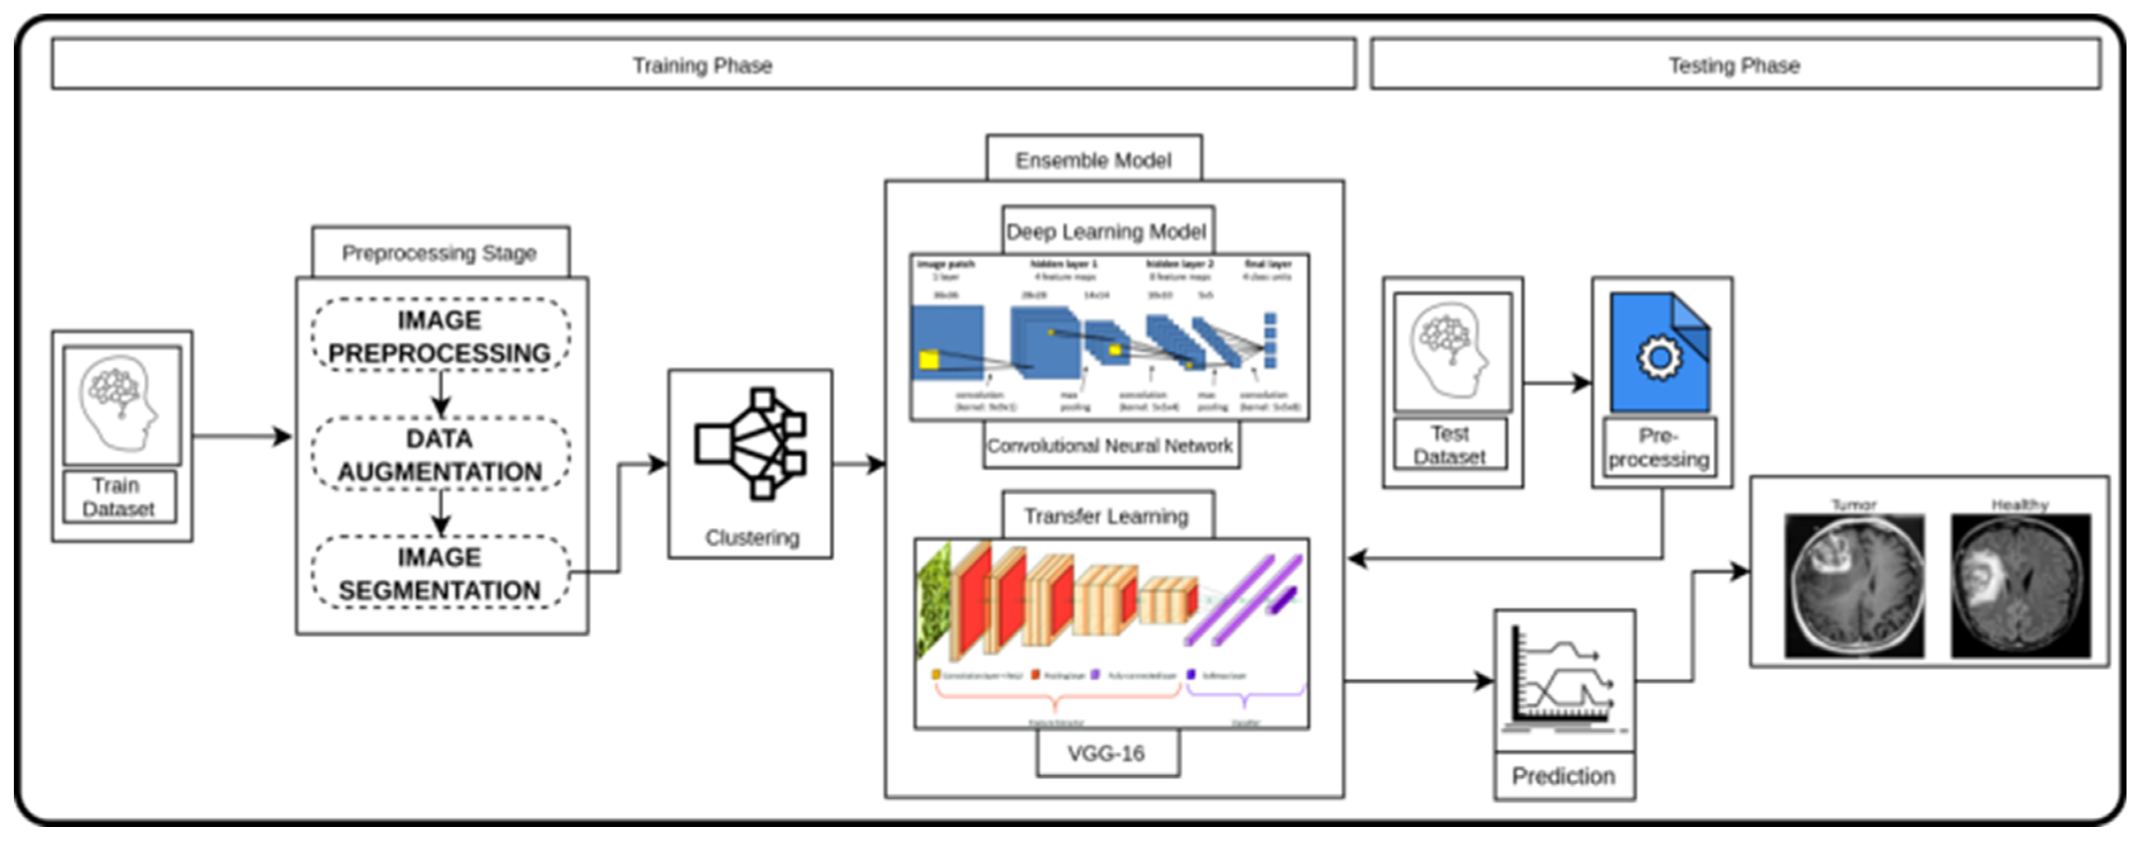
FLOWCHART

Slide 9
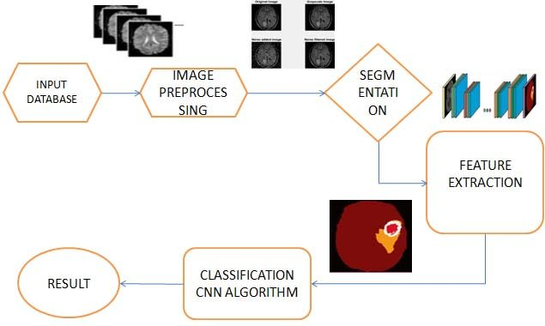

Slide 10
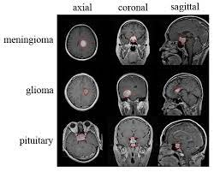
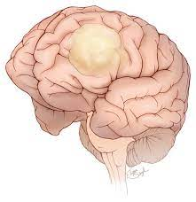
Mobile Application
LOGIN PAGE
Brain Tumor
Uploaded Image
Tumor detected
Create Account
Yes
Login
No
Welcome to Brain Saver

Slide 11
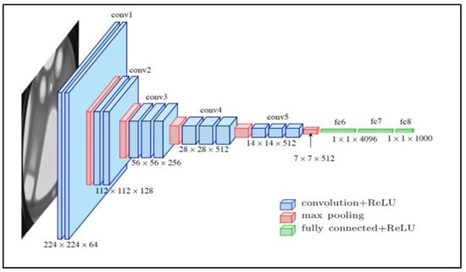
VGG16 Architecture

Slide 12
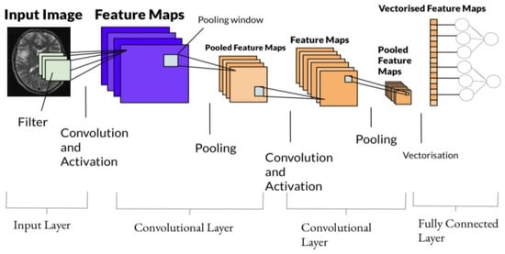
VGG16 Architecture

Slide 13
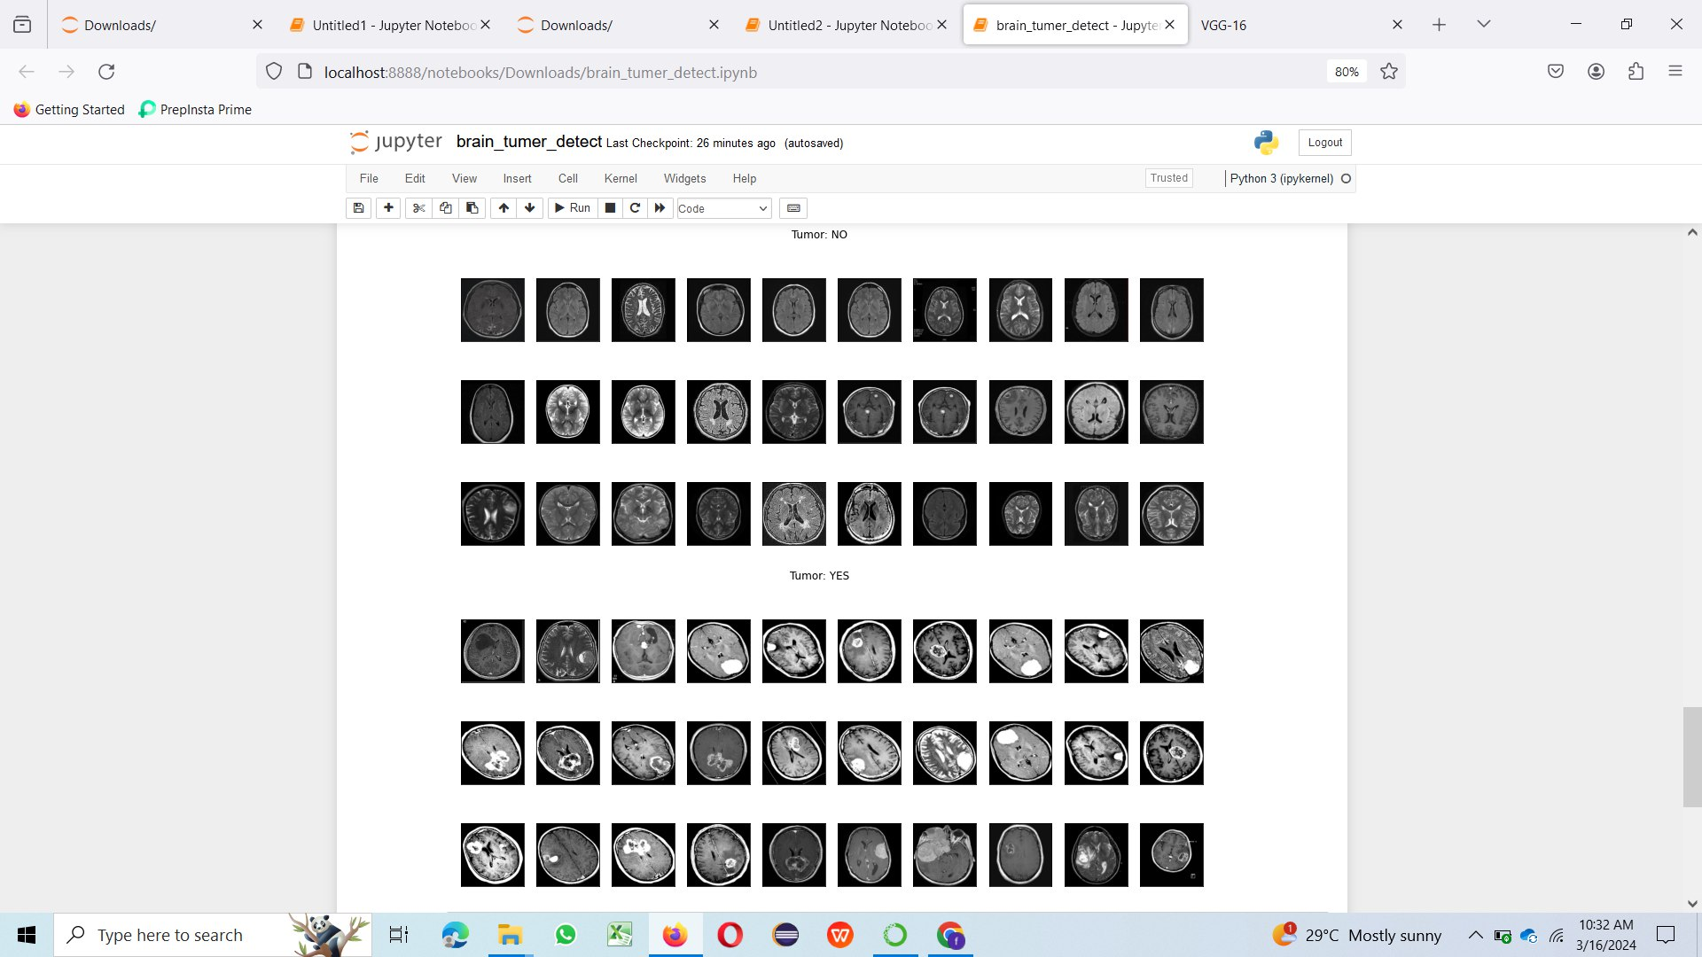
Output:

Slide 14


