Slide 1
The Poverty-Crime Connection
DSC530 – Term Project

Slide 2
About Dataset
Dataset: National Crime Victimization Survey: School Crime Supplement,2011
File Dimensions:
• No. of Cases: 10,341
• No. of Variables: 6,428
• Record Length: 8,854
• Records per Case: 1
• Overall No. of Records: 10,341
https://www.icpsr.umich.edu/icpsrweb/NACJD/studies/33081

Slide 3
List Of Variables
V2026 : HOUSEHOLD INCOME
V3014 : AGE (ORIGINAL)
V3072 : HAVE JOB OR WORK IN LAST 6 MONTHS
VS0005 : THE TOTAL NUMBER OF PERSONS IN THE HOUSEHOLD
VS0006 : THE TOTAL NUMBER OF INCIDENTS FOR THAT PERSON.
V3079 : ATTENDING COLLEGE
V2045 : SEX
V4479_1 : EMPLOYED AT TIME OF INCIDENT
V2049A : RACE

Slide 4
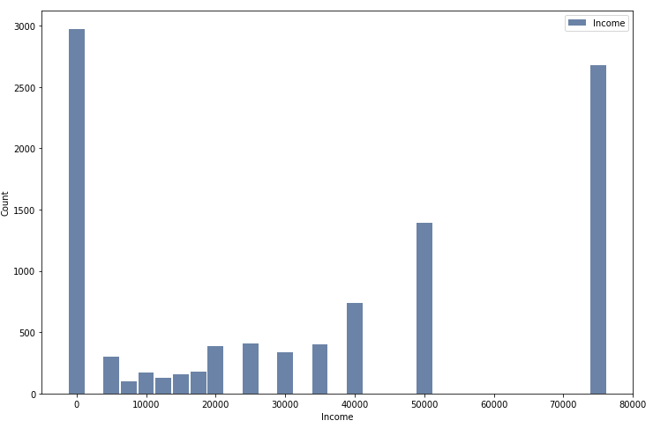
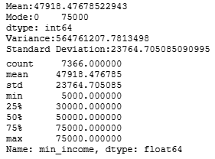
Household Income Histogram

Slide 5
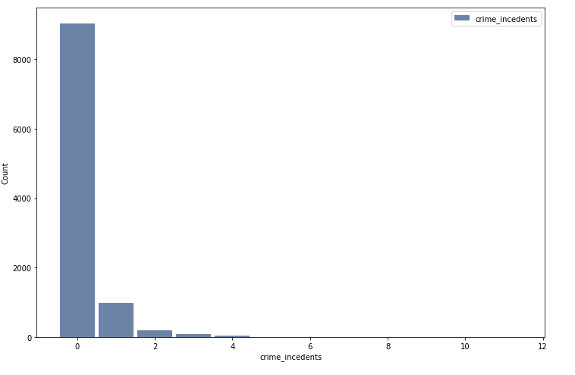
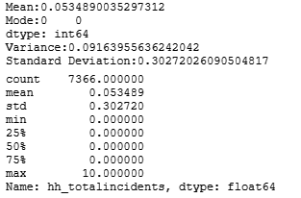
Crime Incidents Histogram

Slide 6
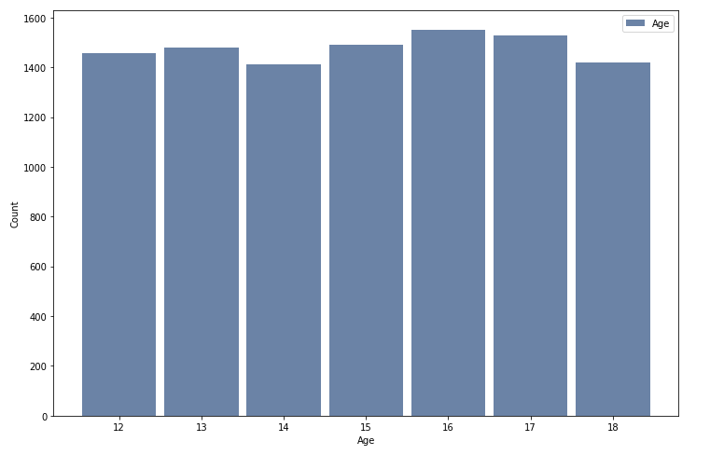
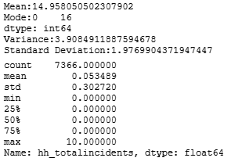
Age Histogram

Slide 7
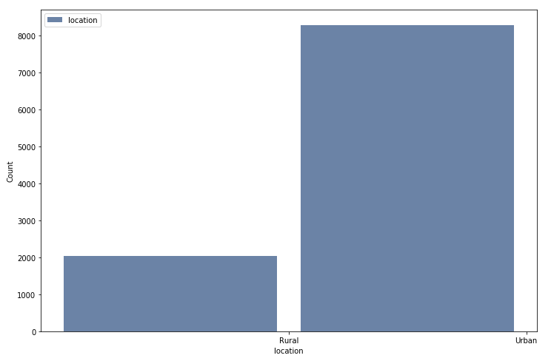
Location Histogram

Slide 8
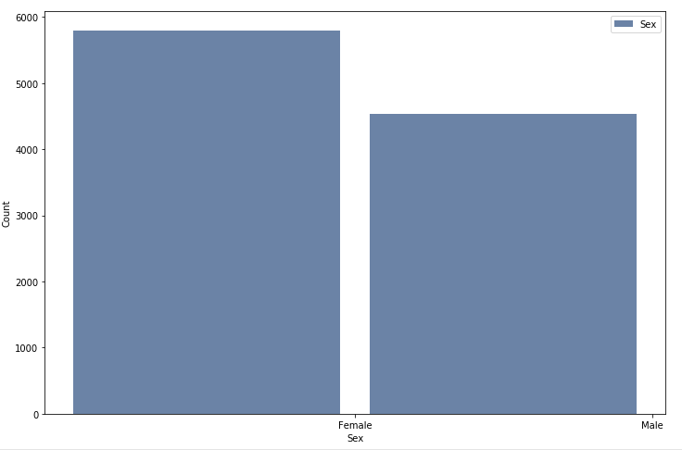
SEX Histogram

Slide 9
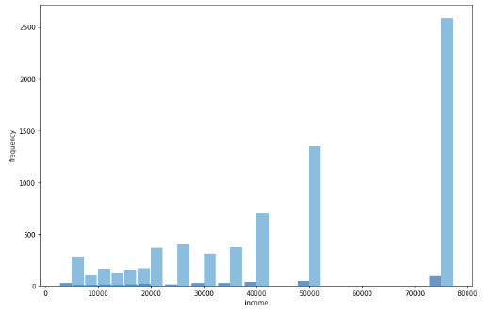
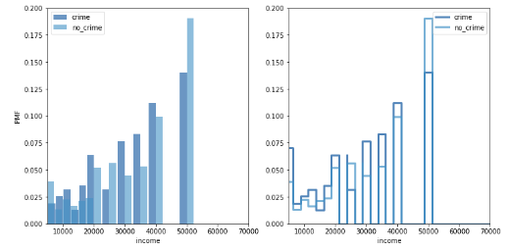
Comparing two scenarios using PMF

Slide 10
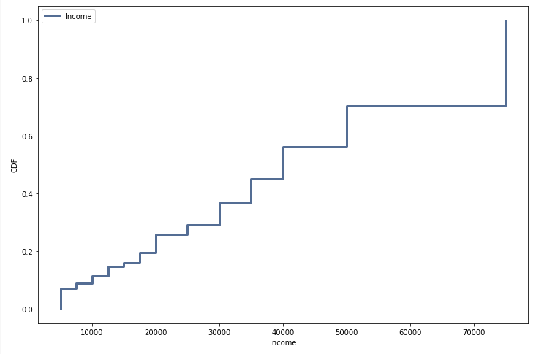
CDF of household Income
60% of crime incidents offenders falls under Income less than $40,000.

Slide 11
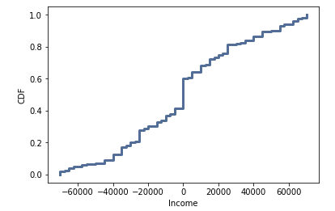
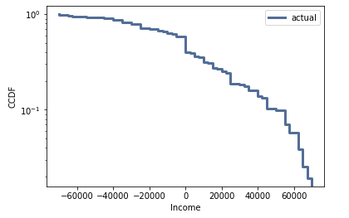
distributions

Slide 12
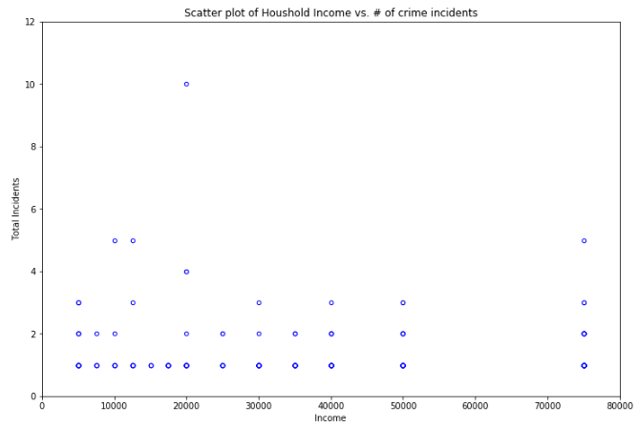
Scatter plot of household Income vs # of crime Incidents
Pearson’s Correlations -0.09992926318560393
Spearman’s Correlation:-0.06064205510124054

Slide 13
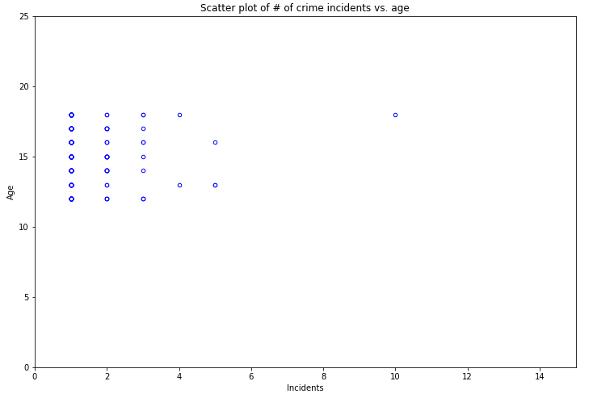
Scatter plot of # of crime Incidents vs age
Pearson’s Correlations 0.02049608319185341
Spearman’s Correlation:-0.02391163191455039

Slide 14
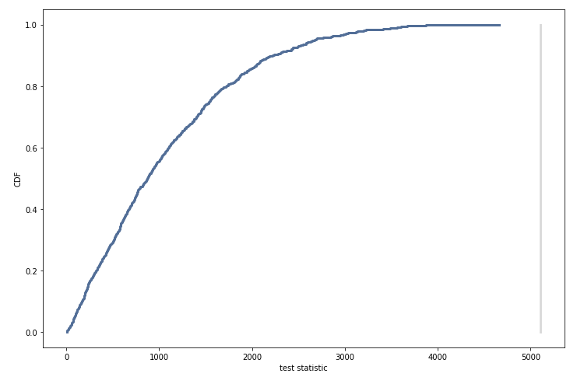
Hypothesis Test
The CDF does not intersects the observed difference

Slide 15
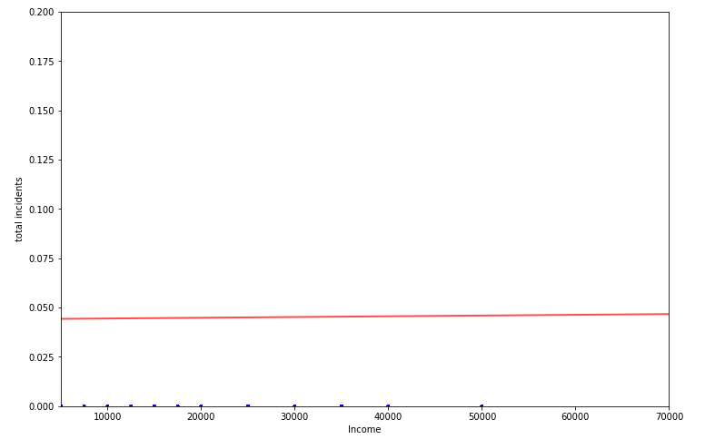
Linear least squares
The scatter plot of income vs # of crimes is not aligning with the fitted line for selected data.
There is no linear relationship between these to variables for selected data.
Based on the current data this seems to be not a good model.

Slide 16
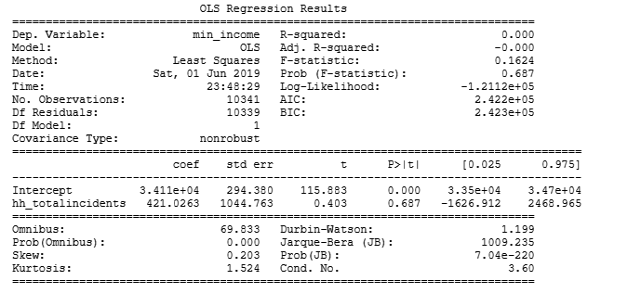
regression analysis
The P-value is greater than 0.05. Based on the current data the # of crime incidents will not depend on income variable.

