Slide 1
NASEC 2016
Energy and Alternative Fuels
Transportation
Midshipman Head Delegate: MIDN 1/C Nick Morris
Midshipman Chairman: MIDN 1/C Brandon Maas, USN
Faculty Representative: Associate Professor Brownell
Officer Representative: CDR Lazzaro, USN

Slide 2
Problems Being Addressed
Although the use of more electric cars has the potential to be ecologically friendly, the increased demand on the power supply has the potential to increase fossil fuel usage in the electricity generation process.
With the ubiquity of motor vehicles, carbon emissions and energy consumption are rapidly growing. The country is in need of ecologically friendly options and programs.
A workforce of 143 million commutes to work each day, with a majority commuting alone. Carpooling is an underutilized solution that could be improved through policy, education, and app implementation.

Slide 3
Background - Energy Generation
A large percentage of electricity is generated using fossil fuels (Figure 1). Though using electricity does not create as much emissions, the production of electricity does.
Most vehicles run on oil based fuels, but a larger percentage of electric cars would decrease direct emissions.
A rise in the percentage of electric cars would cause an increase in the demand for electricity, which is a production gap that would be filled mostly by fossil fuels such as coal and natural gas if alternative energy sources are not implemented into the energy markets more rapidly.

Slide 4
Problem - Energy Generation
The use of more electric cars has the potential to be ecologically friendly, but this increased demand on the power supply has the potential to increase fossil fuel usage in the electricity generation process.

Slide 5
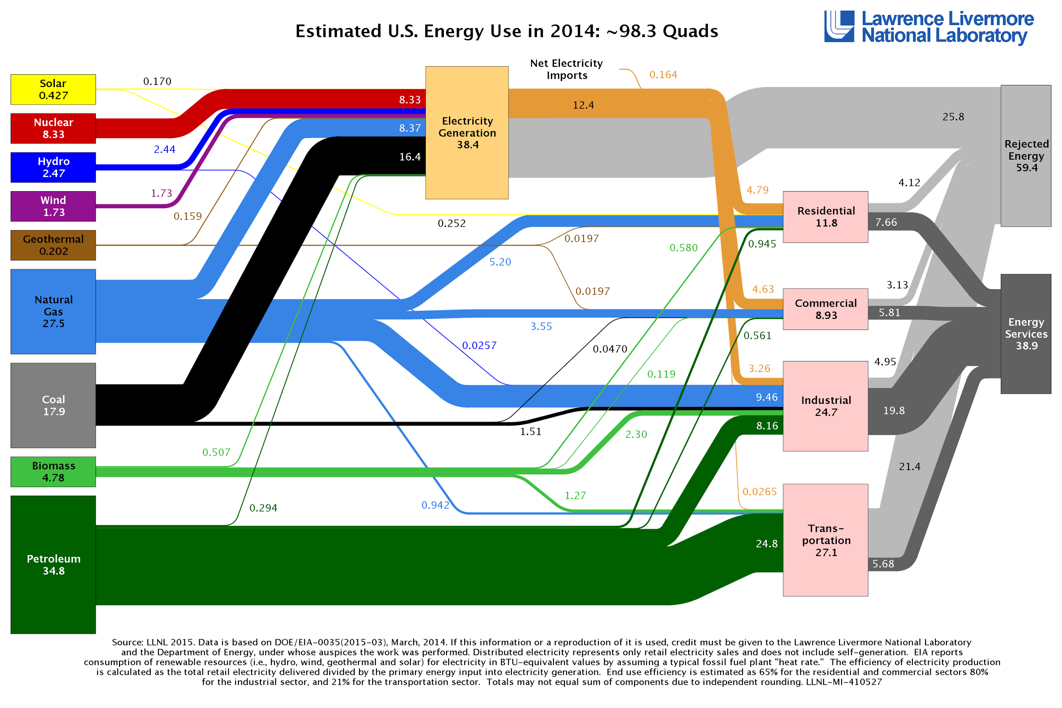
Estimated U.S. Energy Use (2014)
Figure 1

Slide 6
Past Solutions and Results - Energy Generation
Hydrogen fuel cells
Expensive
Requires excessive amounts of electricity
Waste problem
Electric cars
Slow implementation and cost prohibitive
The majority of electricity generated is fossil fuels

Slide 7
Our Solution - Energy Generation
Build more alternative power stations in order to supply the rise in the demand of electricity.
Implement alternative power sources: solar, wind, hydroelectric, geothermal, and nuclear.
As more electric cars are produced, more alternative power sources are needed to limit emissions.
Integrate fast neutron reactors to increase the national electric output while also using nuclear resources.
Distributed generation increases overall electricity output, decreases energy inefficiencies due to line resistance, and decreases dependence on the communal grid.

Slide 8
Engineering Aspect of Design - Energy Generation
New technological advances in nuclear energy is a valuable way to increase the electricity output while limiting emissions.
Fast neutron reactors (breeder reactors) maximize the full potential of nuclear fuel while continuing to produce electricity. There is also less radioactive waste because the spent fuel from the normal fuel cycle goes into the breeder reactors.
Distributed generation can most easily be implemented through installing solar panels on rooftops and the use of new models of wind turbines.
Most noteably, the amount of electric cars would increase the electricity demand of large cities.
Notes:
http://www.world-nuclear.org/information-library/country-profiles/countries-t-z/usa-nuclear-power.aspx
http://www.world-nuclear.org/information-library/current-and-future-generation/fast-neutron-reactors.aspx

Slide 9
Potential Problems - Energy Generation
The forms of waste associated with alternative power, most notably from nuclear sources are a concern. However, they are local forms of waste that can be properly stored and mitigated without creating emissions.
Breeder reactors cause an increased potential for nuclear weapons. This can be mitigated by proper oversight by the NRC.
An increase in the generation of electricity from alternative sources has been associated with a decreased trend in use of natural gas, but an increased trend in the use of coal, which creates more emissions than natural gas (The Economist, Nov 2015).
Notes:
https://www.usna.edu/AcResearch/_files/documents/NASEC/2016/ENERGY%20-%20When%20the%20wind%20blows%20_%20The%20Economist.pdf

Slide 10
Background - Car
Most cars still operate on fossil fuels
Exacerbates global warming
Air and sound pollution
Electric vehicles still rely on standard methods of electricity generation
Alternative fuels are possible
1859: Gaston Plante invented rechargeable lead-acid batteries
Modern batteries improved concept
Hydrogen fuel-cell cars near production on commercial scale
http://www.census.gov/hhes/commuting/files/2014/acs-32.pdf
Notes:
http://www.statisticbrain.com/carpool-statistics/
http://www.electricauto.org/?page=evhistory

Slide 11
Problem
With the ubiquity of motor vehicles, carbon emissions and energy consumption are rapidly growing. The country is in need of ecologically friendly options and programs. These solutions must involve improving emissions, manufacturing processes, power, range, and lifespan of motor vehicles.

Slide 12
Past Solution Attempts and Results - Car
Electric cars:
Tesla, Toyota, Nissan, etc.
Successful in reducing emissions
Gas-powered cars became cheaper when the Ford Model-T was conceived.
Technology for electric cars is limited
Power for battery-electric cars comes from power plants
Manufacturing cars create the same amount of emissions as driving

Slide 13
Our Solution - Car
Longer-lasting/more stable aluminum-air batteries
Replace more inefficient lithium-ion batteries
8 times the range of current batteries
Lowers the overall weight of the vehicle
Solar paneled modular roadways
Reduces emissions (up to 75%) by introducing clean energy into the grid instead of burning fossil fuels
Improves infrastructure
Easier maintenance of roads
“Smart” lane lines direct traffic around accidents, damaged roads, etc.
Research into hydrogen cells to increase fuel efficiency
Human-less manufacturing to increases efficiency (no human error/breaks)
Notes:
http://www.sciencedirect.com/science/article/pii/S0378775302003701

Slide 14
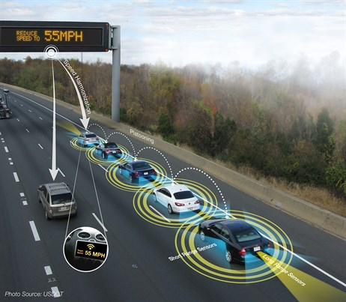
Our Solution - Car (ctd.)
Induction charging and high efficiency lanes
Autonomous electric cars communicate to improve efficiency
Create a “train” of vehicles to reduce air resistance, traffic, and energy consumption
Reduces carbon emissions by charging electric vehicles as they drive, via induction
Alternative to charging from the grid, which uses traditional organic fuels
Increases driving range of electric cars
Potential “fast” charging application similar to smartphone induction chargers
Notes:
http://www.sciencedirect.com/science/article/pii/S0378775302003701

Slide 15
Our Solution - Car (ctd.)
Manufacturing
Manufacturing a new car creates 6-35 tonnes of carbon
Almost 33% of carbon comes from extracting metals and more specifically steel
90% of these emissions are produced in the smelting process
Use lighter & stronger materials such as carbon fiber to reduce weight of car
Steel Manufacturing Value Stream Map
Notes:
http://sites.nicholasinstitute.duke.edu/environmentaleconomics/files/2013/01/Duke-EE-WP-1.pdf
https://www.scientificamerican.com/article/splitting-carbon-dioxide/
https://www.technologyreview.com/s/540706/researcher-demonstrates-how-to-suck-carbon-from-the-air-make-stuff-from-it/
http://hrcak.srce.hr/file/56088

Slide 16
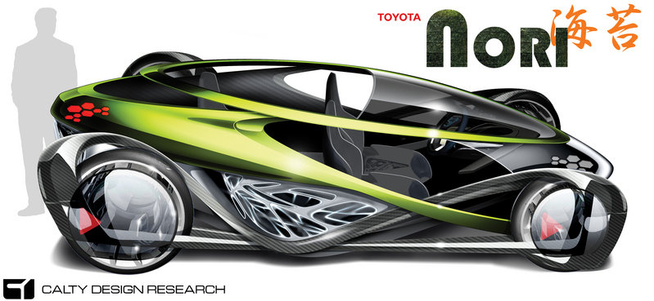
Engineering Aspect of Design - Car
Many futuristic car models (ie - Toyota Nori)
Battery technology and materials science
Lighter, stronger materials (carbon fiber)
Longer-lasting batteries (aluminum-air cell)
Powering the car without producing emissions
Integrate solar panels into the carbody
Utilize an air nozzle to focus airflow through wind turbines
Aerodynamics
Streamlining - use wind simulation programs)
Notes:
http://www.toyotarelease.com/2014/12/toyota-nori-concept.html

Slide 17
Potential Problems - Car
Costs
People prefer fossil fuel-powered vehicles due to their cheapness
Potential political measures to make efficient technology cheaper (subsidies, etc.)
Technological curve with newer ideas
Many ideas are in the prototype stage
Unemployment
If machines replace human labor, fewer people will be able to earn income without increasing their knowledge and education

Slide 18
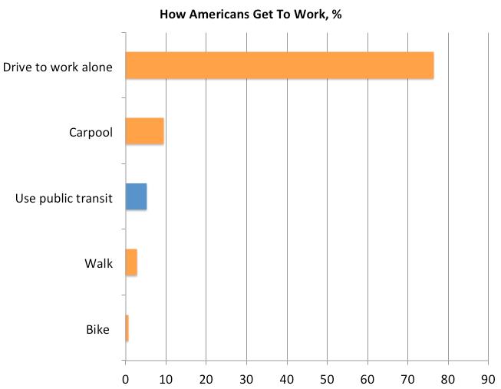
Background - Mass Transit
Workforce strength: 143 million
109 million travel alone
Transportation accounts for 27% of CO2 emissions
The use of public transportation is largely regional; 57% of N.Y.C. and less than 2% of Oklahoma City employees take public transportation to work
$330 billion annual expenditure on fuel
The average American spends 40 hours a year stuck in traffic
Notes:
http://fusion.net/story/139743/just-5-percent-of-workers-in-americas-largest-cities-use-public-transit/

Slide 19
Problem
A workforce of 143 million commutes to work each day, with a majority commuting alone. Carpooling is an underutilized solution that could be improved through policy, education, and app implementation.

Slide 20
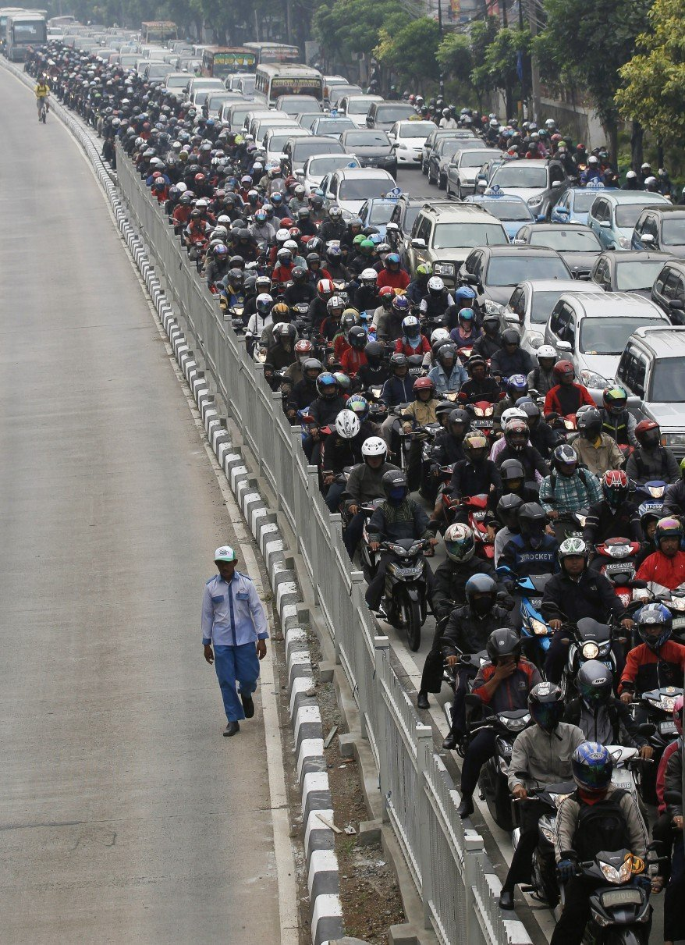
Past Solution Attempts and Results - Mass Transit
Carpool apps
Carpooling parking lots
D.C. Metro: fail, inefficient, unreliable, dirty and expensive ($3 billion budget)
Express lanes / EZ-Pass
Notes:
http://www.thepennyhoarder.com/carpooling-pays-make-money-carpool-to-work/
http://www.globalindonesianvoices.com/5687/solving-jakartas-traffic-congestion/

Slide 21
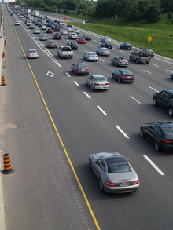
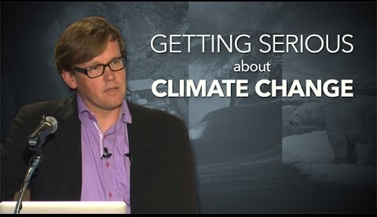

Our Solution - MT
Policy
Education
Application
Notes:
https://upload.wikimedia.org/wikipedia/commons/thumb/f/fd/404HOV_lane.png/220px-404HOV_lane.png
https://i.ytimg.com/vi/ERqGMQsihm4/hqdefault.jpg
http://www.logoinn.com.au/images/mobileapp-bannerleft.jpg

Slide 22
Engineering Aspect of Design - Policy
Government subsidize carpooling
Washington,D.C. carpoolers get $2 subsidy per day
Florida carpoolers earn up to $150 per month
Birmingham, Alabama carpoolers earn $70 for carpooling for over 90 days
San Jose, California drivers earn up to $60 in free gas for carpooling
Infrastructure construction
Improve HOV lanes coverage
Tax reduction
Company involvement
Companies provide carpooling service for their workers
Notes:
http://www.thepennyhoarder.com/carpooling-pays-make-money-carpool-to-work/

Slide 23
Engineering Aspect of Design – App Creation
A 2015 Pew Research Center study found 68% of adults to own smartphones- that's around 220 million people.
In the first year of operation alone, Uber drivers in Austin,TX provided 2.5 million rides.
The U.S. spent $819 billion on application development, hardware and software improvement, and I.T. assistance; the average app costs a mere $6,543 to develop.
Failed attempts, such as SideCar, Ridejoy, and iCarpool attempted to create a carpool app and failed due to a lack of private funding and public outreach.
By providing funding, local supportive policy, public outreach and advertisement, and a feedback system, a carpooling app can be successful.
Notes:
http://expandedramblings.com/index.php/uber-statistics/3/ https://techcrunch.com/2013/07/15/forrester-2-1-trillion-will-go-into-it-spend-in-2013-apps-and-the-u-s-lead-the-charge/
https://www.astegic.com/cost-to-develop-a-mobile-app

Slide 24
Engineering Aspect of Design - Education
Regain trust of public opinion on ride sharing programs by increasing publicity, reliability and cost. Since ridesharing and commuting will have to compete with the comfort and ease of driving your own personal vehicle, people will have to convinced that ridesharing and commuting will save them money, be reliable and safer than driving their personal vehicles.
It is imperative to educate the community to understand the environmental impact of emissions and pollution related to commuting to work and from work, saving them time, stress and money.

Slide 25
Potential Problems - Mass Transit
Convenience/Comfort
Conflicting political agenda for re-election
Single driver habits may be hard to break
Flexibility
Emergency situations
Cost of supporting infrastructure
Allocation of additional land for parking lots and metro lines
Trust / Reliability of Public Transport

Slide 26
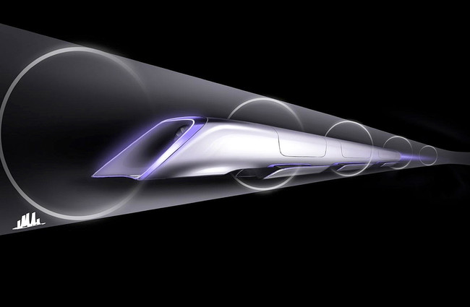
Engineering Aspect of Design - Hyperloop One
"A cross between a Concorde, a railgun and an air hockey table".
Train set inside of a semi-vacuumized tube, therefore reducing air friction and allowing for accelerated speed with less energy expenditure.
Still sustainable- using Tesla batteries and other energy sources, not fossil fuels.
Takes people from San Francisco to L.A. in 30 minutes, otherwise a 3 ½ hour drive.

Slide 27
Conclusion

Slide 28
Notes:
Leave this slide blank

