Slide 1

KASan
HCL
Sreekanth
51679472

Slide 2
Agenda
HCL
What is a Kernel Address Sanitizer?
Design of KASAN and how it works?
  Design and principle of KASan
  Linux Initialisation model
Advantages of KASan
KASAN Initialization
  Allocating the shadow buffer
  Shadow translation
  Error Detection

Slide 3
What is KASan?
KernelAddressSANitizer (KASAN) is a dynamic memory error detector.
It provides a fast and comprehensive solution for finding use-after-free and out-of-bounds bugs.
KASAN uses compile-time instrumentation for checking every memory access, therefore you will need a GCC version 4.9.2 or later.

Slide 4
What is KASan?
GCC 5.0 or later is required for detection of out-of-bounds accesses to stack or global variables.
Currently KASAN is supported only for the x86_64 and arm64 architectures.

Slide 5
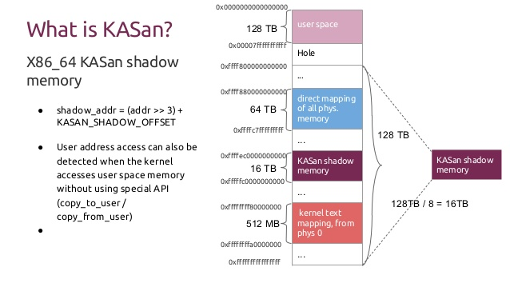
Linux Page Tables 4-levels
Notes:
http://lwn.net/Articles/117749/
PGD = page global directory, PUD = page upper directory, PMD = page middle directory, PTE = page table entry
Q: How does having multiple levels save memory?
A: A single array large enough to hold the page table entries for a single process would be huge, even though many would be unmapped. Tree structure allows tables to be broken up into individual pages, while subtrees corresponding to unused parts of the address space can be absent.

Slide 6
How to use KASan?
To enable KASAN configure kernel with:
CONFIG_KASAN = y
and choose between CONFIG_KASAN_OUTLINE and CONFIG_KASAN_INLINE.
Outline and inline are compiler instrumentation types.

Slide 7
How to use KASan?
To disable instrumentation for specific files or directories, add a line similar to the following to the respective kernel Makefile:
  For a single file (e.g. main.o):
  KASAN_SANITIZE_main.o := n
  For all files in one directory:
  KASAN_SANITIZE := n

Slide 8
Shadow translation
The translation from a memory address to the corresponding shadow offset must be done pretty fast since it happens during every memory read/write. This is implemented similar to the below code
shadow_address = KmemToShadow(address);
void * KmemToShadow(void * addr) {
return (addr >> Shadow_scale) + Shadow_buffer_start;
}

Slide 9
Error Detection
Every read/write is instrumented to have a check which would decide if the memory access was legitimate or not. This would be done in the manner shown below.
shadow_address = KmemToShadow(address);
if (IsPoisoned(shadow_address)) {
ReportError(address, Size, IsWrite);
}

Slide 10
Error Detection
Each byte of shadow buffer memory maps to a qword(8 bytes) of kernel memory. Because of which poisoned memory(*shadow_address) values have only 3 possibilities :
The value can be 0 ( Meaning that all 8 bytes are unpoisoned )
The value can be -ve ( Meaning that all 8 bytes are poisoned )
The value can have first k bits unpoisoned and the rest (8 - k) poisoned

Slide 11
Basic Bug Report
The information about each bug is stored in struct kasan_access_info which is then used to determine the following information
The kind of bug
Whether read/write caused it
Process ID of the task being executed
The address which caused the error

Slide 12
Advantages
KernelAddressSanitizer:
Is based on compiler instrumentation (fast)
Detects OOB for both writes and reads
Provides strong UAF detection (based on delayed memory reuse)
Prints informative reports

Slide 13
        Thank You

