Slide 1







An Autonomous Institution
DEPARTMENT OF COMPUTER SCIENCE AND ENGINEERING
(ARTIFICIAL INTELLIGENCE & MACHINE LEARNING)
PROJECT PHASE – I MODEL REVIEW
DocketPilot : An Agentic AI System for Indian Legal Research, Drafting, Anti-Hallucination Verification and Case Management
Batch No.20
PRESENTED BY
Biotech,
Chemical,ECE &IT
VH13192 SRIGARAN N (113023148048 )
VH13190 SELVARAJ VASANTHAKUMAR (113023148046 )
VH13194 SURYAPRAKASH P (113023148050)
Supervisor Dr. Saravanan R, M.E., Ph.D. Professor | Head of the Department Dr. Manoj Kumar D S, Ph.D Associate Professor
Date:06.09.2026

Slide 2
OUTLINE
Abstract
Objective
Introduction
Literature Survey
Proposed Methodology
Block Diagram/Flowchart
Hardware/Software Requirements
Output
Results
Conclusion

Slide 3
ABSTRACT
Indian courts are increasingly encountering AI-generated legal citations that turn out to be fake, resulting in sanctioned lawyers and invalidated orders.
DocketPilot is a working agentic AI system for Indian legal research, drafting and case management, in which every citation is checked, corrected or removed before it reaches the lawyer.
Using LangGraph, seven agents analyse case papers, research judgments and Central Acts, draft documents, verify citations, assess risk and track deadlines; the lawyer approves before any document is finalised.
Client names are masked on the user's machine before any AI call. The library holds 22,767 judgments and 79 Central Acts, refreshed weekly from India Code, and the verifier caught 99.6% of corrupted citations in testing.

Slide 4
OBJECTIVE
The objective of this project is to design and develop an agentic AI system that assists lawyers in a reliable, verifiable, and privacy-conscious manner.
To eliminate hallucinated/fake legal citations through an independent verification agent
To retrieve the legally correct, amendment-aware version of statutes, updated weekly from India Code
To identify case strengths, weaknesses, and similar past verdicts through a dedicated strategy and risk analysis agent
To read case papers (text PDF, Word, text files) and extract facts, parties and hearing dates
To protect confidential data through local masking and an encrypted vault before AI processing
To generate drafts of any legal document and case reminders, finalised only after the lawyer approves
To maintain a persistent case dashboard and calendar for ongoing matters

Slide 5
INTRODUCTION
Legal professionals in India are rapidly adopting AI tools for research and drafting, but most existing tools generate unverified content, risking factual and legal errors. Courts and the Bar Council have already flagged this as a serious, real-world problem in 2025–2026. This project addresses that gap by building a multi-agent AI system tailored to Indian legal practice.
Focuses on trustworthiness through built-in citation verification, not just automation
Built on Indian legal sources: Supreme Court and High Court judgments, and Central Acts from India Code
Treats confidentiality as a core design requirement, not an afterthought
Supports long-running cases through persistent memory, a case dashboard and a calendar
Goes beyond chat to real actions: Word drafts, reminders, weekly law updates and AIBE exam practice

Slide 6
LITERATURE SURVEY
S.No | Title of the Paper | Name of the Journal | Year of Publication | Algorithms / Techniques | Findings
1 | Neethi AI: An AI-Powered Multi-Agent System for Indian Legal Advisory | IEEE | 2026 | Qdrant supports vector search, RAG , CrewAI-style orchestration | 1, low latency for common queries 2, hallucination free citation 3, Voice-based interaction in 12 Indian languages using Sarvam AI 4, An automated legal document drafting module generates bail applications, FIR drafts, legal notices, and consumer complaints. Cons 1. Made for common people not lawyers 2. no security for personal info

Slide 7
LITERATURE SURVEY
S.No | Title of the Paper | Name of the Journal | Year of Publication | Algorithms / Techniques | Findings
2 | LegalMind: Agentic AI-Driven Process Optimization and Cost Reduction in Legal Services Using DeepSeek | IEEE | 2025 | Agentic AI using DeepSeek R1 fine-tuned | 1, 42.6% cost reduction 2, 60.8% improvement in document processing speed over baseline AI models

Slide 8
LITERATURE SURVEY
S.No | Title of the Paper | Name of the Journal | Year of Publication | Algorithms / Techniques | Findings
3 | Artificial intelligence in the judiciary: a systematic review | The Judicial Review | 2026 | Systematic literature review of AI use in judicial settings; studies AI-supported case handling, decision support, and workflow automation | Found that AI is increasingly used in courts for efficiency, but adoption depends on trust, transparency, and human oversight

Slide 9
LITERATURE SURVEY
S.No | Title of the Paper | Name of the Journal | Year of Publication | Algorithms / Techniques | Findings
4 | Generative AI in Legal Practice: Applications, Challenges, and Ethical Considerations | SSRN | 2025 | Review of LLM-based legal applications; covers legal research, drafting, contract analysis, and client communication | Found that generative AI can improve productivity, but hallucinations, privacy, and professional responsibility remain major concerns

Slide 10
LITERATURE SURVEY
S.No | Title of the Paper | Name of the Journal | Year of Publication | Algorithms / Techniques | Findings
5 | Artificial Intelligence and the Practice of Law Part 1: Lawyers Must be Professional and Responsible Supervisors of A | SSRN | 2023 | Conceptual analysis of AI-assisted legal work such as document review, summarization, translation, and legal analysis | Found that AI is a strong efficiency tool, but lawyers must supervise outputs because AI is not infallible

Slide 11
PROPOSED METHODOLOGY
Build the knowledge base: 22,767 Supreme Court and High Court judgments (AWS Open Data) and 79 Central Acts from India Code, stored in PostgreSQL with vectors in Qdrant.
Design the multi-agent graph in LangGraph: Orchestrator, Document Analysis, Research, Drafting, Verification, Strategy & Risk and Monitoring agents, pausing for the lawyer's approval.
Read uploaded case papers, extract facts and hearing dates, and file each paper into the right case automatically.
Mask names and identifiers locally (rules plus spaCy NER); the lawyer reviews the masks, and real names stay in an encrypted vault.
Retrieve with hybrid search: keyword and dense vectors fused by reciprocal rank fusion, then cross-encoder re-ranking; statutes are looked up as on a given date.
Generate the answer or draft with gpt-oss-120b on Groq, tying every legal statement to a retrieved source.
Verify every citation against the stored judgment or Act; wrong citations are corrected and unsupported ones removed.
Run strength/weakness analysis, create reminders, update the dashboard, and produce the Word file after approval. A weekly scheduled job refreshes the Acts from India Code.
Evaluate citation checking, retrieval, masking, cost and usability on measured test sets.

Slide 12
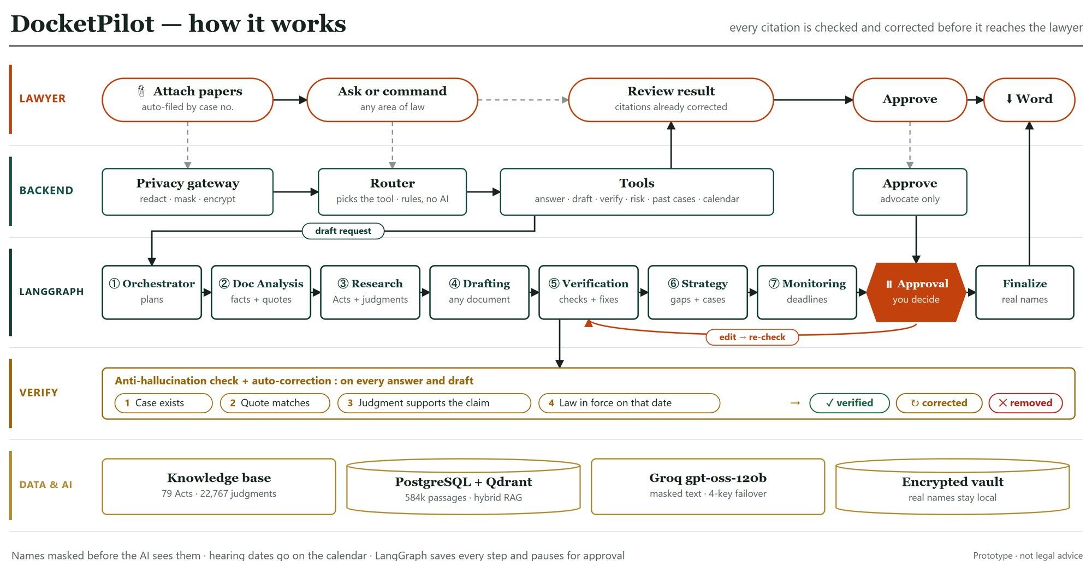
Block Diagram/Flowchart
12

Slide 13
HARDWARE /SOFTWARE REQUIREMENTS
HARDWARE REQUIREMENTS
PROCESSOR: I5/I7
RAM: 16 GB
STORAGE: 256 GB SSD
GPU: NVIDIA (optional, to build the search index)
OS: WINDOWS 11
SOFTWARE REQUIREMENTS
PROGRAMMING LANGUAGE: PYTHON
IDE: VS CODE
BACKEND FRAMEWORK: FASTAPI
FRONTEND: REACT, VITE, TAILWIND CSS
ORCHESTRATOR AGENTIC AI: LANGGRAPH
LLM: GPT-OSS-120B ON GROQ
OTHER LIBRARIES: HYBRID RAG, SPACY, FASTEMBED
DATABASE: POSTGRESQL, QDRANT
DEPLOYMENT: DOCKER
DATA SOURCES: India Code, Supreme Court and High Court judgments (AWS Open Data)

Slide 14
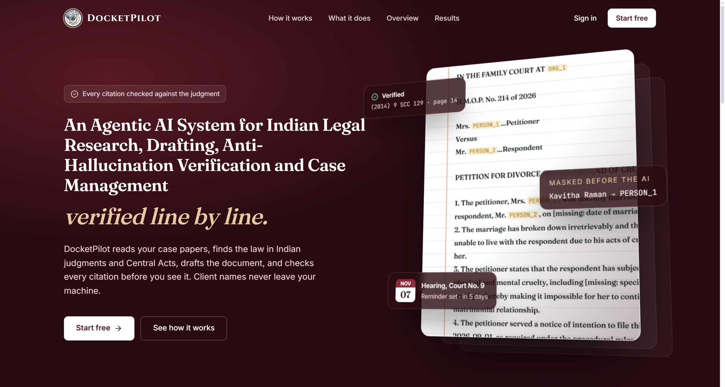
OUTPUT
Home page: the 3D hero shows a draft with its verified citation, masked name and hearing reminder.

Slide 15
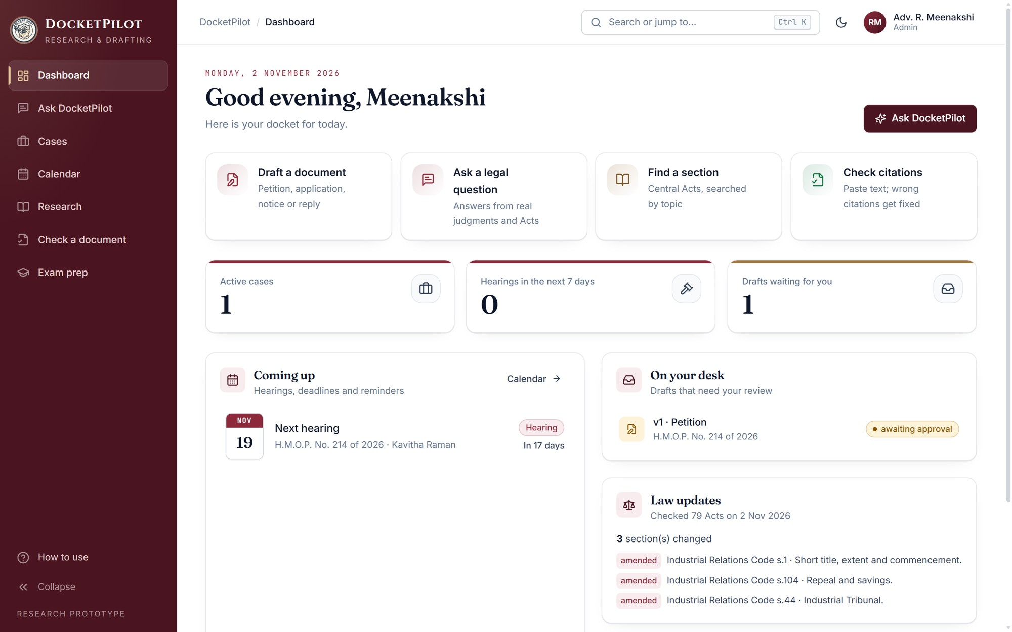
OUTPUT
Dashboard: quick actions, coming hearings, drafts to review and weekly law updates in one place.

Slide 16
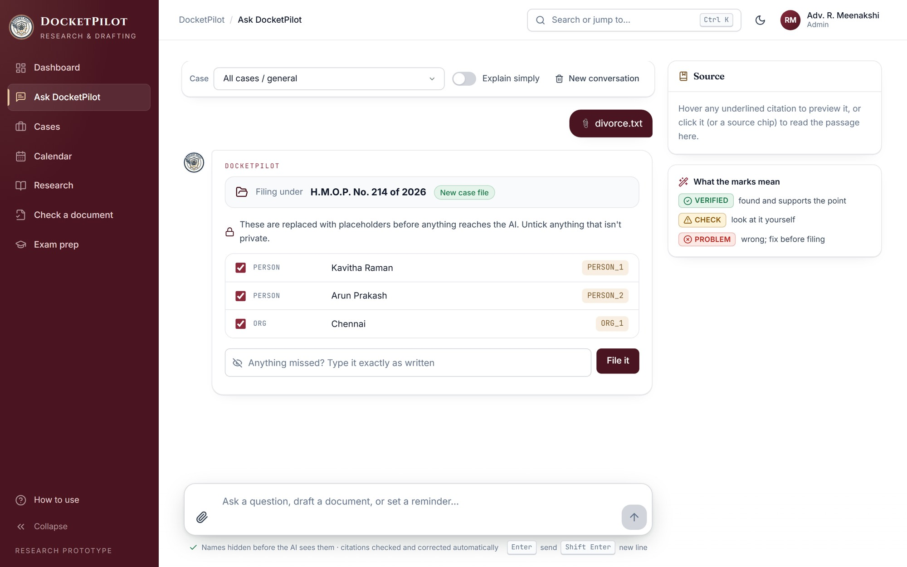
OUTPUT
Masking review: names and identifiers are listed for review before anything reaches the AI.

Slide 17
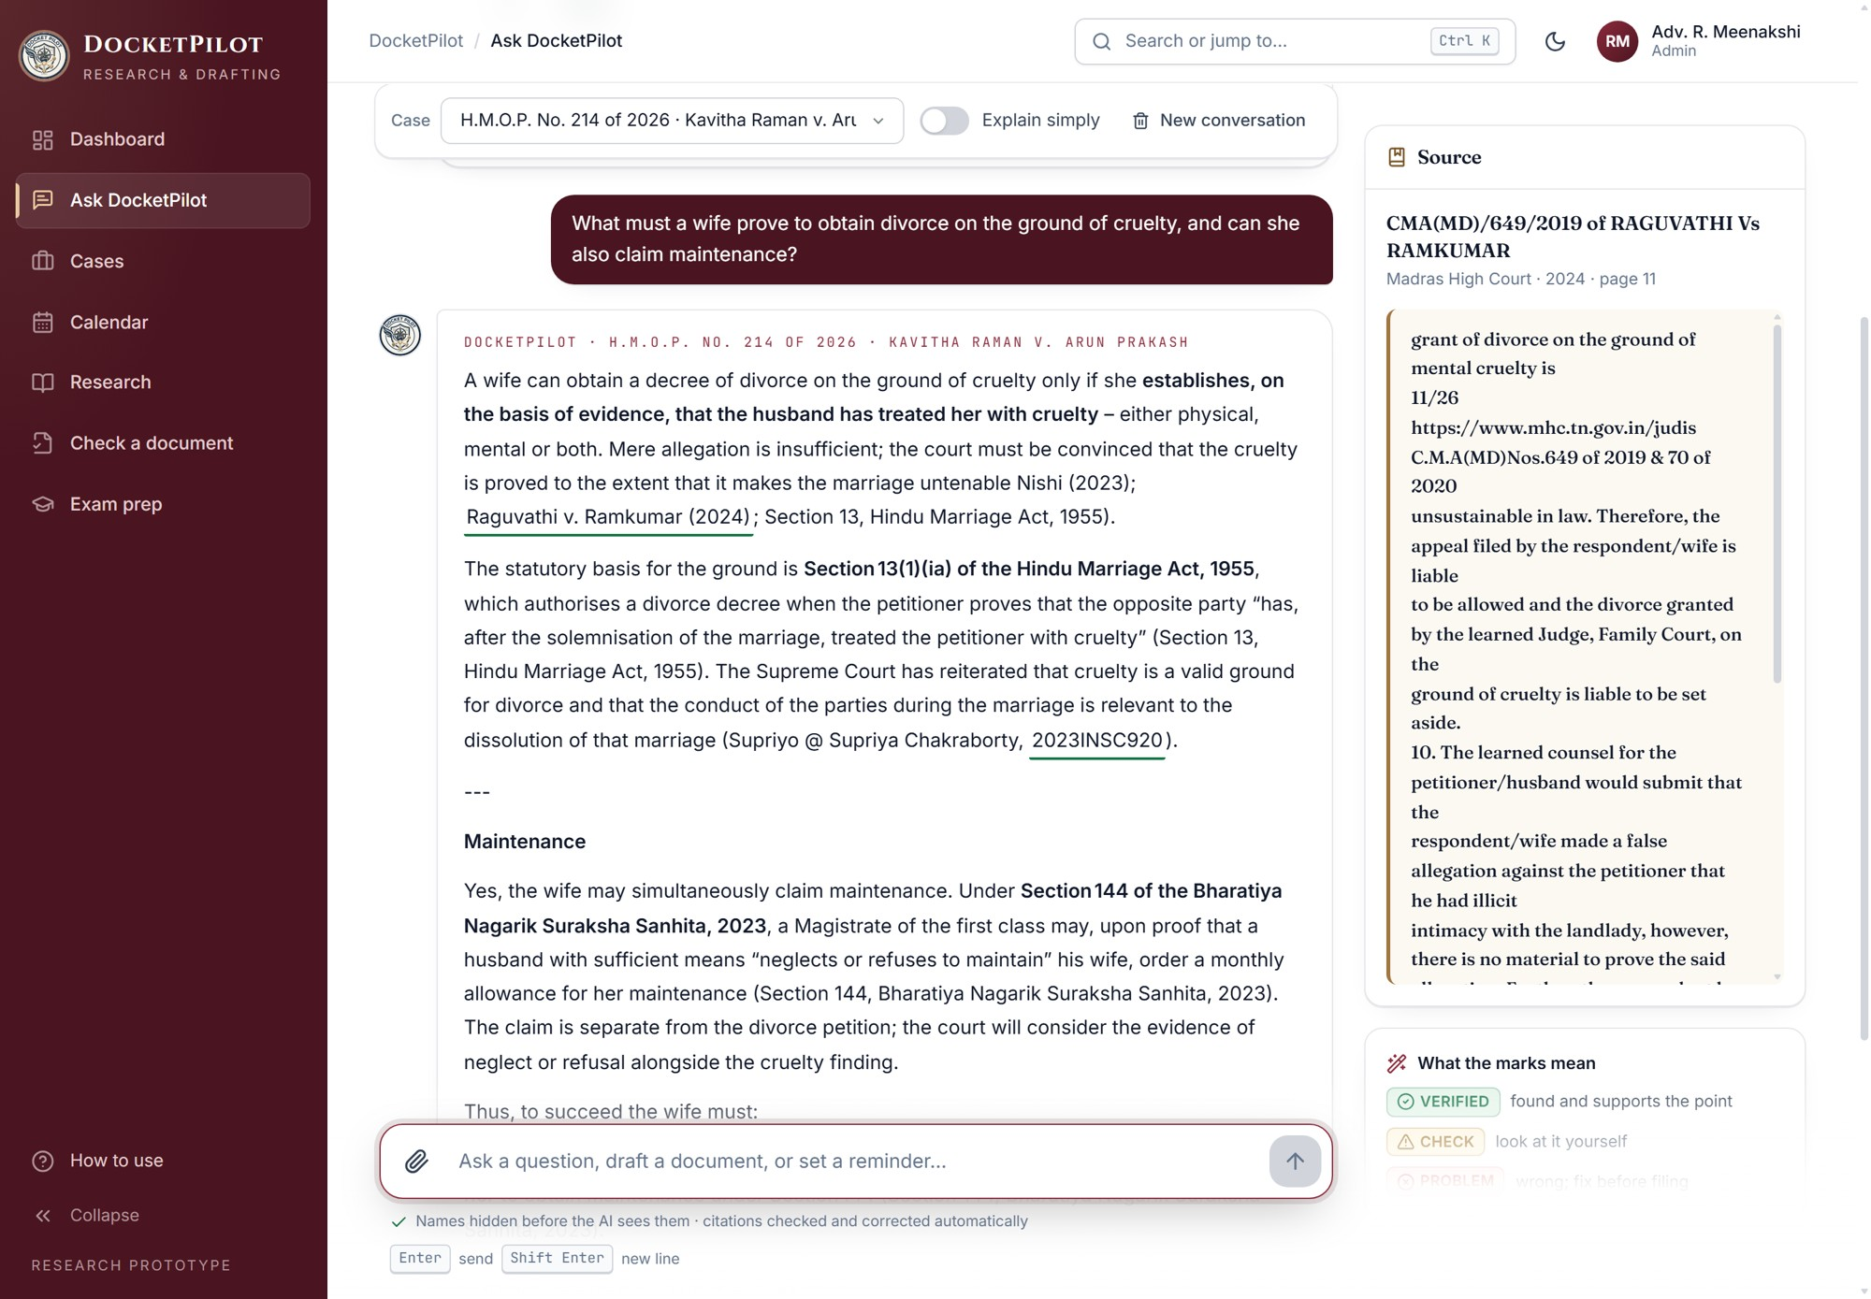
OUTPUT
Verified answer: a legal question answered with checked citations and the source passage alongside.

Slide 18
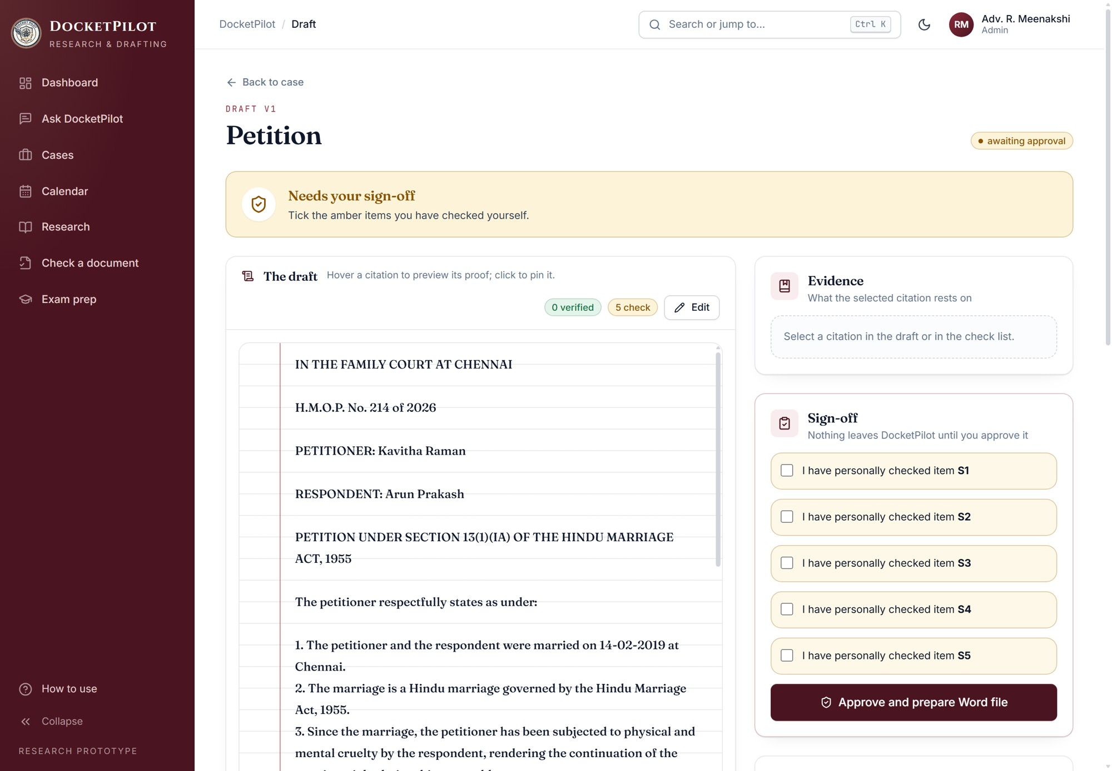
OUTPUT
Draft review: the generated petition with real names, citation checks and the lawyer's sign-off.

Slide 19
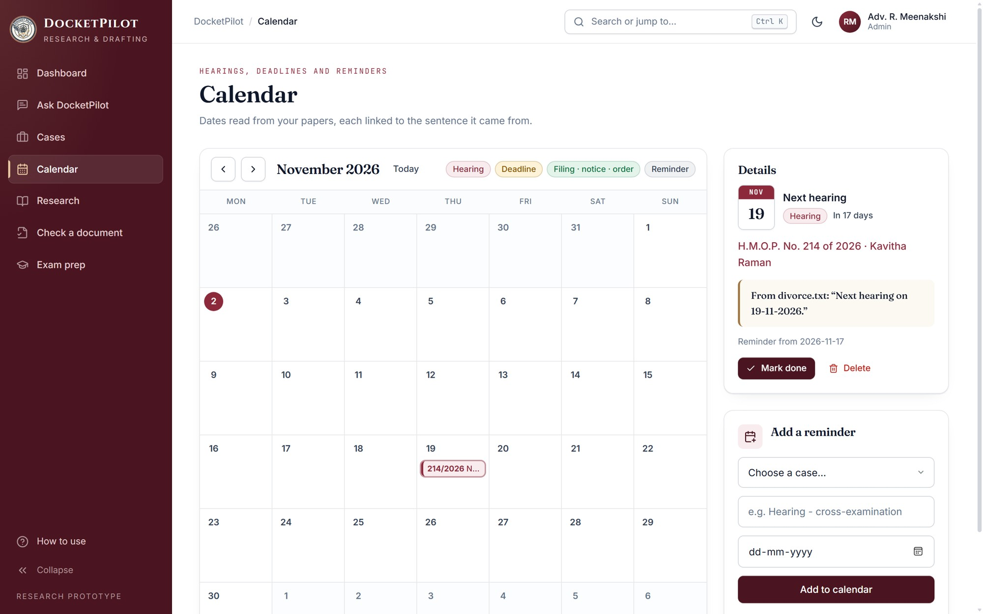
OUTPUT
Calendar: hearing dates read from the papers, each linked to the sentence it came from.

Slide 20
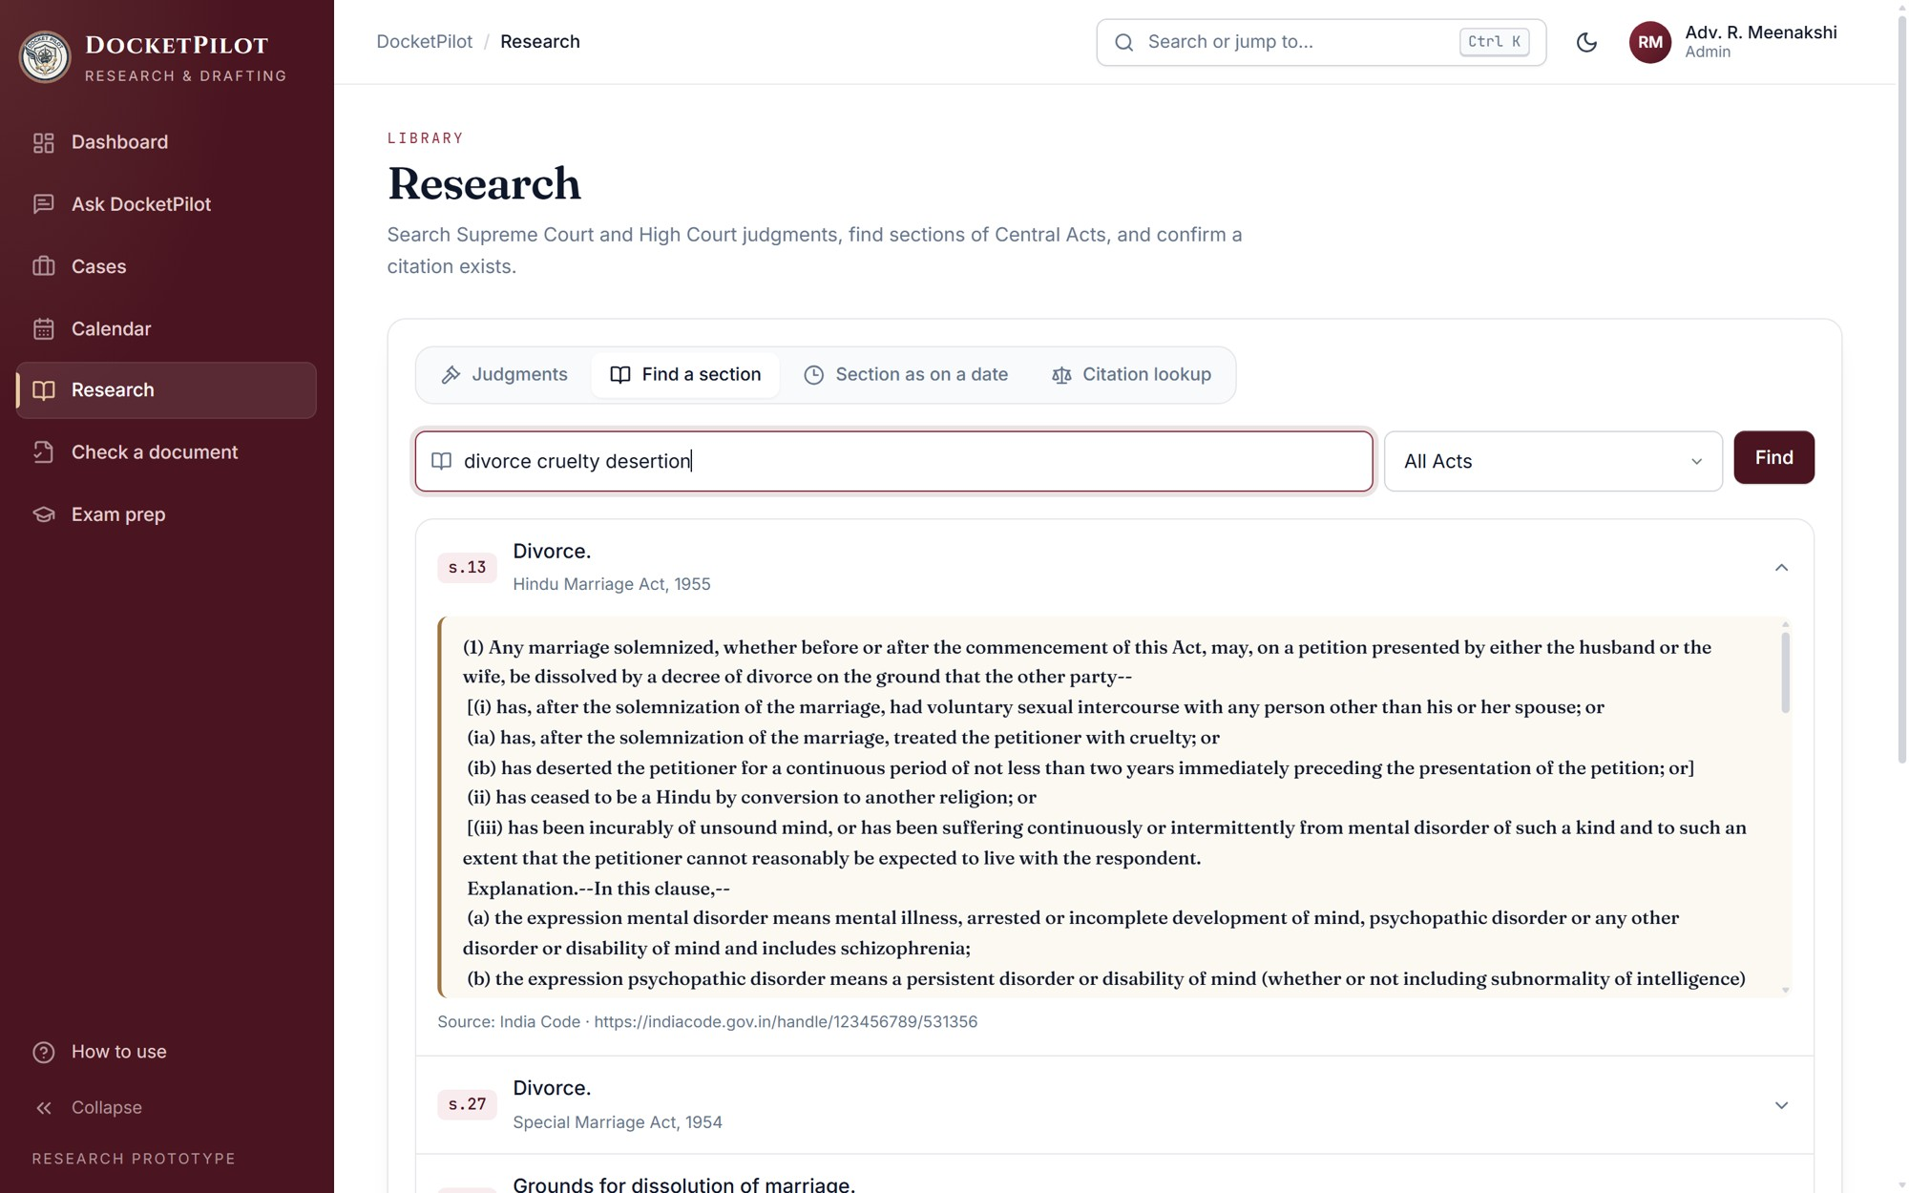
OUTPUT
Find a section: Central Acts searched by topic, with the section text from India Code.

Slide 21
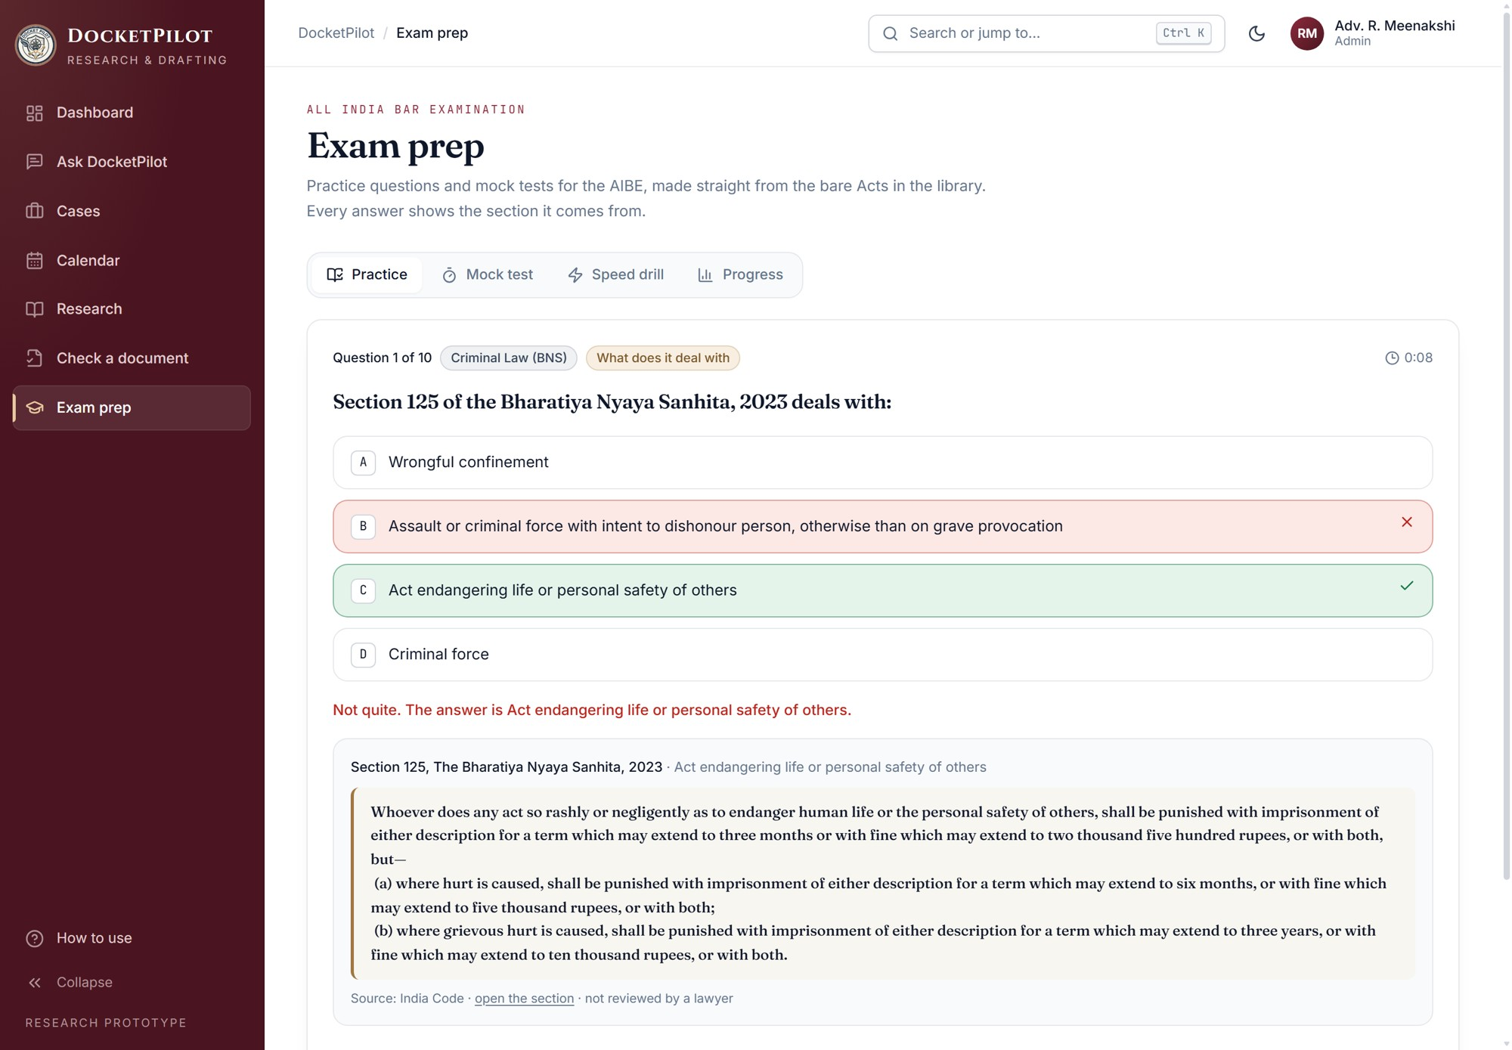
OUTPUT
Exam prep: AIBE practice built from the bare Acts, with the source section shown after each answer.

Slide 22
RESULTS
99.6%
Fake citations caught
756 corrupted and 156 genuine citations; 99.3% precision
16.1% to 0%
Unreliable citations
same model, before and after the full pipeline (8 questions)
95.7%
Retrieval Recall@5
93 headnote-to-judgment queries, after re-ranking
87.2%
Lower cost per answer
against the same model reading the full judgments
96.8%
Personal data masked
every structured identifier caught; person names are the main misses
8 of 8
Usability tasks passed
no WCAG 2.1 AA violations on any page
Measured on the project's own test sets with one model; the eight-question result is indicative.

Slide 23
CONCLUSION
DocketPilot shows that one open-weight model, wrapped in retrieval, source tagging and a self-correcting verifier, can deliver legal answers and drafts whose citations are checked before release.
Unreliable citations fell from 16.1% to 0% only with every layer in place, so verification should be a core part of legal AI, not an optional check.
Client identities stay on the lawyer's machine, and a verified answer costs 87.2% less than having the model read full judgments.
The project grew from a research idea into a working system: case files, calendar, weekly law updates, AIBE exam prep and security hardening.
Future work
A study with practising advocates, wider High Court coverage, OCR for scanned papers, and cloud hosting with encrypted storage.

Slide 24

Thank you
*

