Slide 1

Basic Details of the Team and Problem Statement
Ministry/Organization Name/Student Innovation: Government of Gujrat
PS Code: SIH1364
Problem Statement Title: Fake Social Media Profile Detection and Reporting
Team Name: IT Debuggers
Team Leader Name: Debarghaya Mondal
Institute Code (AISHE): C-6176
Institute Name: Dr B.C. Roy Engineering College

Slide 2
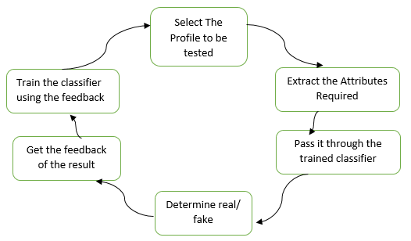
Idea description
Our solution for fake social media profile detection using AI is a robust and adaptable system that combines multiple layers of analysis to identify deceptive accounts. It employs advanced machine learning models to scrutinize user profiles, analyze posting behavior, and assess network interactions. By leveraging natural language processing and computer vision, the system examines the authenticity of text and images, detecting anomalies, inconsistencies, and signs of automation. Social network analysis reveals suspicious connections and behavioral patterns, while user-reported content contributes to the learning process. The result is a comprehensive, continuously improving solution that empowers social media platforms to combat fake accounts and enhance user trust.
USED TECHNOLOGY: Data Collection: Kaggle
Data Preprocessing: Scalar
Machine Learning Models: TensorFlow, Scikit-learn
Backend: Python
Visualization: Matplotlib, Seaborn
Frontend: Flutter

Slide 3
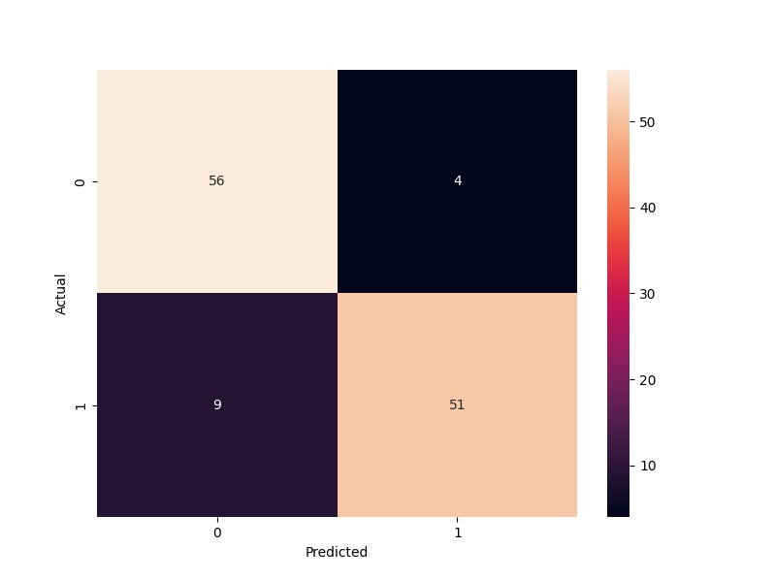
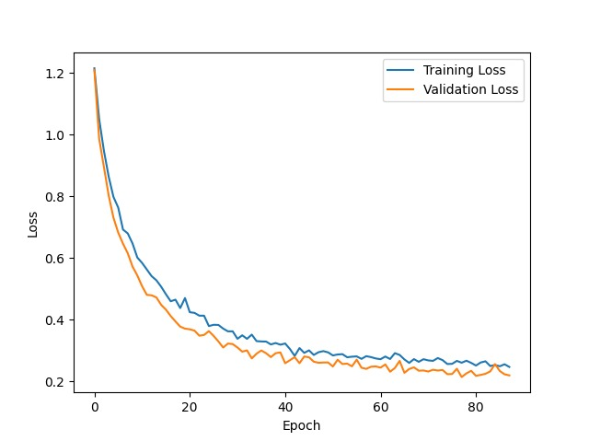
Approach Details:
Result:
Data Handling: The code loads and preprocesses datasets, including feature scaling.
Data Insights: It creates plots to visualize data distribution and feature correlations.
Model Development: Utilizing TensorFlow and Keras, a neural network model is defined, trained, and prevented from overfitting.
Model Evaluation: Metrics like precision, recall, F1-score, and a confusion matrix assess model performance.
Real-time Prediction: An interactive section allows users to input data and receive instant predictions for practical applications
 | precision | recall | f1-score | support
Fake | 0.86 | 0.93 | 0.9 | 60
Not Fake | 0.93 | 0.85 | 0.89 | 60
accuracy |  |  | 0.89 | 120
macro avg | 0.89 | 0.89 | 0.89 | 120
weighted avg | 0.89 | 0.89 | 0.89 | 120

Slide 4
Team Member Details
Team Leader Name: DEBARGHAYA MONDAL
Branch: BTech Stream: IT Year: III
Team Member 1 Name: SNEHASISH SEN
Branch: BTech Stream: IT Year: III
Team Member 2 Name: SRIBAS MAJI
Branch: BTech Stream: IT Year: III
Team Member 3 Name: BISWAJIT SAR
Branch: BTech Stream: IT Year: III
Team Member 4 Name: SUBRATA MONDAL
Branch: BTech Stream: IT Year: III
Team Member 5 Name: ESHANEE GHOSH
Branch: BTech Stream: IT Year: III

