Slide 1
EcoVoice
Your AI powered personal sustainability coach

Slide 2
Theme
EcoVoice is an interactive, multi-modal web app that acts as a personal sustainability coach.
It uses Azure AI to analyze your environmental impact through text (daily activities you input), voice (spoken reflections), and images (photos of items like groceries or waste), then provides tailored, actionable eco-friendly advice in real time.
Think of it as a green lifestyle assistant with a playful, gamified twist—users earn "Eco Points" for sustainable choices, tracked via Azure services.

Slide 3
Technical backbone
Azure AI services – text, speech and image analysis
Azure Open AI services – chat completion to get personalized inputs
Azure content safety service
Azure static web apps
Azure function app
Azure Cosmos DB
Azure AD integration – to manage user identities
Azure storage – to store image and voice blob

Slide 4
Tools
Azure portal with Azure free credit
GitHub Copilot
VSCode
Visual Studio

Slide 5
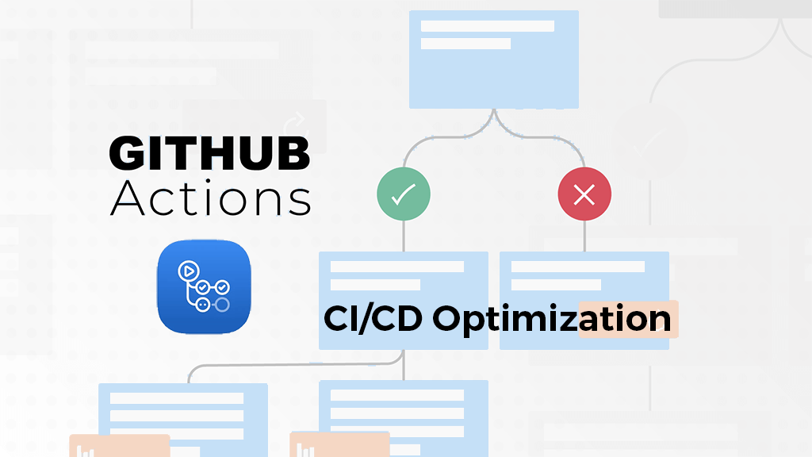
Hosting model: Independent deployment for UX and backend through github workflows
React/Frontend
(static web apps)
Azure Function app/Backend

Slide 6
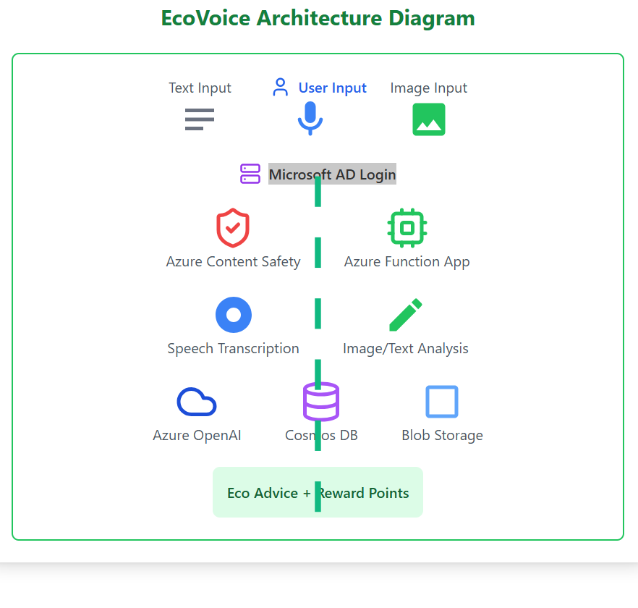
Architecture

Slide 7
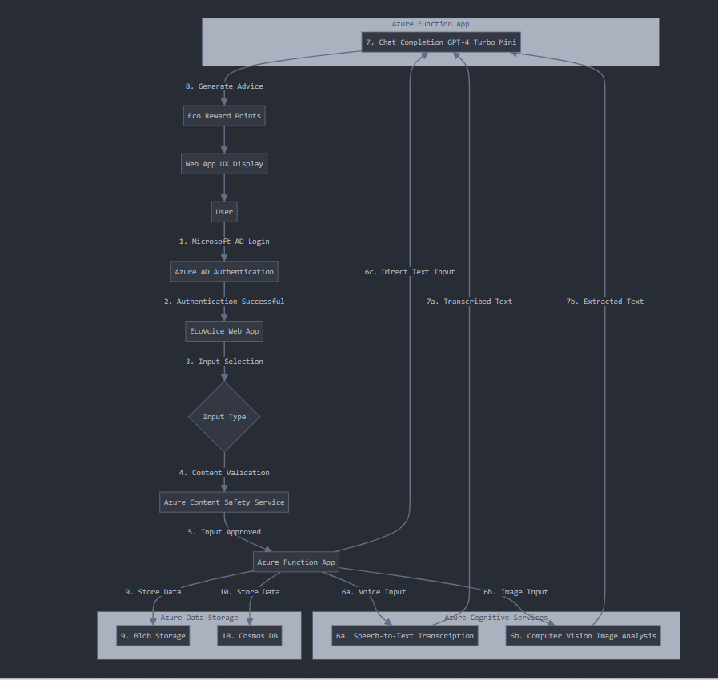
Flow

Slide 8
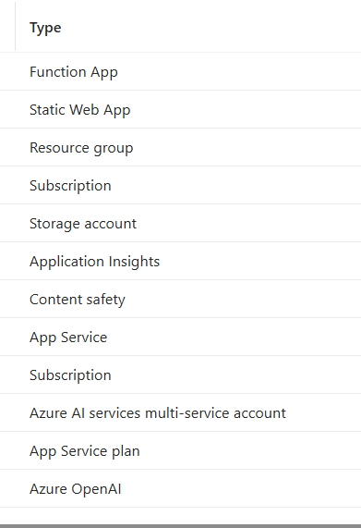
Azure resources:

