Slide 1
MS Applied Data Science Portfolio Milestone Presentation
Srihari Busam
SUID # 742162654
NETID: SBUSAM
LinkedIn: https://www.linkedin.com/in/srihari-busam/

Slide 2
About myself
Education
MS in Applied Data Science (Spring 2022)
Syracuse University, USA
Diploma in Advanced Computing (2003)
CDAC Bangalore, India
Bachelors in Electrical and Electronics engineering (2002)
JNTU Hyderabad, India
Work Experience
12 years as software engineer/Lead in Microsoft
3 yeas as staff software engineer in Qualtrics
Other related notes
Well versed with programming in various programming languages
Never took any formal statistics or analytics course before
Do not have any prior data science experience(machine learning/deep learning ..etc)

Slide 3
Why I choose pursue MS in Applied Data Science @Syracuse?

Slide 4
Projects/Courses covered
Reducing minutes late to office
Process improvement Project
MBC638: Data Analysis and Decision Making
Human Protein Atlas Single Cell Classifier
Image classification using deep learning:
IST 718 : Big Data Analytics
Sony Rules Gaming
Poster project
IST 719: Information Visualization
Hands-on experience on modern RDBMS and NoSQL Databases
IST 769: Advanced Big Data Management

Slide 5
Project1: Reducing minutes late to office
The goal of the project is to “Reduce being late to work by 50%”
Achieved 67.9% reduction
Data contains about 11 continuous and 1 discrete variable. 26 total samples were used.
Applied DMAIC framework
Learnings
Statistics deep dive for data science
Process maps (can be as simple as flow chart)
DMAIC framework (Define, Measure, Analyze, Improve and Control)
Hypothesis testing (defining null and alternative hypothesis)
Importance of operational definition
Standardization using Sigma Quality Level(SQL)
Regression basics

Slide 6

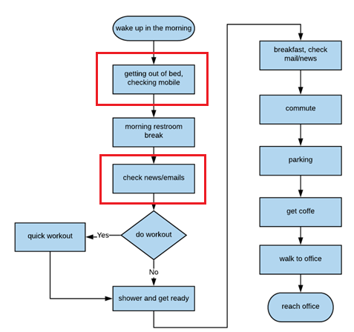

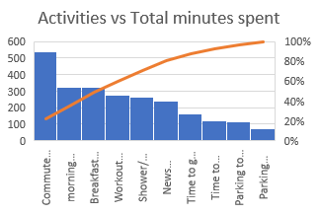
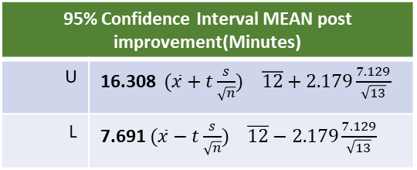
PROJECT1
Reduce minutes late to office
Process owner: Srihari Busam
Launch 7/9/2019
Define: 7/15/2019
Measure: 7/30/2019 (start)
Analyze: 8/17/2019
Improve: 8/19/2019
Control: 9/9/2019
DEFINE
MEASURE
ANALYZE
IMPROVE
Problem statement: Reduce minutes being late to office by 50%.
Impact: Every minute late to office is causing me to spend twice as much time to catch. Roughly this is leading to 14 days of personal productivity loss per year which amounts to $7,000 loss per year.
Reduced minutes late to office by 67%
10 continuous variables and 1 discrete variable are measured for each sample. A total of 26 samples, 13 before improvement and 13 after improvement are collected.
Analysis performed to validate improvements, identify confidence limits and correlation
SQL 3.4
MEAN 12 Min
Pareto Chart and Process Map helped identification of key process improvement to remove redundant activity “news/mail check”
95% Confidence Interval MEAN post improvement(Minutes)
U | 16.308 $(\overline{x}+t\frac{s}{\sqrt{n}})$ $\overline{12}+2.179\frac{7.129}{\sqrt{13}}$
L | 7.691 $(\overline{x}−t\frac{s}{\sqrt{n}})$ $\overline{12}−2.179\frac{7.129}{\sqrt{13}}$
Need Improvement
From ImR chart below after process improvements process is in control
SQL 2.91
Hypothesis testing:
α = 0.05. H_{o} = μ₁ <= μ₂ H_{a} = μ₁ > μ_{2 ,} n <30 (26)
Calculated p = 2.88E-08
Rejected null hypothesis successfully.
H_{a}: “Minutes late to office is less than value before process change”
MEAN 37.46 Minutes
Multiple Regression (After)
Y = -83.5895 + 0.2732*X₃ + 1.335 *X₅ + 1.0964 * X₆ +2.3648*X₈ - 5.934 * X₁₀
R = 0.96, Adjusted R² = 0.82
Strong correlation
Next: Confidence interval upper limit suggests 16.3 and I would like to conduct another process improvement to see if I can bring it below 15 minutes
Notes:
During my “problem definition worksheet” I have outlined that being late to office and subsequently missing meetings. I got a feedback that these 2 may be 2 different problems, based on the feedback now this project is scoped only about being late to office. Impact of the problem is specified as spending double need to be spent to cover the missing time.

Slide 7
Project2: Human Protein Atlas Single Cell Classifier
Objective: To develop models capable of classifying mixed patterns of proteins in microscopic images
Kaggle competition
Paired with another classmate to do the project
About 19 cell types are given
Leaderboard at the time was about 44% success rate and our goal for the project is to get above 44% accuracy in classification

Slide 8
Project approach
Exploratory Data Analysis.
Identified the skew in the data.
Performed association analysis on what types of cells are common
Built individual cell images for training, testing and validation
Built about 151K images with single cells from 10k images in the competition data.
Scope the problem to 12 classes which has enough samples
Removed images under 4KB and >1MB
Converted the images into 528 X 528 resolution
Model building
Deep leaning techniques used with Transfer Learning approach
Used following approaches on images during model building
rotation, width shift, height shift, shearing, zoom and flipping
Used TensorFlow 2.0 with Nvidia GPU to build deep learning model
Used VGG16, resent101, EfficientNetB6
Final model took 2 days to build on Nvidia RTX 3090 GPU

Slide 9
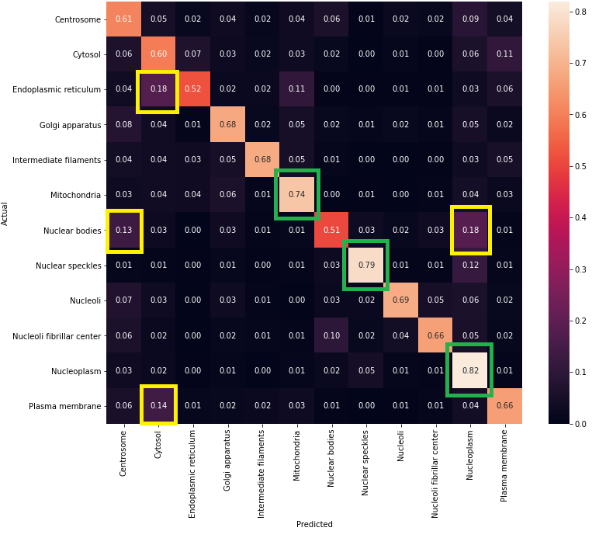
Confusion matrix(actual vs predicted %) – EfficientNetB6
Validation samples: 28,445
Overall Validation Accuracy: 67.14%
Test samples : 9,482
Highest Accuracy:
Nucleoplasm (82%)
Nuclear speckles (79%)
Mitochondria ( 74%)
Lowest Accuracy:
Endoplasmic reticulum – 52%
Top mis classification:
Nuclear bodies
Nucleoplasm
Cytosol

Slide 10
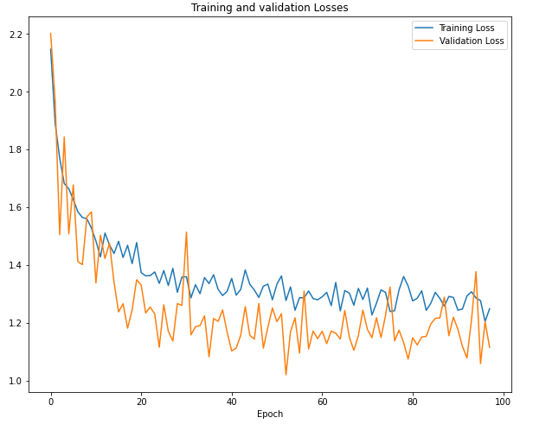
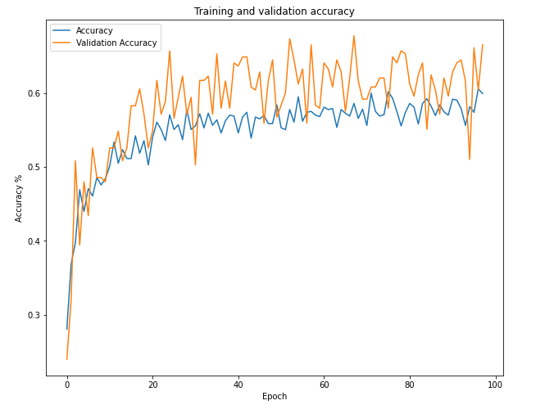
Model loss and accuracy (EfficientNetB6)

Slide 11
Learnings
Real world experience in processing huge data
Exploratory data analysis.
Building, cleaning and transforming datasets
Understanding of deep learning concepts
Tools like Jupyter notebooks
Understanding the concepts of transfer learnings
TensorFlow 2.0 framework
Large data processing. Test small iterations before going big.
Stratified sampling was a big help.

Slide 12
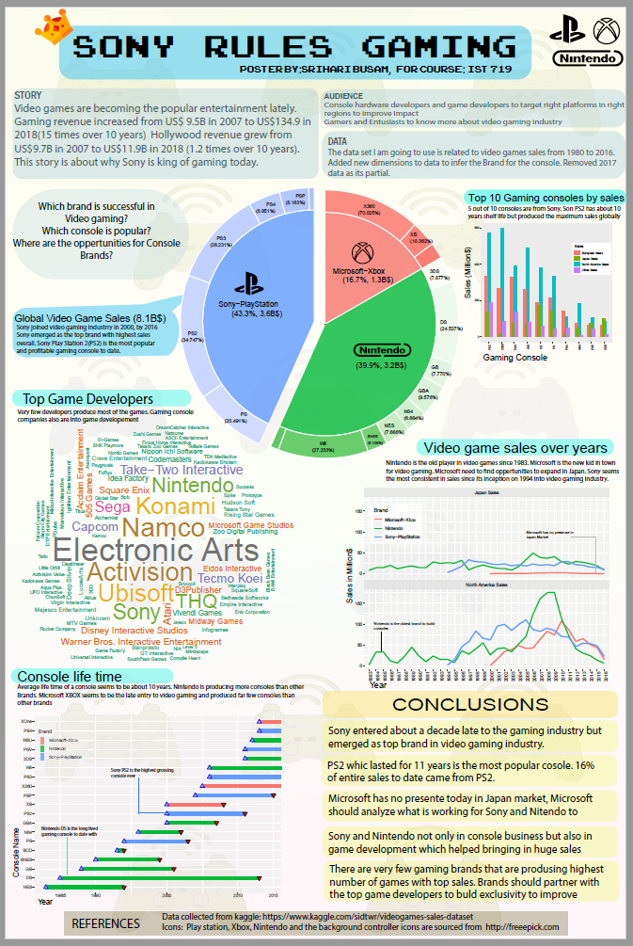
Project3: Sony Rules Gaming
Project is about applying the Information visualization learnings and providing a poster
Data
I choose to analyze the video game dataset and provide the analysis through poster
Dataset has about 13 features
Total of 16,720 observations are present
Data cleanup
Filtered data to scope only 3 popular consoles (Relevant to business domain)
Cleaned up larger text to use short acronyms to help with word cloud
Poster audience
Poster is made in the form of story driven for a focused audience game developers and gaming studios to focus on the PlayStation development.
Its also geared towards gaming enthusiasts to provide analytics on current generation gaming industry
Visualization Strategy
Used 2 column layout
Broke the rules to provide a center image to provide the theme of the poster
Used pareto chars to provide a sense of scale of Sony and the rest of the gaming consoles
Leveraged typography that resonates with the theme

Slide 13
Learnings
Understood the importance of telling story with data
Understood the importance of the audience
Understood Visual design principles
Visual Hierarchy (how to guide user navigation)
Layout
Composition
Rule of thirds principle, Golden Ratio
Typography
Learned how to enhance R plots to tell powerful stories using Adobe Illustrator
Grammar of graphics using ggplot package in R

Slide 14
IST769: Modern Database systems
The 3 Vs of Big Data
Volume, Velocity, Variety
SQL vs NoSQL
Design for storage efficiency
Design for query efficiency
CAP theorem
ETL, Data Engineering
Batch processing, Stream processing
Databases covered
MS SQL Server Advanced features
Hadoop Ecosystem
Pig
HBase
Hive, Impala
MongoDB
Cassandra
Kafka

Slide 15
Key concepts learned in the course
Data science
Sourcing data
Processing the data (Big data)
Cleaning
Transforming
Sampling (stratification)
Framing the research question
Understanding domain
Perform Exploratory Data Analysis
Building models
Testing, Validating, Comparison of models and model optimization.
Visualization
Tell the right story to the audience
Model building, analysis and tuning related to
Multivariate regression analysis
Classification
Anomaly detection
Time series analysis, forecasting
Natural Language Processing
Deep learning models using Transfer Learning
Gained experience in
Google analytics
Hadoop ecosystem
Apache Spark
R ecosystem
Jupyter notebook, python machine learning stack
Google TensorFlow Framework
Adobe Illustrator

Slide 16
How can I apply my learning?
MS in Applied Data Science gave me all the ingredients to plan, build and maintain Data Science projects. On a high-level the following would be my approach to handle any data science project.
Pre-Work:
Ensure the operational definition of the research question and data collection methods are clear. Identify the goals.
Understand the business domain. Identify how the answers to research question helps business.
Source, clean, filter and transform the data to conduct experiments
Do Exploratory data analysis, visualize results and get feedback from stakeholders early.
Modeling
Build various models based on the research question. Do validation and testing and see if results are conclusive.
Repeat model building, validation using hyper parameter tuning to find the optimal models.
Identify the resources(time, compute, storage, latency) taken to build and predict for new inputs. Analysis of Data Engineering costs and modeling costs should be done.
Share results to stakeholders
Build visualization of the results and share with stake holders
Provide details on how the research will help the business
Deploy models in production & Repeat
Deploy the models in production
Build an automated pipeline to take account of new information and update the models and deploy

Slide 17
How am I taking the learnings forward?
For any software system, eventual cost comes from monitoring and maintenance. The cost comes from noisy monitoring and amount of manual effort goes in investigations.
Software systems produces large, schematized operational data. I would like to leverage the techniques learned in big data processing and anomaly detection to improve software systems operations and reduce the costs involved.

Slide 18
References
GIT REPO(projects and code): https://github.com/srihari-busam/MS-ADS-Portfolio
Kaggle competitions referenced:
HPA Kaggle competition: https://www.kaggle.com/c/hpa-single-cell-image-classification
Video game dataset from Kaggle: https://www.kaggle.com/sidtwr/videogames-sales-dataset

