Slide 1

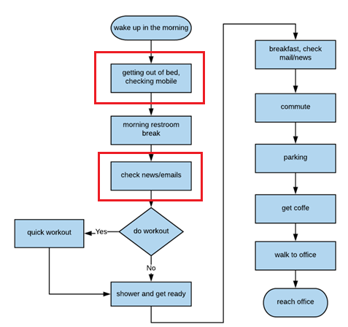

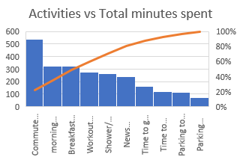
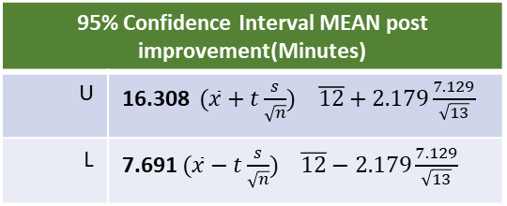
Reduce minutes late to office
Process owner: Srihari Busam
Launch 7/9/2019
Define: 7/15/2019
Measure: 7/30/2019 (start)
Analyze: 8/17/2019
Improve: 8/19/2019
Control: 9/9/2019
DEFINE
MEASURE
ANALYZE
IMPROVE
Problem statement: Reduce minutes being late to office by 50%.
Impact: Every minute late to office is causing me to spend twice as much time to catch. Roughly this is leading to 14 days of personal productivity loss per year which amounts to $7,000 loss per year.
Reduced minutes late to office by 67%
10 continuous variables and 1 discrete variable are measured for each sample. A total of 26 samples, 13 before improvement and 13 after improvement are collected.
Analysis performed to validate improvements, identify confidence limits and correlation
SQL 3.4
MEAN 12 Min
Pareto Chart and Process Map helped identification of key process improvement to remove redundant activity “news/mail check”
95% Confidence Interval MEAN post improvement(Minutes)
U | 16.308 $(\overline{x}+t\frac{s}{\sqrt{n}})$ $\overline{12}+2.179\frac{7.129}{\sqrt{13}}$
L | 7.691 $(\overline{x}−t\frac{s}{\sqrt{n}})$ $\overline{12}−2.179\frac{7.129}{\sqrt{13}}$
Need Improvement
From ImR chart below after process improvements process is in control
SQL 2.91
Hypothesis testing:
α = 0.05. H_{o} = μ₁ <= μ₂ H_{a} = μ₁ > μ_{2 ,} n <30 (26)
Calculated p = 2.88E-08
Rejected null hypothesis successfully.
H_{a}: “Minutes late to office is less than value before process change”
MEAN 37.46 Minutes
Multiple Regression (After)
Y = -83.5895 + 0.2732*X₃ + 1.335 *X₅ + 1.0964 * X₆ +2.3648*X₈ - 5.934 * X₁₀
R = 0.96, Adjusted R² = 0.82
Strong correlation
Next: Confidence interval upper limit suggests 16.3 and I would like to conduct another process improvement to see if I can bring it below 15 minutes
Notes:
During my “problem definition worksheet” I have outlined that being late to office and subsequently missing meetings. I got a feedback that these 2 may be 2 different problems, based on the feedback now this project is scoped only about being late to office. Impact of the problem is specified as spending double need to be spent to cover the missing time.

Slide 2
Project background and Goal
Background:
I rarely reach office by 8AM. Due to global presence of my company, many a times critical meetings are scheduled at 8 AM and joining the meetings late causes repetitive discussions and un-necessary extensions of the meeting. This issue is gets compounded when I am the meeting organizer. I have observed that being in office by 8:05AM seems to be highly productive.
Goal:
The goal of the project is to “Reduce being late to work by 50%”
Notes:
Why the project is chosen and what is the goal.

Slide 3
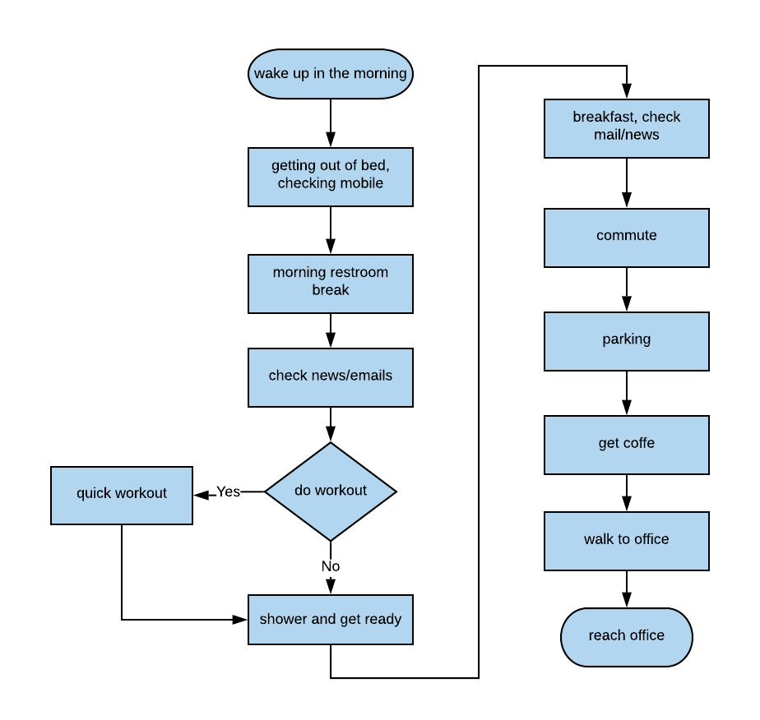
Observe current process: Process Map
Why:
I wanted to understand my current process by identifying the activities involved during my workday morning and outlined them as a process map.
How:
I have observed my daily routine for couple of days and identified activities involved. Each block will represent one or a set of logical actions that are related outlined as activity.
Result:
Visual representation of the activities involved, flow and order identified.
One of the insight I found is that I am spending multiple times checking my mobile for mails/news which seems redundant.
Not in scope:
This process is followed only for the weekdays I go to work. Some days I work from home and the process during those days is out of scope.

Slide 4
Success measures
Goal(re-iterated):
The goal of the project is to “Reduce being late to work by 50%”
Operational definition
Every minute I was I reach past 8:00AM is considered as a defect.
Weekday from Monday to Friday are considered for analysis.
Holidays, sick days, work from home days are a not considered for analysis.
“Late time to office(Y)” is the total minutes total minutes past 8 AM I reached office.
“Time to get out of the bed (X1)”, “Morning bathroom break(X2)”, “Mail and news check(X3)”, “Workout time(X4)”, “Shower and dress up time(X5)”, “Breakfast time(X6)”, “Commute time(X7)”, “Parking time(X8)”, “Coffee pick up time(X9)”, “Parking to office walk time(X10)” are the activities involved in each work day to office. Number of minutes taken to complete the activity is captured. During the measurement(using iPhone) time is rounded to the Minute. All these measurements are time based, so there are continuous variables.
“Traffic Situation(X11)” is a discrete variable measurement variable taken. On any work-day commute, If I am stooped 2+ times of freeway(I90) traffic is considered as “High” else it is considered as “Low”. High is captured as “1”, Low is captured as “0” on the analysis spreadsheet.
If I reached office before 8AM, “Late time to office(Y)” considered as “0”.
Baseline:
Baselines are the statistical measures that are captured on current process. As of now I considering the mean and SQL of the current process as the baselines that I am planning to improve.
Mean Baseline before improvement: Average minutes later per workday seems is: 37.46 Minutes
SQL Baseline before improvement: Current process SQL is 2.91

Slide 5
Data Measurement Plan for the current process
Performace metric to measure | Where captured | How data is collected | Data collector | Collection time frame | Sample size
Time to get out of the bed (X₁) | iPhone mobile excel app | I generally keep my phone accessible during and after the activity. I capture the time on the phone and added in HH:MM format in the excel cell. End of the day, I subtract the time from previous to get the value. For this activity I subtracted value from my alarm wake up time. | Srihari Busam | 7/30/2019 to 9/6/2019 | 26
Morning bathroom break(X₂) | iPhone mobile excel app | I generally keep my phone accessible during and after the activity. I capture the time on the phone and added in HH:MM format in the excel cell. End of the day, I subtract the time from before get the value. | Srihari Busam | 7/30/2019 to 9/6/2020 | 26
Mail and news check(X₃) | iPhone mobile excel app |  | Srihari Busam | 7/30/2019 to 9/6/2021 | 26
Workout time(X₄) | iPhone mobile excel app |  | Srihari Busam | 7/30/2019 to 9/6/2022 | 26
Shower and dress up time(X₅) | iPhone mobile excel app |  | Srihari Busam | 7/30/2019 to 9/6/2023 | 26
Breakfast time(X₆) | iPhone mobile excel app |  | Srihari Busam | 7/30/2019 to 9/6/2024 | 26
Commute time(X₇) | iPhone mobile excel app |  | Srihari Busam | 7/30/2019 to 9/6/2025 | 26
Parking time(X₈) | iPhone mobile excel app |  | Srihari Busam | 7/30/2019 to 9/6/2027 | 26
Coffee pick up time(X₉) | iPhone mobile excel app |  | Srihari Busam | 7/30/2019 to 9/6/2027 | 26
Parking to office walk time(X₁₀) | iPhone mobile excel app |  | Srihari Busam | 7/30/2019 to 9/6/2028 | 26
Late time to office(Y) | iPhone mobile excel app | Data is collected on my iPhone. Once I reach office, I logged the HH:MM of the current time into the spreadsheet cell under the column “Late time to office”. At the end of the day this value is converted as minutes past 8:00 AM. If I reach office before 8:00AM, “Late time to office” is treated as “0” Minutes | Srihari Busam | 7/30/2019 to 9/6/2029 | 26
Traffic situation(X₁₁) | iPhone mobile excel app | Once I reached office, I captured the data as 'High' or 'Low' based on number of times I stopped on the freeway. | Srihari Busam | 7/30/2019 to 9/6/2026 | 26
Note: All the data captured as HH:MM format and entered the spreadsheet before starting another activity. AT the end of the day, these time values are converted into minutes by subtracting from previous value.
Example: “Time to get out of bed “= 5:46AM, “Rest room break” = 6:10AM then “rest room activity time” = 6:10AM – 5:46AM = 24 Min
Notes:
2 step process
Fist capture in HH:MM format on the spreadsheet.
Later the day convert it to “MM” based on previous activity value.

Slide 6
Data Collection, classification, measurement error
Data collection:
Both continuous and discrete data collected
Data collection dates: 7/30 to 816 (13 samples)
Data collection dates: 8/19 to 9/6 (13 samples)
Collection method
Collection is done manually by a human checking the phone and updating the same.
Used my iPhone as tool to log the data into mobile excel. I also used my iPhone to get and log time.
Data logged in spreadsheet where the activities are columns and day as the row. Logged HH:MM under each activity cell on the day. “Traffic situation” is discrete data and captured at the end of the day as “1” or “0” as defined in operational definition.
At the end of every sample collection period, converted the data into activity minutes by subtracting current activity time with previous activity time. (Ex: Time to get out of bed = 5:46AM, Rest room break = 6:10AM then “rest room activity time” = 6:10AM – 5:46AM = 24 Min)
Data classification
Continuous data: 11 variables:
Minutes late to office(Y)
Time to get out of bed(X₁)
Morning restroom break(X₂)
News/email checkup time(X₃)
Workout time(X₄)
Shower/ready time(X₅)
Breakfast(and mobile) time(X₆)
Commute time(X₇)
Parking time(X₈)
Coffee pickup time(X₉)
Parking to office walk time(X₁₀)
Discrete data: 1 variable
Traffic situation(X₁₁) does impact my commute time so captured that data as “light” or “heavy”
Measurement error:
Rounded the calculation to next minute(rounded off the seconds)
Sometimes previous activity time is updated during the next activity where the value entered was an estimate. In such cases rounded time values by 5 minutes.
Sometimes missed updating couple of activities. When updating multiple activities, used approximate estimates. Estimates rounded by 5 min.
How to minimize measurement error:
One of the idea I have is to have automated sensors to be key areas of activity. These sensors will detect time of entry and exit of places, which will be more accurate, however this needs more effort on setup which is out of scope for the project. There are some systems in place ex: office entry sensor but those systems are not used to capture data for this project.

Slide 7
SQL (Sigma Quality Level)
Before Improvement
Defect opportunities per unit | 1
Units produced | 480
Total possible defects | 480
Total actual defects | 38
Defects percentage | 38/480 *100 = 7.91666666%
Defects per million | 79,167
SQL Value | 2.91
Why:
SQL (Sigma Quality Level) I used this tool to communicate my process quality in a standardized, statistical approach. I also calculated SQL value for my baseline and after improvement analysis to identify any improvement in the quality is observed.
Defect Definition:
After I reach office, every minute that is past office opening time(8AM) in an 8-hour workday is considered as a defect.
Result
There is a significant change in SQL value after process improvement. This suggests that the process improvement is a success. For my project, the SQL value changed from 2.91 to 3.46 after process improvement.
After Improvement
Defect opportunities per unit | 1
Units produced | 480
Total possible defects | 480
Total actual defects | 12
Defects percentage | 12/480*100 = 2.5%
Defects per million | 25,000
SQL Value | 3.46

Slide 8
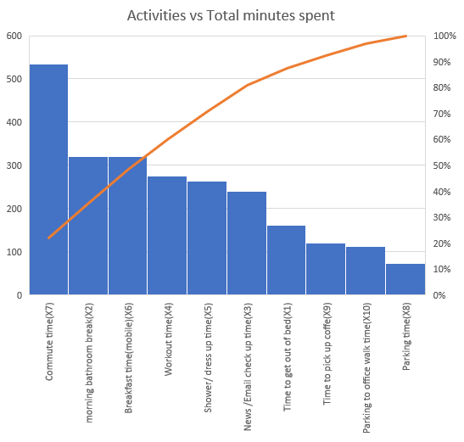
Tool: Pareto chart (Finding where the most of the time spent)
Why
I have an intuition that commute activity I spend more time than any other, however I want to see overall how all activities lined in-terms of total minutes cost. I wanted to use this chart to find what should be the activity that should be targeted for improvement.
Result:
I have identified 80-20 break up of activities vs time consumed. I want to focus on the activities on the 80% area to control to get the desired results. For my project I picked “News and Email checkup time” activity as redundant as I was doing it in dedicated activity and as part of other activities. This activity is my focus for improvement.
Redundant activity which can be removed during process improvement.

Slide 9
Identify Process Changes
3 weeks worth of data(13 samples) collected about the current process. Process map, SQL baselines and Pareto charts are analyzed to identify potential activities that needs improvement which will help with overall project goal.
Observations:
From the process map its observed that I am spending checking my mobile for either news/emails during the morning multiple times.
Even I woke up when the alarm set off, I am spending quite a bit of time not getting out of bed. This is coming mostly from checking my mobile the moment I wake up.
From Pareto chart analysis, top time burners are commute time, bathroom break, breakfast time may not be reduced much but “news and email” activity time feels a lot redundant as I spent checking these a lot at workplace also. This activity has a Mean of 18.4Min. Removing this activity altogether should improve the Y at least about 18.4 Min.
Maximum time is spent in commute with Mean = 41.15Min with standard deviation of 5.8 min. In my view I did not feel that there is a lot of dispersion in this value. This can be a potential candidate if any other process improvement did not help to reach my goal.
Planned Improvements:
I feel the multi news/email check is redundant. I plan to remove one of the dedicated activity between bathroom break and workout.
I am spending quite a bit of time getting out of bed. I would want to improve this by not keeping the mobile phone in the arms reach during sleep and see how that helps

Slide 10
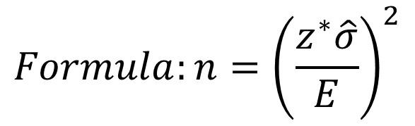
Sample Size Calculations
Not practical based on timelines
I have about 6 weeks to complete the project and considering the workdays of the week I could capture a maximum of 30 samples(5 days a week * 6 weeks).
Initial thought process
Initially I thought to get sample size based on 95% confidence, with a margin of error of 2 min. Samples sizes calculated are outlined in the table. However with this approach I need to have at least 136 samples which I can not collect as per the timelines.
I think the margin of errors could be avoided with improved data collection methods but that is out of scope for the current project. This can be an item to add in next iteration of process improvement.
Practical sample size calculation for the project based on timeline
Overall when I looked at my process following are the errors in measurements
Rounding time value to next minute(Max error 1 min)
Approximations when updating multiple activities( Max error about 5 min)
For the current project I will go with 95% confidence level with margin of error 5 min. Using this I need to get about 22 samples (14 before, 8 after) which is totally doable based on the timelines of the project.
Sample Size (95%, E = 2) | Count
Total | 136 samples
Before improvement | (1.96*9.492/2)^2 = 87(rounded)
After improvement | (1.96*7.13/2)^2 = 49(rounded)
Sample Size (95%, E = 5) | Count
Total | 22 samples
Before improvement | (1.96*9.492/5)^2 = 14(rounded)
After improvement | (1.96*7.13/5)^2 = 8(rounded)
Practical based on timelines
$$Formula:n={\left(\frac{z^{∗}\hat{σ}}{E}\right)}^{2}$$

Slide 11
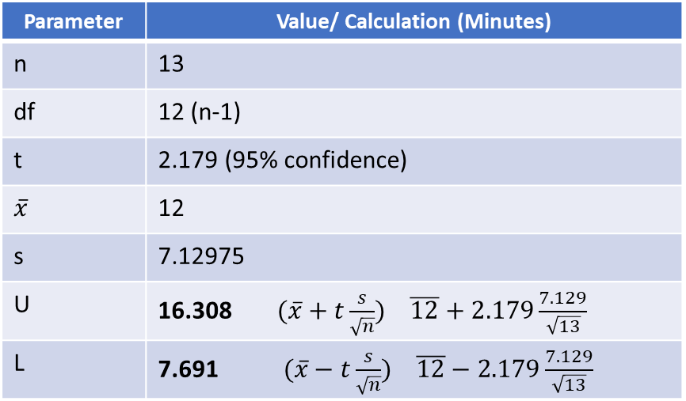
[Tool]Confidence Intervals for Mean: After improvement
WHY:
I wanted to figure out based sample data post improvement what would be the range of the Mean with 95% confidence interval. This data will help plan for effectively based on the upper limit, if the upper limit is higher than my expected value, that could indicate a change in the process is needed.
Result:
During the first improving of the process wanted average “minutes late to office” should not exceed 15 min. Based on the analysis the population Mean will be between 7.7 Minutes to 16.308 Minutes. As higher limit is above 15 minutes, I would consider going with another process improvement to see if I can achieve the upper limit not go beyond 15 min.
What is population mean for this project:
Population for this project in my view would be all my working days data in the current company at the current place assuming the process improvement plan is followed.
Calculation:
As the sample size n =13, this will be a “t” test using deflection-factor (df) as the sample size is less.
Parameter | Value/ Calculation (Minutes)
n | 13
df | 12 (n-1)
t | 2.179 (95% confidence)
$$\overline{x}$$ | 12
s | 7.12975
U | 16.308 $(\overline{x}+t\frac{s}{\sqrt{n}})$ $\overline{12}+2.179\frac{7.129}{\sqrt{13}}$
L | 7.691 $(\overline{x}−t\frac{s}{\sqrt{n}})$ $\overline{12}−2.179\frac{7.129}{\sqrt{13}}$
Need Improvement

Slide 12
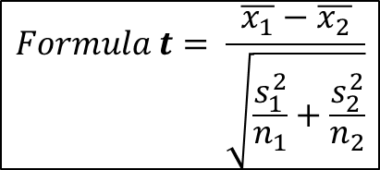
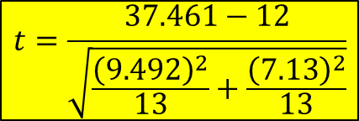
Hypothesis testing: [2 sample Right tailed test]
WHY
Hypothesis test is used to assert whether the process change helped reducing “minutes late to office”
I chose 2 sample test(Before improvement and after improvement), with right tailed test.
Samples(n) < 30 so using t-test
α = 0.05
Hypothesis statements for the study
H_{o} = μ₁ <= μ₂ “Minutes late to office is more than or equal post value before process change”
H_{a} = μ₁ > μ₂ “Minutes late to office is less than value before process change”
Data and calculations
x₁ bar = 37.461, x₂ bar = 12, s₁ = 9.492, s₂ = 7.13, n₁ = 13, n₂ = 13, df = 13 +13 -2 = 24
t = 7.732955
p = 2.88E-08
RESULT:
P << α so null hypothesis (H₀) is rejected and suggests that process
After process improvement “minutes late to office” is less than the value before process improvement
$$Formula t= \frac{\overline{x_{1}}−\overline{x_{2}}}{\sqrt{\frac{s_{1}^{2}}{n_{1}}+\frac{s_{2}^{2}}{n_{2}}}}$$
$$t=\frac{37.461−12}{\sqrt{\frac{{\left(9.492\right)}^{2}}{13}+\frac{{\left(7.13\right)}^{2}}{13}}}$$
Process improvement has positive impact

Slide 13
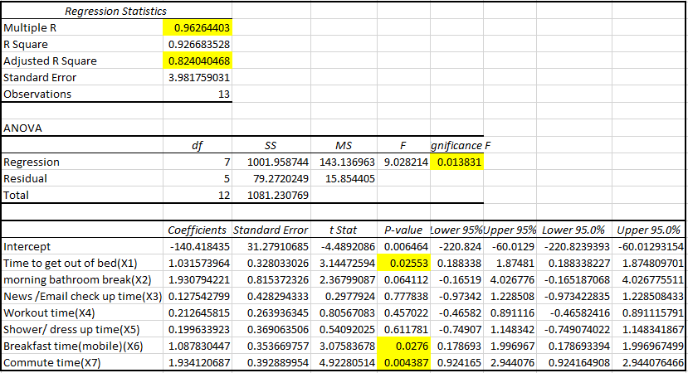
Regression (Before Improvement)
WHY
Multiple Regression tool is used to get a forecasting model and also to find strength of relationship between X’s and Y.
Observations:
First iteration used all variables, none of them gave p values less than 0.05(α)
Summary presented on the right is 2nd iteration generated removing Parking time(X₈),Time to pick up coffee(X₉), walk from parking(X₁₀), Heavy Traffic(X₁₁) variables whose p value is over 0.5
RESULT: (2nd iteration)
R (Correlation Coefficient) = 0.96. Based on the value strong correlation between Y and predicted Y.
Adjusted R²(Coefficient of determination) = 0.82. As the value is close to 1 we can conclude that, the dependent variable can be computed from independent variables.
For α = 0.05, the Significance F < 0.05 so the model is good to use.
X’s that seems to be very much correlated to the Y(Minutes late to office are) Time to get out of bed(X₁), Breakfast Time(X₆) and commute time(X₇)
2nd iteration formula Y = -140.418 + 1.032*X₁ + 1.931*X₂+0.128*X₃+0.213*X₄+0.2*X₅+1.088*X₆+1.934*X₇
* It makes more sense to remove further variables whose p value is more than 0.05 and re-run regression, which will be done for the Regression data after improvement as I want to use that mode for prediction/forecast. This model here is outlined to compare with after improvement model.

Slide 14
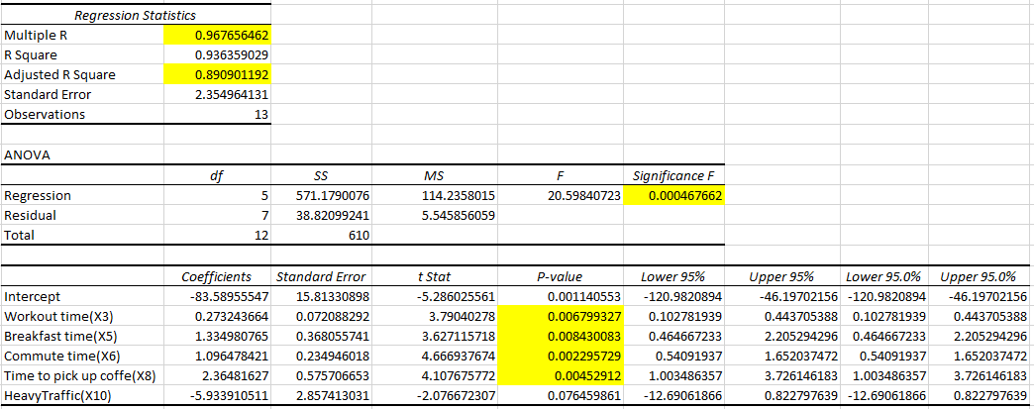
Regression (After Improvement)
Multiple Regression tool is used to get a valid forecasting model and find the X variables has relationship with Y variable.
Observations:
α = 0.05
I had to perform regression analysis 3 times to remove variable that are giving p > 0.05
Summary presented on the right is 3rd iteration generated removing Time to get out of bed(X1), Shower/ dress up time(X4), Parking Time(X7), Morning bathroom break(X2), Parking to office walk time(X9)
RESULT: (3rd iteration)
R (Correlation Coefficient) = 0.967. Based on the value strong correlation between Y and predicted Y.
Adjusted R² (Coefficient of determination) = 0.89. As the value is close to 1 we can conclude that, the dependent variable can be computed from independent variables.
For α = 0.05, the Significance F < 0.05 so the model is good to use.
X’s that seems to be very much correlated to the Y(Minutes late to office are) are Workout time(X₃), Breakfast time(X₅), Commute time(X₆), Time to pick up coffee(X₈), Heavy Traffic(X₁₀)
Equation Y = -83.5895 + 0.2732*X₃ + 1.335 *X₅ + 1.0964 * X₆ +2.3648*X₈ - 5.934 * X₁₀

Slide 15
Control chart: XmR (Individual with Moving Range)
WHY
I wanted to plot both before and after process improvement data on a XmR chart to identify
Check whether process is in control
Identify signals if any
Charting approach:
Sub-group size =1 ( this is why XmR chart is chosen)
Result:
Old process seems to be in control(1-13)
When process change is introduced on 13th day, following showing a signal
In X bar chart by going lower LCL and all 13 points are on the lower side.
The process change caused a good outcome by lowering the X bar value. The XmR chart must be re-calculated for the new values and should be the new baseline for the process.
Positive signal

Slide 16
Summary
My project is about self improvement to reduce number of minutes late to office by 50% by implementing improvements to my current process. Before thinking about statistics, I was attributing “commute” time as the main reason of my problem but never substantiated my intuitions. Having taken the statistics course, I wanted to try what are the variables that might be impacting my goal, I also wanted to see whether the improvements I made are statistically significant and identify relationship of the overall activities involved for any future improvements.
What are the tools used and their purpose for this project:
I have used following tools during my project: ProcessMap, DataMeasurementPlan, SQL calculation, Pareto Chart, Sample Size calculation, Confidence Interval for Mean, Multiple Linear Regression, Hypothesis Testing, and control chart tools for various purposes. All the tool usage is ultimately used to identify, improve and validate whether process changes helped to reach the goal.
To understand the problem and outline the problem clearly, I used Problem Definition Worksheet, Process map, Operational definition helped me clearly identify, outline the problem. Gave me initial insights about improvements. Clear guidelines on how to collect data that can be used for analysis.
To identify what I need to measure and how I should measure to use statistical analysis I used Data Measurement plan. This is based of Process Map.
To identify process improvements I used Process Map and Pareto chart to find which activities are redundant and which activities consuming more time that can be part of improvement.
To establish baselines for the process to compare with improvements I used SQL, Mean.
I wanted to be very accurate on the statistical calculate which are dependent on sample size. I used sample size calculation tools to find the right sample size I need to collect for analysis.
I used Hypothesis testing to validate whether I was able to “reduce minutes late to office”
I used Multiple Regression Model to find which X variables are impacting the Result(Y) before and after process improvement. I also wanted to find a model that can help me predict Y based on X’s. I thought this model can be used to finetune my process by concentrating on the right dependencies.
I wanted to see whether there are any signals in my process and used ImR chart to find out signal/anomalies. I also used this chart to see whether the process followed is in control.

Slide 17
Data Analysis/Conclusion
Data Analysis Summary:
Mean minutes being late to office reduced from 37.46 Minutes to 12 Minutes. About 67.9% decrease observed
After process improvement SQL increased from 2.91 to 3.46.
Hypothesis test successfully rejected H₀
H_{o} = μ₁ <= μ₂ “Minutes late to office is more than or equal post value before process change”
H_{a} = μ₁ > μ₂ “Minutes late to office is less than value before process change”
Mean with 95% Confidence interval found to be between “7.691” and “16.308” Minutes.
Multiple Regression model derived with R (Correlation Coefficient) = 0.967 and R2 (Coefficient of determination) = 0.89. This suggests strong correlation between Y and predicted Y and the dependent variable can be computed from independent variables using the model
Multiple regression model Equation Y = -83.5895 + 0.2732*X₃ + 1.335 *X₅ + 1.0964 * X₆ +2.3648*X₈ - 5.934 * X₁₀
ImR Control chart clearly indicated a positive signal(reduction in minutes late to office) right around the process change.
Conclusion:
Process changes implemented produced 67.9% reduction in “Minutes being late to office” which exceeded the goal of 50% reduction.

