Slide 1
Robot framework
Automation framework

Slide 2
Robot framework
Robot Framework is a generic open source automation framework. It can be used for test automation and robotic process automation (RPA).
Utilizes the keyword-driven testing approach
Robot Framework is actively supported, with many industry-leading companies using it in their software development.
It follows different test case styles – keyword-driven, and data-driven for writing test cases.
Test cases are written using keyword style in a Robot framework.

Slide 3
Robot Framework
Robot Framework provides good support for external libraries, tools that are open source and can be used for automation.
The most popular library used with Robot Framework is Selenium Library used for web development & UI testing.

Slide 4
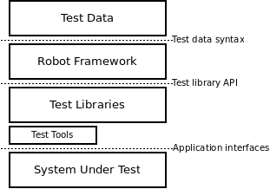
Architecture

Slide 5
Install for robot framework
# Install the latest version (does not upgrade)
pip install robotframework
# Upgrade to the latest version
pip install --upgrade robotframework
# Install a specific version
pip install robotframework==2.9.2
# Uninstall
pip uninstall robotframework

Slide 6
standard libraries
Builtin
Operating System
Collections
Screenshot
String
Datetime
XML

Slide 7
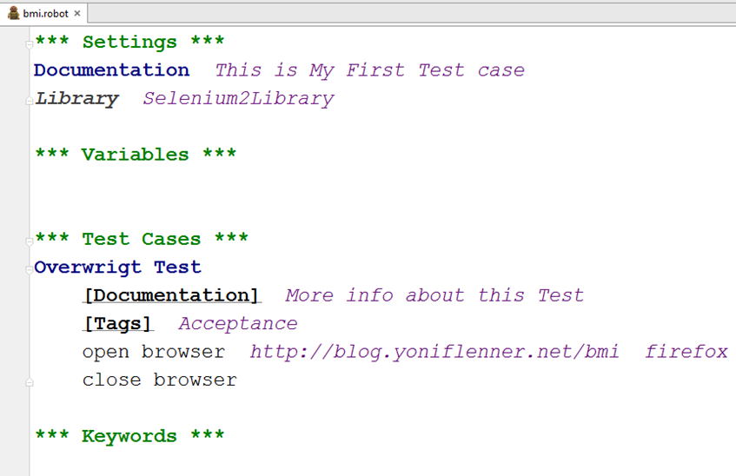
Coding Structure

Slide 8
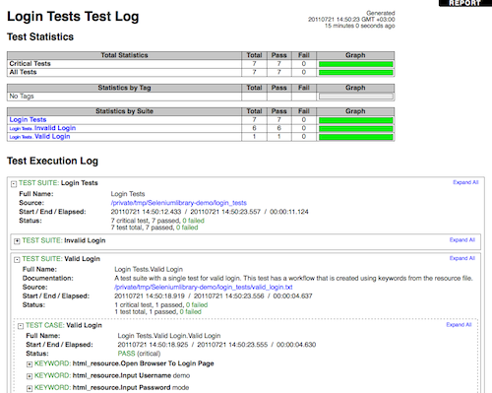
LOG File

Slide 9
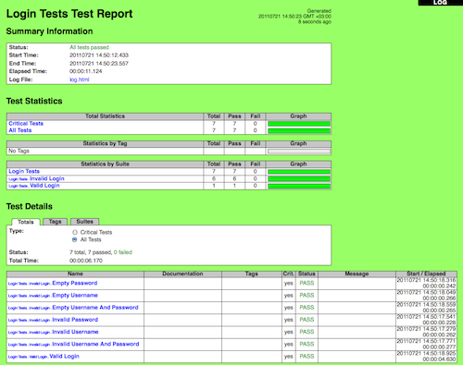
Report File

Slide 10
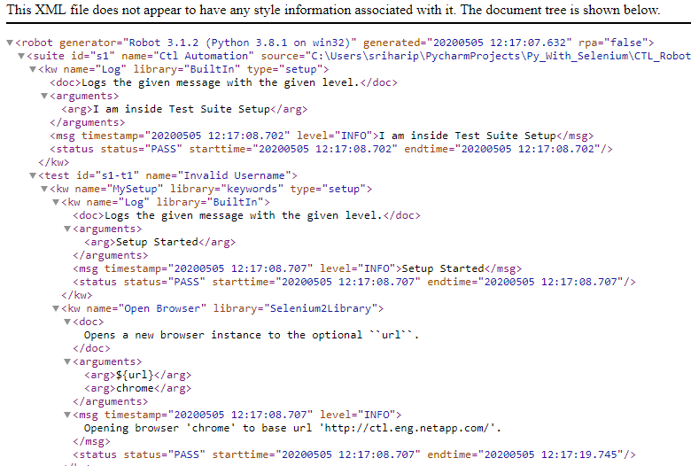
Xml File

Slide 11


Slide 12
Pytest Framework
Pytest is a testing framework which allows us to write test codes using python. you can write code to test anything like database, API, and UI .
Pytest is mainly being used in industry to write tests for API’s

Slide 13
Pytest Features
Parametrize: It is use to run same test case repeatedly with set of inputs.
syntax : @pytest.mark.parametrize()
Fixtures: Fixtures are used when we want to run some code before every test method. So instead of repeating the same code in every test we define fixtures. Usually, fixtures are used to initialize database connections, pass the base , etc. To keep setup and teardown function in fixtures. using scope for both . * setup will execute before all the test methods only one time. * teardown will execute after all the test methods only one time.
syntax : @pytest.fixture
Markers: it is used to mark the particular methods and run the method using marker name.
syntax : @pytest.mark.markername
Skip: it is used to skip the particular testcase or method.
syntax : @pytest.mark.skip

Slide 14
Pytest
Very easy to start with because of its simple and easy syntax.
syntax
ex: test_login.py --→ valid
login_test.py --→ valid
testlogin.py ---→ invalid
Can run tests in parallel.
Can run a specific test case or subset of tests.
Note: yes we can explicitly ask pytest to pick testlogin.py .

Slide 15
Assertion in Pytest
Assertions are checks that return either True or False status .
If we get fails in test method . The execution is stopped in that method itself. The remaining code in that test method will get stop for execution process.
Pytest will continues with the next test methods.

Slide 16
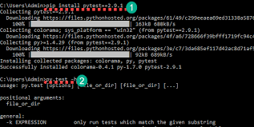
Installation for Pytest

Slide 17
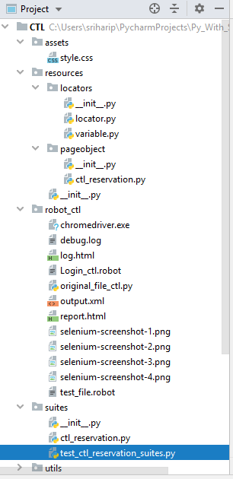
Basic Structure for pytest

Slide 18
Sample code for Pytest
Example:
def func(x):
return x+1
def test_func(): assert func(5)==5,”the condition is failed”
Run the test cases by using pytest .
py.test <file name>

Slide 19
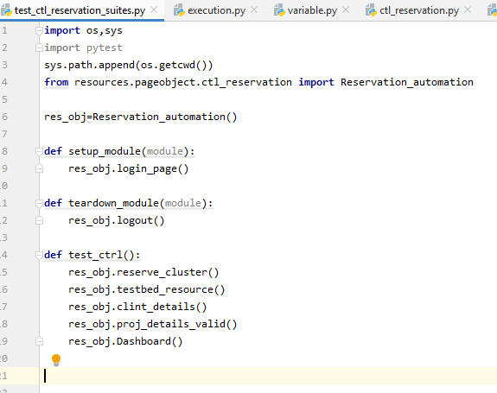
using Code for Pytest

Slide 20
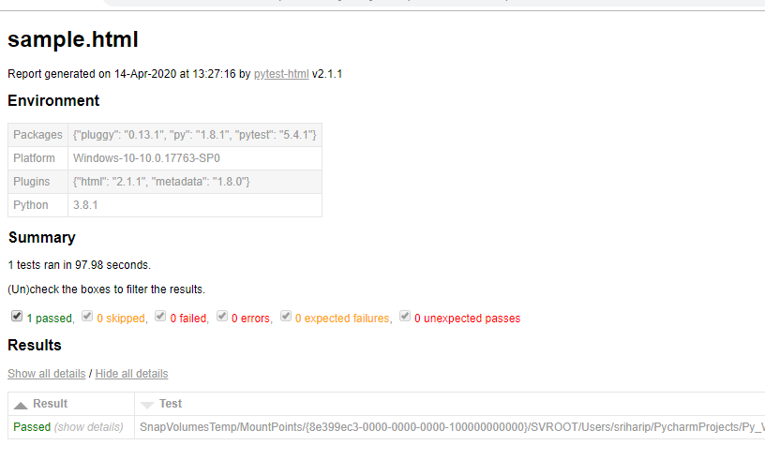
Report for Pytest

Slide 21
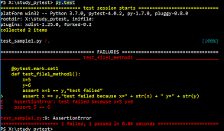
Exception using Pytest

Slide 22
Thank you

