Slide 1
Kiddoloco
A app to track the locations o

Slide 2
Scope
Real-time Location Tracking:The application will provide real-time updates on the child's location using GPS technology when they are outdoors and WiFi tracking when they are indoors.
Geofencing and Alerts:Parents can set up geofences around specific areas such as schools, parks, or home. They will receive instant notifications when their child enters or leaves these predefined zones.

Slide 3

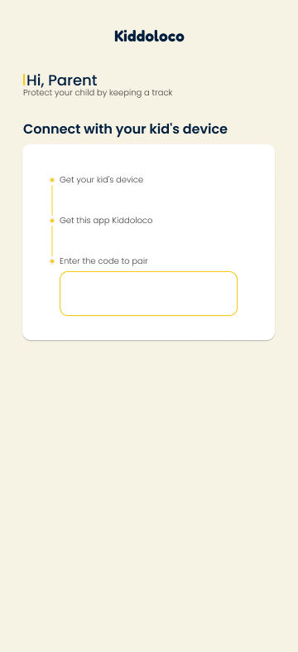
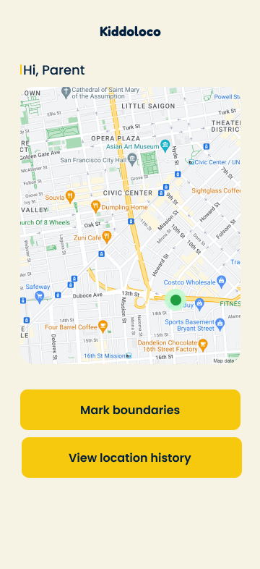

UI and UX

