Slide 1
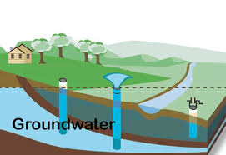
ANALYSIS OF
GROUND WATER-LEVEL AND ESTIMATION OF DISTRICT’S STAGE OF GROUND WATER DEVELOPMENT

Slide 2
PROBLEM STATEMENT
Groundwater is the major source of freshwater for drinking, irrigation and industrial purposes and has always been a hidden treasure because of its dynamic nature. The health of the groundwater system is reflected in the groundwater levels of the region. There is a need for analysis to understand the groundwater scenario and groundwater resources of regions to identify the districts/state which has been critical compared to other districts/states.

Slide 3

INTRODUCTION
Groundwater levels – District wise
Central Ground Water Board
Recharge – Through Natural [Rainfall]
Discharge – Irrigation , Domestic and Industry use
Stage of ground water development

Slide 4
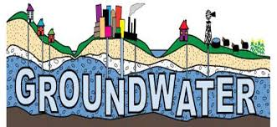
Analysis of Ground Water
Ground water levels have been monitored throughout the country
Critical position of a State /District
hard to justify the stages
" Prevention is better than cure"
There is need to forecast district's stage of ground water development

Slide 5

OBJECTIVE
To develop a model using Machine Learning Algorithms
Compare the accuracy among developed algorithms
To Predict district’s stage of ground water development

Slide 6
DATASET
STATE
District
Recharge from Rainfall during Monsoon season(Ham)
Recharge From Other Sources during monsoon season(Ham)
Recharge from Rainfall during non-monsoon season(Ham)
Recharge From Other Sources during non-monsoon season(Ham)
Annual Replenish able resources(Ham)
Annual Natural Discharge (Ham)
Net Annual Ground Water Availability (Ham)
Draft due to Irrigation Needs(Ham)
Draft due to Domestic & Industrial Water Supply Needs(Ham)
Total annual Draft(Ham)
Projected demand for Domestic and Industrial uses upto 2025 (Ham)
Ground Water Availability for Future Irrigation use (Ham)
Stage of Ground Water Development (%)

Slide 7
S.NO | STAGE OF GROUNDWATER DEVELOPMENT (%) | CATEGORISATION
1. | <=70% | SAFE
2. | >70% and <=90% | SEMI CRITICAL
3. | >90% and <=100% | CRITICAL
4. | >100% | OVER EXPLOITED

Slide 8
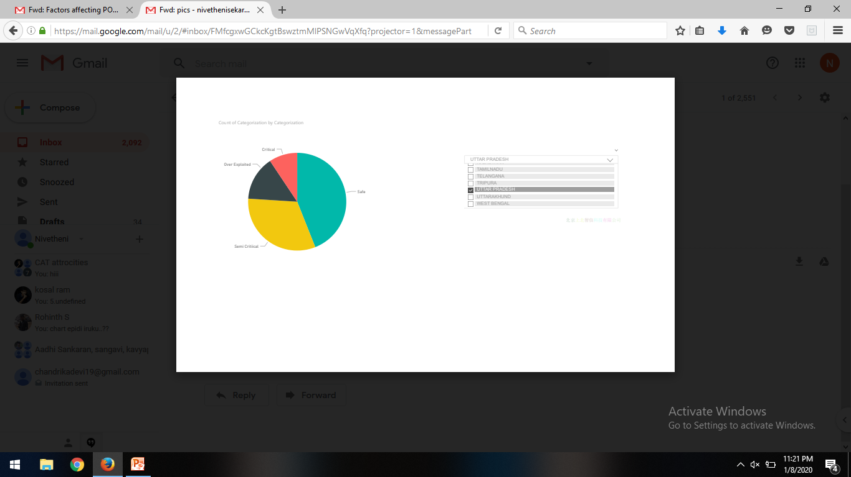
DATA VISUALIZATION

Slide 9
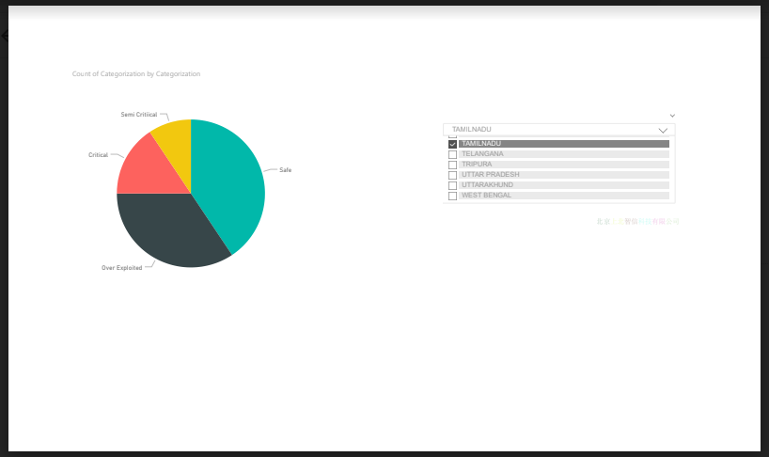

Slide 10
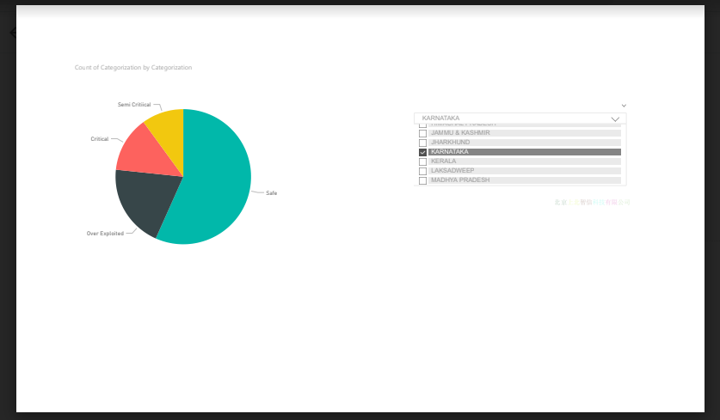

Slide 11

PREPROCESSING
Mean imputation
- Handling missing values
-Replacing with mean values.
- Maintains sample size.
Data wrangling(Data mungling)
-Transformation of data.
-Makes analytics easy.

Slide 12
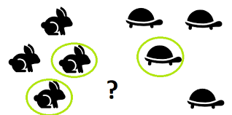
K-NEAREST NEIGHBOR
Supervised machine learning algorithm
Label – stages of ground water development
Training and Testing
Euclidean distance
K – square root (No. of observations)
Accuracy

Slide 13

DECISION TREE
Supervised machine learning algorithm
Tree structure representation
Continuous into discrete
Gini Index
Accuracy

Slide 14

RESULT
K-Nearest Neighbor Vs. Decision Tree
74%(approx.) 88%(approx.)

Slide 15
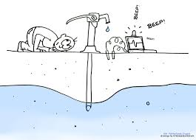
CONCLUSION
15 % of District is in Over Exploited position and 5% of District is in critical position.
Need to take some measures
Install rain water harvesting structures
reducing over usage of water
Public awareness program

