Slide 1

AI for Blockchain
Dr. Avinash Kumar Singh
avinash@intainft.com

Slide 2

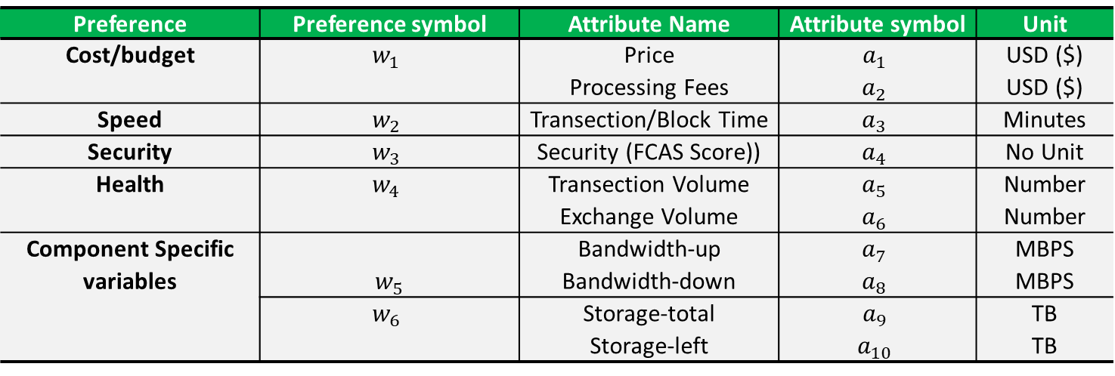
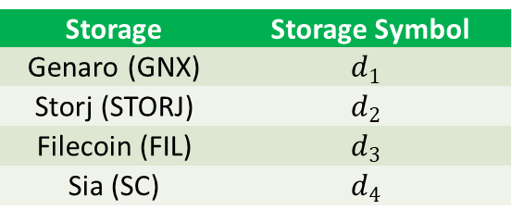
Dataset Representation
Preference and attribute information
Preference | Preference symbol | Attribute Name | Attribute symbol | Unit
Cost/budget | $$w_{1}$$ | Price | $$a_{1}$$ | USD ($)
 |  | Processing Fees | $$a_{2}$$ | USD ($)
Speed | $$w_{2}$$ | Transection/Block Time | $$a_{3}$$ | Minutes
Security | $$w_{3}$$ | Security (FCAS Score)) | $$a_{4}$$ | No Unit
Health | $$w_{4}$$ | Transection Volume | $$a_{5}$$ | Number
 |  | Exchange Volume | $$a_{6}$$ | Number
Component Specific variables | $$w_{5}$$ | Bandwidth-up | $$a_{7}$$ | MBPS
 |  | Bandwidth-down | $$a_{8}$$ | MBPS
 | $$w_{6}$$ | Storage-total | $$a_{9}$$ | TB
 |  | Storage-left | $$a_{10}$$ | TB
Storage tokens
Some insights
Storage | Storage Symbol
Genaro (GNX) | $$d_{1}$$
Storj (STORJ) | $$d_{2}$$
Filecoin (FIL) | $$d_{3}$$
Sia (SC) | $$d_{4}$$
Every storage tokens are summarized in terms of defined attribute, some attribute can have missing values.
Historical data for above attributes are given (date vs value representation)
A weightage between 1 to 10 is assigned for every preference variable.

Slide 3

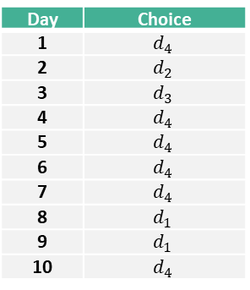
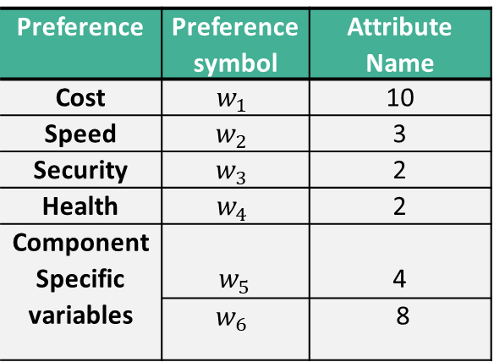
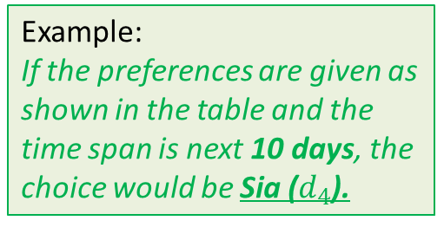
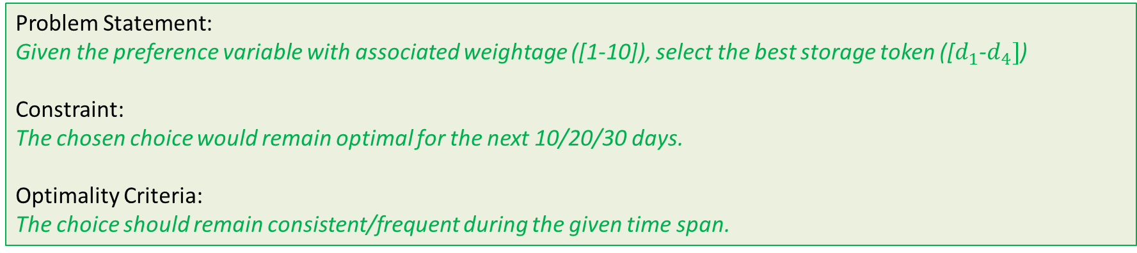
Problem Definition
Problem Statement:
Given the preference variable with associated weightage ([1-10]), select the best storage token ([$d_{1}$-$d_{4}]$)
Constraint:
The chosen choice would remain optimal for the next 10/20/30 days.
Optimality Criteria:
The choice should remain consistent/frequent during the given time span.
Example:
If the preferences are given as shown in the table and the time span is next 10 days, the choice would be Sia ($d_{4}$).
Preference | Preference symbol | Attribute Name
Cost | $$w_{1}$$ | 10
Speed | $$w_{2}$$ | 3
Security | $$w_{3}$$ | 2
Health | $$w_{4}$$ | 2
Component Specific variables | $$w_{5}$$ | 4
 | $$w_{6}$$ | 8
Next 10 days predictions at day-0
Day | Choice
1 | $$d_{4}$$
2 | $$d_{2}$$
3 | $$d_{3}$$
4 | $$d_{4}$$
5 | $$d_{4}$$
6 | $$d_{4}$$
7 | $$d_{4}$$
8 | $$d_{1}$$
9 | $$d_{1}$$
10 | $$d_{4}$$
Final Choice
$$Sia (d_{4})$$

Slide 4












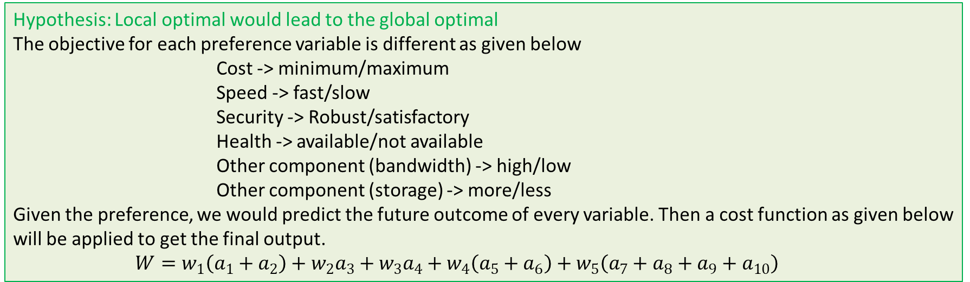
Solution Approach – Model 1
Hypothesis: Local optimal would lead to the global optimal
The objective for each preference variable is different as given below
Cost -> minimum/maximum
Speed -> fast/slow
Security -> Robust/satisfactory
Health -> available/not available
Other component (bandwidth) -> high/low
Other component (storage) -> more/less
Given the preference, we would predict the future outcome of every variable. Then a cost function as given below will be applied to get the final output.
${W=w}_{1}\left(a_{1}+a_{2}\right)+w_{2}a_{3}+w_{3}a_{4}+w_{4}\left(a_{5}+a_{6}\right)+w_{5}\left(a_{7}+a_{8}+a_{9}+a_{10}\right)$
Normalize each variable between 0-1
Calculate maximum likelihood
Apply Weightage

Slide 5
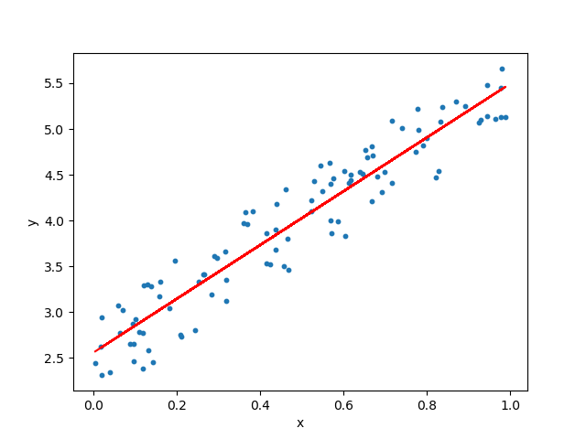
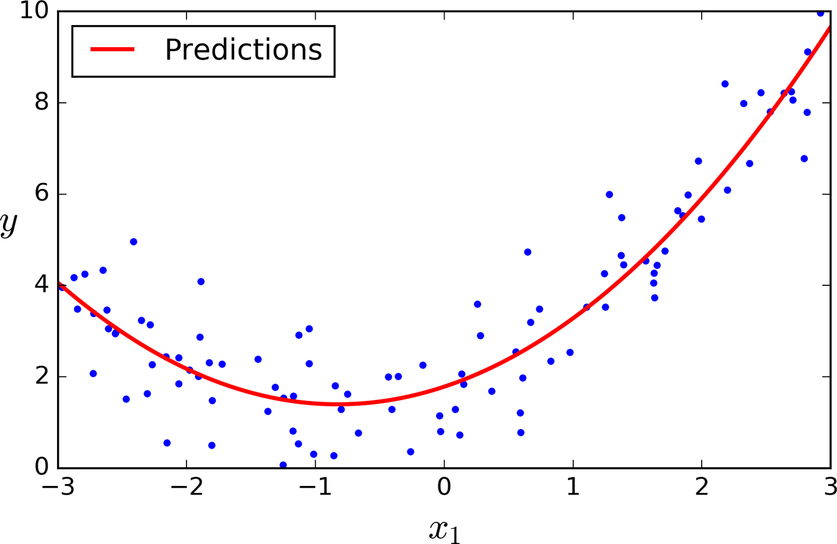
Prediction Model (ARIMA)
Objective: Estimate the function from the given historical data and apply it for the unseen sample.
ARIMA stands for Autoregressive Integrated Moving Average
It has three parameters
p is the number of autoregressive terms,
d is the number of nonseasonal differences needed for stationarity, and
q is the number of lagged forecast errors in the prediction equation.
An example of Linear Regression
An example of Non-Linear Regression

Slide 6
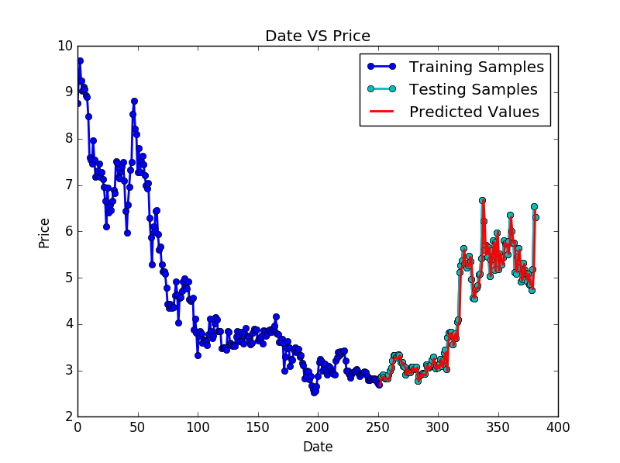
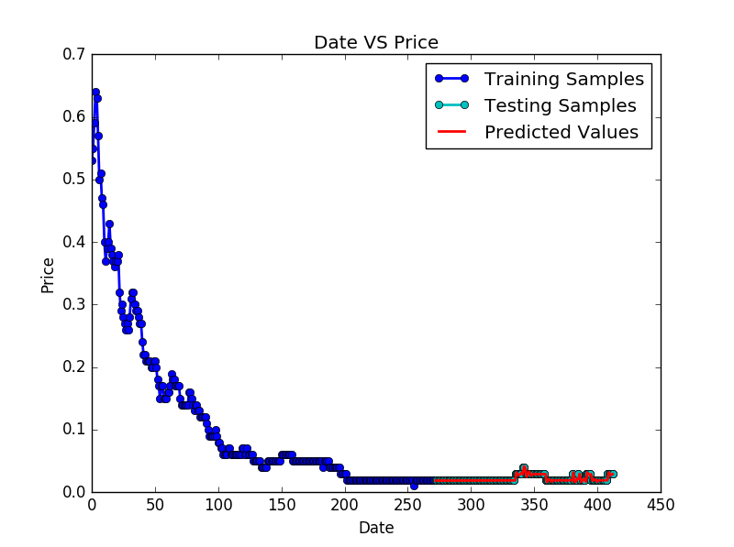
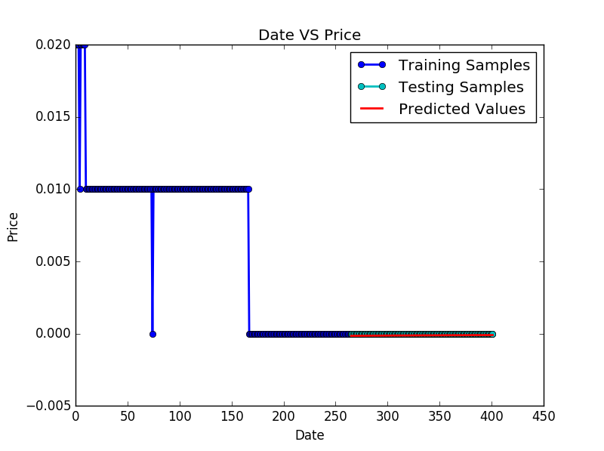
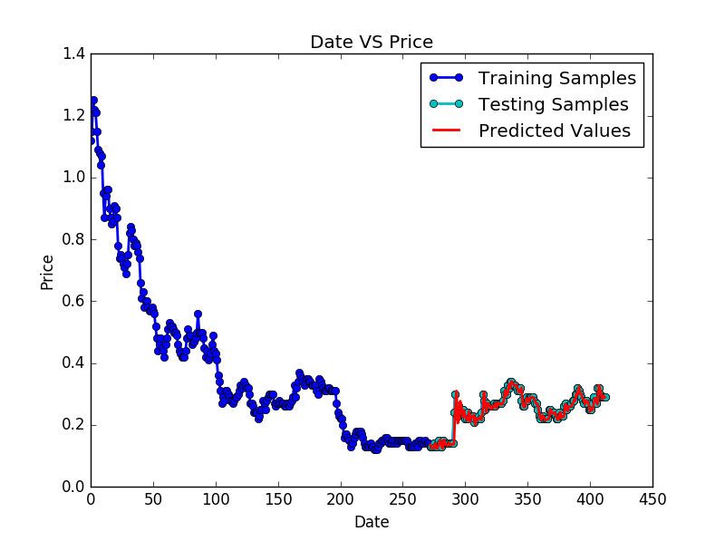
Cost Prediction
Filecoin:
MSE(0.094)
Genaro
MSE(0.0)
Sia:
MSE(0.0)
Storj:
MSE(0.0)

Slide 7
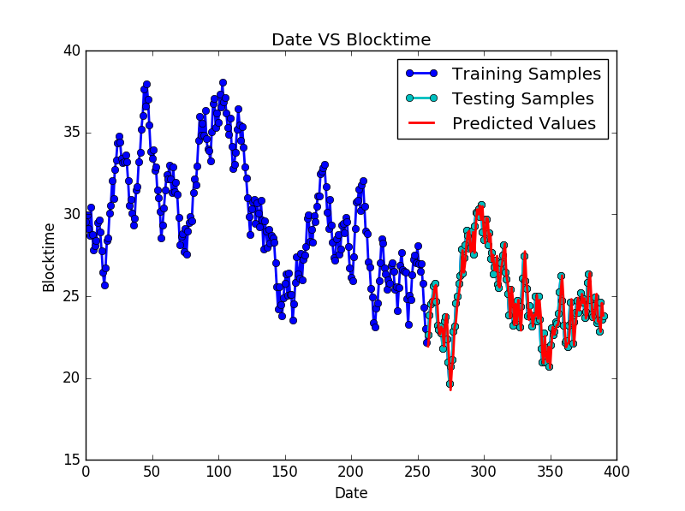
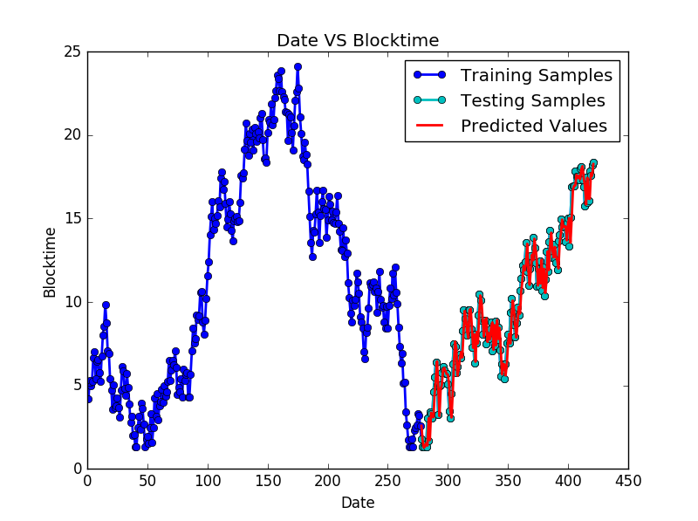
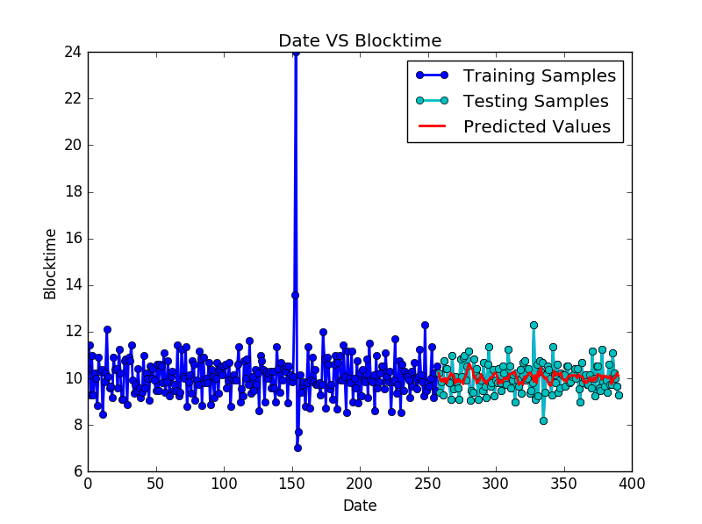
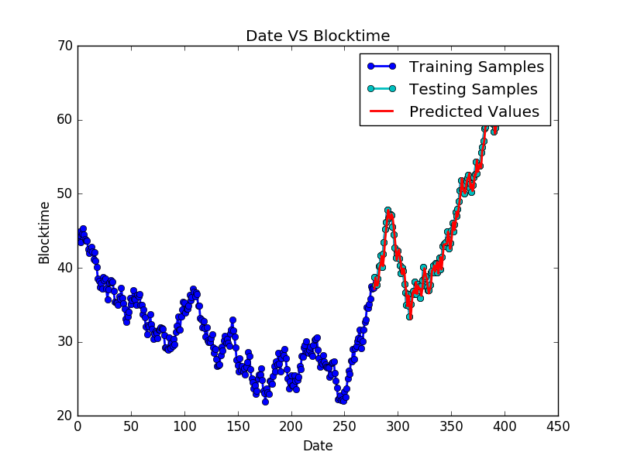
Blocktime Prediction
Filecoin:
MSE(1.126)
Genaro
MSE(1.080)
Sia:
MSE(0.437)
Storj:
MSE(1.358)

Slide 8

Cost Prediction
Every token has its own predictor function for predicting the variable outcome.
=
F(date)
Predicted Price
Input Date
Predictor Function
{Flipcoin_price, Genaro_price, Sia_price, Storj_price}
Normalize price between 0-1 (min-max reverse normalization)

Slide 9
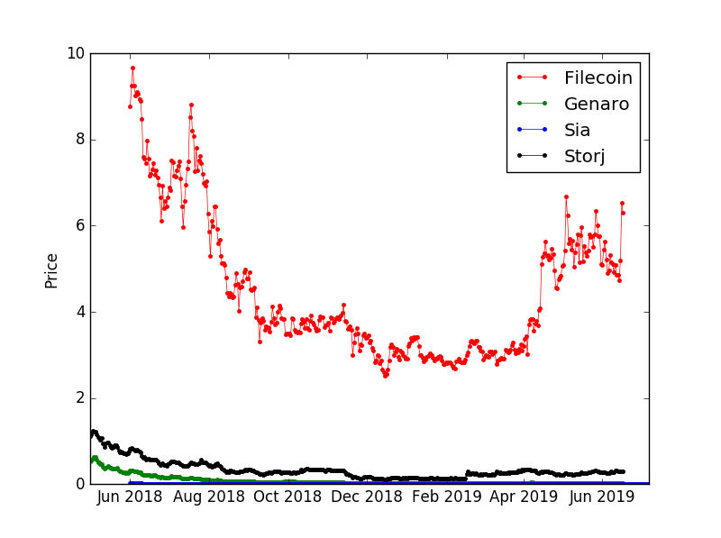
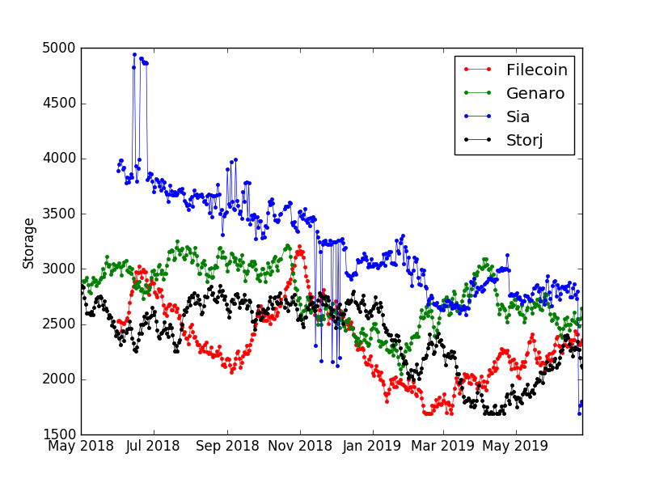
Cost Prediction
Every token has its own predictor function for predicting the variable outcome.
{Flipcoin_price, Genaro_price, Sia_price, Storj_price}
(8.77, 0.31, 0.02, 0.82)
Reverse Normalization
Maximum
Minimum
(0.0, 0.9668571428571429, 1.0, 0.9085714285714286)
Price
Storage
Normalization Methods: Stand deviation, variance, Mean-zero, min-max, etc

Slide 10
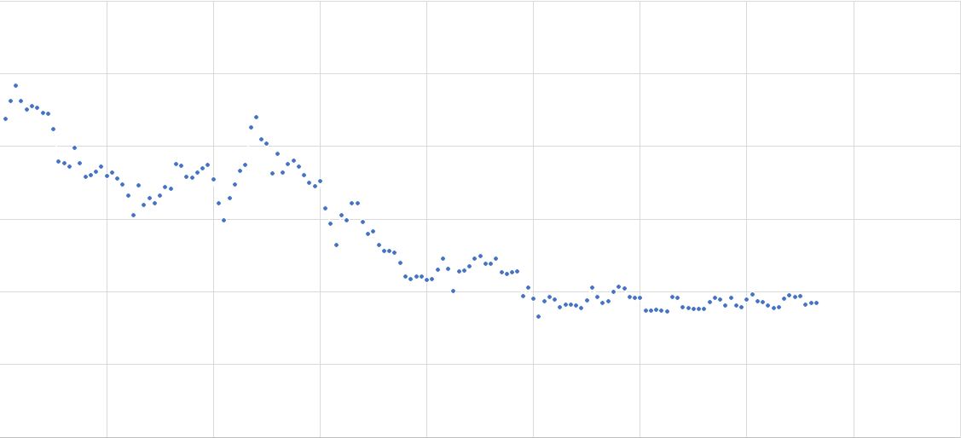
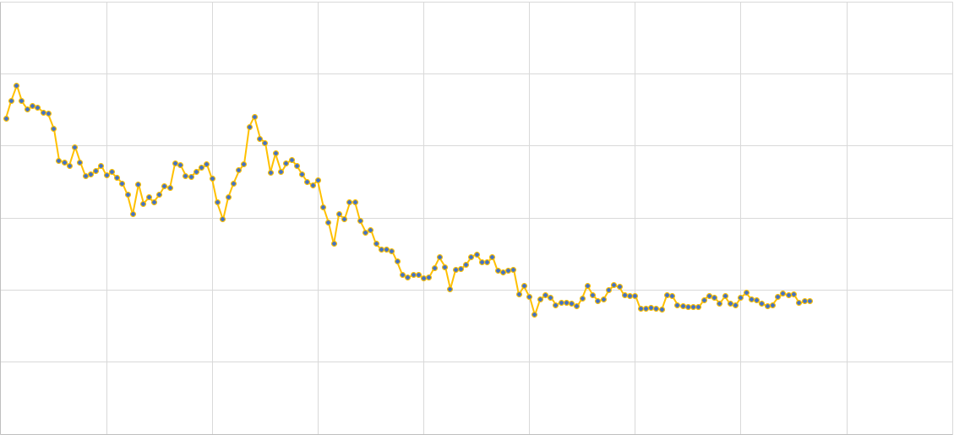
Prediction Model
Prediction Mechanism.
Price
Date

Slide 11
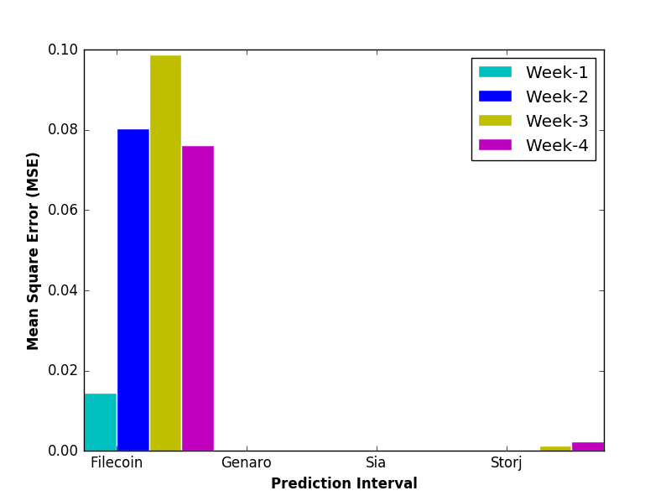
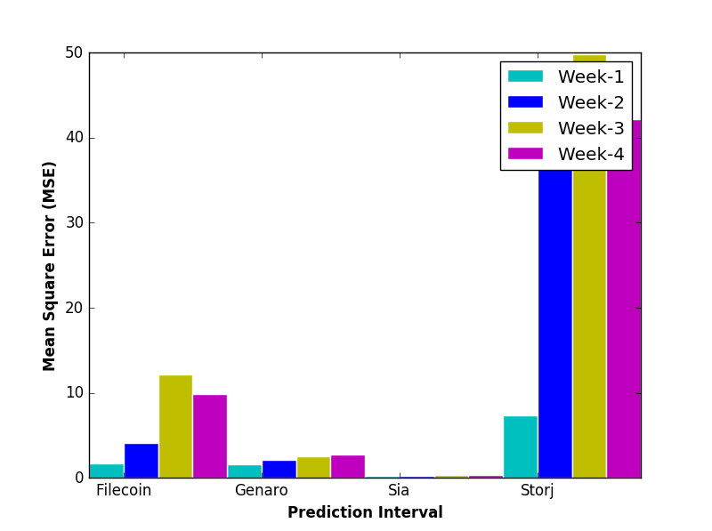
Model Sustainability
The sustainability is checked by injecting the last known point to predict new point and then evaluating the mean square error (MSE)
MSE | Filecoin | Genaro | Sia | Storj
First Week | 0.014587 | 0.000004 | 0.0 | 0.00015
Second Week | 0.080371 | 0.000017 | 0.0 | 0.000158
Third Week | 0.098779 | 0.000038 | 0.000001 | 0.001369
Fourth Week | 0.076201 | 0.000068 | 0.000001 | 0.00242
MSE | Filecoin | Genaro | Sia | Storj
First Week | 1.701214 | 1.563762 | 0.236007 | 7.320646
Second Week | 4.060722 | 2.121644 | 0.281034 | 36.847055
Third Week | 12.187062 | 2.56706 | 0.342001 | 49.84064
Fourth Week | 9.899688 | 2.768317 | 0.391895 | 42.154799
Blocktime Prediction
Price Prediction

Slide 12

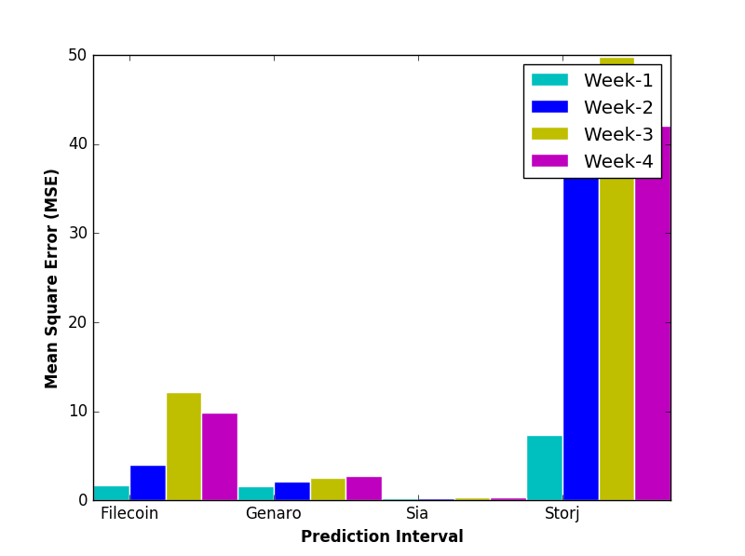
Model Sustainability
The sustainability is checked by injecting the prediction point to predict new point and then evaluating the mean square error (MSE)
MSE | Filecoin | Genaro | Sia | Storj
First Week | 0.01461546355 | 0.00000414 | 0.0000000823 | 0.0001492833754
Second Week | 0.08090968278 | 0.0000167 | 0.000000267 | 0.000156245659
Third Week | 0.0998695653 | 0.0000371 | 0.000000557 | 0.001375103734
Fourth Week | 0.07728157553 | 0.0000649 | 0.000000938 | 0.00245063226
MSE | Filecoin | Genaro | Sia | Storj
First Week | 1.702523 | 1.562672768 | 0.2360048556 | 7.317577396
Second Week | 4.052895 | 2.126407629 | 0.2810331541 | 36.81955595
Third Week | 12.160602 | 2.580502943 | 0.3420009324 | 49.78156275
Fourth Week | 9.874158 | 2.787956031 | 0.3918949451 | 42.08240053

Slide 13



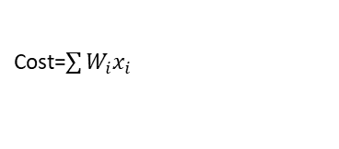
Constraint Optimization
There are possibly two kind of constraint exists.
Global Constraint: This is applicable to the final value (cost function), mainly act as selection.
Local Constraint: This implies on every day cost value, if the constraint disobeyed, it penalizes that token.
Constraint
Global
Local
Cost
Speed
Security
Health
Bandwidth
Storage
Input Variables
Cost=$\sum{W_{i}x_{i}}$
Penalty
Select the first token from the token ranking which satisfies the constraint
Constraint
Preference (Weights)

Slide 14
TO DO Next
Find the best parameter for the ARIMA model to minimize the mean square error.
Check the sustainability for other variables.
Adding constraints in the cost function to optimize the cost as per the set constraints.
To find other prediction models

Slide 15
Thank you

