Slide 1
PRODUCT REVIEW
SENTIMENT ANALYSIS
Detailed Technical Project Presentation
G. Srihari | 23BCB7055
Python • TF-IDF • Logistic Regression • Streamlit
Students: G. Srihari (23BCB7055) | Shaik Abdullah (23BCB7242)
Electrical, electronics and computer product reviews
G. Srihari (23BCB7055) | Shaik Abdullah (23BCB7242)

Slide 2
Project overview
A complete baseline pipeline from labelled review data to interactive prediction
• Classifies review text into Positive, Negative or Neutral sentiment.
• Uses a 300-row synthetic dataset balanced across three classes.
• Trains a TF-IDF + Logistic Regression pipeline with Scikit-learn.
• Saves the trained model, metrics, confusion matrix and test predictions.
• Provides a Streamlit interface for individual review analysis and dataset exploration.
2
G. Srihari (23BCB7055) | Shaik Abdullah (23BCB7242)
PRODUCT REVIEW SENTIMENT ANALYSIS | G. SRIHARI | 23BCB7055

Slide 3
Problem statement and objectives
• Manual review analysis is slow when many product opinions must be examined.
• Goal: automatically identify the polarity expressed in each review.
• Prepare and validate a labelled CSV dataset.
• Train and evaluate a reproducible three-class text classifier.
• Expose the model through a simple web application.
3
G. Srihari (23BCB7055) | Shaik Abdullah (23BCB7242)
PRODUCT REVIEW SENTIMENT ANALYSIS | G. SRIHARI | 23BCB7055

Slide 4
Dataset profile
Statistics computed from data/input/product_reviews_sample.csv
300
Total review records
10
Product categories
3
Sentiment classes
• 100 positive, 100 negative and 100 neutral examples.
• CSV fields: product_category, review_text, sentiment, data_origin.
• All rows are marked synthetic_demo; they are not genuine marketplace reviews.
4
G. Srihari (23BCB7055) | Shaik Abdullah (23BCB7242)
PRODUCT REVIEW SENTIMENT ANALYSIS | G. SRIHARI | 23BCB7055

Slide 5
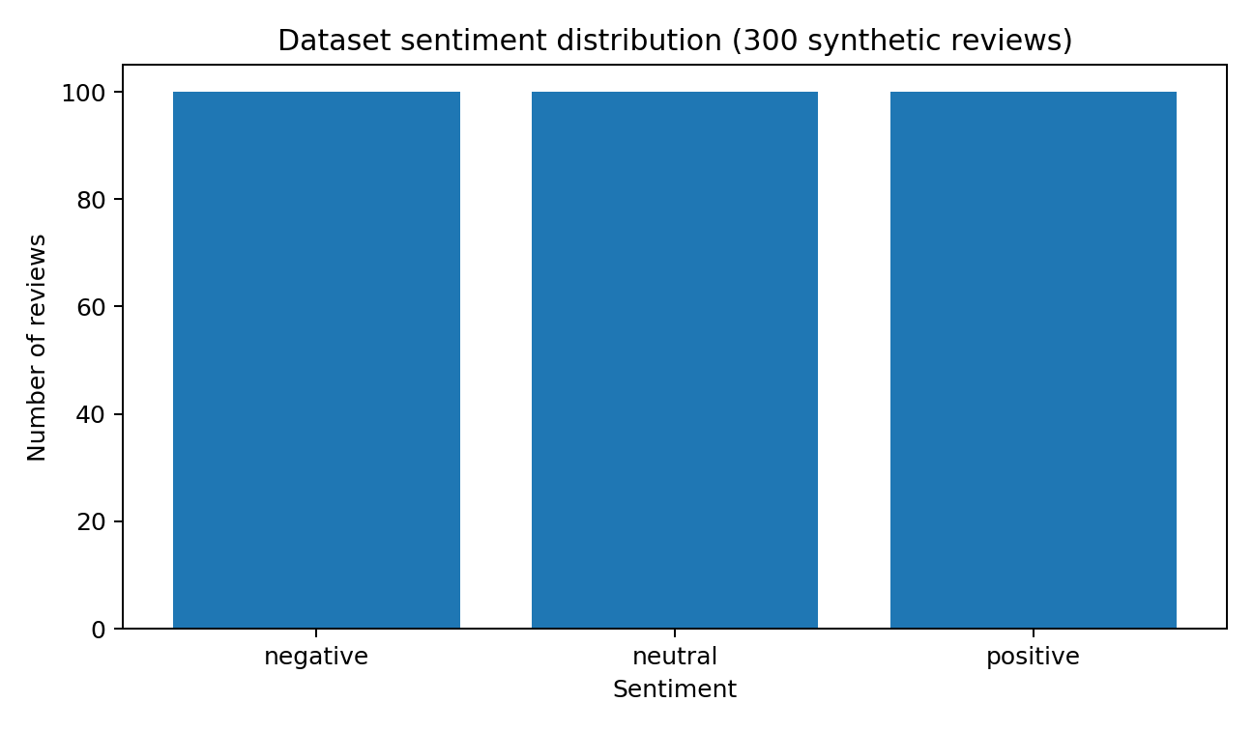
Sentiment distribution
100 records in each class; source: submitted input CSV.
5
G. Srihari (23BCB7055) | Shaik Abdullah (23BCB7242)
PRODUCT REVIEW SENTIMENT ANALYSIS | G. SRIHARI | 23BCB7055

Slide 6
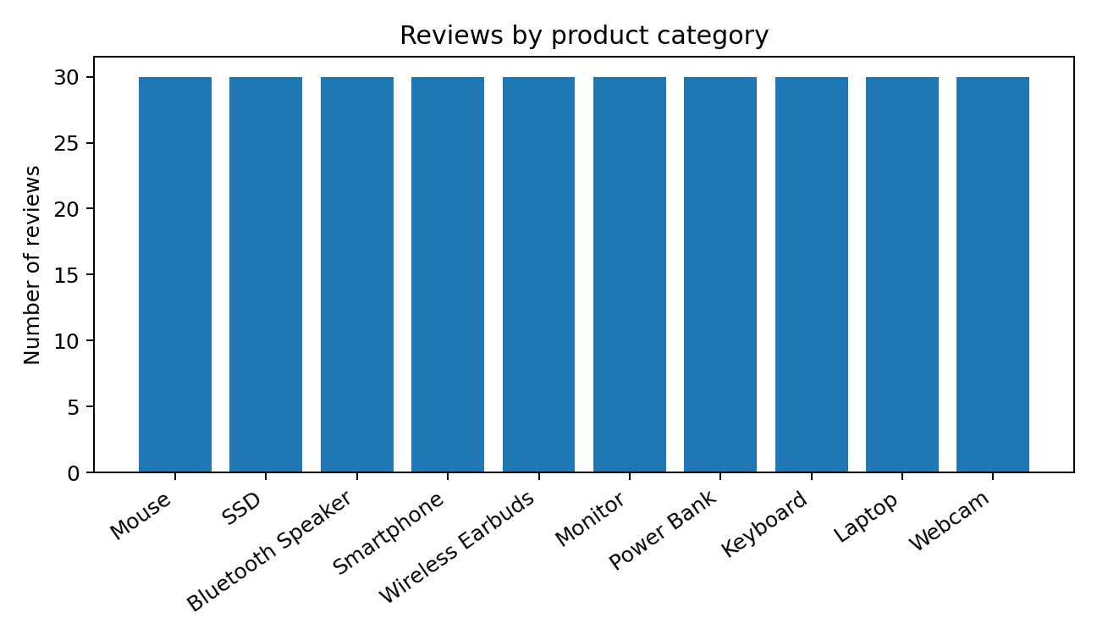
Product category coverage
30 synthetic review examples per category.
6
G. Srihari (23BCB7055) | Shaik Abdullah (23BCB7242)
PRODUCT REVIEW SENTIMENT ANALYSIS | G. SRIHARI | 23BCB7055

Slide 7
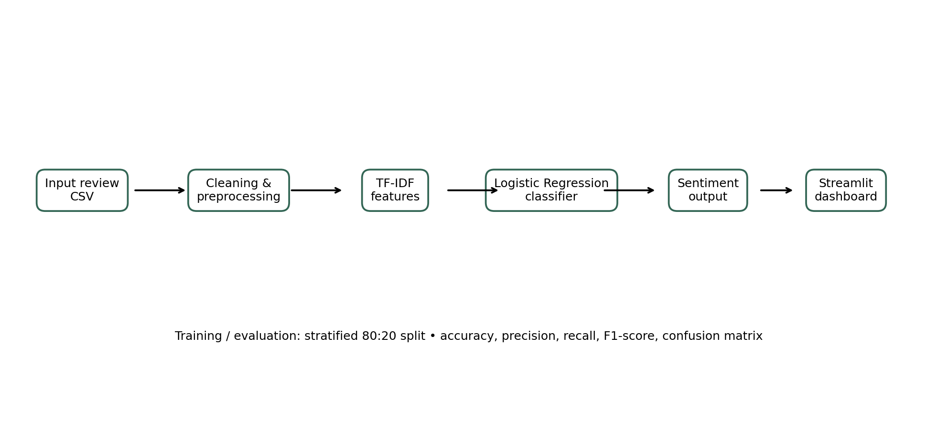
System architecture
Architecture graphic included in the submitted project ZIP.
7
G. Srihari (23BCB7055) | Shaik Abdullah (23BCB7242)
PRODUCT REVIEW SENTIMENT ANALYSIS | G. SRIHARI | 23BCB7055

Slide 8
Training methodology
Implementation details from src/train.py
• Load CSV with Pandas; validate review_text and sentiment columns.
• Drop rows missing either required field.
• Stratified 80:20 train/test split; random_state = 42.
• TF-IDF: lowercase, unigrams + bigrams, max_features = 12,000, sublinear_tf = True.
• Logistic Regression: max_iter = 1,000, class_weight = balanced.
• Fit a Scikit-learn Pipeline and serialize it with joblib.
8
G. Srihari (23BCB7055) | Shaik Abdullah (23BCB7242)
PRODUCT REVIEW SENTIMENT ANALYSIS | G. SRIHARI | 23BCB7055

Slide 9
Code highlight – model pipeline
Excerpt from the submitted src/train.py
model = Pipeline([
('tfidf', TfidfVectorizer(
lowercase=True,
ngram_range=(1, 2),
max_features=12000,
sublinear_tf=True
)),
('classifier', LogisticRegression(
max_iter=1000,
class_weight='balanced',
random_state=42
))
])
model.fit(X_train, y_train)
9
G. Srihari (23BCB7055) | Shaik Abdullah (23BCB7242)
PRODUCT REVIEW SENTIMENT ANALYSIS | G. SRIHARI | 23BCB7055

Slide 10
Training and test split
Actual counts from saved metrics.json
240
Training records
60
Test records
• 80% training / 20% testing.
• Stratification preserves the sentiment proportions.
• Test set: 20 negative, 20 neutral and 20 positive records.
10
G. Srihari (23BCB7055) | Shaik Abdullah (23BCB7242)
PRODUCT REVIEW SENTIMENT ANALYSIS | G. SRIHARI | 23BCB7055

Slide 11
Evaluation results
Values read from data/output/metrics.json
100%
Test accuracy
• Precision: 1.00 for each sentiment class.
• Recall: 1.00 for each sentiment class.
• F1-score: 1.00 for each sentiment class.
• Support: 20 test examples per class.
• Macro average and weighted average: 1.00.
11
G. Srihari (23BCB7055) | Shaik Abdullah (23BCB7242)
PRODUCT REVIEW SENTIMENT ANALYSIS | G. SRIHARI | 23BCB7055

Slide 12
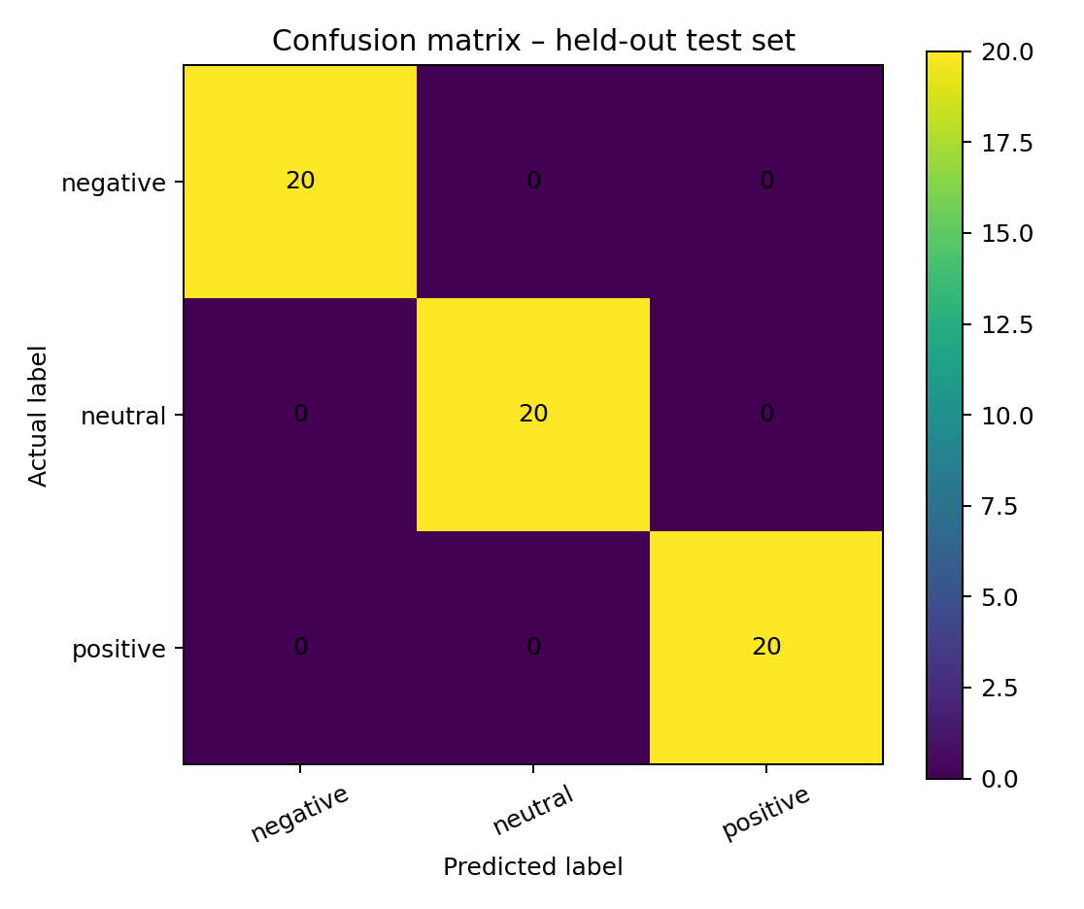
Confusion matrix
All 60 synthetic test records were correctly classified in this saved run.
12
G. Srihari (23BCB7055) | Shaik Abdullah (23BCB7242)
PRODUCT REVIEW SENTIMENT ANALYSIS | G. SRIHARI | 23BCB7055

Slide 13
Sample test predictions
Rows selected from submitted data/output/test_predictions.csv
Review excerpt | Actual | Predicted
Battery drains quickly and performance is slow. Overall, I di... | negative | negative
Received a defective item. Would not recommend. | negative | negative
Clear sound and comfortable design. Very satisfied. Overall, ... | positive | positive
Amazing product, delivery was quick and packaging was good. | positive | positive
Battery life is great and setup was simple. Overall, I like it. | positive | positive
13
G. Srihari (23BCB7055) | Shaik Abdullah (23BCB7242)
PRODUCT REVIEW SENTIMENT ANALYSIS | G. SRIHARI | 23BCB7055

Slide 14
Streamlit application
Functionality implemented in app.py
• Tab 1 – Analyze a review: text area, Analyze sentiment button and predicted label.
• Displays the largest class probability as a model confidence score.
• Shows class probability values in a bar chart.
• Tab 2 – Explore dataset: review count, category count and sentiment class count.
• Displays sentiment distribution and up to 30 rows of the sample dataset.
• Loads the serialized model from models/sentiment_model.joblib.
14
G. Srihari (23BCB7055) | Shaik Abdullah (23BCB7242)
PRODUCT REVIEW SENTIMENT ANALYSIS | G. SRIHARI | 23BCB7055

Slide 15
How to run the project locally
pip install -r requirements.txt
python src/train.py
streamlit run app.py
The training script regenerates the model and evaluation files; the Streamlit app loads the saved model.
15
G. Srihari (23BCB7055) | Shaik Abdullah (23BCB7242)
PRODUCT REVIEW SENTIMENT ANALYSIS | G. SRIHARI | 23BCB7055

Slide 16
Limitations and honest interpretation
• Dataset is synthetic demonstration data, not genuine customer feedback.
• Only 300 rows and 60 held-out test examples are available.
• Repeated/formulaic wording can make synthetic classification easier than real reviews.
• Sarcasm, context, spelling variation, multilingual text and mixed opinions remain challenging.
• 100% test accuracy is not a claim of real-world or production performance.
16
G. Srihari (23BCB7055) | Shaik Abdullah (23BCB7242)
PRODUCT REVIEW SENTIMENT ANALYSIS | G. SRIHARI | 23BCB7055

Slide 17
Future enhancements
• Use a larger, licensed and representative real-world review dataset.
• Remove duplicate/template leakage and evaluate on a genuinely independent test set.
• Compare Logistic Regression with Linear SVM and Naive Bayes.
• Add CSV batch upload, downloadable predictions and category-wise dashboards.
• Calibrate prediction confidence and route ambiguous reviews for human review.
17
G. Srihari (23BCB7055) | Shaik Abdullah (23BCB7242)
PRODUCT REVIEW SENTIMENT ANALYSIS | G. SRIHARI | 23BCB7055

Slide 18
Conclusion
• Implemented a complete baseline text-classification workflow.
• Integrated Pandas, TF-IDF, Logistic Regression, joblib and Streamlit.
• Generated reproducible test predictions, metrics and confusion matrix.
• The saved run scores 100% on the synthetic 60-row test set only.
• Real-world effectiveness requires evaluation on genuine, representative product reviews.
18
G. Srihari (23BCB7055) | Shaik Abdullah (23BCB7242)
PRODUCT REVIEW SENTIMENT ANALYSIS | G. SRIHARI | 23BCB7055

Slide 19
Repository and project artifacts
github.com/srihari20032006/Product-Review-Sentiment-Analysis
• src/train.py – training and evaluation code
• app.py – Streamlit user interface
• data/input – original sample dataset
• data/intermediate – preprocessed review data
• data/output – metrics, confusion matrix and test predictions
• models – serialized trained pipeline
• docs – architecture, report and presentation
19
G. Srihari (23BCB7055) | Shaik Abdullah (23BCB7242)
PRODUCT REVIEW SENTIMENT ANALYSIS | G. SRIHARI | 23BCB7055

Slide 20
G. Srihari (23BCB7055) | Shaik Abdullah (23BCB7242)

Slide 21
THANK YOU
Questions & Discussion
G. Srihari | 23BCB7055
Shaik Abdullah 23BCB7242
G. Srihari (23BCB7055) | Shaik Abdullah (23BCB7242)

