Slide 1

SSP Course Project End Submission
End Of Phrase Detection
PROF. ANIL KUMAR VUPPALA
TEAM
Srihari Bandarupalli : 2021112006
Jalluri Ram Gopal: 2021102013
Monsoon 2023
1
November 17th, 2023

Slide 2
R
S
Agenda
i) | MID PRESENTATION | 3
ii) | METHOD AND APPROACH-I | 6
iii) | METHOD AND APPROACH-II | 7
iv) | DATASET | 8
v) | OBSERVATIONS | 9
vi) | METHOD AND APPROACH-III | 11
vii) | METHOD AND APPROACH-IV | 14
viii) | REFERENCES | 10
Monsoon 2023
2
November 17th, 2023

Slide 3
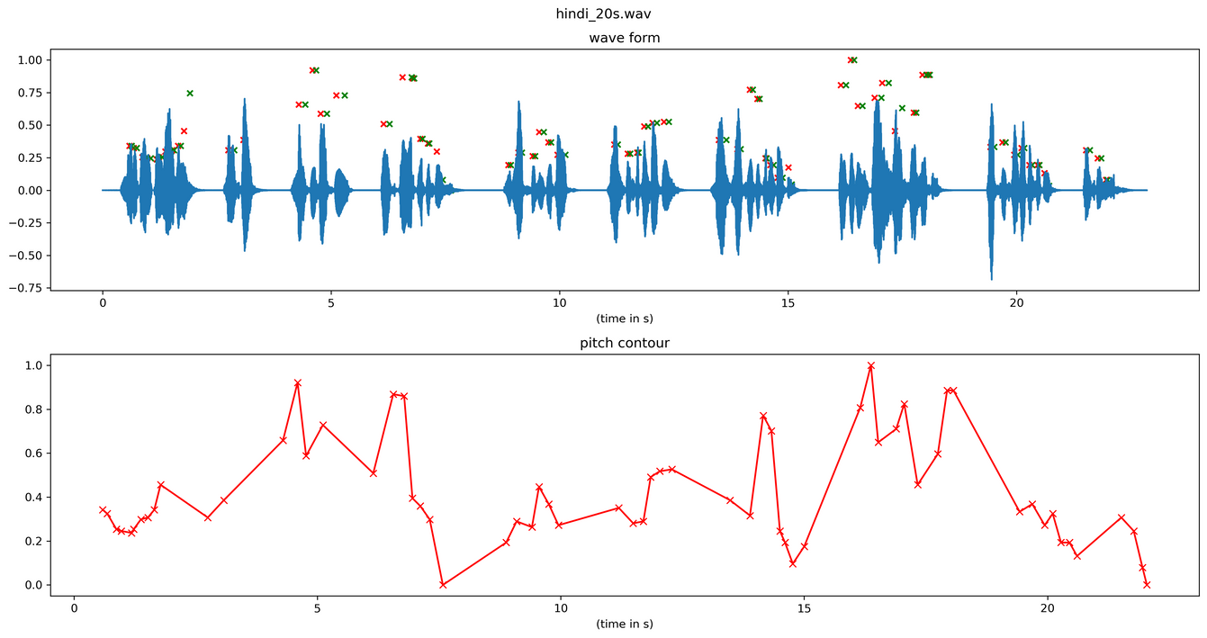
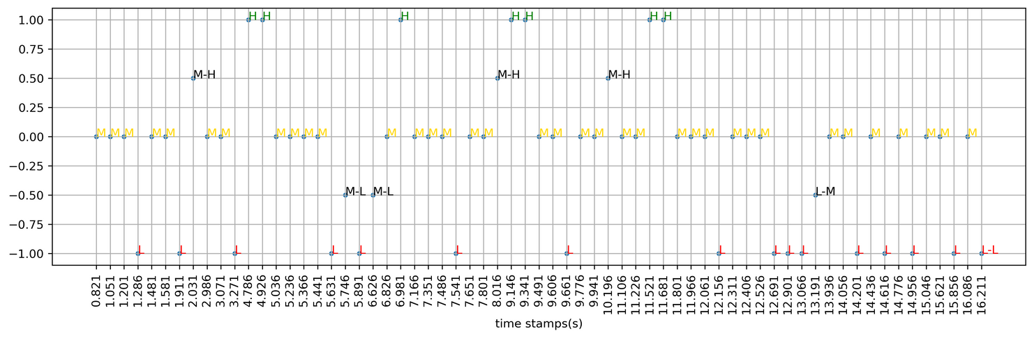
i) Mid Presentation
Hindi Example (20 s)
Pitch Contour
Prosogram
We have quantized the Pitch Contour into H,M and L to create a Prosogram
Monsoon 2023
3
November 17th, 2023

Slide 4
i) Mid Presentation
Till Mid evaluation
Up until the mid-evaluation, our primary focus was to find some trends in prosogram which will help us detect the punctuations in the telugu audio files.
But the main problem we faced with telugu data was that there were too many variations in the prosogram even within a word, which made it vary difficult to observe any trends manually
Monsoon 2023
4
November 17th, 2023

Slide 5
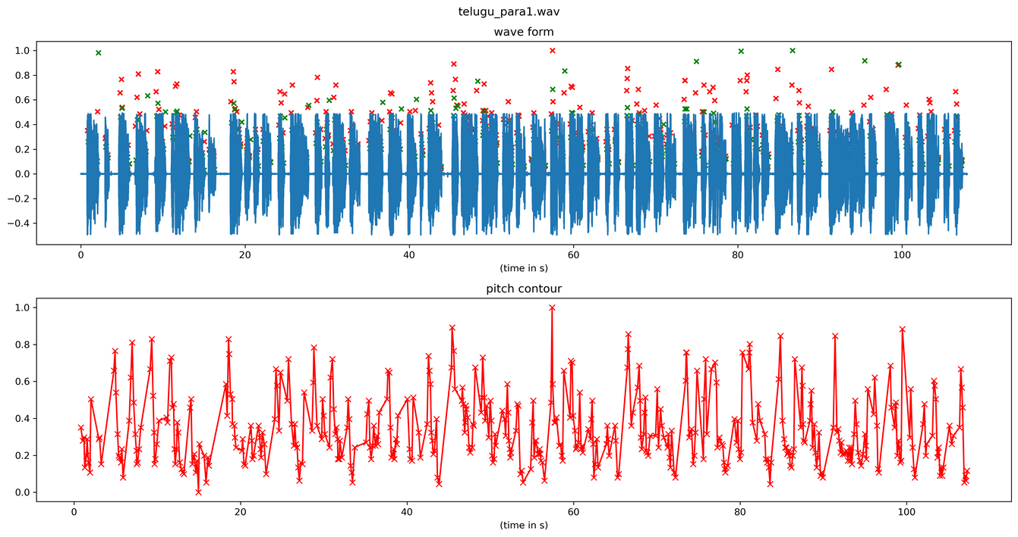
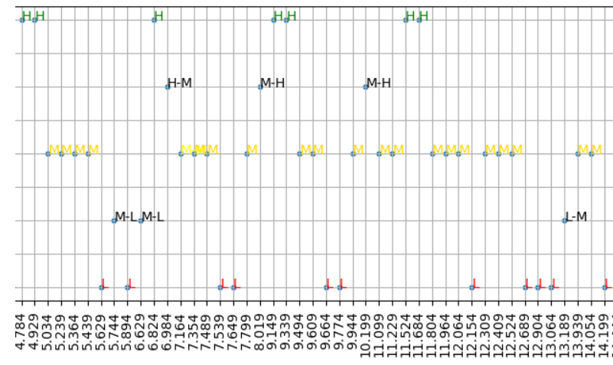
i) Mid Presentation
Telugu Example
Pitch Contour
Prosogram
We have quantized the Pitch Contour into H,M and L to create a Prosogram
Monsoon 2023
5
November 17th, 2023

Slide 6




ii) Method and Approach - I
R
S
Method and Approach - I
Our first approach was to analyse only those parts of prosogram which are close to silence regions as there is a more likely chance of end of phrase there
But we discarded this idea, as this involves a silence detection block which fails in cases of noise and might add additional error to our model.
Monsoon 2023
6
November 17th, 2023

Slide 7
iii) Method and Approach - II
R
S
Method and Approach - II
Our next idea was to try to predict punctuations directly from the prosogram by using the below features for each sample
But for this we needed at least a few paragraphs of annotated data for analysing the trends
Monsoon 2023
7
November 17th, 2023

Slide 8
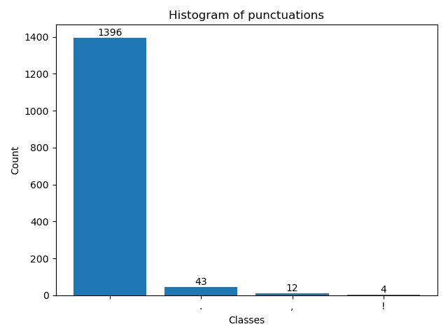
iV) Dataset
R
S
Mann - ki - Baat Telugu Audio
We have taken we telugu audio files from PM Modi’s Man ki baat in telugu and have manually annotated to mark the punctuation marks.
We have considered only “,” and “.” punctuations
Monsoon 2023
8
November 17th, 2023

Slide 9
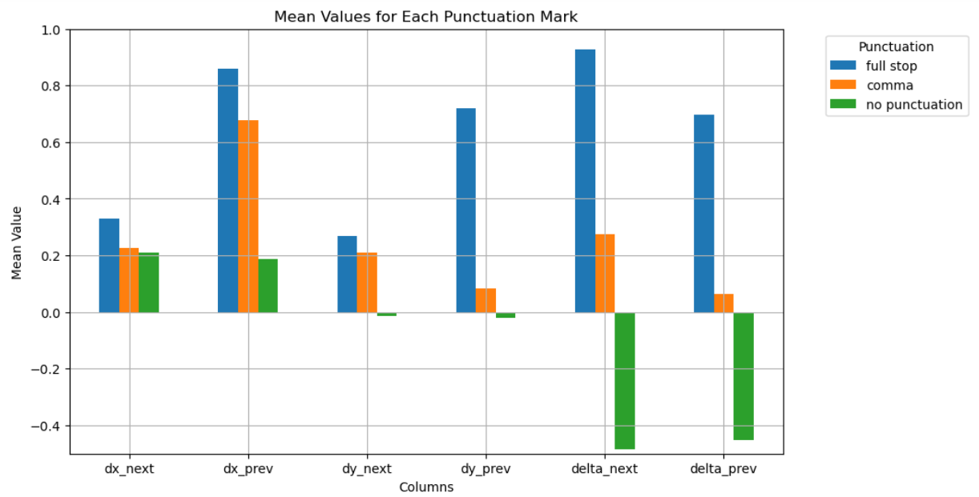
v) Observations
R
S
Observation
We have observed the following on the dataset that we annotated
Monsoon 2023
9
November 17th, 2023

Slide 10
v) Observations
R
S
Observation
End of phrase means presence of unvoiced region. But some pauses can be present in the speech which should not be recognized as end of phrase.
Mainly for Telugu speech, we can observe end of phrase occurs after the appearance of a vowel.
Hence, we can use VOP detection algorithm and can add a constraint that for end of phrase detection, pitch trend and vowel occurrence both must be followed.
Monsoon 2023
10
November 17th, 2023

Slide 11
vi) Method and Approach - IIII
R
S
Method and Approach
For VOP detection, we used modulation spectrum procedure from the reference paper, “Vowel Onset Point Detection for Low Bit Rate Coded Speech”.
Here, we tried to build a model which is trained by the information related to pitch and VOP’s near the end of phrase as feature parameters.
Monsoon 2023
11
November 17th, 2023

Slide 12
vi) Method and Approach - IIII
Method and Approach
Features used from pitch contour: Pitch Label(end of phrase), next label, previous label and their respective time stamps.
Features used from VOP: VOP instance(nearest to the end of phrase region), next VOP instant and previous VOP instance.
We have extracted above features and tried to plot them.
Monsoon 2023
12
November 17th, 2023

Slide 13
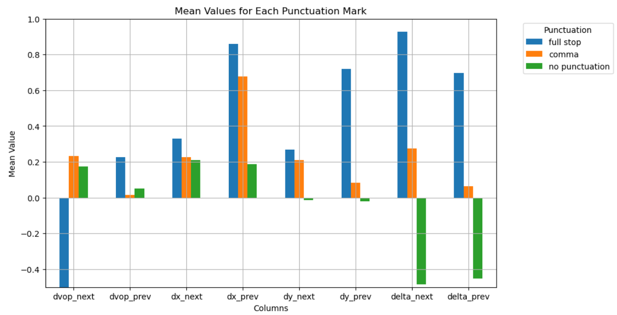
vi) Method and Approach - IIII
Method and Approach
Monsoon 2023
13
November 17th, 2023

Slide 14
vii) Method and Approach - IV
Method and Approach
From the previous plot we can set some thresholds directly and predict the end of phrases, but we have just plotted averages of the entire dataset and that might not represent the classes correctly.
We then tried to see if an ML Model like Random Forest regressor which can handle imbalanced data could predict the punctuation marks
Monsoon 2023
14
November 17th, 2023

Slide 15
vii) Method and Approach - IV
Method and Approach
Since we have very limited data , we have used cross validation where each paragraph is taken as test each time to find the accuracy with which we can predict the end of a phrase.
We have tried building model both with and without VOP features, but we got similar accuracy of around 65%.
However we can’t take this accuracy to be the accuracy of our model considering that our train dataset and test datset are very small, so thre might be overfitting.
Monsoon 2023
15
November 17th, 2023

Slide 16
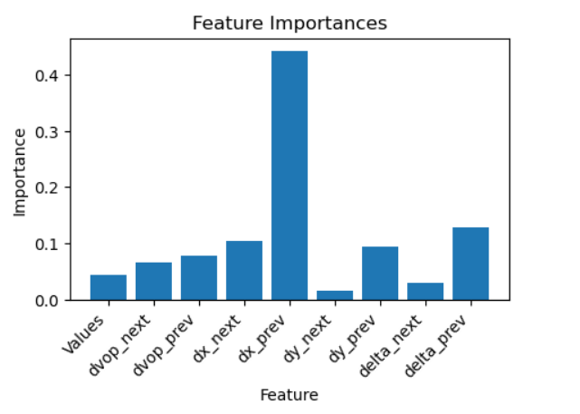
vii) Method and Approach - IV
Method and Approach
Additionaly for the random forest classifier , we have analysed how important each feature was in predicting the end of phrase.
As we can see from the graph some of the important features are duration gap between the current and previous sample in the pitch contour and the slope at which the pitch is changing
Monsoon 2023
16
November 17th, 2023

Slide 17
vii) Further Plan
Further Plan
Extracting more features from the data:
We can explore what other features can be added in order to get better predictions
Creating a Bigger Dataset:
We can expect much better results if the model has enough data to train.
Monsoon 2023
17
November 17th, 2023

Slide 18
viii) References
References
Tanmai Khanna, Ganesh Mirishkar, Dipti M. Sharma, Anil K. Vuppala. Exploring the role of pitch in predicting clause and sentence boundaries. R & D Showcase 2020.
Monsoon 2023
10
November 17th, 2023

Slide 19
THANK YOU
TEAM
Srihari Bandarupalli : 2021112006
Jalluri Ram Gopal: 2021102013
Monsoon 2023
11
November 17th, 2023

