Slide 1
BStack
Under The Guidance of Vaishali Sonanis mam

Slide 2
INTRODUCTION
Browser Stack is a cloud testing platform that allows developers and testers to test websites and mobile applications across different browsers, operating systems and real devices.

Slide 3
OVERVIEW
What is BStack?
Browser Stack is a cloud-based testing platform that enables developers and testers to test website and mobile applications on real browsers and devices without maintaining physical infrastructure.
My project is a demo setup using Browser Stack.
It helps users understand how cross-browser and cross-device testing works.
Browser Stack provides instant access to thousands of browsers, operating systems and mobile devices.
It supports both manual and automated testing, with integrations for Selenium, TestNG, Junit, Appium and CI/CD tools.

Slide 4
MODULES
MODULE-1: LOGIN
Checked the functionalities of username and password in the sign in page for login.
5 user types: demouser, image_not_loading_user, existing_orders_user, fav_user and locked_user.
MODULE-2: ADD TO CART
Checked the functionality of add to cart button by adding an item to the cart.
MODULE-3: REMOVE FROM CART
Checked the functionality of remove from cart by removing an item from the cart.

Slide 5
MODULE-4: CHECKOUT
Check the functionality of checkout by buying an item from the cart.
MODULE-5: SEARCH MULTIPLE ITEMS
Checked the functionalities of search buttons by searching multiple items.
MODULE-6: SHOP BY BRANDS
Checked the functionalities of vendors button by selecting different company phones.
MODULE-7: ORDER BY
Checked the functionality of order by button by changing lower to higher and higher to lower.
If we click lower to higher then products should be arranged in ascending order according to price.
If we click higher to lower then products should be arranged in descending order according to price.

Slide 6
MODULE-8: FAVOURITES
Checked the functionality of favourites button by adding items to favourites.
MODULE-9: OFFERS
Checked the functionality of offers button
MODULE-10: PRIVACY POLICY
Checked the functionality of privacy policy button
MODULE-11: LOGOUT
Checked the functionality of logout button

Slide 7
DEFECTS
Search Engine is not working.
Privacy Policy Read More is not navigating to policy page.
Subscribe mail is not sending mails.
Product images are not clickable.

Slide 8
DEFECT REPORT
Defect Identifier | Def_001
Defect Summary | Expected result is when we click on “Search” product list shows iPhone or related products, but it is navigating to the home page Search engine is not working.
Test ID | TC_001, TC_002, TC_003
Test Case Name | Search_Valid, Search_Invalid, search_Blank
Module Name | Search
Reproducible | When we search iPhone in search Product list shows iPhone or related products
Severity | High
Priority | High
Raised By | Srihari
Assigned To | Developer
Date Of Assignment
Status | Pending
Fixed By | Developer
Date Of Fixing

Slide 9
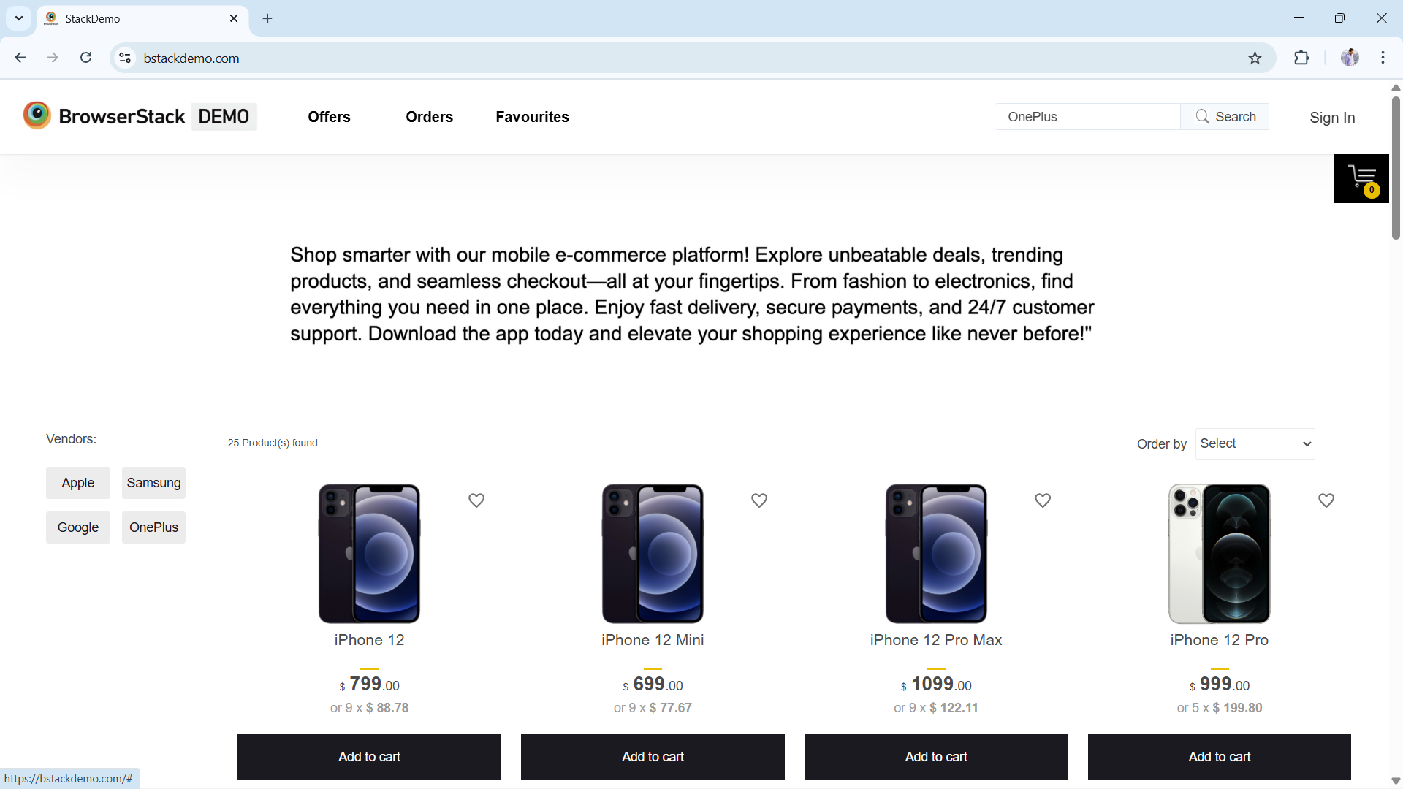

Navigating To Home Page

Slide 10
Defect Identifier | Def_002
Defect Summary | Expected result is when we click on “Privacy Policy Read More” it need to navigate to the privacy policy page, but it is navigating to home page.
Test ID | TC_001
Test Case Name | Privacy_Policy_Read_More and Subscription
Module Name | Privacy Policy
Reproducible | When we click on “Privacy Policy Read More” it need to navigate to the privacy policy page.
Severity | Medium
Priority | Medium
Raised By | Srihari
Assigned To | Developer
Date Of Assignment
Status | Pending
Fixed By | Developer
Date Of Fixing

Slide 11
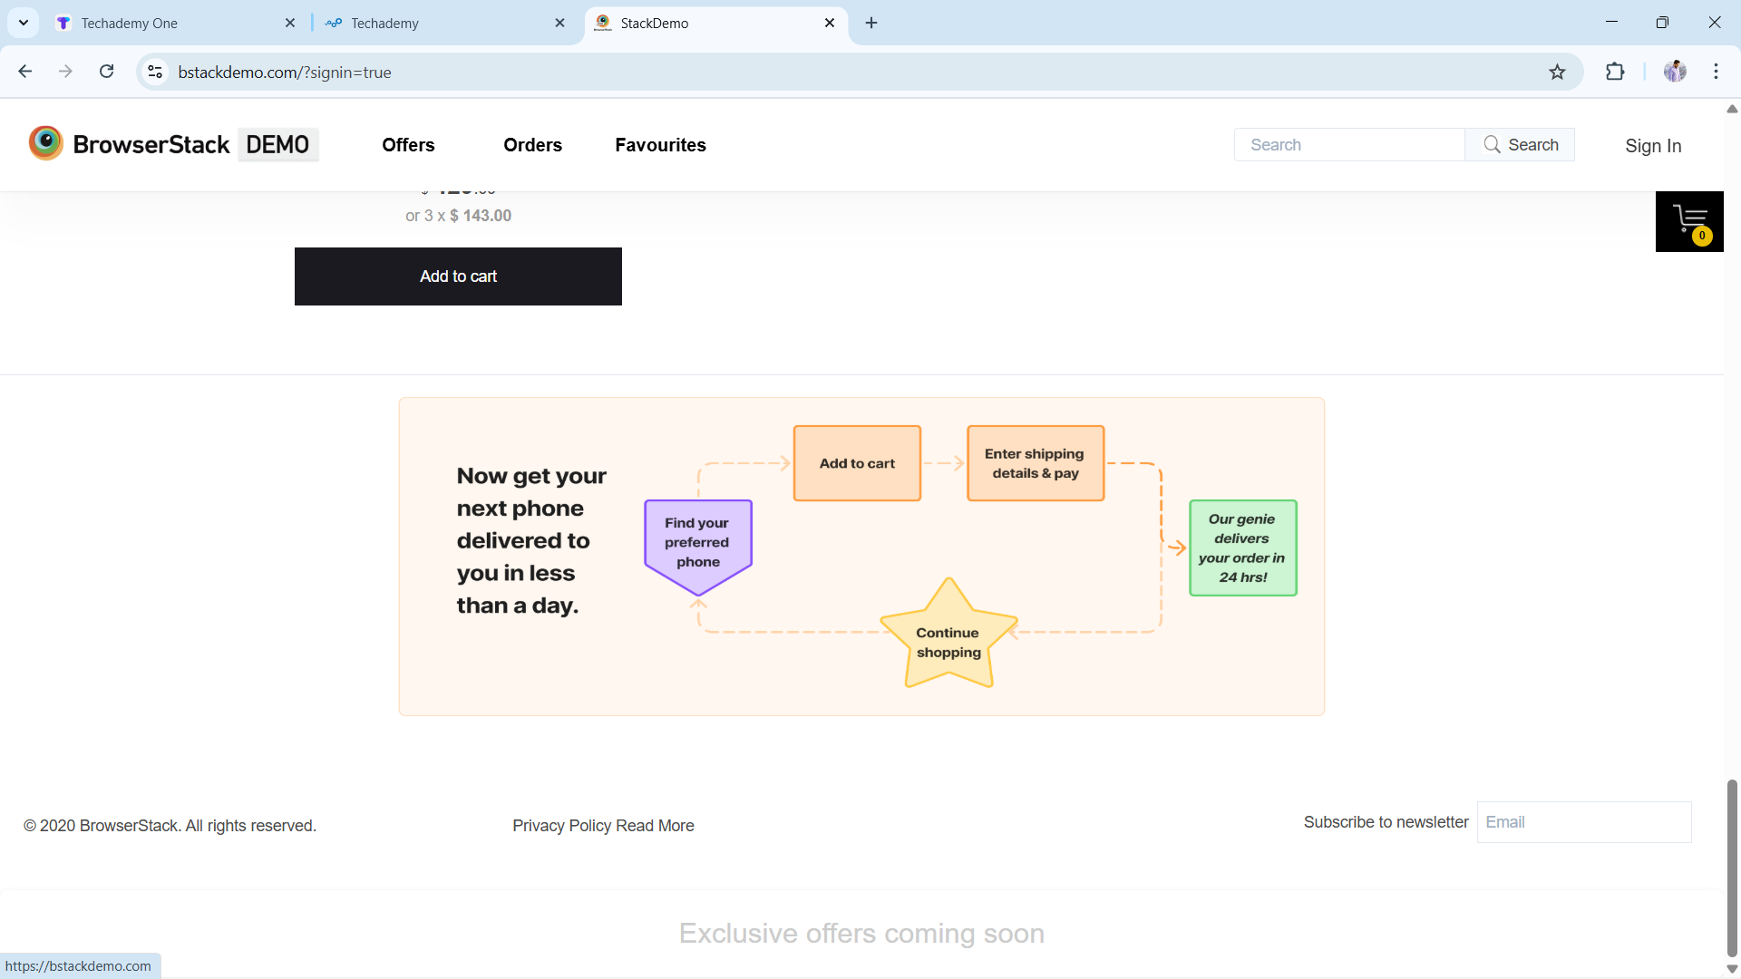
Navigating To Home Page

Slide 12
Defect Identifier | Def_003
Defect Summary | Expected result is when we click on subscribe mail it need to send subscription mail to mail box but no mail is found.
Test ID | TC_002
Test Case Name | Subscribe to news letter
Module Name | Privacy_Policy_Read_More and Subscription
Reproducible | When we click on subscribe mail it need to send subscription mail to mail box.
Severity | Medium
Priority | Medium
Raised By | Srihari
Assigned To | Developer
Date Of Assignment
Status | Pending
Fixed By | Developer
Date Of Fixing

Slide 13
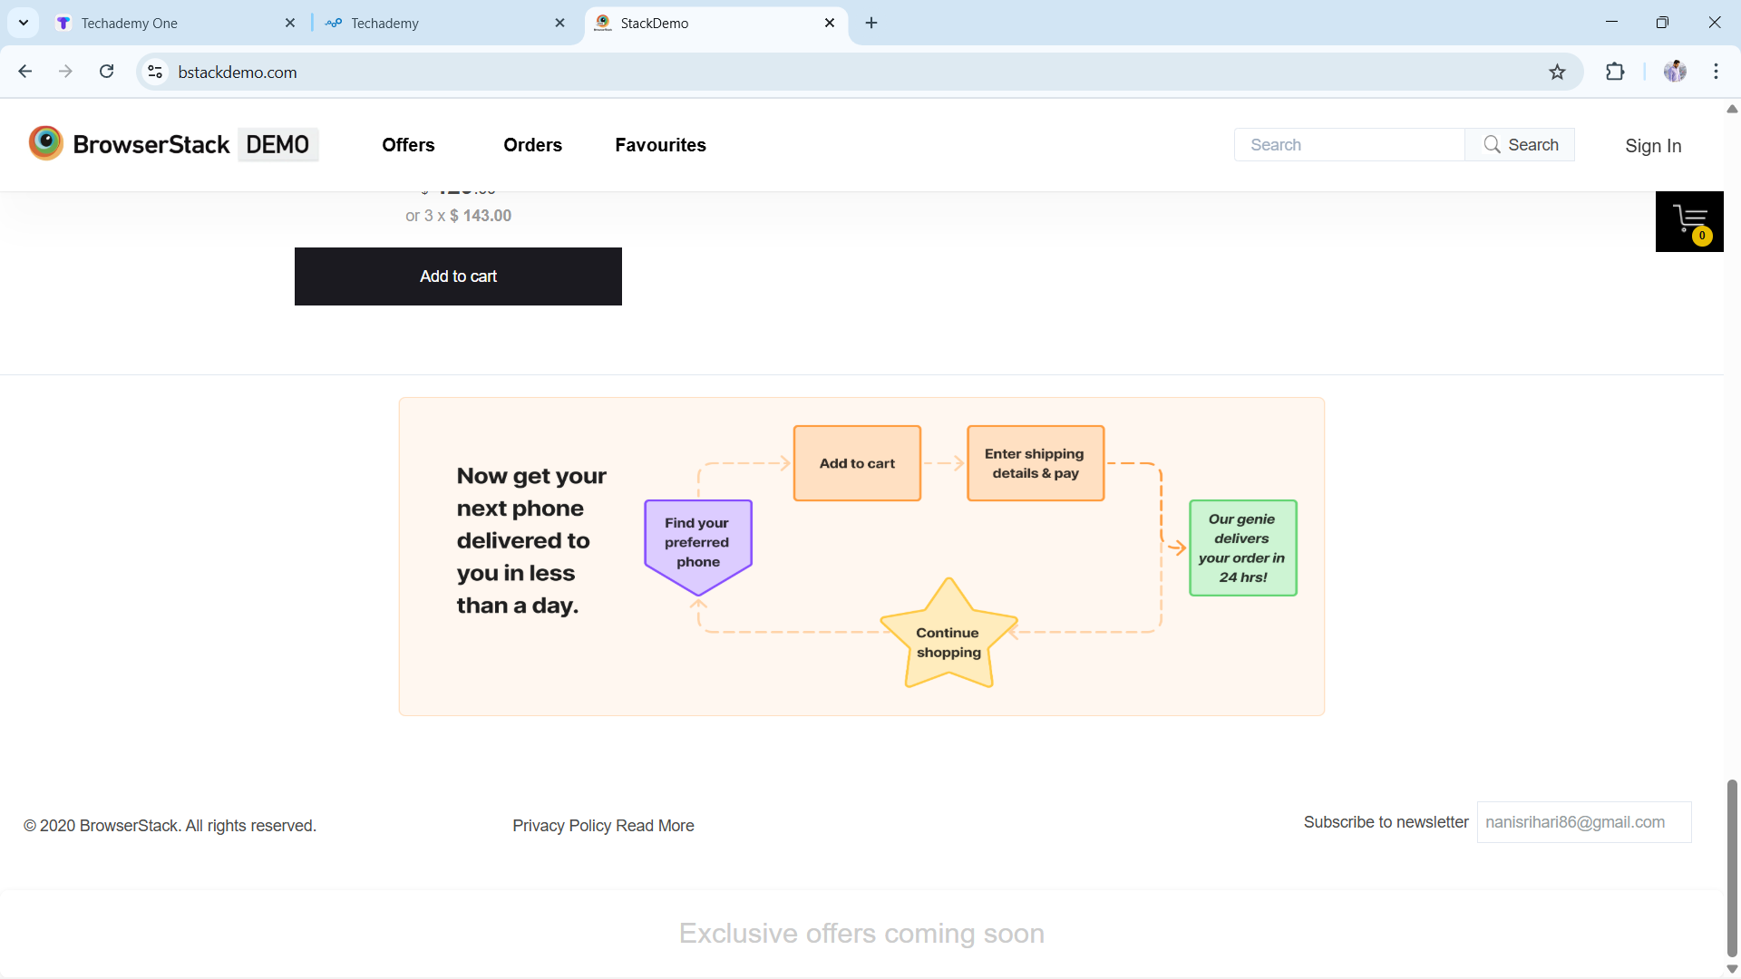
Navigating To Home Page

Slide 14
CHALLENGES
Login module was bit difficult because of locators.
Sometimes the automation flow was fails because of timeout exception.
Sometimes the automation flow was fails because of slow and unstable network.
Multiple Cart module also little bit tricky because of locators and timeout exception.

Slide 15
EXPERIENCE
Gained Hands-On experience in E-Commerce Testing by working on BStack Demo shop.
Learned to write and execute automation test cases for product listing , search, cart and checkout flows.
Faced real-world challenges like captcha/verification , network issues and element synchronization during automation.

Slide 16
THANK YOU

