Slide 1

Capstone Project
Predicting House Prices in KING COUNTY

Slide 2
Agenda
01
Define the Problem
.
02
Exploratory data analysis
03
Data pre processing
04
MODELLING

Slide 3
Introduction
Our goal for this project was to use regression techniques in order to estimate the sale price of a house in King County, Washington given the feature and pricing data for around 21,000 houses sold within one year.

Slide 4
About Dataset
Our dataset contains house sale prices and its features for homes sold in King County, Washington between May 2014 and May 2015.
King County is the most populous county in Washington and is included in the Seattle-Tacoma-Bellevue metropolitan statistical area. The county is considered the 13th most populous county in the United States.
There are 21,613 observations in the dataset.
There are 23 total attributes in the dataset, four of which we derived from current columns.

Slide 5
Data pre-processing
01 – Visual Analysis
02 - Pre-processing
03 – Missing values
04-Duplicates
A majority of the fields found in the King County housing dataset were deemed acceptable for performing our statistical analyses. However, while traversing the data we found that some of the columns needed to have their data types adjusted to meet our needs.
We found that we needed to create new columns. New columns, essential for analysis, were created by applying new formulae on existing variables.
Not considering the features cid and dayhours for Descriptive Stats as will not be of any help in giving value add information
05 - Outliers
During cleaning and pre-processing, we created four attributes derived from other attributes:
sold_year
sold_month
house_age
age_after_renovation
The attribute "price" is the Target variable which also known as dependent variable
We checked for missing variables and the dataset didn’t contain any.
There are duplicate rows based on the cid’s. There are 353 duplicate rows. All these duplicate rows have same values except price.
Removed the duplicates and the no of observations are 21436
Outliers were detected and analyzed using the Outlier Boxplots. From the outliers boxplot we inferred that the data consists of many outliers for the target variable, Price. However, the outliers for price variable corresponded to outliers for
Number of Bedrooms, Number of Bathrooms and Square Feet Living. On further investigation, we inferred that these outliers correspond to High values of Grade, Condition, and View. Hence, we concluded that these outliers are legitimate outliers and we decided to retain them in the data.

Slide 6
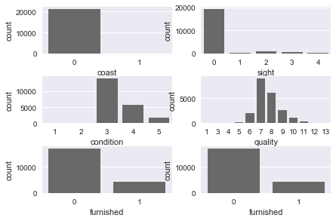
Feature Engineering
There are 353 duplicate rows. All these duplicate rows have same values except price.
Basement has the high(60%) percentage of zero values. However when clarified the attribute "basement" is having 0 indicates not every house will have the basement. Hence it is a valid value
The other features such as furnished, year-renovated, coast, sight will have no impact because feature
furnished - Valid option to represent status
Coast - Valid option to represent status
sight - Valid option to represent status
yr-renovated - Valid option to represent status
Not considering the features cid and dayhours for Descriptive Stats as will not be of any help in giving value add information.
Majority of houses are not facing the waterfront
Majority of the houses are sold with no customer visits
Majority of the houses belong to condition 3 followed 4 & 5
Most of the houses belong to quality 7 followed by 8

Slide 7
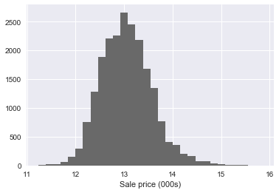
Price Analysis (target)
Sale prices look more normally distributed

Slide 8
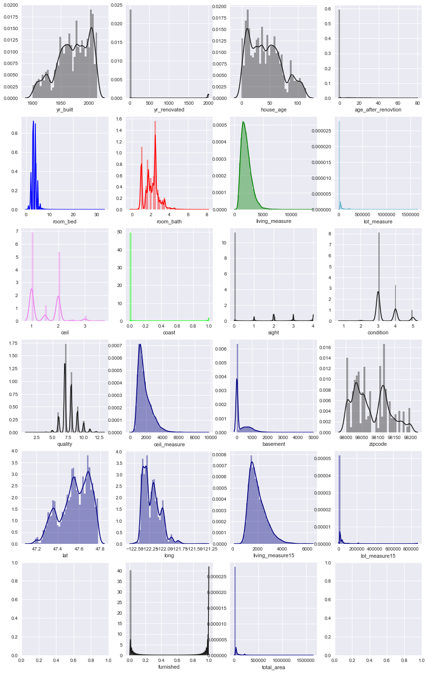
Univariate Analysis
Majority of houses are not facing the waterfront
Majority of the houses are sold with no customer visits
Majority of the houses belong to condition 3 followed 4 & 5
Most of the houses belong to quality 7 followed by 8
The most often occurrence of floors is 1 and then 2.
2.5 is the most often number of bathrooms in the building, then one bathrooms
Number of bathrooms higher than 3.5 are rare cases as well as 0.75 and 1.25.
we can see that majority of properties do not have a basement

Slide 9
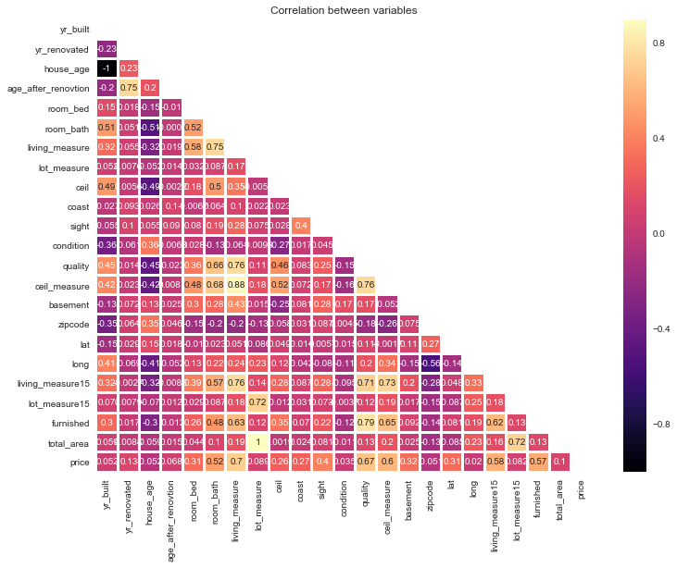
Multivariate Analysis
Based on our correlation matrix
The following independent variables
No of bedrooms
Bathrooms
Overall square footage
Sight visits
quality
furnished
are highly correlated with price

Slide 10
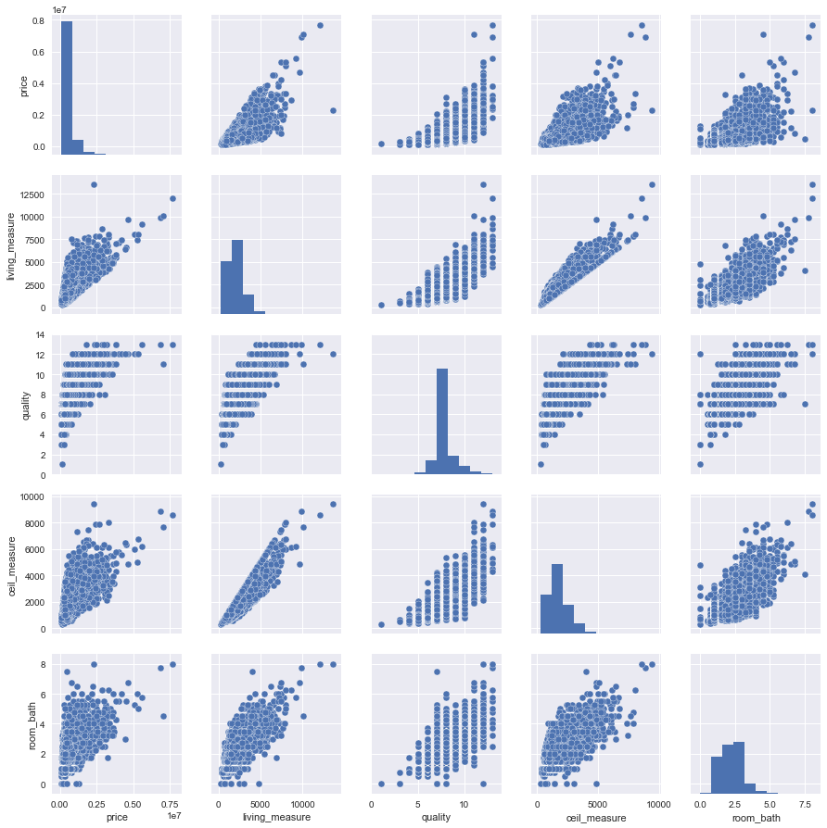
Multivariate Analysis
There is myriad of linear correlation between sqft_living, sqft_above, bathrooms and grade.
The relationship between price and condition shows that at condition 1 and 2 have similar price distributions as well as conditions 3, 4 and 5. Similar situation we have with price vs condition.
We see that from floor 1 to 2.5 price increasing and then drops at floor 3 and 3.5. Similar situation with relationship floors and living area
Number of bathrooms has uptrend with price and living area as bedrooms with price and and living area
Correlation between living area and price is positive moderate with coefficient 0.68. Only 0.02 is needed to be classified as positive strong correlation.

Slide 11
Project analysis slide 2
Longitude and Latitude Analysis
Arial View of Top 2 Quality Housing areas
Arial View of the King County Houses facing the Water Front
Arial View of High Cost Houses Spread
High cost houses (Green) are densely populated in middle of King County area
Almost half of King County houses belong to quality 7 & 8, while quality 7 houses (Blue) dominating in the county
Very few houses in King County area are facing the Water Front (Marked in Blue)
The latitudes and longitudes in the dataset points to the location of the houses in the King County Village of Washington, lies on the north east of North America
3 Rated houses(Blue) spread across the KingCount area, followed by 4(Green) & 5 (Black)
Arial View of Top 3 Rated Housing Categoies

Slide 12
Project analysis slide 2
Feature engineering
Geo location analysis using latitudes and longitudes to identify high price locations, addresses of high cost houses, quality house areas and also able to create new gold feature by visualizing the house price outliers
Created new column representing Premium house if the cost of house (> 1128000)
Created new column representing house age

Slide 13
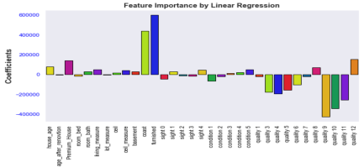
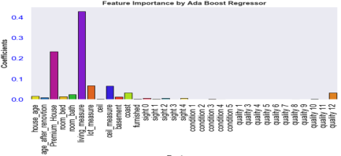
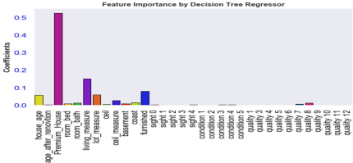
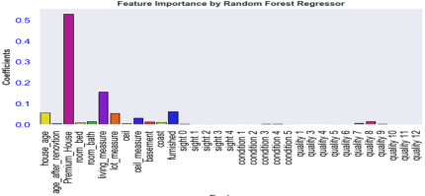
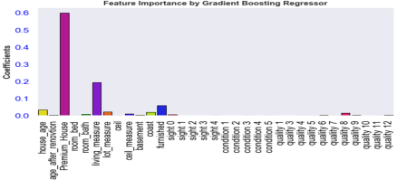
Project analysis slide 2
Multiple Regression Models to extract important features using data standardization
Feature Importance by Ada Boost Regressor
Feature Importance by Decision Tree Regressor
Feature Importance by Gradient Boosting Regressor
Feature importance by Linear Regression
Feature Importance by Random Forest Regressor

Slide 14
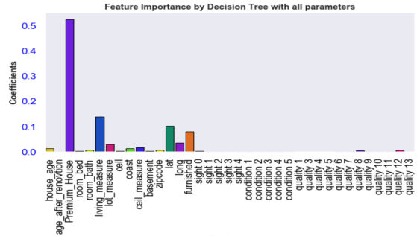
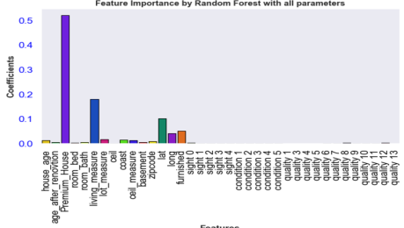
Project analysis slide 2
Multiple Regression Models to extract important features using normal data
Feature Importance by Decision Tree Regressor
Feature Importance by Gradient Boosting Regressor

Slide 15
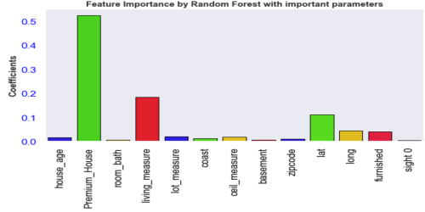
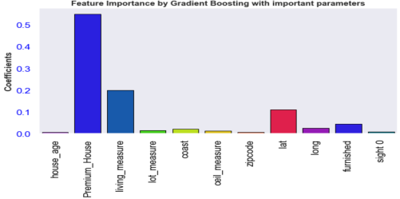
Project analysis slide 2
Multiple Regression Models with important features
Decision Tree Regressor
Gradient Boosting Regressor

Slide 16
Project analysis slide 2
Drop the features and Re-build the test and training dataset
Feature Importance by Ada Boost Regressor
Feature Importance by Decision Tree Regressor
Feature Importance by Gradient Boosting Regressor
Feature importance by Linear Regression
Feature Importance by Random Forest Regressor

Slide 17
Metrics comparison
Model | R2 Score | RMSE
Linear Regression with Standardization data | 0.76 | 168036.24
Ada Boost Regressor with Standardization data | 0.61 | 215371.61
Decision Tree Regressor with Standardization data | 0.57 | 22465.16
Random Forest Regressor with Standardization data | 0.75 | 169895.62
SVM Regressor with Standardization data | 0.04 | 337919.35
Gradient Boosting Regressor with Standardization data | 0.78 | 161261.31
Decision Tree Regressor with important features & regular data | 0.80 | 156057.82
Random Forest Regressor with important features & regular data | 0.89 | 116126.84
Gradient Boosting Regressor with important features & regular data | 0.88 | 120053.84
Decision Tree Regressor after Parameter Tuning | 0.82 | 145357.47
Random Forest Regressor after Parameter Tuning | 0.89 | 114279.98
Gradient Boosting Regressor after Parameter Tuning | 0.90 | 107007.13
Model "Gradient Boosting Regressor with regular data, after parameter tuning is the choice because of high RSquare with low RMSE when compared to the other models

Slide 18
Final Gradient Boosting Hyper Parameters
The best model is Gradient Boosting Regressor with hyper parameter values
learning_rate= 0.2
max_depth= 4
min_samples_split= 8
min_samples_leaf=8
n_estimators= 400
Gradient Boosting Regressor - After Parameter Tuning has given high performance of 90% on the test data
This model is saved as finalized_model.sav, which can be loaded by various users to make new predications

Slide 19
Prepare data to make new predications
User SHOULD provide following attributes to make new predictions
dayhours
price
living_measure
lot_measure
coast
sight
ceil_measure
yr_built
zipcode
lat
long
furnished

