Slide 1


Governance
About
Locations
Find a Career
A Worker Decentralized Autonomous Organization (DAO) with Incredible Worker Benefits Generating Meaningful Social Impact
A Platform Providing Long Term Employee Benefits and Shared Community Values To Freelancers While Creating Social Impact
Join the Community
Contract Talent in a Shared Workspace Community
Direct Business to Worker Model
Holistic costs reduced via DLT Smart Contracts
Peer to Peer
Governed
As an employee, if you don’t like something, vote to change it
Socially
Responsible
Community voting system for social impact
A Worker Decentralized Autonomous Organization (DAO) with Incredible Worker Benefits Generating Meaningful Social Impact

Slide 2
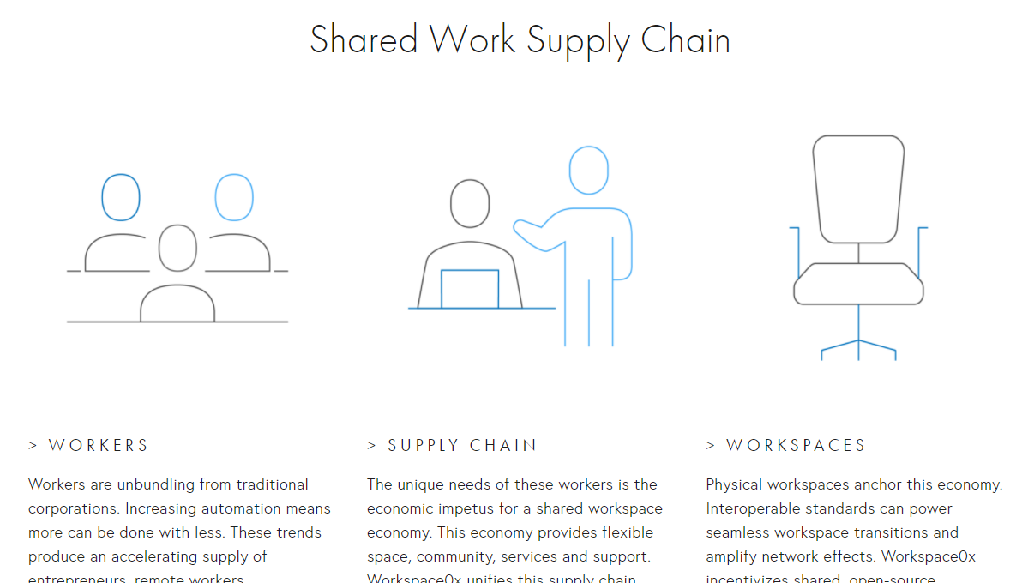
Governance
About
Locations
Find a Career
Home: Button-> Join the Community
What We Do
Complete a Project
Join the Team
Businesses, find talent!
Talented? We Want You!

Slide 3
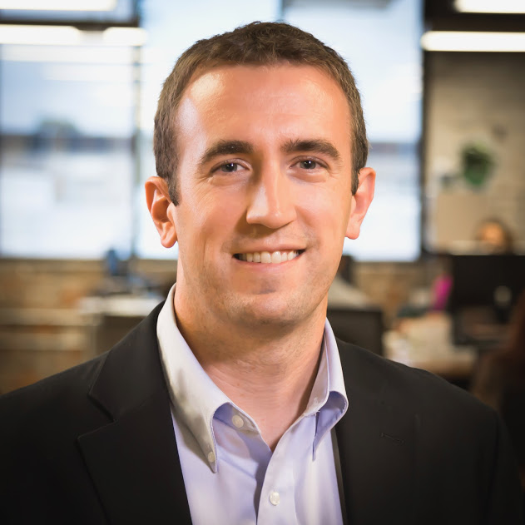

Governance
About
Locations
Find a Career
Home: Button-> About->Team
Team
What We Do
Michael Nolivos
Michael is passionate about using blockchain to create more valuable win-win Business 2 Worker models. He’s a strong Full-Stack developer.
William McGuire
William believes in using blockchain as a Force for Good. He believes Workspace0x will revolutionize the way companies are managed.
Betina Schnepf
Betina has a passion for research and a technical mind for the balance between on and off-chain architecture. She’s also an incredible Front-End Developer.
The Workforce

Slide 4
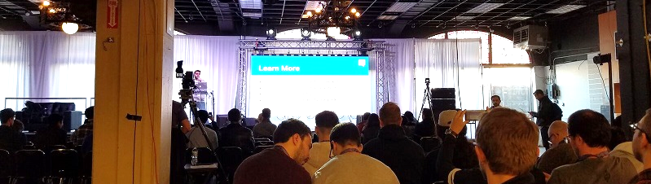
Governance
About
Locations
Find a Career
Home: Button-> About->Team
The Workforce
What We Do
Geographically Distributed
Latest statistics from the platform show the workforce is comprised of individuals all across the US from the East to West Coast.
Diverse Backgrounds
Full-Stack Developers, Blockchain Engineers, Project Managers, and UI/UX Designers are just a sample of the expertise the community has to offer your project
Continuous Innovators
The workforce is naturally inclined to pushing the envelope of technological innovation. To maximize value generation, the community voted governance protocol also monetarily incentivizes cross worker interaction and training.

Slide 5
Original Idea Below

Slide 6
Creating Community & Social Impact Through Peer to Peer Shared Workspaces
Governance
About
Locations
Find a Space
Join the Community
Nearly $0
Transaction Fees
Holistic costs reduced via Peer to Peer Transactions on DLT
Peer to Peer
Governed
If you don’t like something, vote to change it
Socially
Responsible
Community votes and participates in social impact

Slide 7
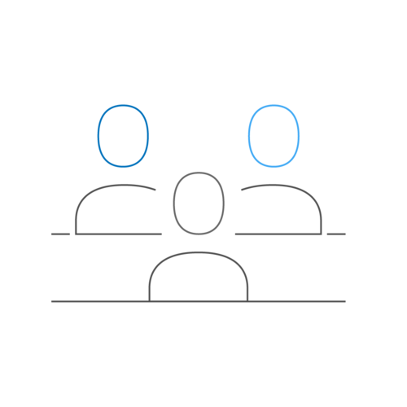

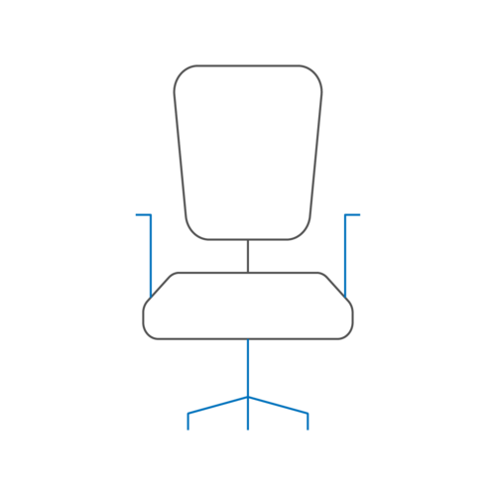
Governance
About
Locations
Find a Space
Home: Button-> Join the Community
What We Do
Talent
Workspace
Workers Benefit
Workspace Owner Benefits
Community Benefits
Find a Space
Rent My Space

Slide 8
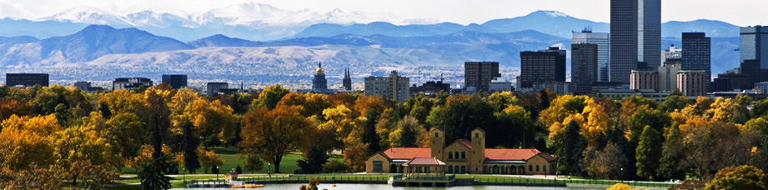
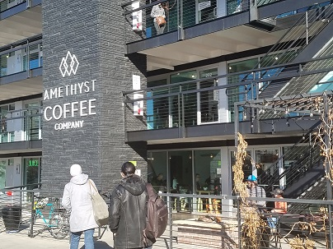
Governance
About
Locations
Find a Space
?
How We Do it
RE is not owned by the platform, unless the community wants to invest in RE
Workspace Owners remain Owners
Shared Insurance Policy governed by the platform and specific criteria for claims executed by smart contracts
Globally Terms
“Social Impact” doesn’t mean the same thing outside of USA
Available Co-working Spaces in Denver
What’s your preference?
Amethyst Coffee Co (Free)
Chic location for great coffee and collaboration
6% of your in-store purchase goes toward community social impact
Free
(e.g. coffee shop)
Home
(e.g. Loft, room in house)
101 reviews
Private
Shared Office
Strong Social Focus
>5% gift to social impact

Slide 9
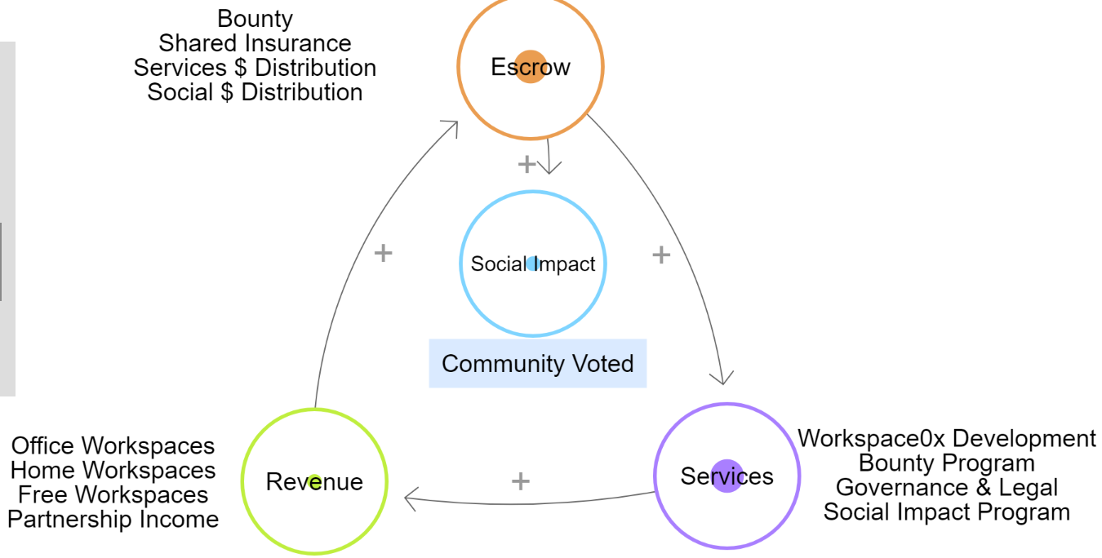
Governance
About
Locations
Find a Space
?
Workspace0x provides a peer to peer workspace sharing network using the benefits of a DApp
How We Do it
RE is not owned by the platform, unless the community wants to invest in RE
Workspace Owners remain Owners
Shared Insurance Policy governed by the platform and specific criteria for claims executed by smart contracts
The Whole Community Benefits
Workers | Workspace Owners | Charitable Causes
No Middleman & Community Voted
Services
Governance
Benefits
Social Impact

Slide 10
Find My Space
Location
Location
Location

Slide 11
Find My Space
Frankfurt, Germany
Private space
Open Workspace
Meeting Room
Location
Location

Slide 12
Insert value thing from loopy
Perhaps don’t even use the above

Slide 13
0x
Multi-dimensional
Business for Good
Shared Economy
Social Impact
0 waste
Social Impact
Shared Economy
Business for Good
The sweet spot

Slide 14
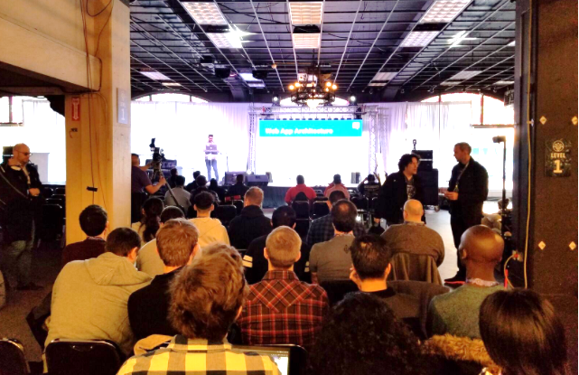
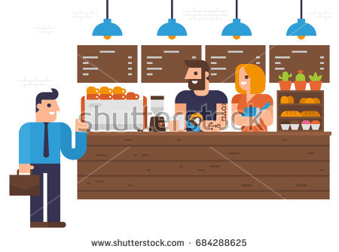



Workers
Platform
Workspaces
Workspace0x

Slide 15
Insert the Raise page which also talks about the social investment

Slide 16
Augmented Reality
Google Earth
Talent | Education | Events
Community Driven
Identity Mgt v2
Integrate with …
Other Ideas
Chips for payments at Free locations
X% of proceeds from free locations go to charity (to person who bought or allow free location to have vote?)

Slide 17
Register for the IBO
Things we have bounties for
Money for the following

Slide 18
Problem Statement: Keeping benefits for free-lancers and employees even inbetween contracts
We’re also creating transparency in how payments are made and letting the community vote on how valuable work is to the eco-system (e.g. the voting system for educational contribution)
Business for Good
Social Impact
Shared Economy

