Slide 1


Governance
About
Locations
Find a Career
A Worker Decentralized Autonomous Organization (DAO) with Incredible Worker Benefits Generating Meaningful Social Impact
A Platform Providing Long Term Employee Benefits and Shared Community Values To Freelancers While Creating Social Impact
Join the Community
Contract Talent in a Shared Workspace Community
Direct Business to Worker Model
Holistic costs reduced via DLT Smart Contracts
Peer to Peer
Governed
As an employee, if you don’t like something, vote to change it
Socially
Responsible
Community voting system for social impact
A Worker Decentralized Autonomous Organization (DAO) with Incredible Worker Benefits Generating Meaningful Social Impact

Slide 2
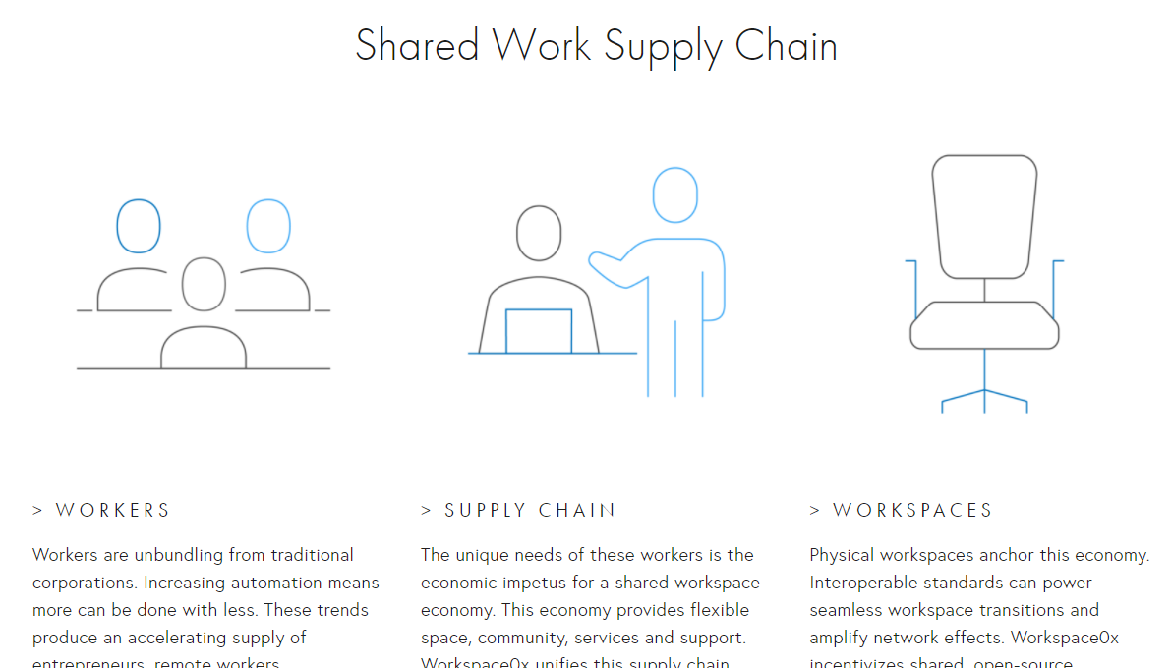
Governance
About
Locations
Find a Career
Home: Button-> Join the Community
What We Do
Complete a Project
Join the Team
Businesses, find talent!
Talented? We Want You!

Slide 3


Governance
About
Locations
Find a Career
Home: Button-> About->Team
Team
What We Do
William McGuire
William believes in using blockchain as a Force for Good. He believes creating a shared Workspace Community Governed by the Community will revolutionize the way companies are structured

Slide 4
Original Idea Below

Slide 5
Creating Community & Social Impact Through Peer to Peer Shared Workspaces
Governance
About
Locations
Find a Space
Join the Community
Nearly $0
Transaction Fees
Holistic costs reduced via Peer to Peer Transactions on DLT
Peer to Peer
Governed
If you don’t like something, vote to change it
Socially
Responsible
Community votes and participates in social impact

Slide 6



Governance
About
Locations
Find a Space
Home: Button-> Join the Community
What We Do
Talent
Workspace
Workers Benefit
Workspace Owner Benefits
Community Benefits
Find a Space
Rent My Space

Slide 7

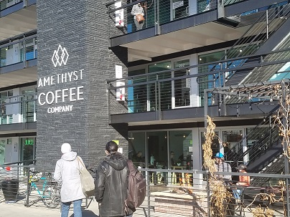
Governance
About
Locations
Find a Space
?
How We Do it
RE is not owned by the platform, unless the community wants to invest in RE
Workspace Owners remain Owners
Shared Insurance Policy governed by the platform and specific criteria for claims executed by smart contracts
Globally Terms
“Social Impact” doesn’t mean the same thing outside of USA
Available Co-working Spaces in Denver
What’s your preference?
Amethyst Coffee Co (Free)
Chic location for great coffee and collaboration
6% of your in-store purchase goes toward community social impact
Free
(e.g. coffee shop)
Home
(e.g. Loft, room in house)
101 reviews
Private
Shared Office
Strong Social Focus
>5% gift to social impact

Slide 8
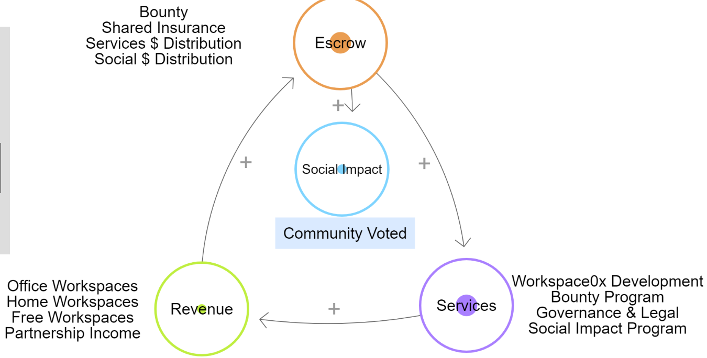
Governance
About
Locations
Find a Space
?
Workspace0x provides a peer to peer workspace sharing network using the benefits of a DApp
How We Do it
RE is not owned by the platform, unless the community wants to invest in RE
Workspace Owners remain Owners
Shared Insurance Policy governed by the platform and specific criteria for claims executed by smart contracts
The Whole Community Benefits
Workers | Workspace Owners | Charitable Causes
No Middleman & Community Voted
Services
Governance
Benefits
Social Impact

Slide 9
Find My Space
Location
Location
Location

Slide 10
Find My Space
Frankfurt, Germany
Private space
Open Workspace
Meeting Room
Location
Location

Slide 11
Insert value thing from loopy
Perhaps don’t even use the above

Slide 12
0x
Multi-dimensional
Business for Good
Shared Economy
Social Impact
0 waste
Social Impact
Shared Economy
Business for Good
The sweet spot

Slide 13
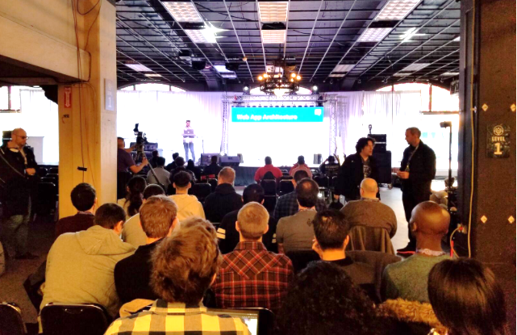
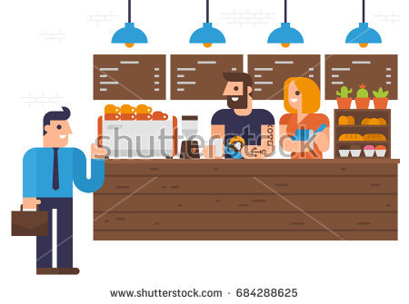

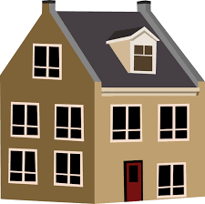

Workers
Platform
Workspaces
Workspace0x

Slide 14
Insert the Raise page which also talks about the social investment

Slide 15
Augmented Reality
Google Earth
Talent | Education | Events
Community Driven
Identity Mgt v2
Integrate with …
Other Ideas
Chips for payments at Free locations
X% of proceeds from free locations go to charity (to person who bought or allow free location to have vote?)

Slide 16
Register for the IBO
Things we have bounties for
Money for the following

Slide 17
Problem Statement: Keeping benefits for free-lancers and employees even inbetween contracts
We’re also creating transparency in how payments are made and letting the community vote on how valuable work is to the eco-system (e.g. the voting system for educational contribution)
Business for Good
Social Impact
Shared Economy

