Slide 1

Z-KNIFTY

Slide 2


Merkel Root (on-chain)
Hash
Hash
NFT #0
NFT #1
NFT #2
NFT #3

Slide 3
Merkel Root (on-chain)
Hash
Hash
NFT #0
NFT #1
NFT #2
NFT #3

Slide 4
Merkel Root (on-chain)
Hash
Hash
NFT #0
NFT #1
NFT #2
NFT #3

Slide 5
Merkel Root (on-chain)
Merkel Root (on-chain)
Hash
Hash
Hash
Hash
NFT #0
NFT #1
NFT #2
NFT #3
NFT #0
NFT #1
NFT #2
NFT #3

Slide 6
0x87sdyga7gk0912390nn2 ...
0x87iy123bygu9812hu3 ...
Hash
Hash
Hash
Hash
NFT #0
NFT #1
NFT #2
NFT #3
NFT #0
NFT #1
NFT #2
NFT #3

Slide 7
zk-SNARK
0x87sdyga7gk0912390nn2 ...
0x87iy123bygu9812hu3 ...
Hash
Hash
Hash
Hash
NFT #0
NFT #1
NFT #2
NFT #3
NFT #0
NFT #1
NFT #2
NFT #3

Slide 8
Demo

Slide 9
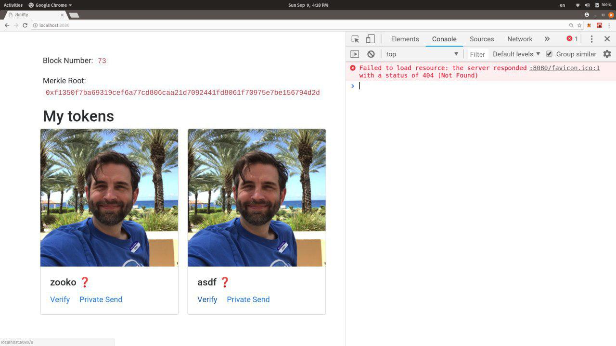

Slide 10
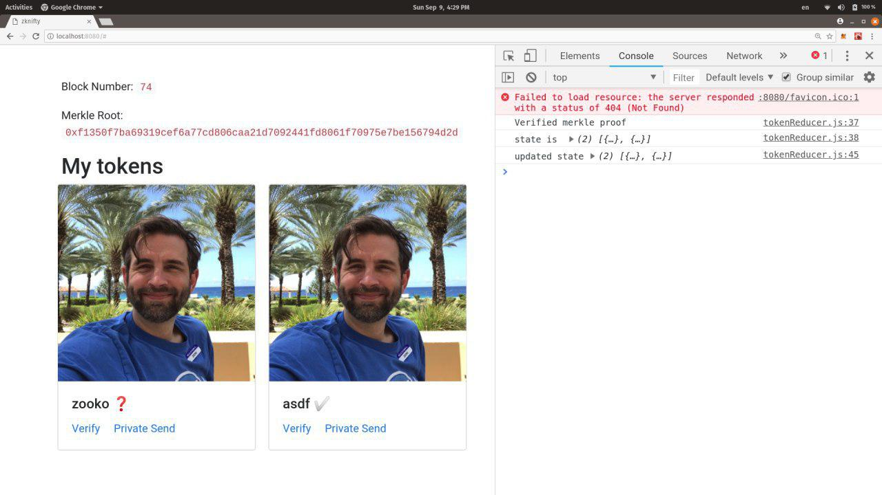

Slide 11
Z-KNIFTY
Georgios Kostantopoulos @gakonst
Liam Horne @liamihorne
Yondon Fu @YondonFu
Philippe Castonguay @PhABC
https://github.com/snario/zknifty
Enormous thank you to @BarryWhiteHat & @ETHBerlin

