Slide 1
SORTING VISUALIZER
by - G . SRI HARINI – 421146 B . SOWJANYA - 421117

Slide 2
Under Guidance Of :- Mr .D . Prasad
DEPARTMENT/SCHOOL OF - COMPUTER SCIENCE AND ENGINEERGING
NATIONAL INSTITUTE OF TECHNOLOGY , ANDHRA PRADESH
TADEPALLIGUDEM-534102, INDIA
MARCH - 2023

Slide 3
ABSTRACT
There is nothing that needs to be told newly to us regarding data structures.
Data Structures are forum for any developer.
Sorting techniques are the Back- Bone of Data Structures.
We learn those endless times but we often fail to build better understanding of algorithms and forget them. One thing that hits my mind – “Why we often forget such important things”? Let us consider movie as an example; we do not forget the scenes easily because as we experience them visually.
In the analogous manner if we visualize sorting algorithms, they can be learned with a picture-perfect way and it also enroots the algorithms in our mind.
It would be the best feasible way if we learn sorting algorithms through visualization which helps man to grasp sorting techniques quickly and easily.

Slide 4
introduction
Sorting is commonly used algorithm in Computer Science. Many students fails to understand and immensely feels difficult to learn these Algorithms. On vigours research and survey analysis they concluded that " The one of the best possible way to learn algorithms is through Visualization". So Here we are to work on Algorithmic Visualization which uses computer graphics and shows clearly the movement of the elements in the Algorithm.

Slide 5
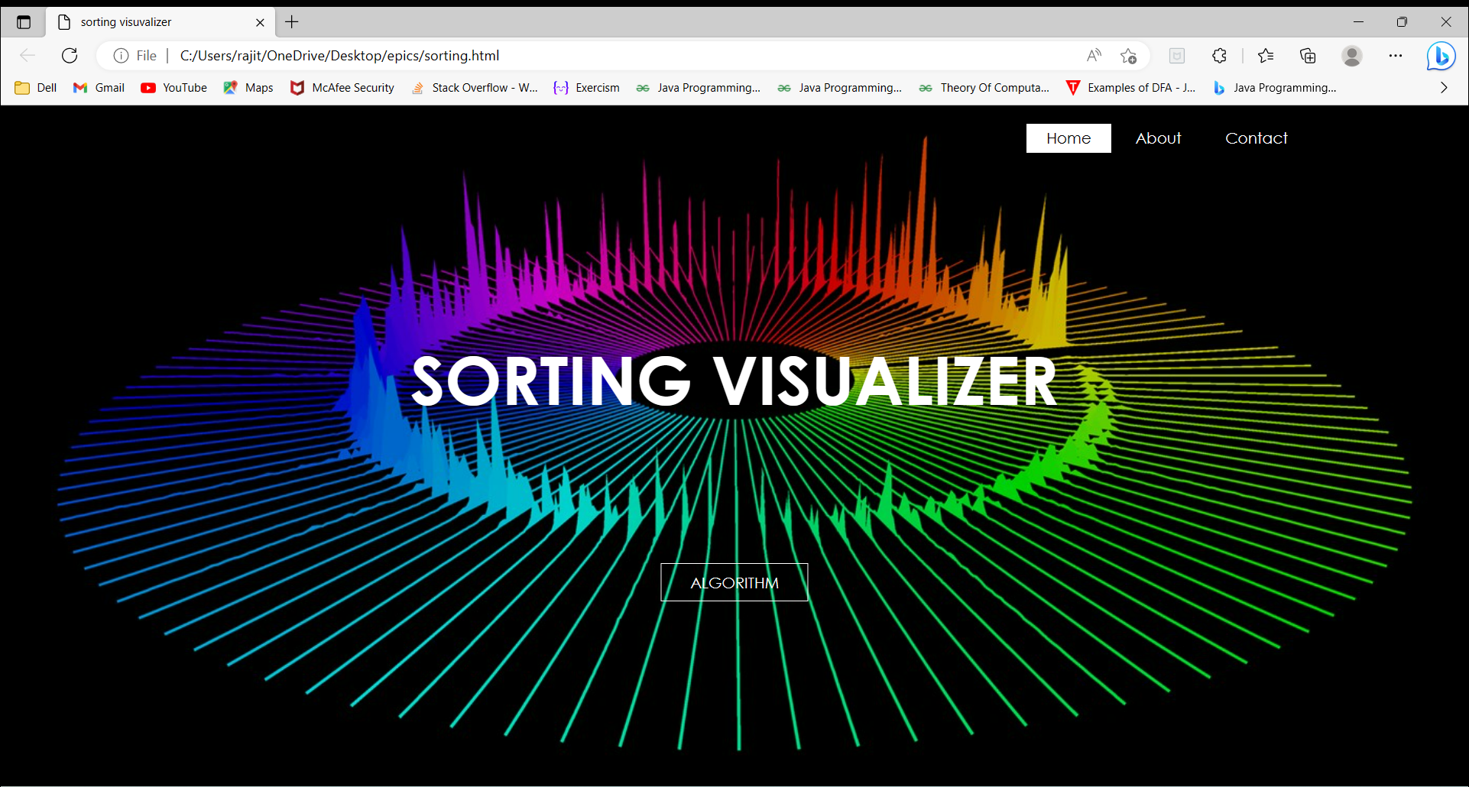
OUT LOOK OF HOME PAGE

Slide 6
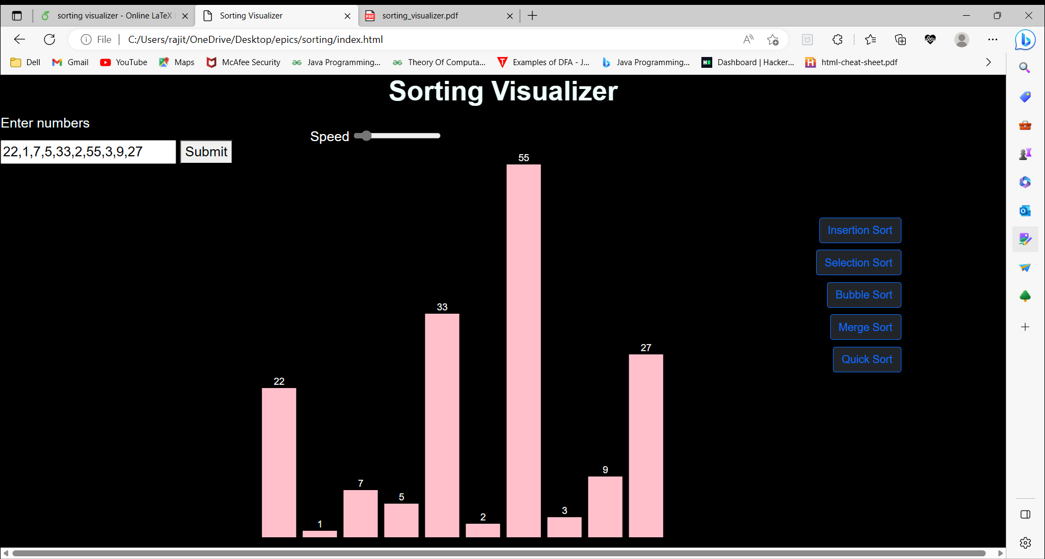
OUT LOOK OF MAIN PAGE

Slide 7
Materials & methods used
JAVASCRIPT – 75.4%
HTML – 16.9%
CSS – 7.7%

Slide 8
HTML:
Every website has some content in it. HTML5 is the language that is used to write the content of the Static webpage.
In our project, we used HTML to create buttons, input sliders.
CSS:
Cascading Style Sheet adds style to our web page. In our project, we used it to set the position of the input buttons, sliders and adding colour to the web page. It enhances the look of the Website.
JAVASCRIPT:
Java script gives life to the website. In our website we linked the buttons to the algorithm, on clicking the button it will run the algorithm and we also used it for writing algorithms .

Slide 9
WHAT IS SORTING?
Sorting is the technique of arranging the elements of a list in an particular order. Most commonly, we use sorting for arranging numerical values in ascending or descending order . There are Mainly 9 types of Sorting Algorithms. Even though the result is same but they differ in the process, time complexity, space consumed .
The Algorithms are:
Insertion Sort
Selection Sort
Bubble Sort
Merge Sort
Quick Sort

Slide 10
INSERTION SORT :
Insertion sort is a basic algorithm that is very much suitable for lists with less number of elements.
In this algorithm,
we assume the very first element only as the sorted array and remaining as the unsorted array .
It iterates through the whole array from 2nd element to the last element .
Compare the current element with it’s predecessor .
If the current element is smaller, then we swap the current element with the previous one .
Until the current element finds the appropriate position, do step-3 and step-4.
Repeat this process until the pointer reaches the end of the array.
Time complexity is generally O(n^2) [ where, n=Number of elements in the array]
Space Complexity is O(1) .

Slide 11
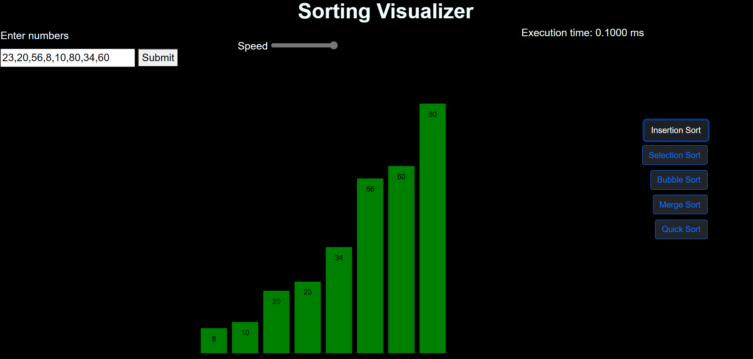

Slide 12
SELECTION SORT :
In this algorithm , sorting works by continuously finding smallest element in the array and bringing it to the sorted part of the array.
In this algorithm,
We assume the first element at Zeroth index as the smallest element.
Then we iterate through complete array, from the element at the first index to the element at the (n-1) th index and find the smallest Element.
Swap the smallest element with the current element.
Then increment the index by 1.
Repeat the above steps through the complete array.
Time complexity is generally O(n^2) [ where, n=Number of elements in the array]
Space Complexity is O(1) .

Slide 13
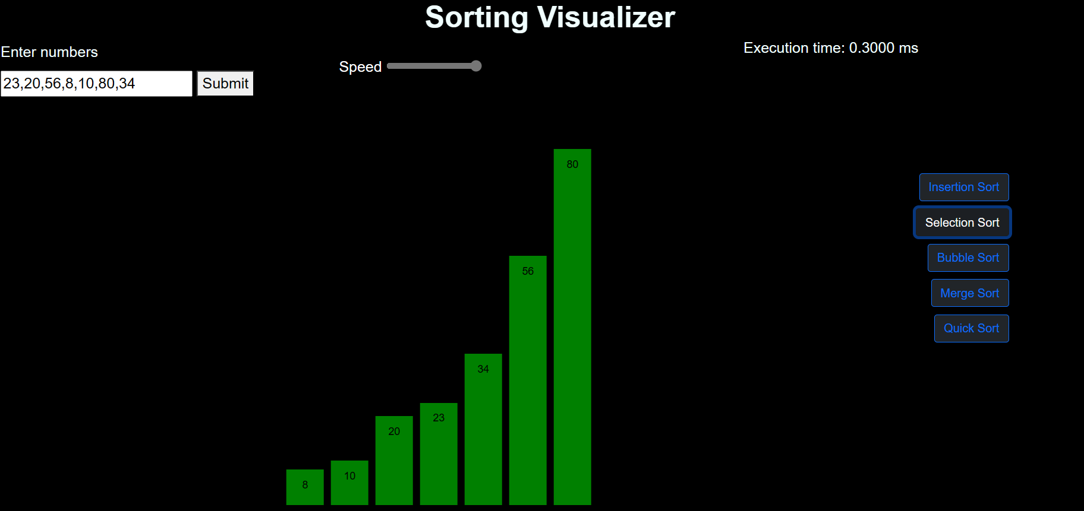

Slide 14
BUBBLE SORT :
In this sorting algorithm , the algorithm compares each pair of adjacent elements in array and swap them if they are in incorrect place , moving from left to right . After each iteration the largest unsorted element moved to the end of the array and the process goes on until the array gets sorted.
In this algorithm,
1. We assume the first element at Zeroth index as the smallest element of array.
Then we iterate through complete array, from the element at the first index to the element at the (n) th index and find the smallest Element.
Swap them if current element is greater than the next element .
Then increment the index by 1 and . repeat the above steps .
Continue this process until the array gets sorted.
Time complexity is generally O(n^2) [ where, n=Number of elements in the array]
Space Complexity is O(1) .

Slide 15
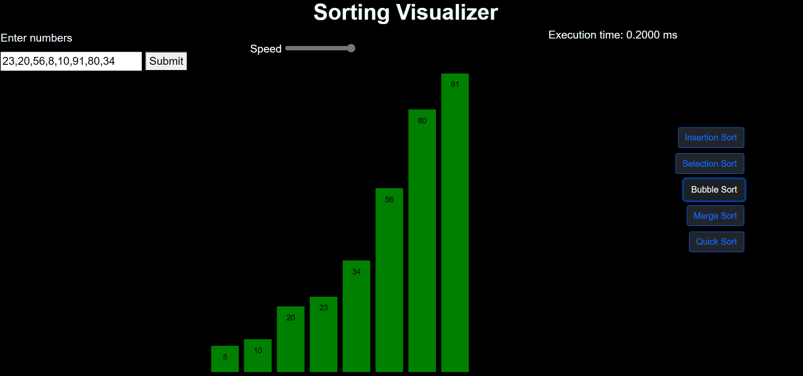

Slide 16
MERGE SORT :
In this sorting algorithm we will use divide and conquer algorithm where it works by recursively.
In this algorithm,
We divide the given array into two sub arrays .
Recursively sort both left and right sub arrays of the array.
Merge the both sub sorted arrays back together to get sorted array.
Time complexity is generally O(n logn) [ where, n=Number of elements in the array]
Space Complexity is O(n) .

Slide 17
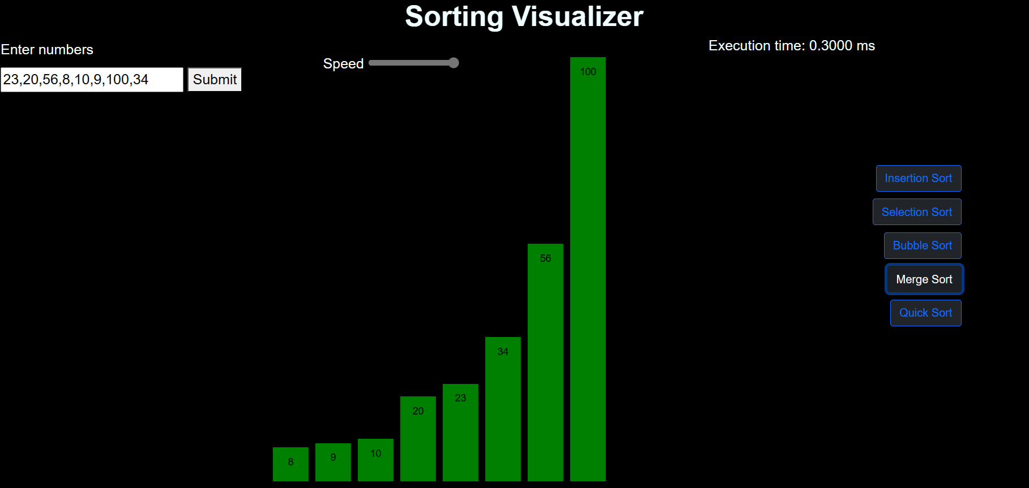

Slide 18
QUICK SORT :
It is also like a divide and conquer algorithm that works by partitioning the input array into two sub arrays with a pivot element and then recursively sorting each sub array.
In this algorithm,
1. First we will choose a pivot element from array.
2. Next we divide(partition) the array into two sub arrays where one sub array elements less than the pivot element and other contains the greater than or equal to the pivot element.
3. We recursively sort the sub arrays by above steps until sub arrays get sorted.
4. We merge the sorted sub arrays to get final sorted array
Time complexity is generally O(n ^2) [ where, n=Number of elements in the array]
Space Complexity is O(n) .

Slide 19
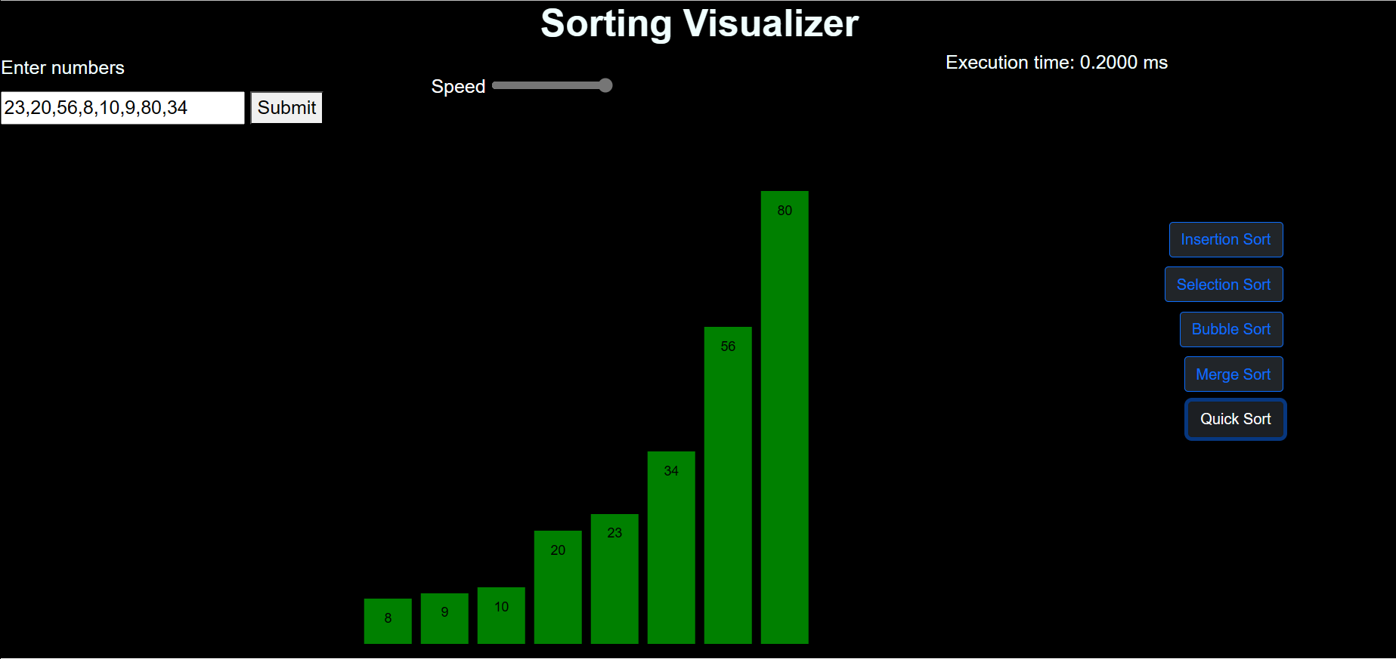

Slide 20
ADVANTAGES
Sorting visualizers help users understand how sorting algorithms work by showing the sorting process step by step. Users can see how algorithms works and we will get final sorted array. By watching how sorting algorithms , users can develop problem-solving skills. They can see how the algorithm works and apply that knowledge to other problems. In future sorting visualizer helps a lot to understand how algorithms works.

Slide 21
DISADVANTAGES
Sorting visualizers only show how sorting algorithms work with a small set of input data. In real-world applications, sorting algorithms are used to sort large datasets, and the visualizer may not be able to handle such large data sets . Some users completely depend up on sorting visualizer and they fail to develop understanding .

Slide 22
Conclusion –
From this project, we conclude that Visualization makes understanding better .
If you learn Algorithms priorly and understand working of algorithms this sorting visualizer helps you to roots the algorithm deeply in our mind .
By this visualization experience we will get more grip on sorting algorithms.

Slide 23
References :
1. Dr . Hadi Sutopo , MMSI is a member of Indonesian Association of Educational Technology (IPTPI) and Association of Education and Communication Technology (AECT), Department of Informatics, Universitas Persada Indonesia YAI, Jakarta, Indonesia.

Slide 24
THANK YOU

