Slide 1



Department of Computer Science & Engineering
About The Department

Slide 2

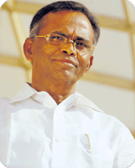
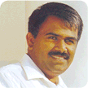
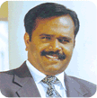
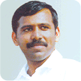
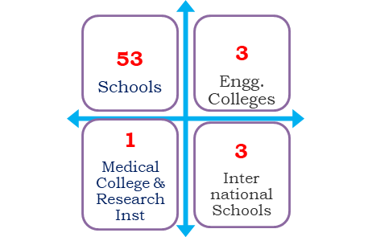
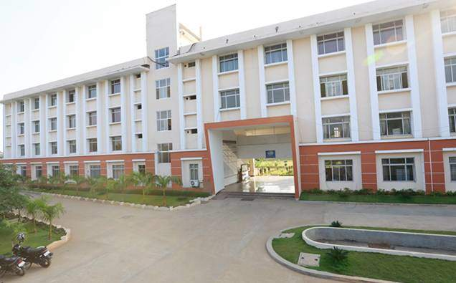
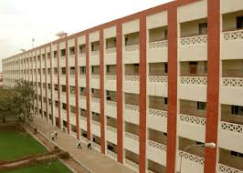
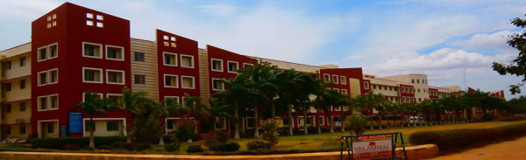
Institutional Promoters of Velammal Educational Trust
Shri.M.V.Muthuramalingam
Founder & Chairman
Shri.M.V.M.Velmurugan
Chief Executive Officer
Shri.M.V.M.Velmohan
Correspondent
Shri.M.V.M.Sasi Kumar
Director
1986 with 183 students & 13 staff members synonym for quality education with 60 institutions
Group of Institutions
Velammal Institute of Technology
Velammal Engineering College
Velammal College of Engg. & Tech

Slide 3
