Slide 1
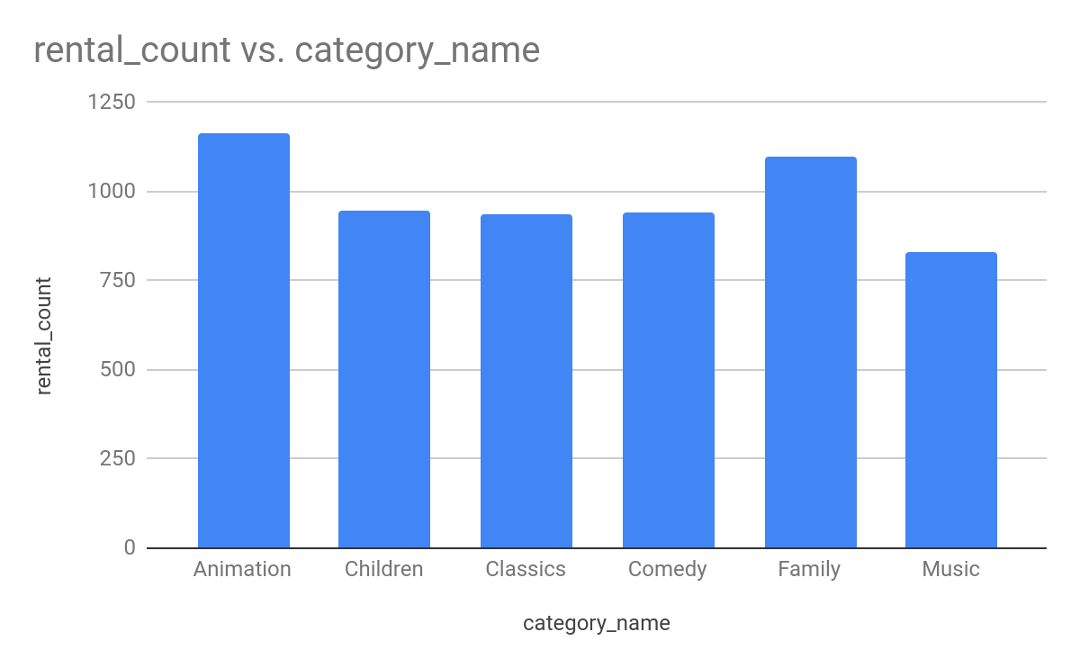
What kind of movies are Family Friendly to Watch?
<visualization>
“Animation” category is in the top most likely rented movie from the data among families . We should target Animation, Family and Comedy most to increase Rentals.

Slide 2
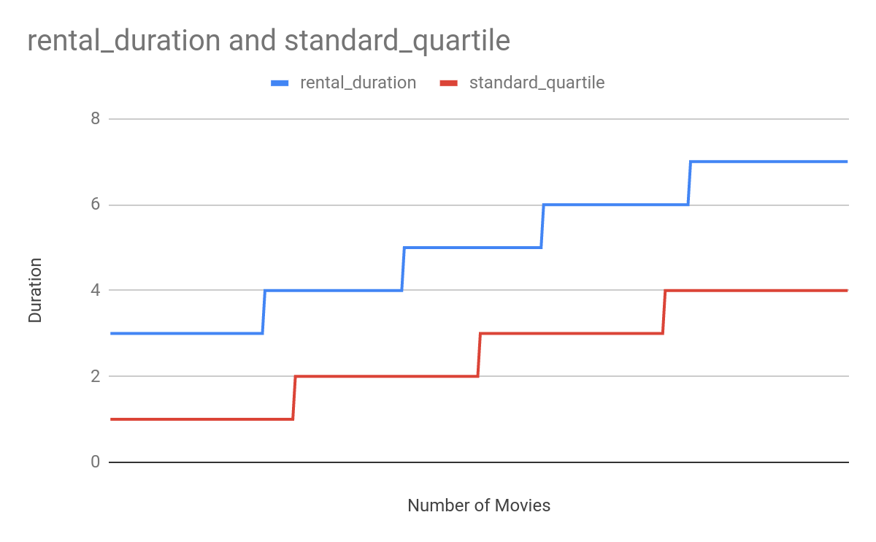
What is the shortest and longest rental duration?
<visualization>
Shortest rental duration is three days. Longest rental duration is seven days. Each and every Genre contains Shortest rental duration and Longest Rental duration, But Median of Standard quartile for Classics and Comedy is different compared to rest of Genres.

Slide 3
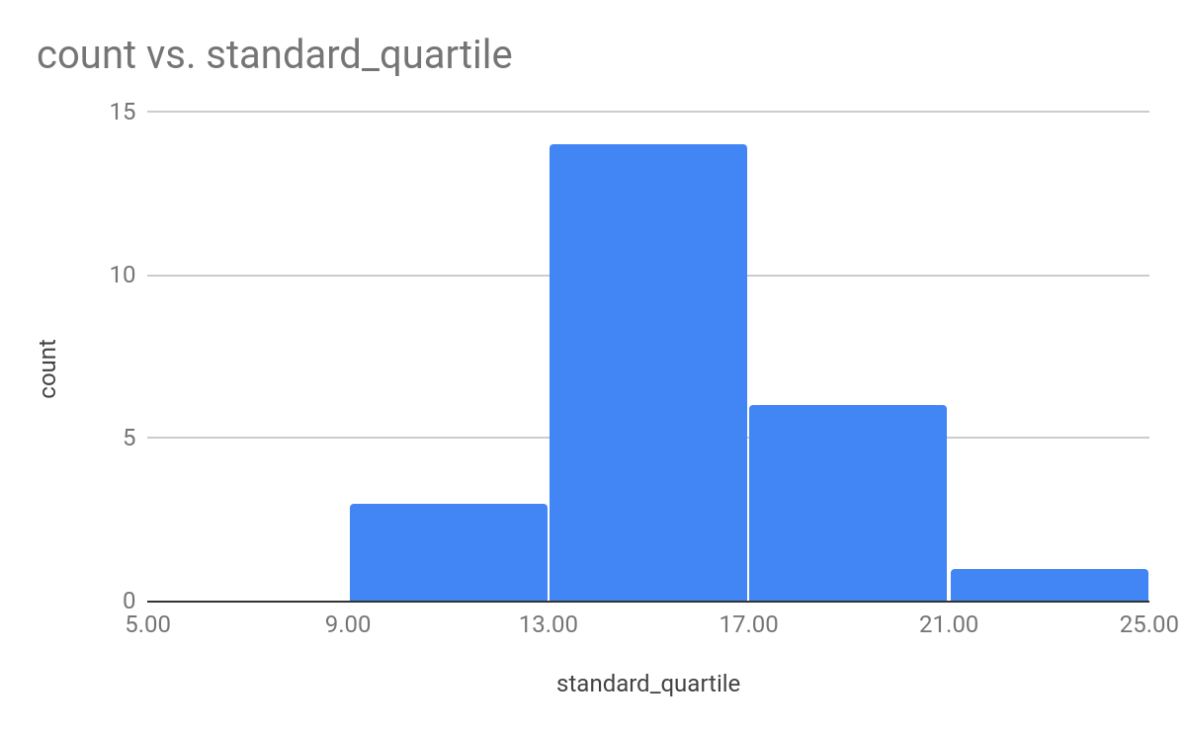
Which Quartile based on the rental duration for movies across family category has highest count
<visualization>
The second Quartile

Slide 4
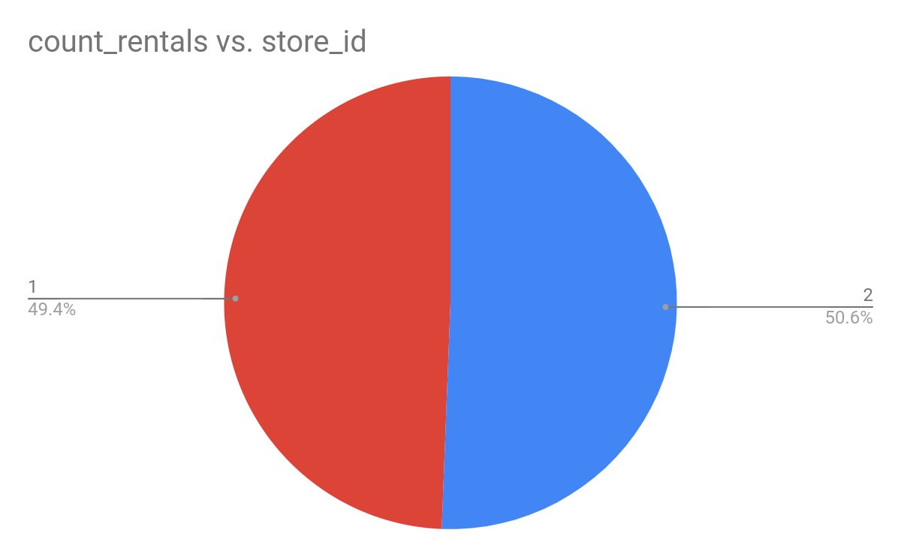
Which Stores among 1 and 2 rented more movies and What Margin
<visualization>
Store 2 rented more movies than Store 1 by a margin of 0.6% under the 2005-06 financial year

