Slide 1
Data Warehousing Project
Teradata University Network Data Challenge 2016
Group No: 6
Our Team:
Sarath
Ranjith
Sri Harsha
Amarnath
Raviteja

Slide 2
Our Challenge
To find the effect of social media on the amount of donations received over the years.
To find the impact created by hosting the website on the amount of donations received over the years.
To visualize the correlation among them

Slide 3


Solution
For the above challenge we show the trend between the amount donated and the various social media statistics. We also use the website statistics to show the impact created by the hosted website on the amount donated.
Datasets used :
Donor perfect
Hub spot
Twitter
LinkedIn
Google Analytics
Facebook
Software used : Tableau , Microsoft Excel

Slide 4
Data Cleaning
Removed junk characters like ‘$’
Removed unnecessary rows which are not present in our time frame
Removed columns that were not useful or irrelevant
Data Transformation
Transformed data from cross tab valuation mode to normalised mode
Converted dates from string format to date format
Created relationships to link datasets
Why do we need data transformation?
Excel stores data in cross tab valuation mode/ aggregated mode
Tableau needs data in normalised form.

Slide 5
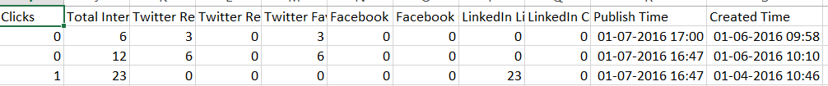
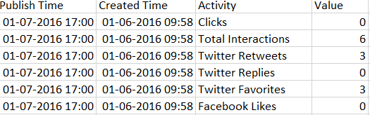
What is difference between cross tab and normalized data?
Cross tab data
Normalised data

Slide 6
Donor perfect
Date
Gift type
Hubspot
Account
Activity
Twitter
Time
Tweet activity
GL code
ID
Receipt number
Amount
Campaign
Channel
Publish time
Twitter count
LinkedIn
Facebook
Date
LinkedIn activity
LinkedIn count
Date
Facebook activity
Facebook_count
Google Analytics
Date
Page views
Datasets-Schema
Note: Schemas shown above are after transformation

Slide 7
Data and Time frames
Donor perfect : 07/2007 – 01/2016
Hub spot data: 04/2015 – 07/2016
Twitter data : 09/2014 - 12/2015
LinkedIn data: 06/2014 – 01/2016
Facebook data(page data): 01/2014 – 01/2016
Google Analytics: 04/2012 – 12/2015
Data is available for social media from 2014, so most of the analysis is done from 2014. Data available prior to 2014 in donor perfect is ignored.

Slide 8
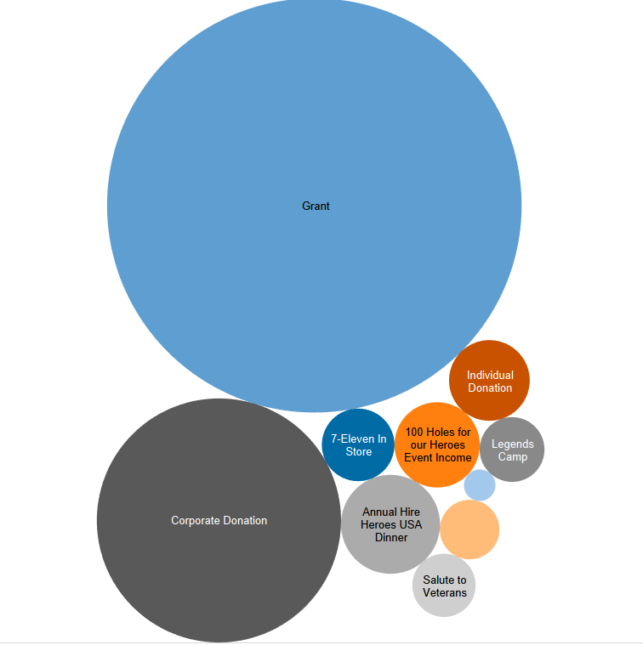
Most of the amount is coming as “Grants” which is in the form of funds by the government. This is not impacted by social media presence . So we can ignore the grants.
Donation type
Why donation type is important to consider?
Grant
Corporate Donation

Slide 9
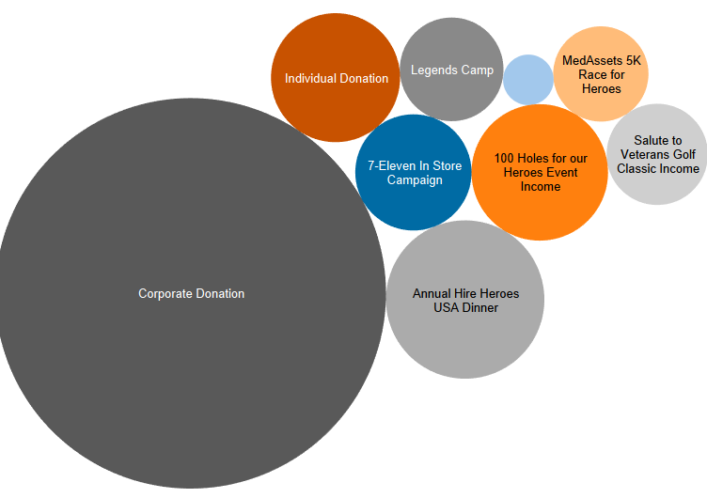
Donation type excluding Grant

Slide 10
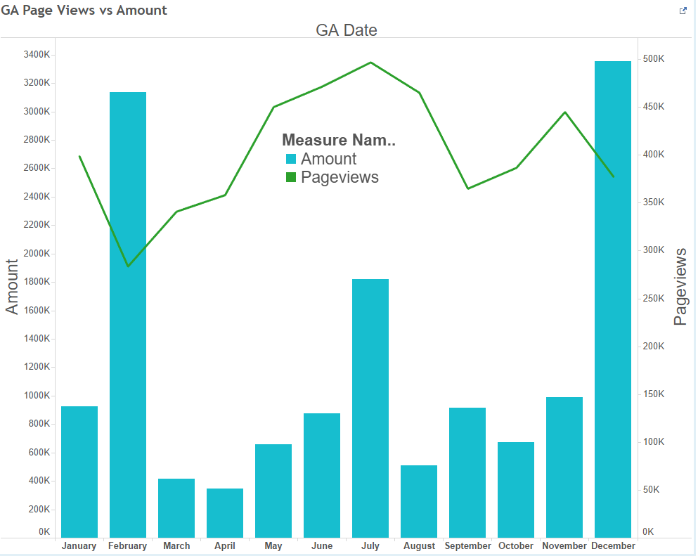
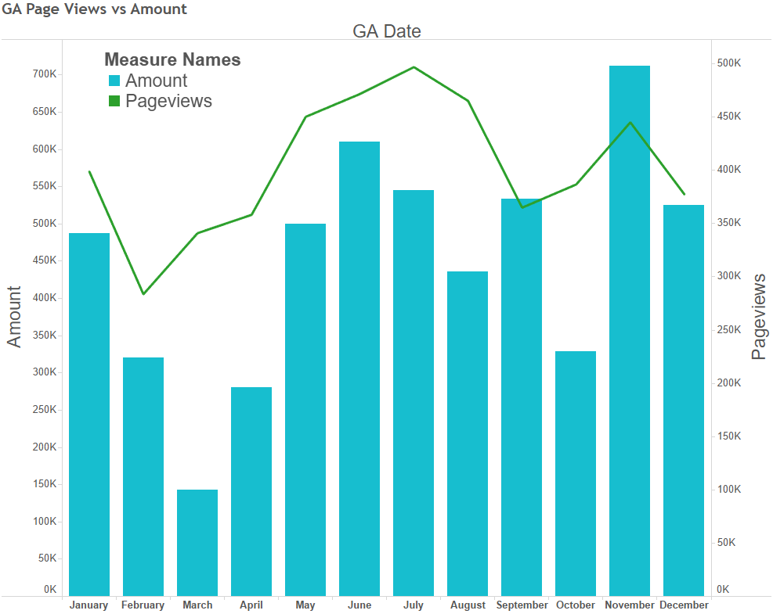
Sample trend when including grant in the amount
Grants released in months of Feb, July, December(high peaks)
No specific trend can be detected
Sample trend when excluding grant in the amount

Slide 11
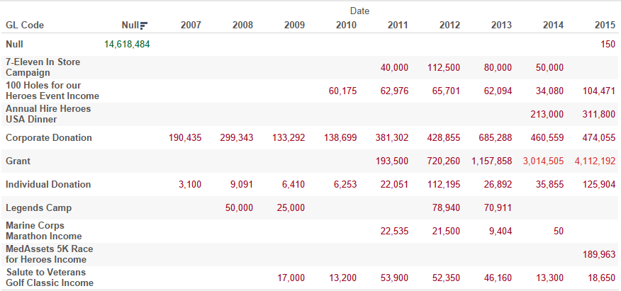
Campaigns and their donations

Slide 12
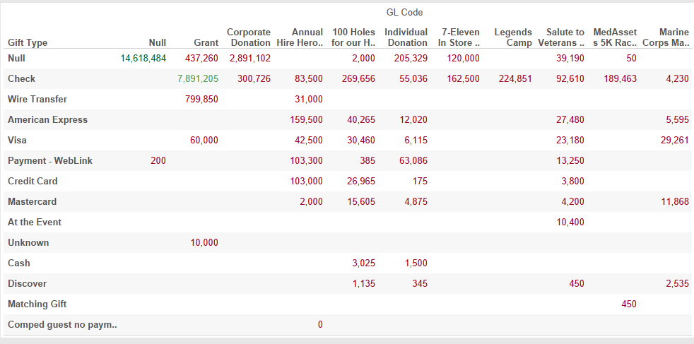
Type of transfer

Slide 13
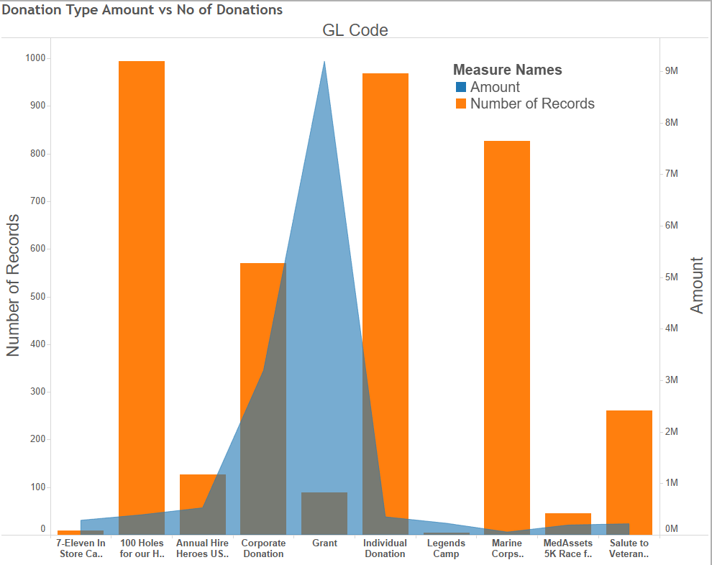

Slide 14
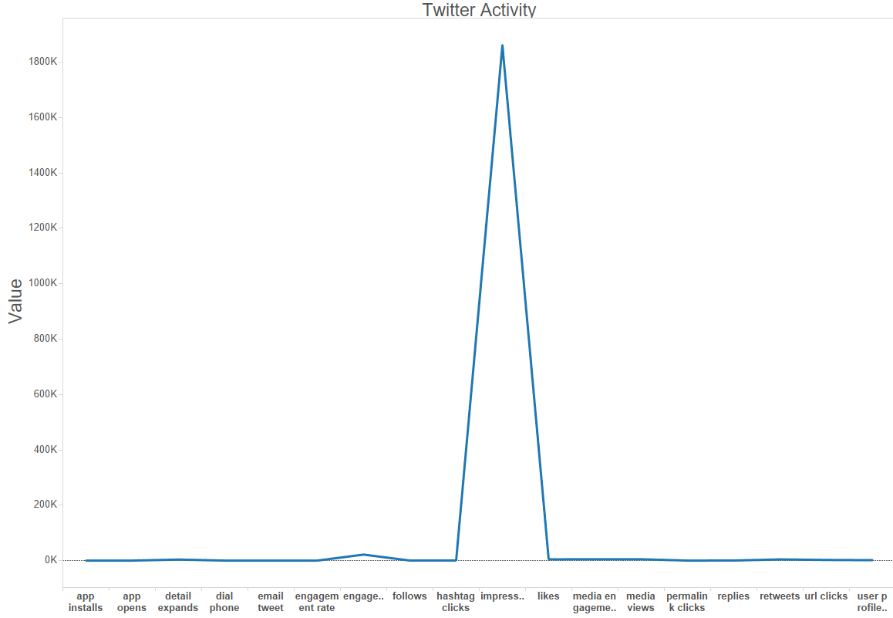
Twitter activity vs Value
Twitter impressions are the maximum of all the twitter activities performed.

Slide 15
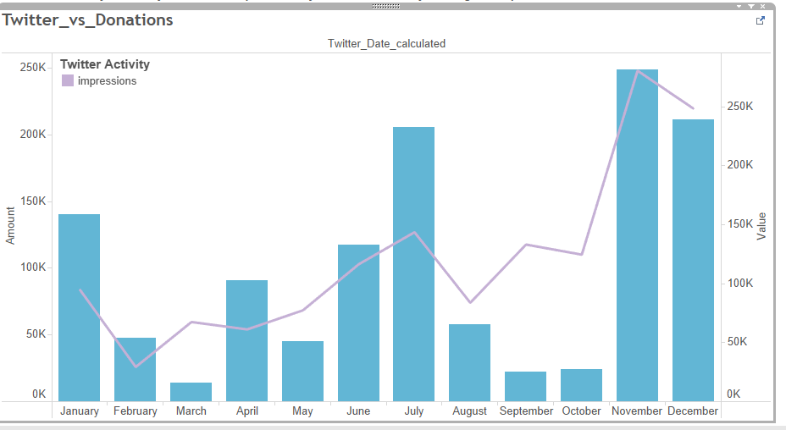
Donations are increasing with increase in twitter impressions and they are decreasing when impressions are decreasing.
Twitter impressions Vs Donations

Slide 16
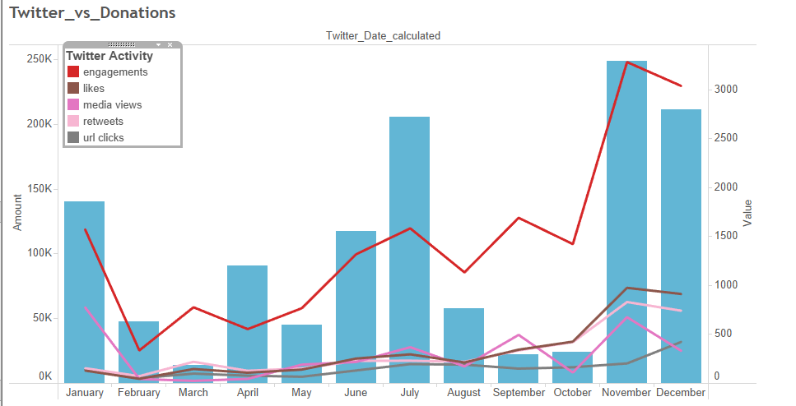
Other Twitter activities vs Donation

Slide 17
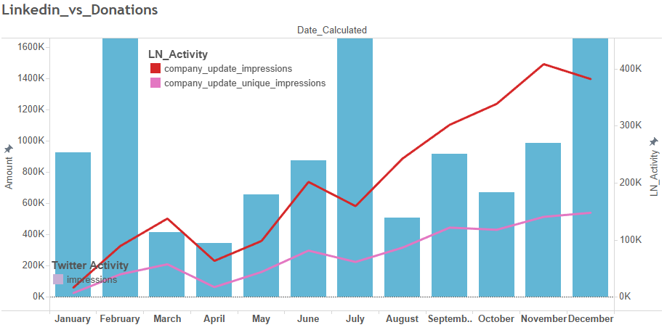
LinkedIn activity vs Donations

Slide 18
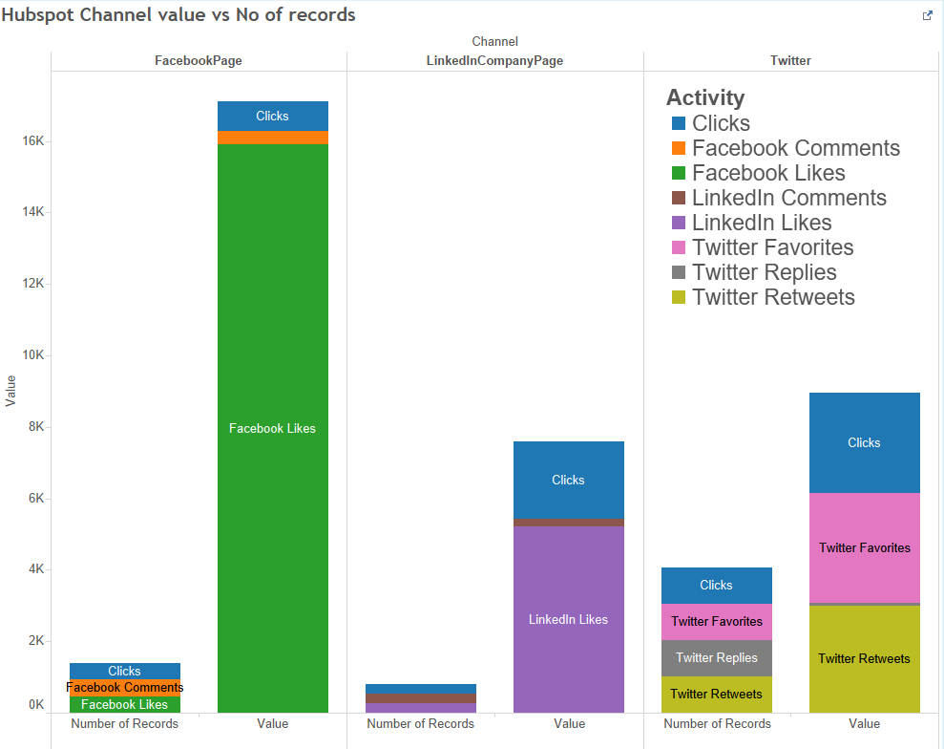

Slide 19
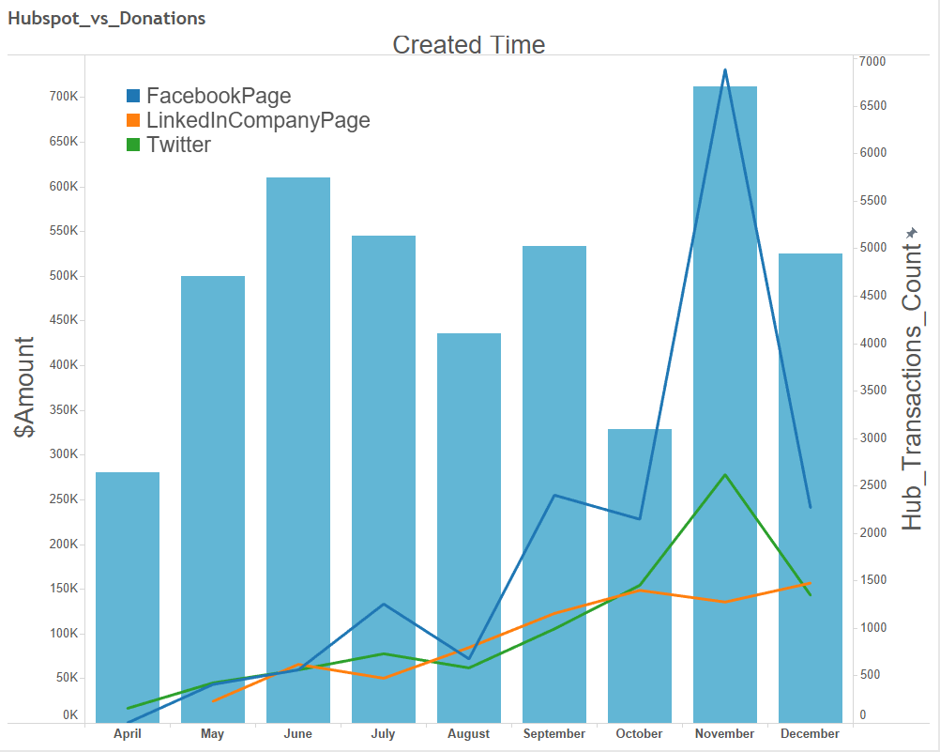
Considering the social media presence from the Hubspot data, we can say that Facebook had the maximum effect on donations followed by Twitter and Linkedin.
Hubspot vs Donations

Slide 20
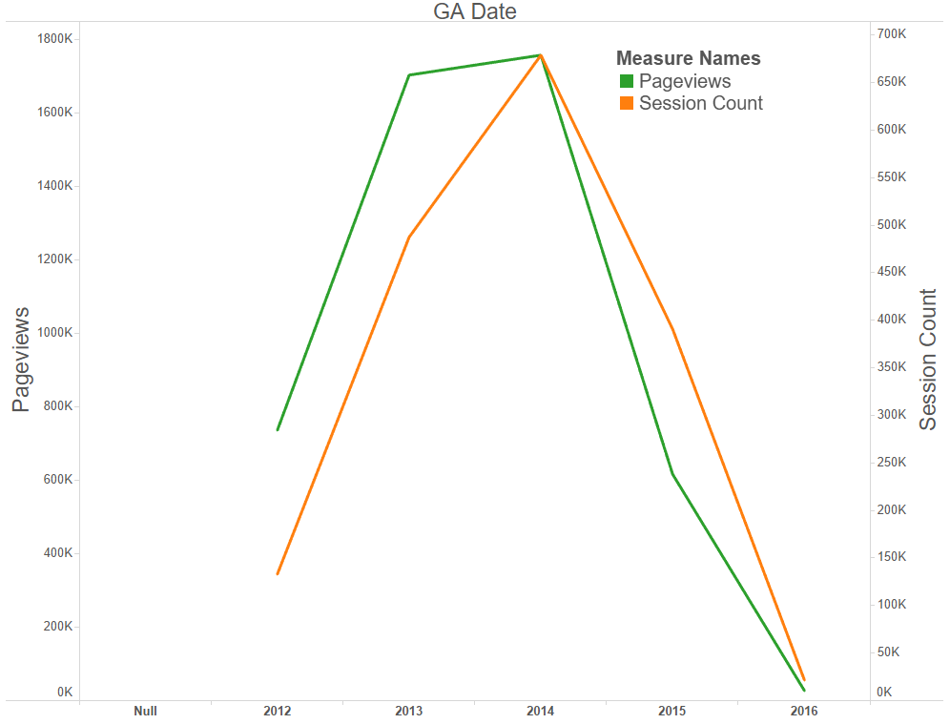
Google Analytics

Slide 21
Page views vs Amount

Slide 22
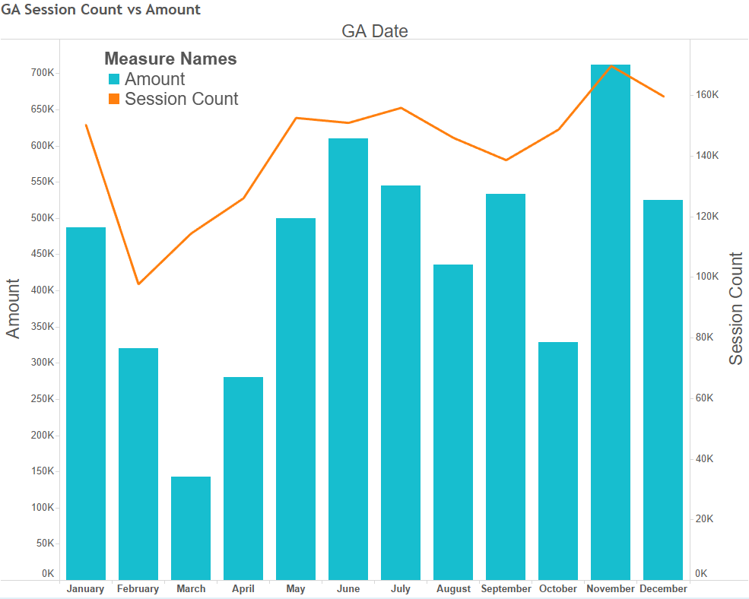
Session count vs Amount

Slide 23
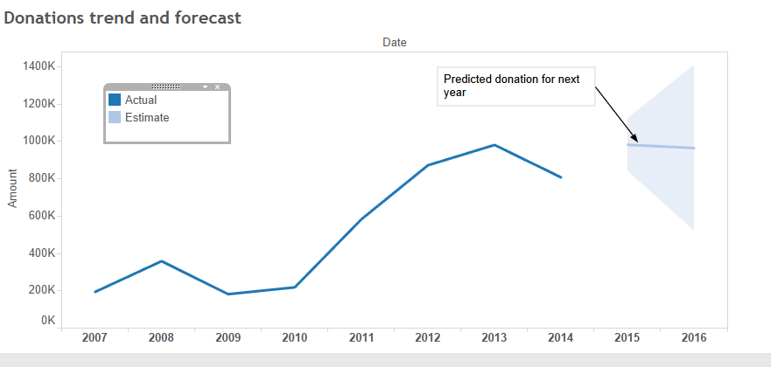
From the available data, donation prediction for year 2016 would be around 1000K excluding grants.
Donation Trend and Forecast

Slide 24

Under Construction

Slide 25
Thank You

