Slide 1
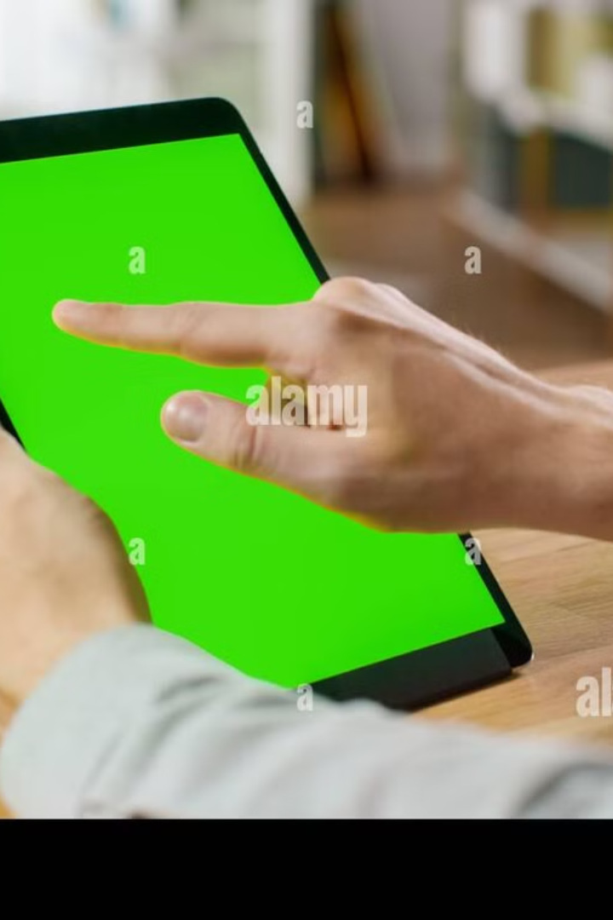
Gesture-Based Human-Computer Interaction System
Imagine controlling your computer without touching a mouse or keyboard. This presentation explores a system that uses hand gestures for intuitive and touch-free interaction.
Done By:
Faders
( B.Hemanth Rao.
M.Manesh Kumar.
S.Sai Ram.
K.Snehith.
S.Sri Harsha Sai.)

Slide 2
The Challenge of Traditional Input
Limitations
The Solution
Traditional input devices like mice and keyboards limit interaction possibilities and can be physically demanding.
Gesture-based control offers a more natural and intuitive way to interact with technology.

Slide 3

Objective: Gesture-Based System
1
Develop a real-time system that recognizes hand gestures using a standard webcam.
2
Enable system actions like mouse movement, clicks, scrolling, and zooming.
3
Leverage the power of computer vision libraries, OpenCV and MediaPipe, for gesture detection and analysis.

Slide 4
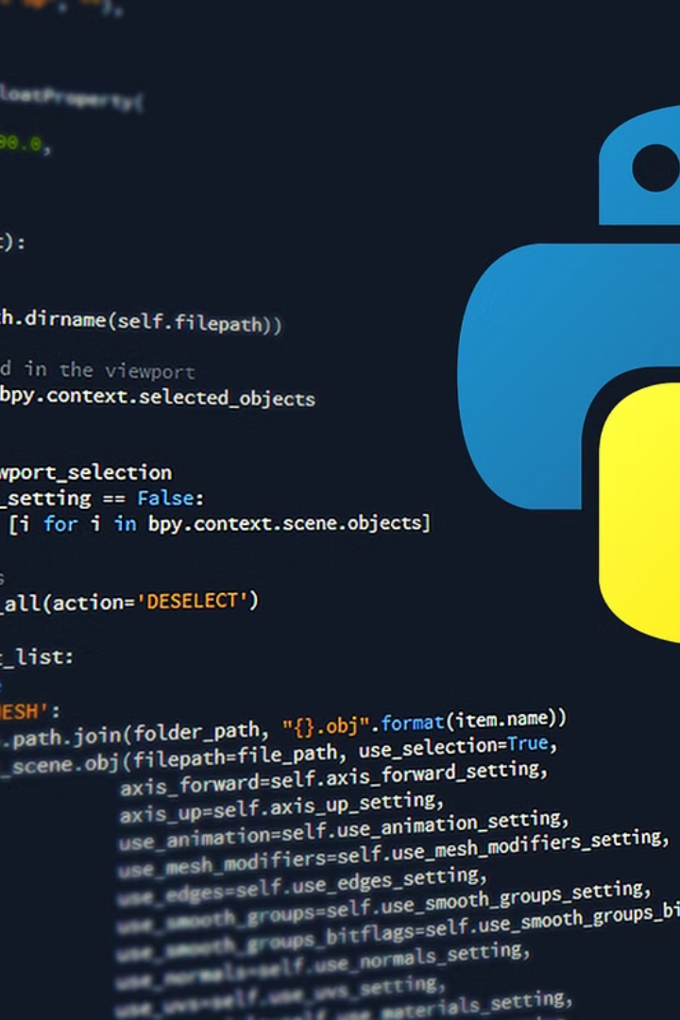
Technology Stack: Building Blocks
Python
The system is implemented in Python, a popular programming language for computer vision applications.
OpenCV
OpenCV is a powerful library for computer vision tasks, including image and video processing.
MediaPipe
MediaPipe is a framework for building real-time machine learning pipelines, ideal for gesture recognition.
PyAutoGUI
PyAutoGUI is used for controlling system actions like mouse movements and clicks.

Slide 5
Working Mechanism: The Process
Capture
1
The system captures video frames from the webcam.
2
Detect
MediaPipe analyzes each frame to identify hand landmarks.
Analyze
3
Finger positions are analyzed to identify gestures based on predefined criteria.
4
Command
Recognized gestures are mapped to specific system commands, such as cursor movement or clicks.
Execute
5
System actions are executed using PyAutoGUI, providing touch-free control.

Slide 6





Gesture Controls: User Interaction
Cursor Movement
Click
Right Click
Scroll
Extend the index finger and curl the others to control the cursor.
Bring the thumb and index finger close for a left click.
Bring the thumb and middle finger close for a right click.
Extend the index and middle fingers, curl the others to scroll up or down.
Zoom
Use both hands with varying finger distances for zooming in or out.

Slide 7





Challenges & Solutions: Overcoming Obstacles
Accuracy
Adjusted detection confidence thresholds to minimize false positives.
False Positives
Implemented gesture cooldown timers to prevent unwanted actions.
Smooth Movement
Used interpolation techniques for smoother cursor transitions.
Lighting
Adaptive brightness handling in OpenCV for reliable gesture detection.

Slide 8
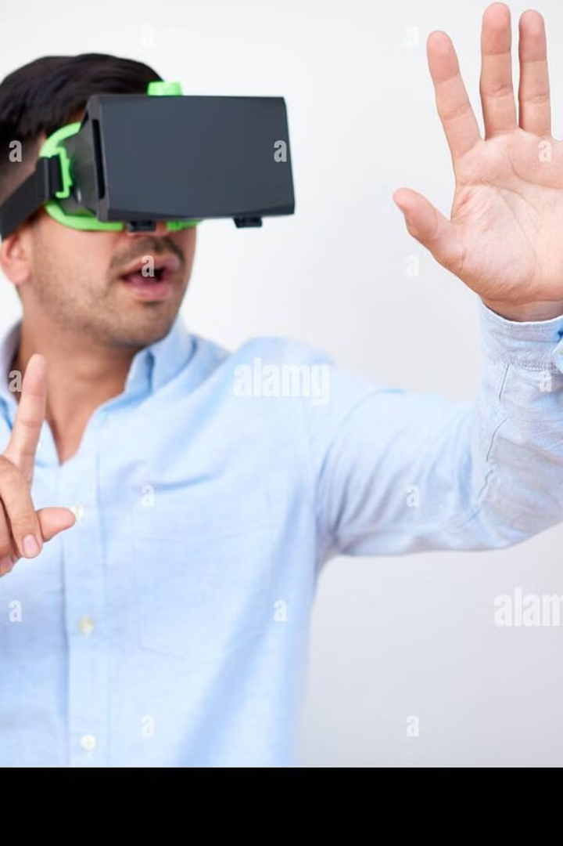
Future Scope: Expanding Possibilities
Custom Gestures
Implement AI-based learning to enable personalized gestures.
Diverse Applications
Extend support to various applications including games, smart homes, and AR/VR.
Multi-hand Control
Improve support for multiple users interacting simultaneously.
Voice Integration
Integrate voice commands for hybrid control.

Slide 9

Conclusion: Empowering the Future
This project showcases the potential of gesture-based interaction for enhanced accessibility and user experience. It paves the way for advancements in human-computer interaction and a more intuitive way to interact with technology.

