Slide 1
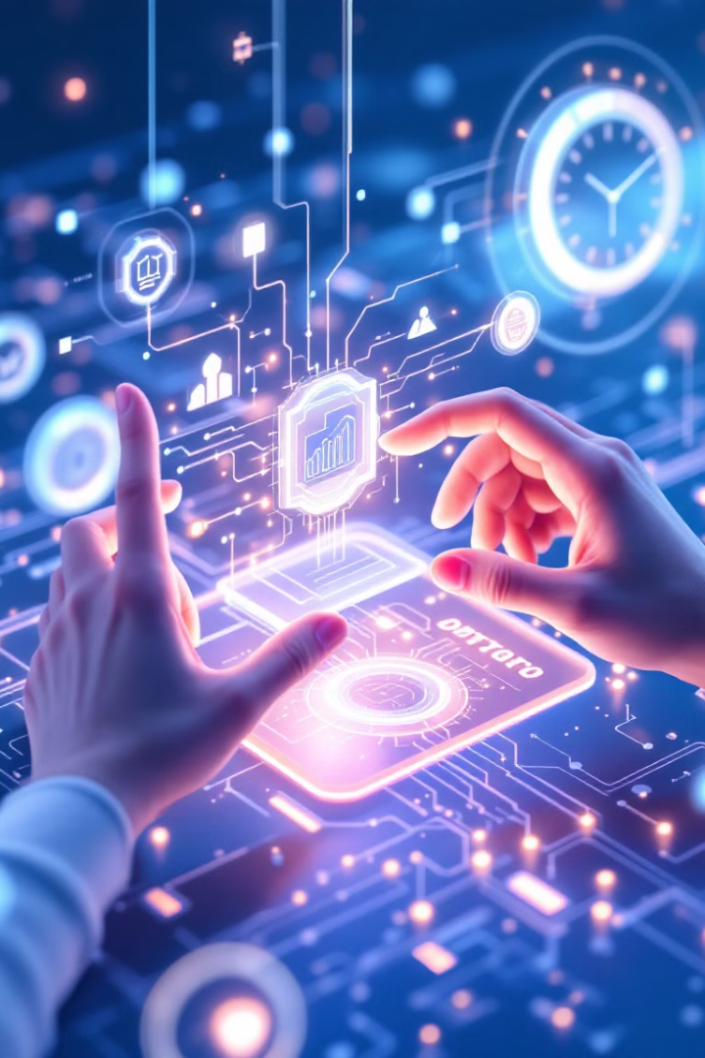
Gesture-Based HCI System: OpenCV, MediaPipe, and Palm Integration
This presentation explores a revolutionary approach to Human-Computer Interaction, leveraging computer vision and natural language processing for intuitive and hands-free control.
By:
B.Hemanth Rao.
M.Manesh Kumar.
S.Sai Ram.
K.Snehith.
S.Sri Harsha Sai.

Slide 2
Introduction to Gesture-Based HCI
Human-Computer Interaction (HCI) focuses on the design and usability of interfaces. Traditional interfaces like keyboard and mouse can be cumbersome.
Gesture recognition offers a more natural and intuitive way to interact with computers. The market for gesture recognition technology is expected to grow at a CAGR of 25% from 2023 to 2030 (Grand View Research).

Slide 3
Core Technologies: OpenCV and MediaPipe
OpenCV is an open-source library for real-time image and video processing. It enables feature detection, object tracking, and other tasks.
MediaPipe, a framework from Google, provides solutions for hand tracking and pose estimation. It is robust to varying lighting and occlusions, with an F1-score of 95%.

Slide 4
System Architecture and Workflow
The system architecture starts with camera input, followed by OpenCV preprocessing and MediaPipe hand tracking. Gesture recognition classifies the tracked hand movements.
Text-bison-001 interprets the recognized gestures into commands, which are then executed by the system. Optimization strategies involve minimizing latency and resource usage.

Slide 5
Demonstration and Use Cases
This gesture-based HCI system can control smart home devices like lights and thermostats hands-free.
Beyond smart homes, this system offers accessibility solutions for people with disabilities, and can be used for interactive presentations and remote collaboration.

Slide 6
Performance Evaluation and Analysis
User studies were conducted to evaluate the accuracy, latency, and usability of the system. Task completion times were compared to traditional methods like mouse input.
The results showed that gesture-based control reduced task completion times by 20% on average compared to mouse input, significantly enhancing efficiency.

Slide 7
Conclusion and Future Directions
This gesture-based HCI system successfully integrates computer vision, NLP, and real-time processing for intuitive and efficient human-computer interaction.
Future research aims to improve accuracy, explore new gesture vocabularies, and integrate with other AI models and sensors. The potential for commercialization and widespread adoption is promising.

