Slide 1
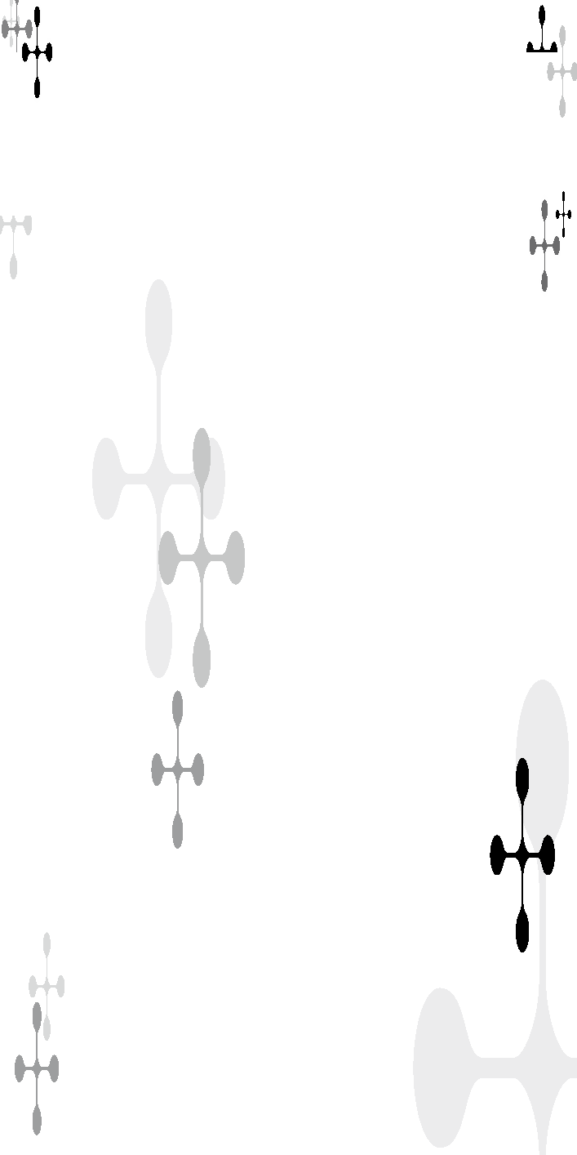



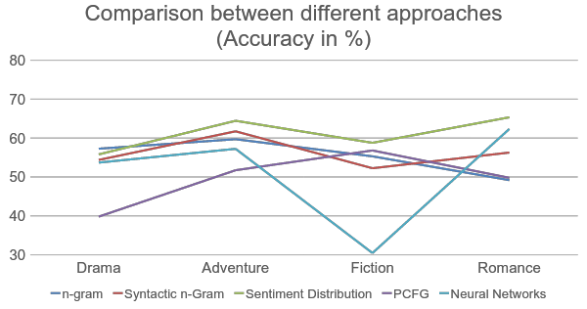
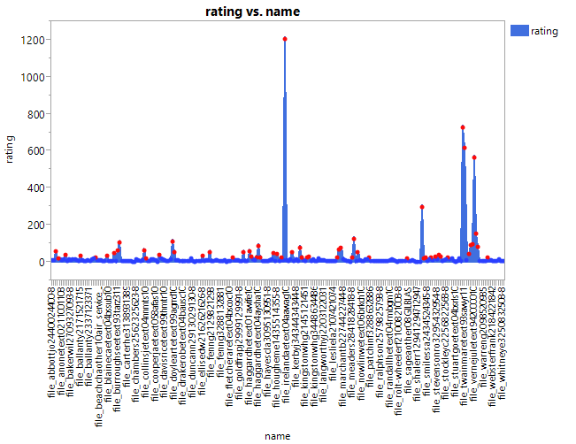
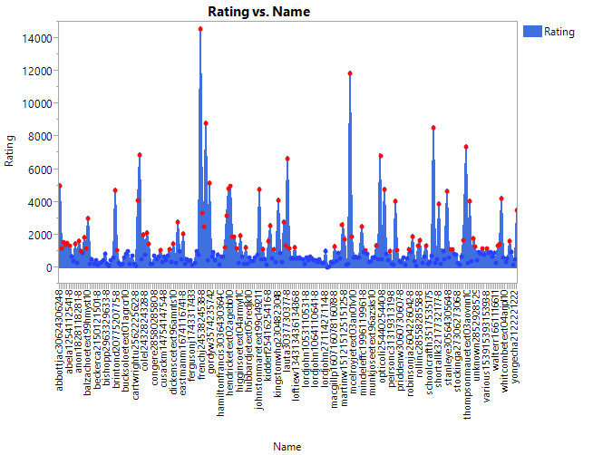

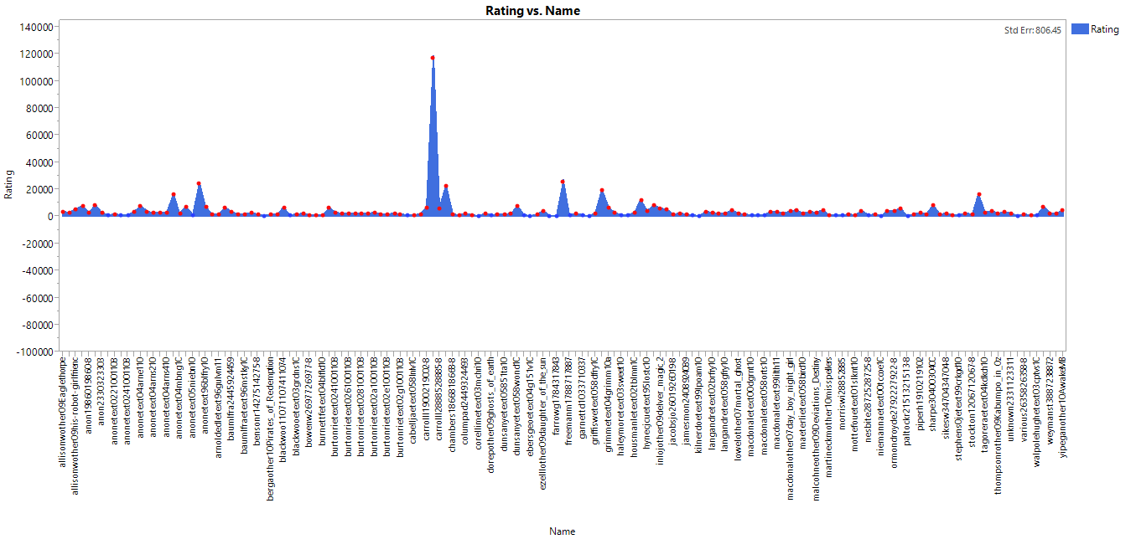
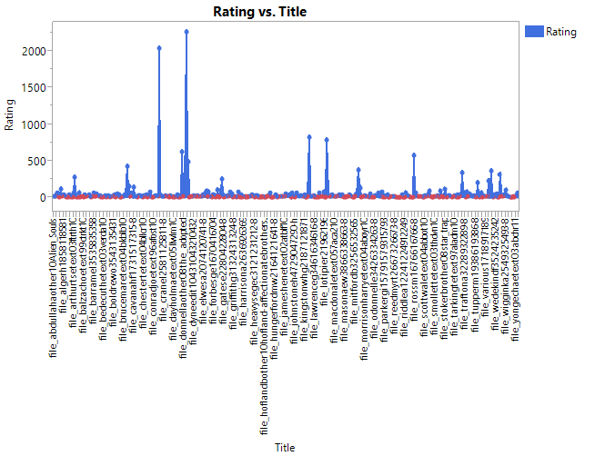

Predicting Success of Literary Writings
Mohit Raman, Raj Kansagra, Ajinkya Mandhare, Sri Harsha Anand Pushkala
{ mohitram | rkansagr | mandhare | anandpus } @usc.edu
Introduction
Approach II: Sentiment Distribution
Threshold plot for Data Annotation
Fiction
Drama
Examine the quantitative connection between writing style and success of a novel
Perform a comparative study of 4 NLP Techniques
Perform statistical analysis to identify the NLP technique best suited for a genre
Who will benefit from this?
Authors, publication houses, script writers, literary agents
Examine if Sentiment Distribution has any correlation with success of Literary work
Key chapters of a Novel: First few, Middle few and last few
Features: Sentiments from the key chapters
Success Neu_1 Pos_2 Neg_3….Neg_45 Pos_46….Neg_98 Pos_99
Failure Neu_1 Neu_2 Neg_3….Pos_45 Pos_46….Neg_98 Neu_99
….
Success Neu_1 Pos_2 Neg_3….Neg_45 Pos_46….Neg_98 Pos_99
Adventure
Romance
Conclusion
Data Annotation
Approach III: PCFG
There exists distinct linguistic patterns shared among successful literature
Statistical stylometry can be effective in discriminating successful literature
Interesting relation observed between sentiment distribution and literary success
Comparative insights between the different approaches
Constructed a Web Scraper that mined the Gutenberg pages
Extracted the meta-data for each book
Meta-data was used to annotate the training data as successful or not
Computing Threshold:
0.7 * (No. of Downloads/Recency of File) + 0.3 * (No. of Votes)
Approach I:
Created features from CFG rules for each sentence for classification
Sparse feature space resulted in bad results
Approach II:
Used lexical parsing to get PCFGs (G_{succ},G_{nonsucc}) from training set for each genre
Use PCFGs for classification
Decent results for relatively new books of famous genres
Comparison between the different approaches (Accuracy in %)
APPROACH | GENRE |  |  |  | Avg
 | Adventure | Fiction | Drama | Romance
n-Gram | 59.7 | 55.3 | 57.26 | 49.18 | 55.36
Syntactic N-Grams | 61.73 | 52.24 | 54.38 | 56.27 | 56.15
Sentiment Distribution | 64.44 | 58.77 | 55.8 | 65.33 | 61.08
PCFG | 51.73 | 56.81 | 39.8 | 49.78 | 49.39
Neural Networks | 57.23 | 30.45 | 53.69 | 62.33 | 50.93
Future Work
Approach I: n-Grams/ Syntactic n-Grams
Approach IV: Artificial Neural Networks
Genre-wise sentiment annotated data can increase accuracy of sentiment distribution
Combine features from different approaches and conduct further comparative studies
Dynamically selecting best technique depending on genre
Evaluate the role of commonly occurring patterns(nGrams) in Novel success
Improve by considering the neighbours taken by following path in syntactic trees
Syntactic nGrams provide better results by identifying related patterns
eg: “The strongest rain ever recorded”
(ROOT-0, rain-3) (The-1, strongest-2) (rain-3, The-1) (rain-3, recorded-5)
Constructed a 5 layer Artificial Neural Network to analyse some statistical data related to the books.
Some of the features extracted are:
The richness of the text
Distribution of verbal clauses
Ease of reading
Average length of the line
Number of Downloads
References
Vikas Ganjigunte Ashok, Song Feng and Yejin Choi. S uccess with Style: Using Writing Style to Predict the Success of Novels

