Slide 1

Motion detection by H.264 motion vectors
--------Yan Meng
--------Sriharsha Madala

Slide 2
main function
Call
R running order
DecodeOneFrame
FinitDecoder
decode_one_frame
flush_dpb
output_one_frame_from_dpb
detection
decode_slice
exit_picture
decode_one_slice
store_picture_in_dpb
Motion vector
detection
output_one_frame_from_dpb

Slide 3
decode_one_frame
{
decode_slice
{
decode_one_slice
{
extraction of motion vectors for current slice
}
}
store all the motion vectors into a Linked List for future use
exit_picture
{
store_picture_in_dpb
{
check buffer?
}
}
}
output_one_frame_from_dpb
{
detect the moving object in the frame to be output from the buffer , based on its motion vectors
}
full

Slide 4
decode_one_frame
{
struct fmvnode *frame_node;
for( ; ; )
{ decode_slice;}
}
typedef struct framemv
{
short mv[2][BLOCK_MULTIPLE][BLOCK_MULTIPLE][2];
int fb;
}frame_mv;
fmv is an array whose element type is frame_mv and size is the number of macroblocks in one frame.
frame_node->fmv
: parameter passing
struct fmvnode
{
frame_mv *fmv;
int poc;
struct fmvnode *next;
};
struct mv_linklist
{
struct fmvnode *head;
int length;
};
node
Linked List

Slide 5
typedef struct framemv
{
short mv[2][BLOCK_MULTIPLE][BLOCK_MULTIPLE][2];
int fb;
}frame_mv;
fmv is an array whose element type is frame_mv and size is the number of macroblocks in one frame.
decode_one_slice
{
}
while (end_of_slice == FALSE)
{
extraction of motion vectors for current macroblock
}
extraction of motion vectors for current slice
a:forward or backword
b c:coordinate of the 4x4 submacroblock
in one 16x16 macroblock
for(a=0;a<2;a++)
for(b=0;b<4;b++)
for(c=0;c<4;c++)
{
fmv[currMB->mbAddrX].mv[a][b][c][0]=……
fmv[currMB->mbAddrX].mv[a][b][c][1]=……
}
Index of the macroblock in current frame
Motion vector of one macroblok

Slide 6
decode_one_frame
{
struct fmvnode *frame_node;
for( ; ; )
{ decode_slice;}
store all the motion vectors into a Linked
List for future use
}
typedef struct framemv
{
short mv[2][BLOCK_MULTIPLE][BLOCK_MULTIPLE][2];
int fb;
}frame_mv;
fmv is an array whose element type is frame_mv and size is the number of macroblocks in one frame.
frame_node->fmv
frame_node->fmv include all the motion vectors of this frame
struct fmvnode
{
frame_mv *fmv;
int poc;
struct fmvnode *next;
};
struct mv_linklist
{
struct fmvnode *head;
int length;
};
node
Insert the node into the Linked List
Poc marks one frame
Linked List

Slide 7
exit_picture
{
store_picture_in_dpb
{
check buffer full?
}
}
yes
output_one_frame_from_dpb
{
detect the moving object in the frame to be output from the buffer , based on its motion vectors
}
poc get the corresponding node get motion vectors detection

Slide 8
detection
Decide forward or backward MV use
Threshold computation
Small boxes collection
Big box plotting

Slide 9
detection
Decide forward or backward MV use
Threshold computation
Small boxes collection
Big box plotting

Slide 10
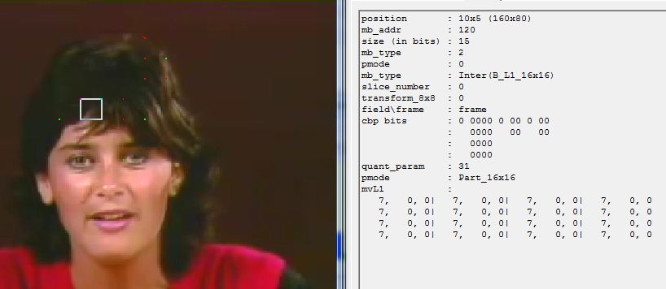
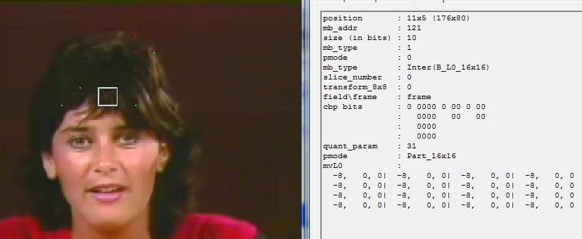
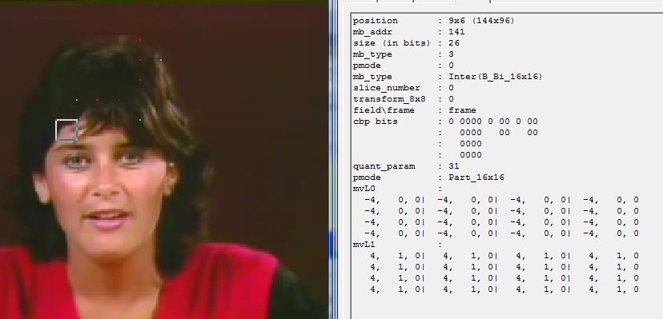

Slide 11
For unity, we use one direction MVs for each macroblock when computing norm threshold.
MVL0 and MVL1: use MVL0
If all the forward MVs are zero, we will use backward MVs, no matter whether backward MVs are zero.

Slide 12
typedef struct framemv
{
short mv[2][BLOCK_MULTIPLE][BLOCK_MULTIPLE][2];
int fb;
}frame_mv;
filemv is an array whose element type is frame_mv and size is the number of macroblocks in one frame.
fb=0:use forward MVs. fb=1:backward
void judge_forward_or_backward(frame_mv *filemv,int mbs)
{ int i,b,c,a;
for(i=0;i<mbs;i++)
{
a=1;
for(b=0;b<4;b++)
{
for(c=0;c<4;c++)
if((filemv[i].mv[0][b][c][0]!=0)||(filemv[i].mv[0][b][c][1]!=0))
{
a=0;
break;
}
if(a==0) break;
}
filemv[i].fb=a;
} }

Slide 13
detection
Decide forward or backward MV use
Norm threshold computation
Small boxes collection
Big box plotting

Slide 14
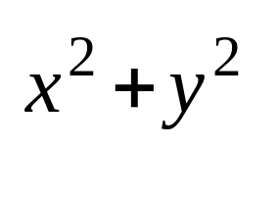

Hash table
0 16 320 80 352 16 56 0 16
0 16 0 80 352 16 56 0 16
10
15
20
25
30
35
40
45
50
∞
?
?
Because ,and the index of 320 is smaller than that of 352.
To avoid false positive, we may not choose the biggest threshold, but choose the one lower and close to the biggest.

Slide 15
detection
Decide forward or backward MV use
Threshold computation
Small boxes collection
Big box plotting

Slide 16
In one frame, we search macroblock by macroblock.
x y:location of a macroblock in one frame
for(y=0;y<p_Vid->height/16;y++)
for(x=0;x<p_Vid->width/16;x++)
if(search_nonzero(x,y,filemv,max,p_Vid->width/16)!=0)
{
rec_box(x,y,filemv, p_Dpb->fs[pos]->frame->imgY,list,max,p_Vid->width/16);
}

Slide 17
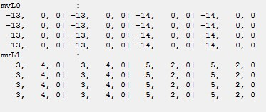

search_nonzero
In one macroblock, we search 4x4 submacroblock by 4x4 submacroblock.
Judge forward or backward?
Search row by row. Once
in one submacroblock , jump out of the loop and return 1.

Slide 18
In one frame, we search macroblock by macroblock.
for(y=0;y<p_Vid->height/16;y++)
for(x=0;x<p_Vid->width/16;x++)
if(search_nonzero(x,y,filemv,max,p_Vid->width/16)!=0)
{
rec_box(x,y,filemv, p_Dpb->fs[pos]->frame->imgY,list,max,p_Vid->width/16);
}

Slide 19
Rec_box
Submacroblock merging to small boxes using graph BFS
Small boxes inserted to the Linked List for future use

Slide 20
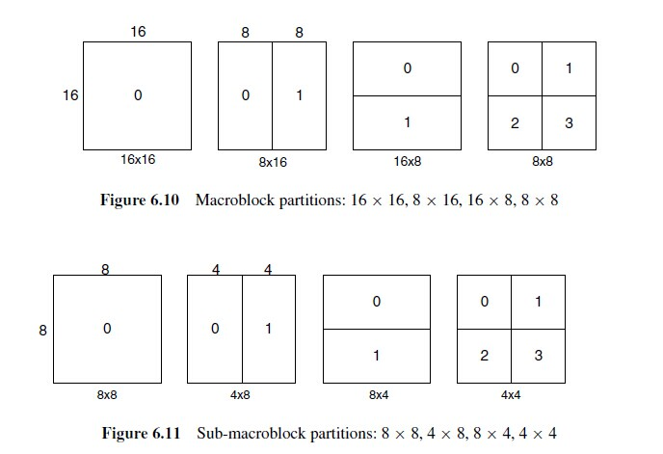

Slide 21
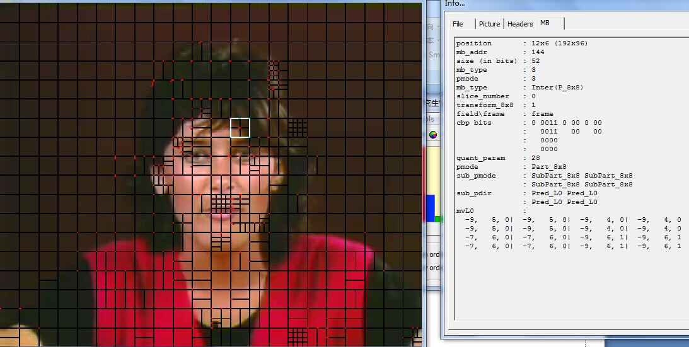
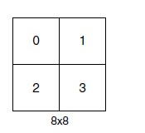
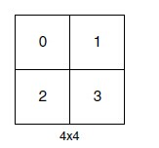
0
-9,4
16
2
1
-9,4
-9,4
3
-9,4

Slide 22
Each graph is a small box. The BFS of a graph returns the right bottom pixel of the small box.
With the left top and right bottom pixels, we insert the small box to a Linked List.

Slide 23
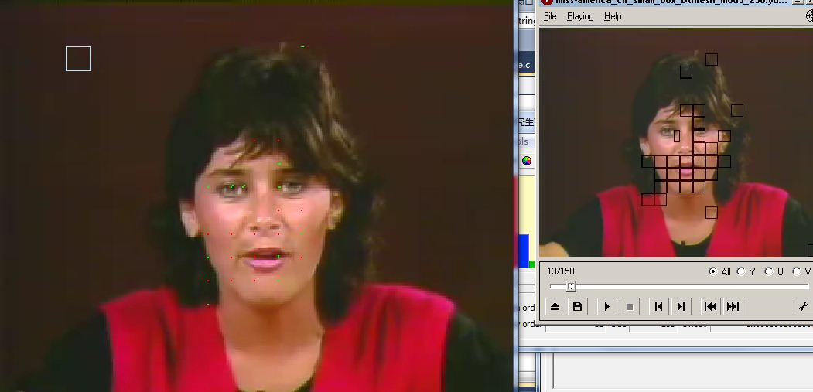

Slide 24
detection
Decide forward or backward MV use
Threshold computation
Small boxes collection
Big box plotting

Slide 25
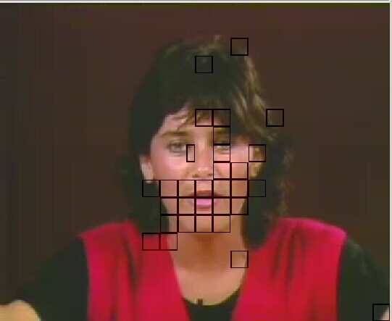

Traversal of the Linked List, we group the nodes(small boxes) connected to each other into special trees.
Special: each node has only one child
Use distance between small boxes to decide whether they are connected.
16
16

Slide 26
Then, we will get several trees.

Slide 27
We choose the tree which has most nodes and traverse this tree to obtain the greatest x and y coordinates and smallest x and y coordinates, the so-called top-left and right-bottom pixels of the big box.
Finally, we draw the big box by changing the pixel value of the frame before it is outputted from the buffer.

Slide 28
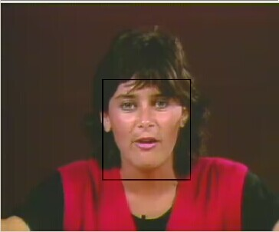
x,y
x,y

Slide 29
Tracking
Some frames have little motion. In this case, tracking is used.
struct track
{
int spx;
int spy;
int epx;
int epy;
}
Each time when doing detection , we update it.

Slide 30
Tracking
If one frame is “static”, we use the box of the closest one of its previous frames.

Slide 31
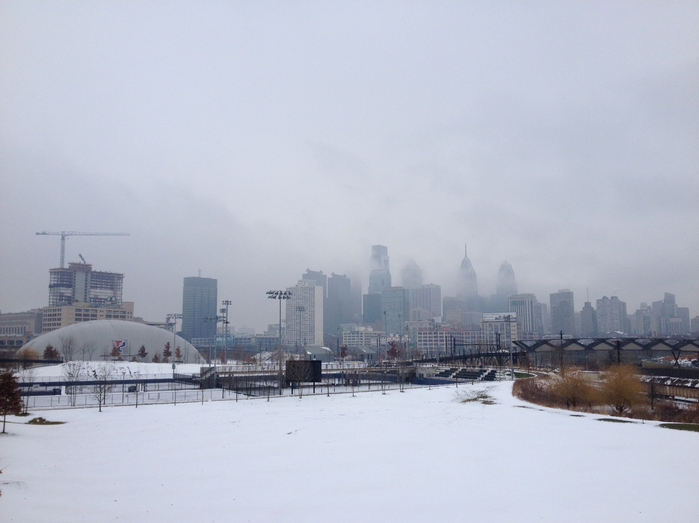

Thank you!

