Slide 1
Health Monitoring Kit
with
Data Analysis
Guide Name:-
Mr. S. Karunakar Reddy
By:-
Sriharsha MVS (15AG1A0425)
Ravi Teja T (15AG1A04B8)
Deepthi T (15AG1A04C0)

Slide 2

PRESENTATION OUTLINE
<number>
Introduction
Implementation
Block Diagram
Working
Conclusion

Slide 3
INTRODUCTION
The vital signs of people is crucial in today’s medicine.
It’s imperative that today to make a portable and low cost Electronic Health Monitoring Kit to deploy in rural areas and health camps in order to measure vital signs in longer period for proper analysis of the patient and to take actions accordingly.

Slide 4
HARDWARE
<number>
Controller Board ( Arduino Based Dev. Board)
WiFi Module (NodeMCU)
Cloud (Raspberry Pi 3 Model B+)
Display Module (OLED)
Sensors

Slide 5
SOFTWARE
<number>
Arduino Dev. Environment
Python Dev. Environment (Python3)
GNU Linux (Raspbian)
Data Analytics (Pandas)
Web Frame Work (Bottle)

Slide 6
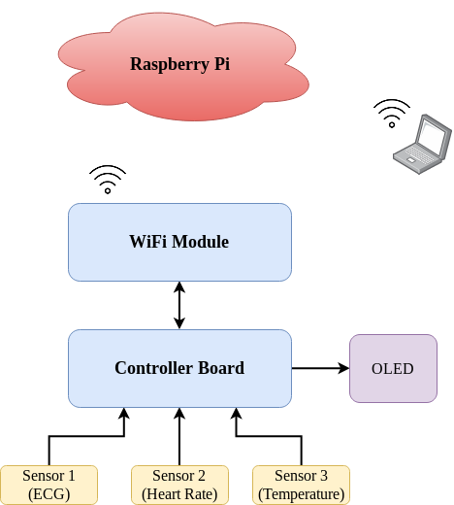
BLOCK DIAGRAM
<number>

Slide 7
WORKING
The Controller Board collects the data from all the Sensors and sends the data to WiFi module.
This Data is sent is sent to the Cloud in JSON format through WiFi communication.
The received data is used for Data Analysis and a Web Portal is hosted on the cloud.
These Analysis can be accessed on any browser platform by connecting to the cloud.

Slide 8
CONCLUSION
With this project we can build a Portable and Low Cost Health Monitoring Kit to deploy in Health Camps and Rural areas

