Slide 1
Machine Learning with IOT
Sri Harsha MVS,
Data Engineer, Newsclick

Slide 2
Contents:
Introduction to ML
Data Collection
Data Preprocessing
Introduction to Orange
Conclusion

Slide 3
Introduction To ML
A subset of artificial intelligence (AI), machine learning (ML) is the area of computational science that focuses on analyzing and interpreting patterns and structures in data

Slide 4
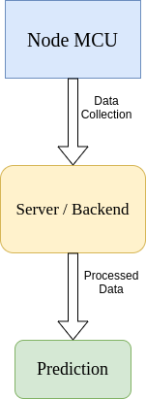
Data Collecting:
Data Collecting is the key part for Machine Learning
IOT devices will be the data collection points.
Analog data coming from IOT devices are saved into storage units
using PUB-SUB model(MQTT, KAFKA, etc)

Slide 5
Data Pre-processing
Data preprocessing is required task for cleaning the data and making it suitable for a machine learning model which also increases the accuracy and efficiency of a machine learning mode

Slide 6
Introduction to Orange
Orange is a Interactive platform which helps in identifying which model is effectively applicable to the given data.

Slide 7
Conclusion

Slide 8
Questions

Slide 9
Thankyou

