Slide 1

SafeBank
CSYE6200-Concepts of Object Oriented Design
Sri Harsha Peri(002921346)
Varun Vuppala(002193132)
Rajesh Kaireddy(002198556)

Slide 2

SafeBank
Project Idea:
Develop an internet banking application.
Solve problems for banks and customers.
Provide convenience and save time for customers.
Ensure the security of customer data and prevent fraud.
Offer multiple banking services through a single platform.
Build a secure layered JavaFx application architecture.

Slide 3

SafeBank
Purpose:
Provide customers with a convenient and secure banking experience.
Enhance customer experience with easy-to-use features.
Enable customers to perform banking transactions and manage their accounts online.
Reduce the need for in-person banking transactions and improve accessibility for customers.

Slide 4

SafeBank
Technical Concepts:
Java Functionalities and concepts used in this project are
Class: static and non static variables, methods and blocks, constructors
Interfaces: abstract and concrete methods,
OOPS Concepts : References, Inheritance, Polymorphism, Exception Handling
Advanced Implementation: Functional Interfaces, Java Collection Framework(List,
Map), Streams and Concurrency API, Multithreading, Recursion,
API’s: Date and Time API,SMTP API for Email service and Twillio for OTP Service
Libraries: Bcrypt password hashing library for encrypting passwords
Architecture: Layered Application
DataBase: RDBMS (MySQL) for storing user data in relationally associated schemas like users, transactions, beneficiaries Accounts and Credit Cards

Slide 5
SafeBank
Technical Challenges:
Database design was the most challenging task as schemas and their respective associations
decide the complexity of the applications
In order to ensure the smooth workflow of the application, multiple database queries based on multiple database columns and constraints were designed which were challenging as it involved complex queries
Designing the layered application architecture considering best practices as per the industry standards were challenging in initial stage. However, that went very smooth for the rest of the application development
Using classes, interfaces and their respective methods of the java collection framework reduced lot of complexities. But we had to refer to the documentation of JavaDoc to make it simpler
Initially implemented thread safe classes for every transaction(includes deposits, payments, transfers to self and beneficiaries and credit card bill payments)However, it was challenging to update UI changes synchronously on a separate thread as JavaFx allows only 1 thread for updating UI changes
Later came up with the better solution and implemented Java.util.concurrency API
Setup cron job for updating repayment status of credit card transactions with respect to the due date. This was very much challenging to schedule a run for every sec

Slide 6

SafeBank
Design and Implementations:
For UI , we have written multiple JavaFx files and conditional rendering of layouts
We maintained a continuous and streamline progress through out the application development phase through github
Implemented functional interface(Anonymous method) for all transactions which is very optimal approach as it does not generate separate .class file and improves code execution time
Used components from JavaFx libraries to systematically organize box model layout design
Designed associations and mappings in database schemas involving lot of constraints to ensure high security
Enabled Two-Factor authentication by sending an OTP to the registered email and verifying with it before proceeding further
Implemented polling functionality to continuously update the cached state in the application

Slide 7
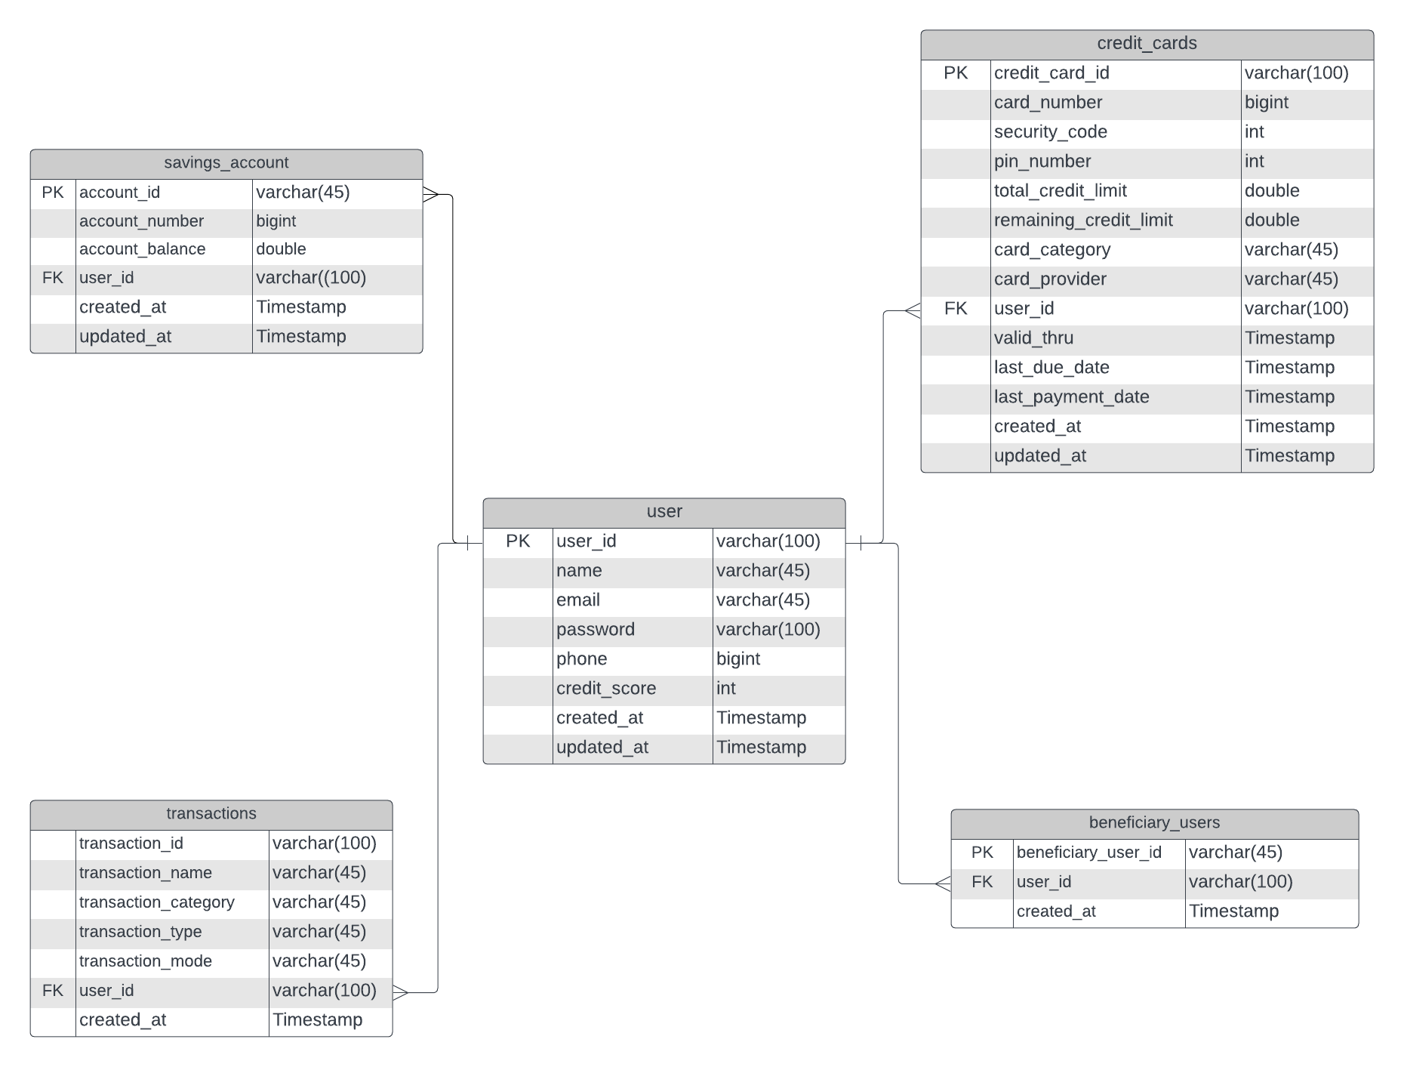
SafeBank
ER-Diagram

Slide 8
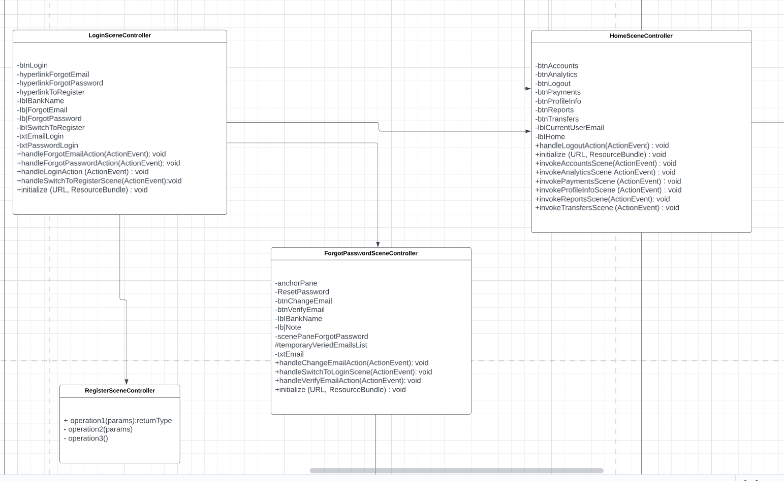
SafeBank
UML Class Diagram FLow:

Slide 9
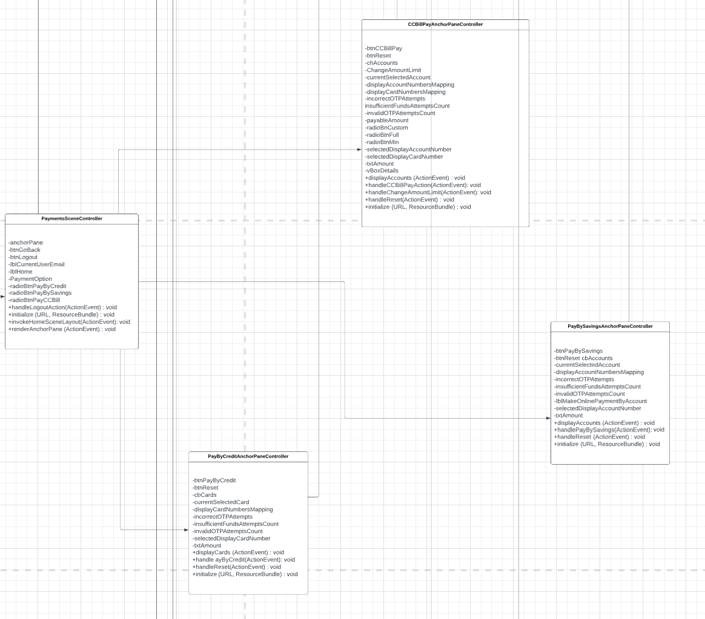
SafeBank
2 .Payment SceneControllers(CCbillPayments, PayBySavingAnchorPane, PayByCredit Anchor pane)

Slide 10
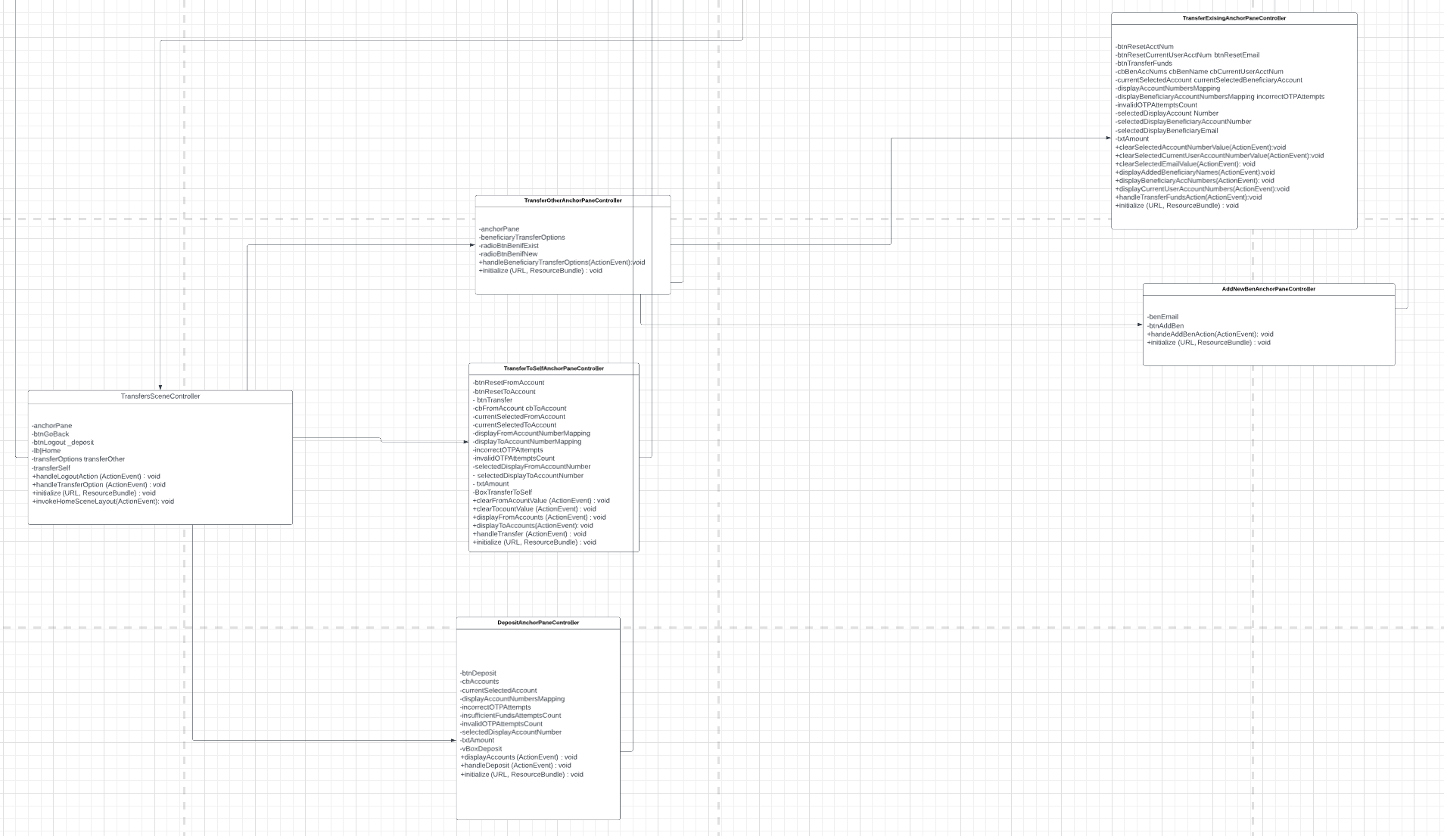
SafeBank
3.Transfers(TransferOther-{TransferExisting, Add NewBeneficiary} ,TransferSelf,Deposit)

Slide 11

SafeBank
Evaluation: files and their purposes
Application: It contains .fxml and Controller files which used for Front-end UI part
DataAccessObjects(DAO): It provides a simple interface for accessing and manipulating the data in the database, allowing for easy modification of CRUD operations
Enums: created Enums for creditCardtypes, cardProviders, transactionType, paymentStatus etc.
Models: It act as blueprint for the tables in database such as users, transactions, SavingsAccount, creditCard, BeneficiaryUser
Notifications: used email and otp services using smtp service, Twilio API’s
Services: It will act as a middle layer between DAO objects and methods in backend where it executes the business logic
Utils: It provides the feasibility to the business logic which reduces the redundancy for contain methods and performing simple calculations or conversions, manipulating data structures, or validating user input
Validations: written validations for the users, passwords and for the transactions

Slide 12
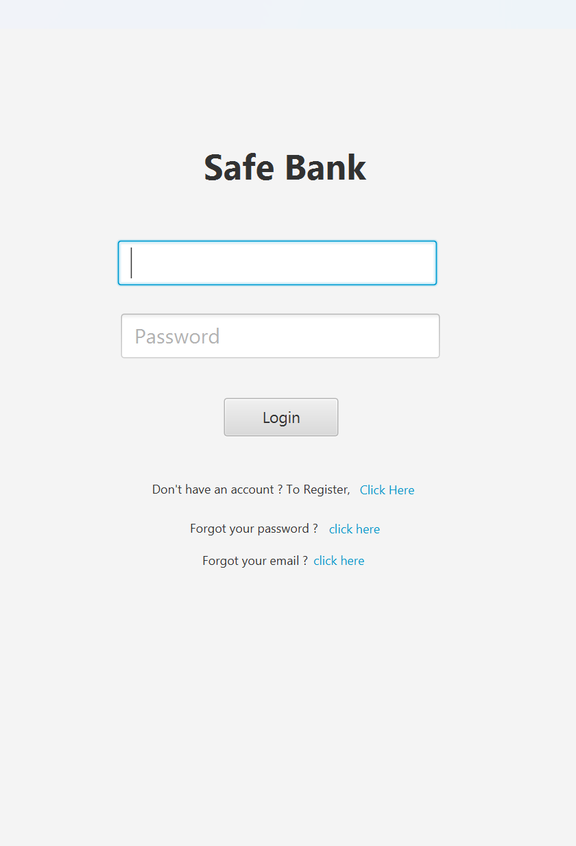
SafeBank
LoginPage:-
The LoginSceneController class is responsible for handling user login authentication and redirects the user to the Home Scene Layout on successful login.
The class uses various concepts such as event listeners, validations, DAO (Data Access Object) methods, and scene switching to implement the required functionality. Additionally, it reads email and password from the properties file for the login validation process.

Slide 13
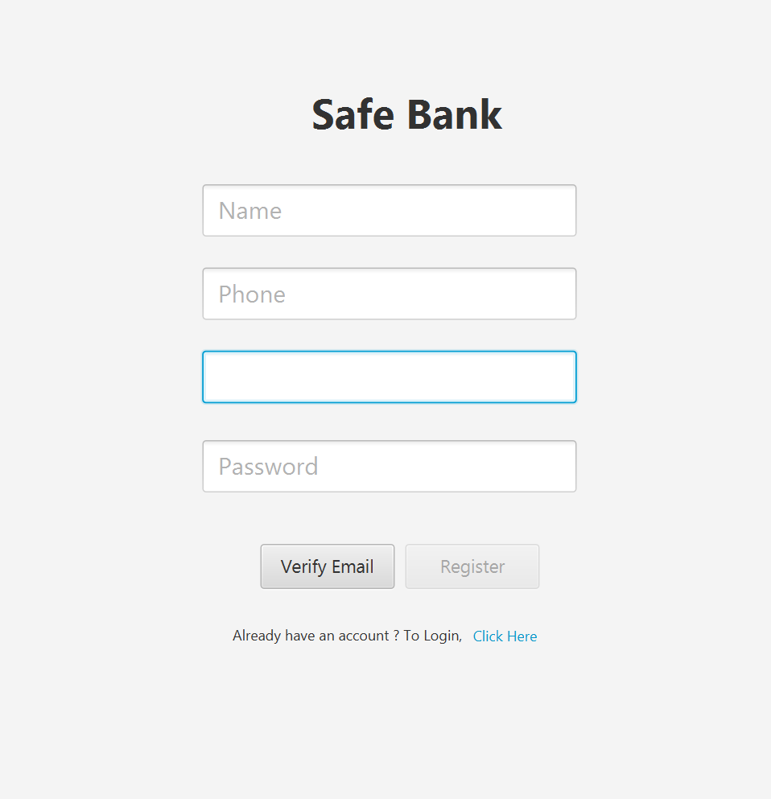
SafeBank
RegisterUI:-
This is a JavaFX controller class for a user registration form in a banking app.
It uses other classes for various functionalities such as database operations, password hashing, email sending, and input validation.
The handleRegisterAction method creates a new user account and savings account if input is valid or displays an error message.
The handleSwitchToLoginScene method switches the screen to the login screen, and the handleVerifyEmailAction method validates email input and sends OTP for email verification.

Slide 14
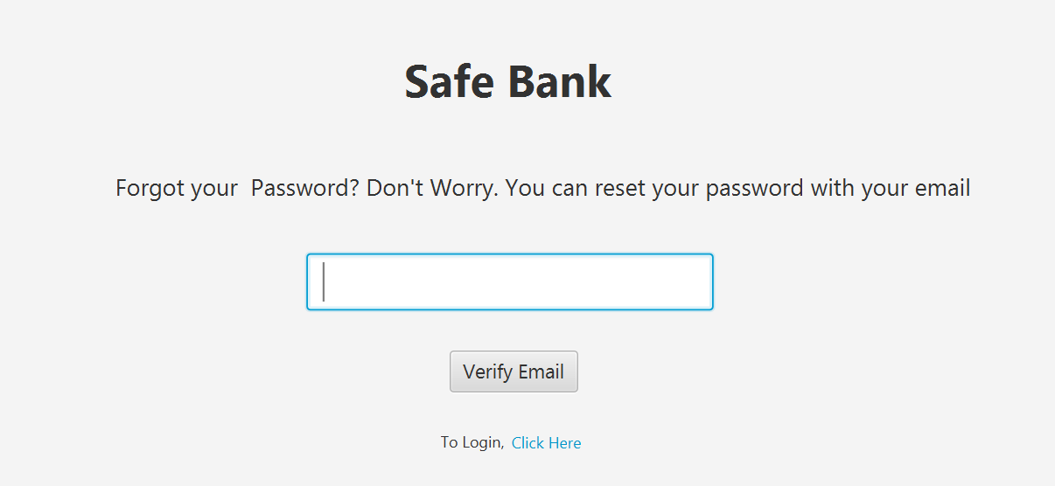
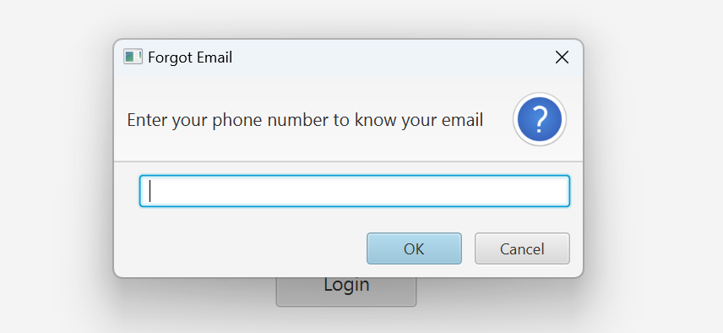
SafeBank
Forgot email and password UI
The ForgotPasswordSceneController class is responsible for handling user interactions with the forgot password screen in the application.
It includes methods for verifying a user's email address, generating and sending an OTP to the email address, and allowing the user to reset their password once their email has been verified.
Similarly for forgot email you will get the popout to enter the mobile number where u can retrieve your emailID.

Slide 15
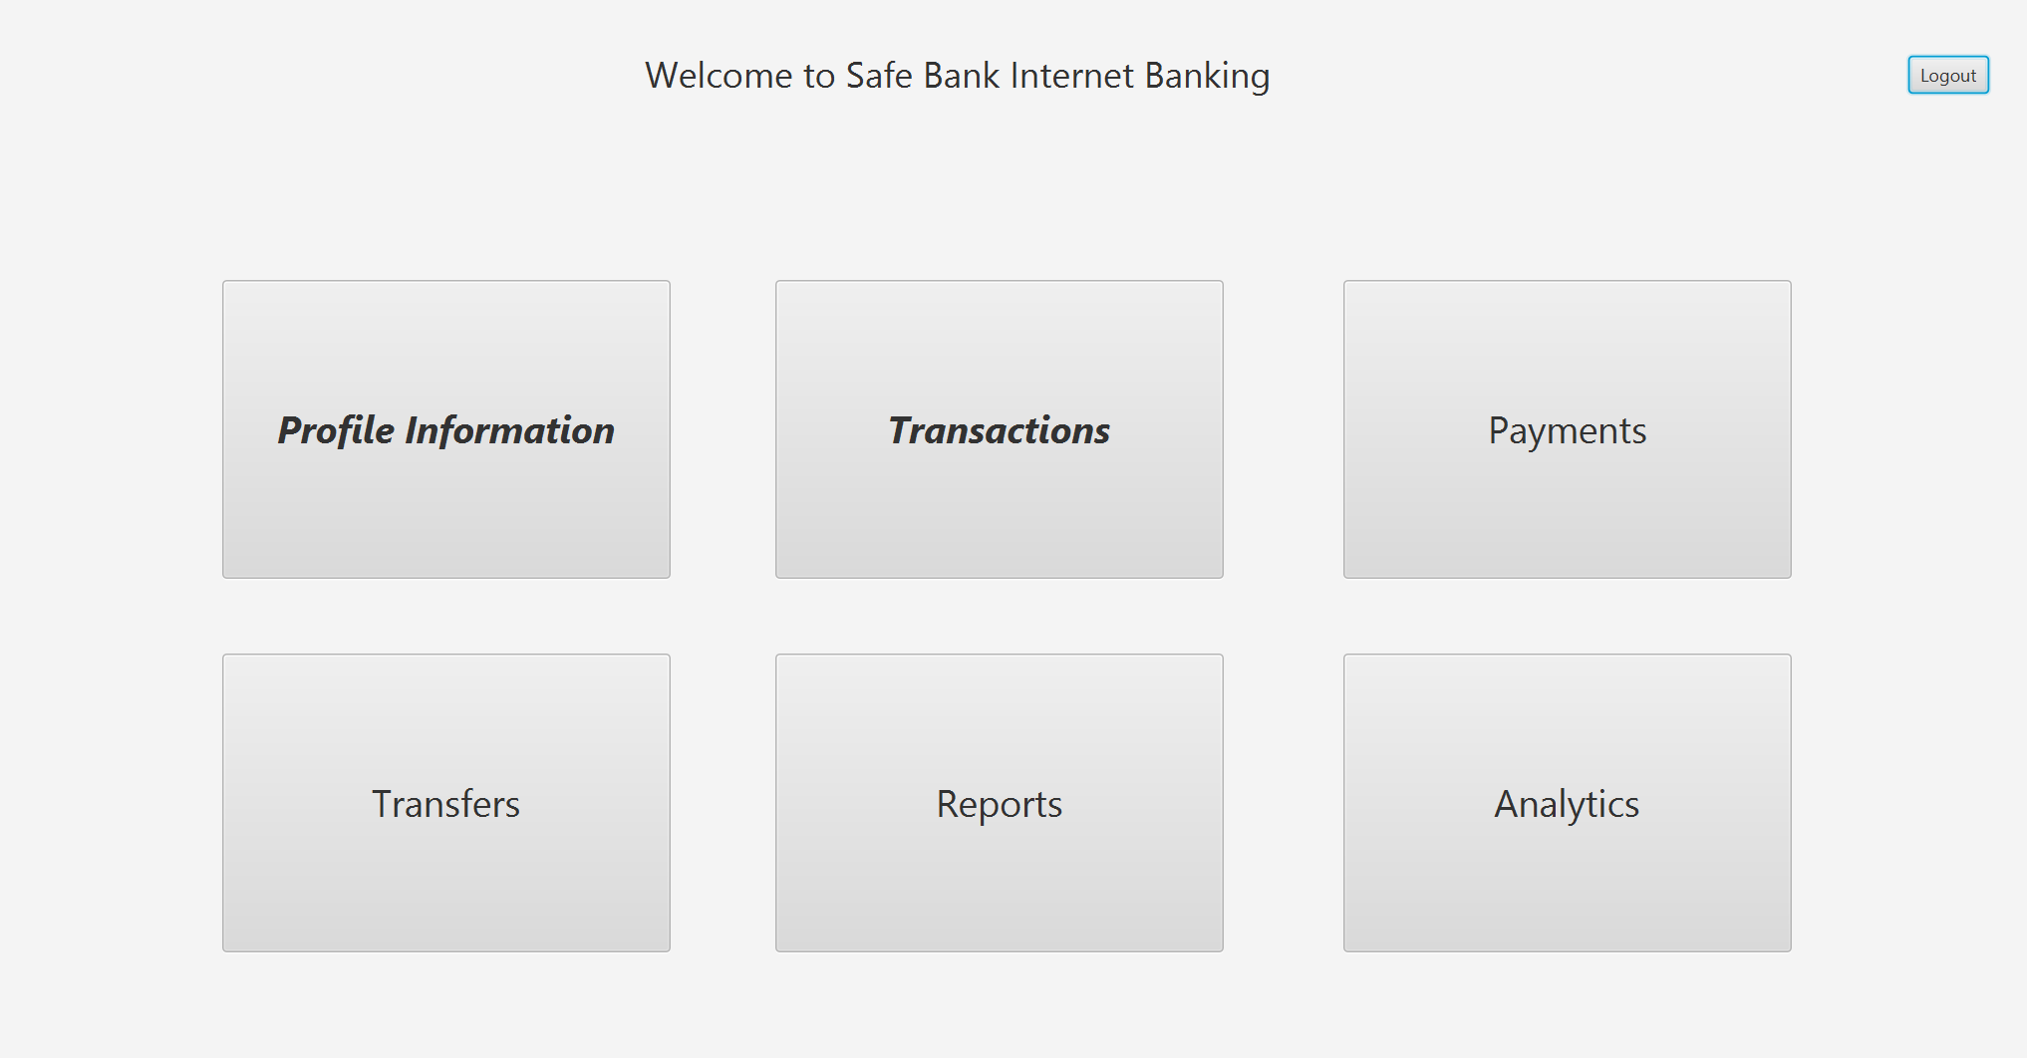
SafeBank
HomeSceneUI:
The class HomeSceneController implements the Initializable interface, which ensures that its initialize method is called when the scene is loaded.
The class defines several @FXML-annotated fields that correspond to UI elements in the scene, such as labels and buttons.
The class also defines several methods that handle user events, such as clicking on a button, and use the SwitchSceneController class to switch to another scene.
The handleLogoutAction method logs out the current user and switches to the login scene.
The invokeProfileInfoScene, invokePaymentsScene, invokeAccountsScene, invokeTransfersScene, invokeReportsScene, and invokeAnalyticsScene methods switch to their corresponding scenes when their corresponding buttons are clicked.
The initialize method calls the refreshState method, which updates the UI with the current state of the application.

Slide 16
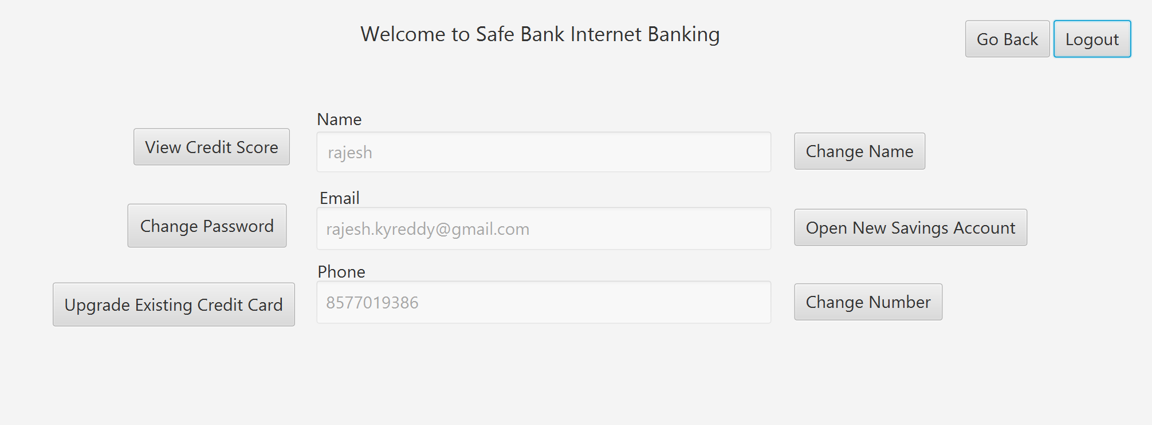
SafeBank
Profile Information:
This is a JavaFX controller class for a profile information scene that allows users to view and edit their account information, request a credit card upgrade, view their credit score, and create a new savings account. It imports various classes from other packages, contains instance variables and methods for handling user actions such as changing the user's name or phone number, changing their password, and creating a new savings account. The methods validate user input, update the user's account information or create a new savings account, and send email notifications to the user

Slide 17
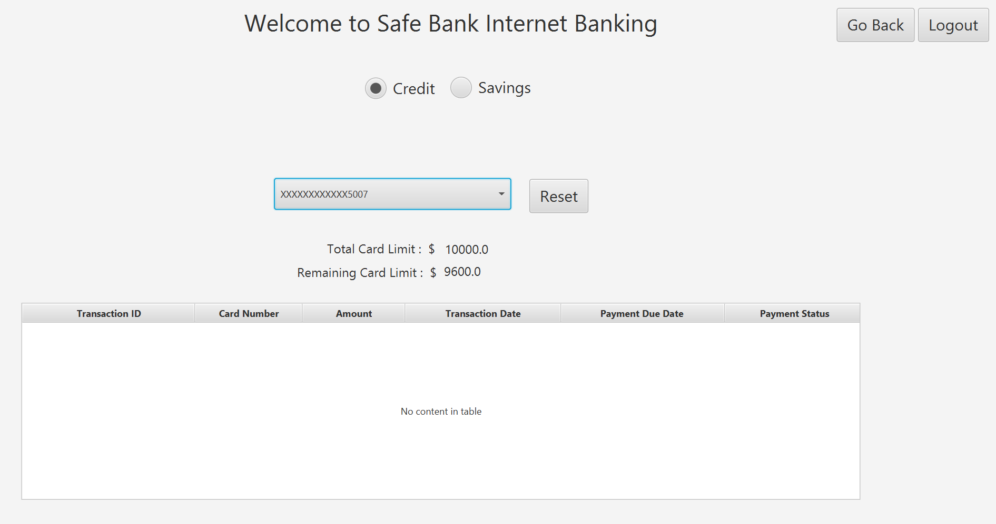
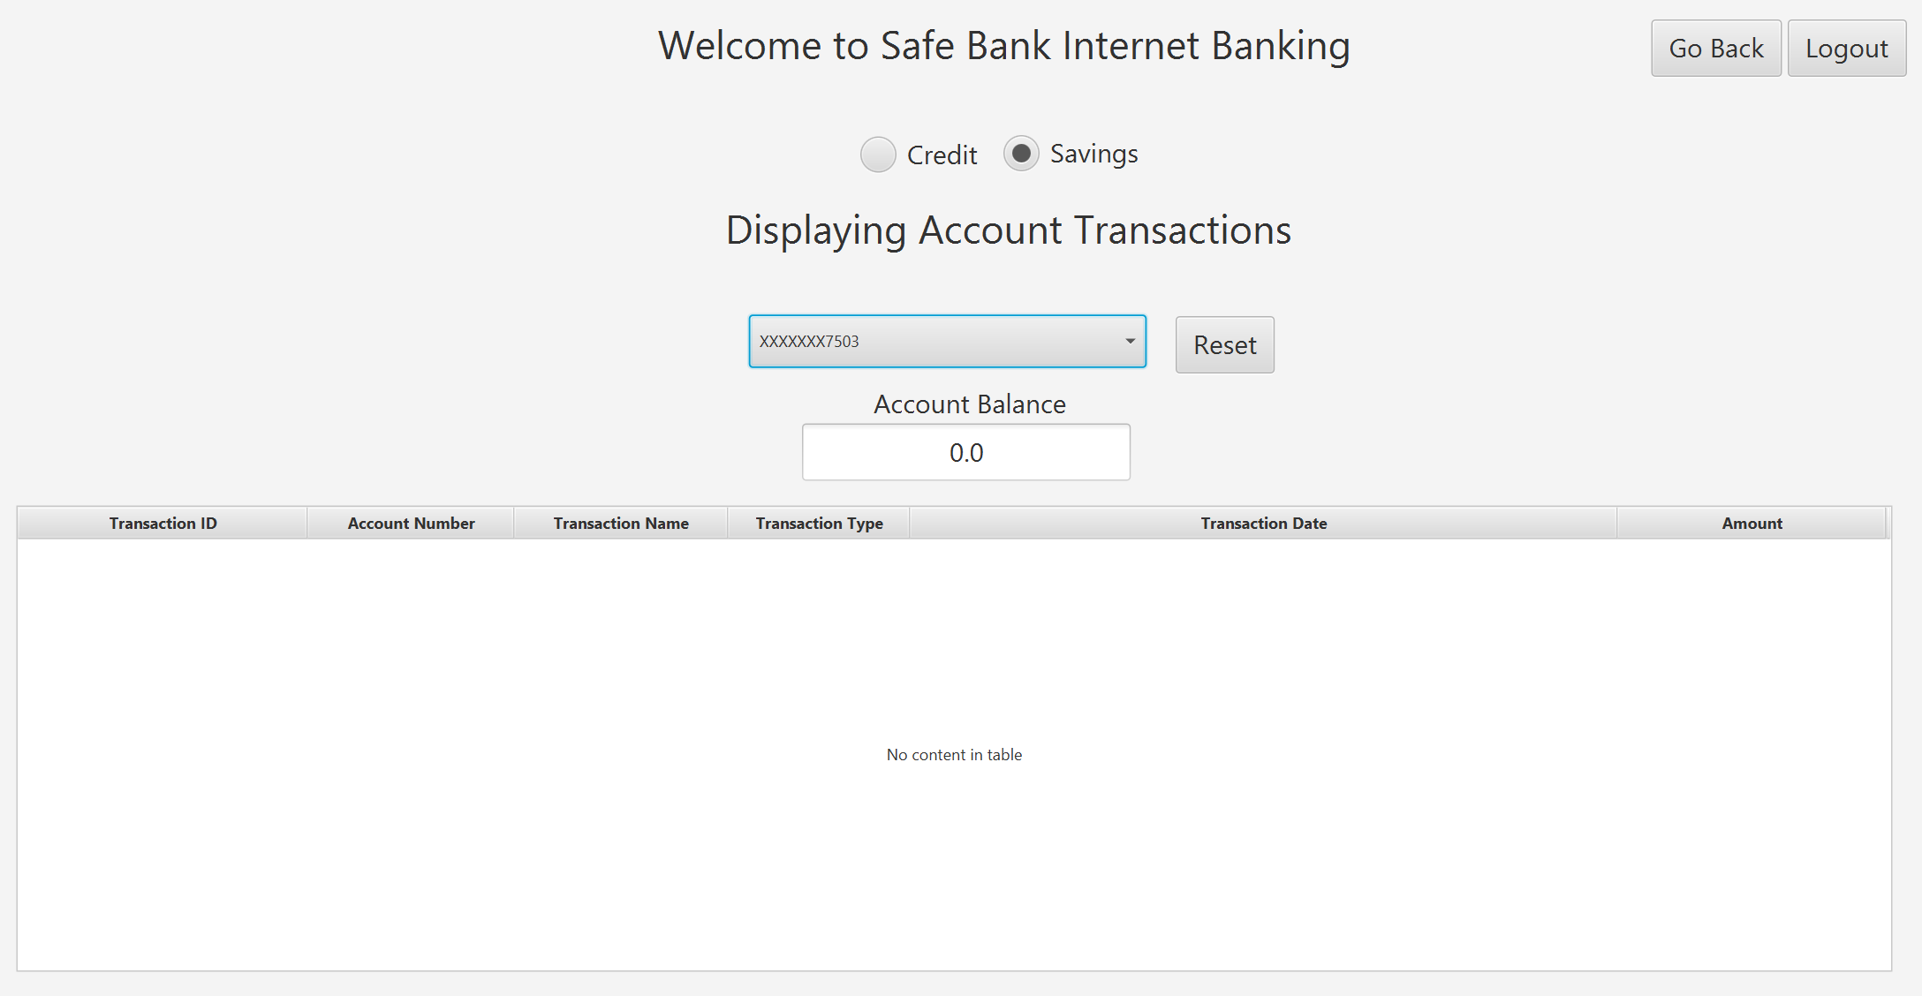
SafeBank
Transactions UI :
Credit:
The class "CardTransactionsAnchorPaneController" is a controller class for a JavaFX GUI application that manages credit card transactions.
The class contains methods to display credit card information and transactions, as well as clear the selected credit card.
The class uses DAO classes to access and update credit card and transaction data in a database.
Savings:
The class implements the Initializable interface for initialization of its components.
It contains event listeners for ComboBox selection and button click actions to display and clear selected account transactions respectively.
It utilizes DAO classes to fetch and display data in a TableView for selected SavingsAccount transactions.

Slide 18
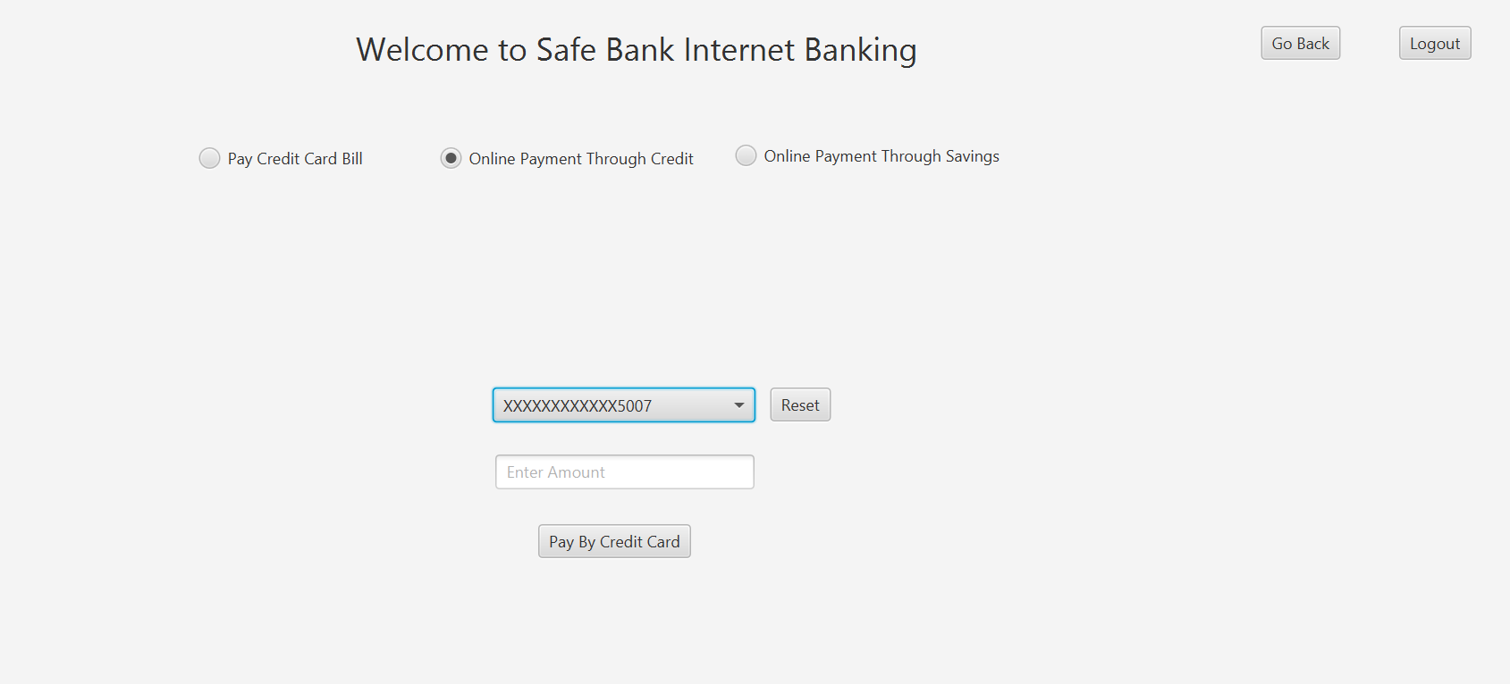
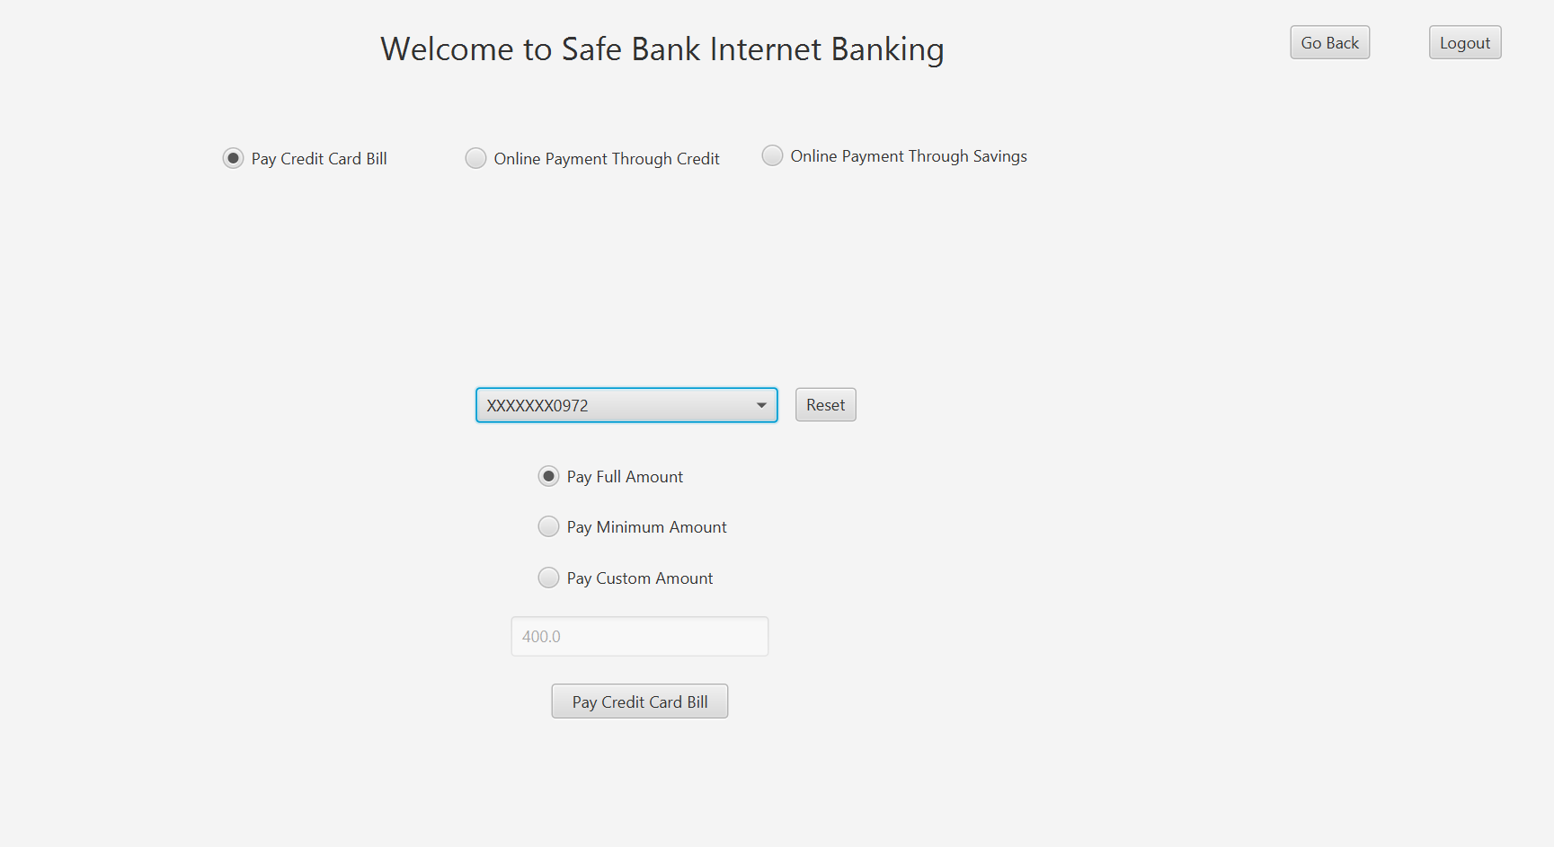
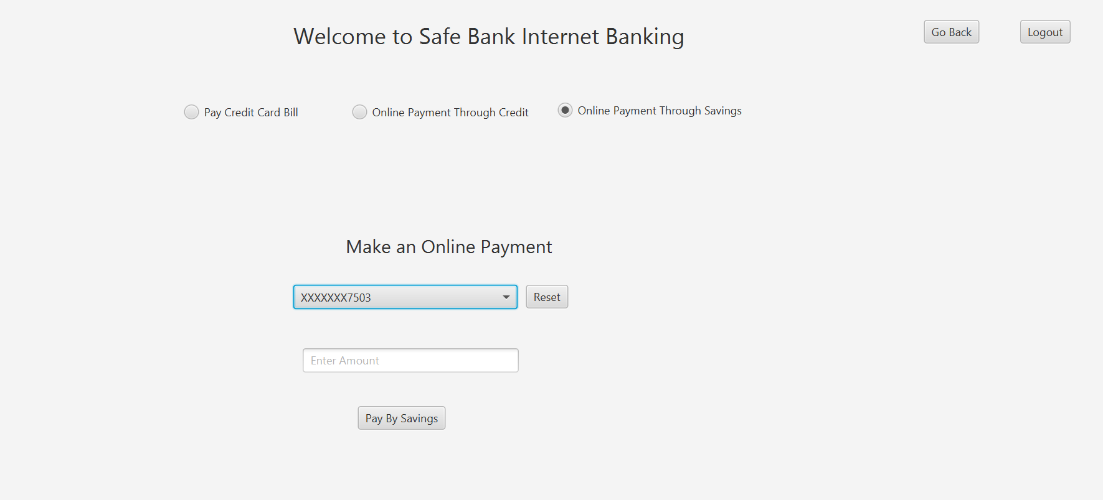
SafeBank
PayMentsUI:-
For Credit:
The PayByCreditAnchorPaneController class handles the payment process for online credit card payments in a banking application. It uses a ComboBox to display the user's credit cards and allows them to select one for payment.
The class validates the payment amount and handles various payment status scenarios, including insufficient funds, incorrect/invalid OTP, and payment exceptions. It also displays success/failure alerts to the user based on the payment status.
For Savings:
The Java class implements a controller for a user interface component for making online payments from a savings account.
The class has event handlers for selecting an account, entering payment amount, and submitting the payment, and performs validations to ensure input data is correct.
The payment transaction uses a PaymentFromAccountTransaction object with user ID, account ID, account balance, amount to be paid, and transaction category.
Payment status is checked to determine whether the transaction was successful or not, and an appropriate message is displayed to the user.

Slide 19
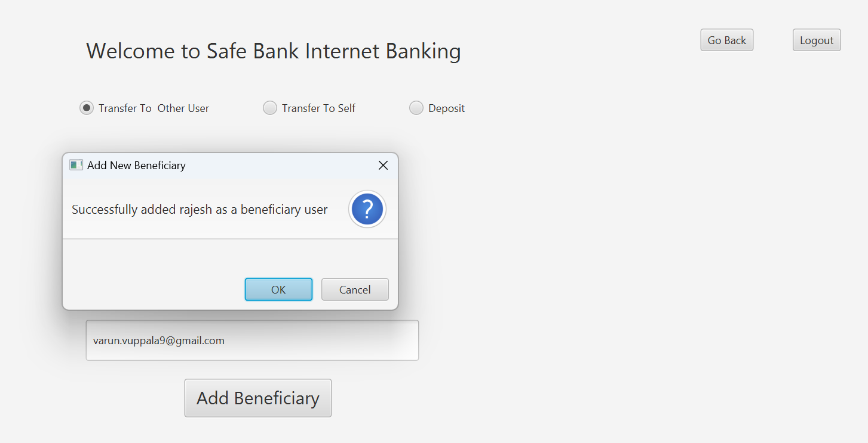
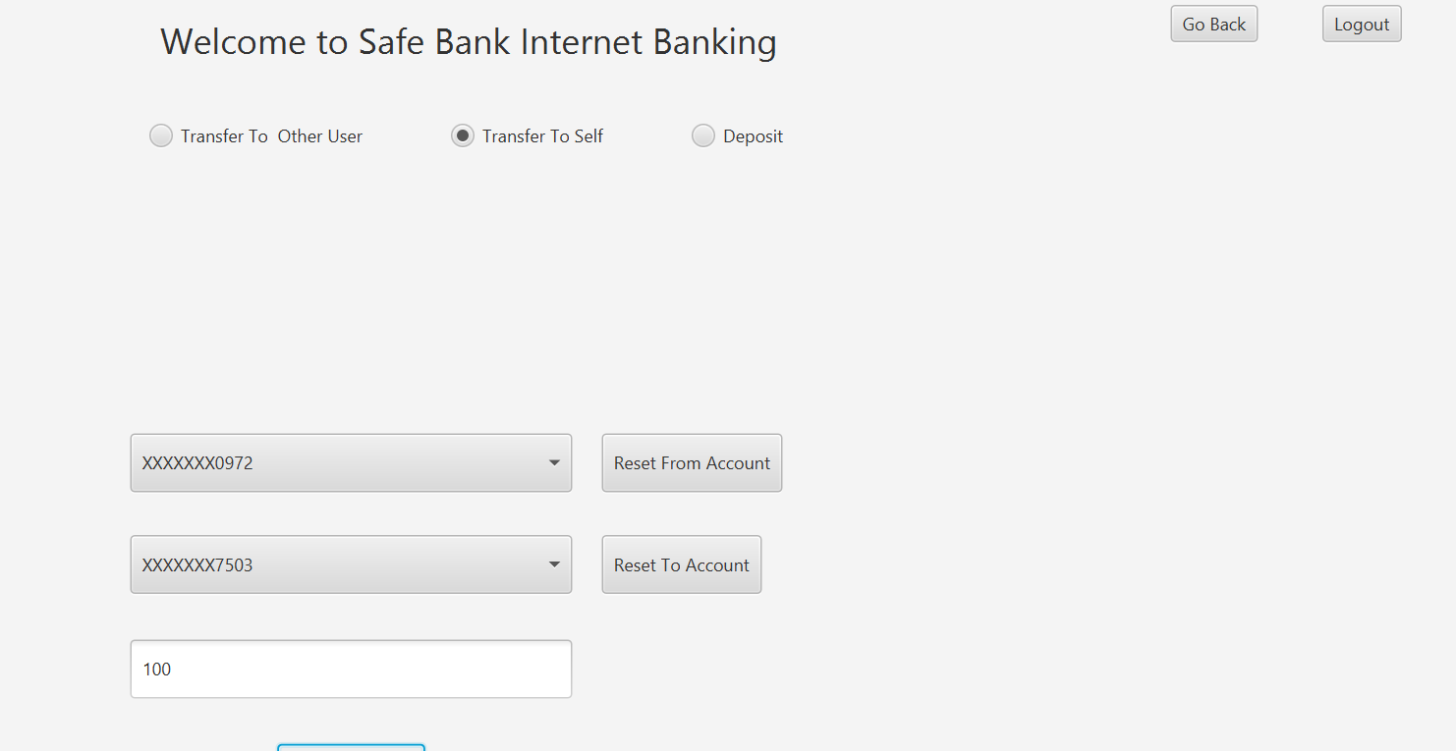
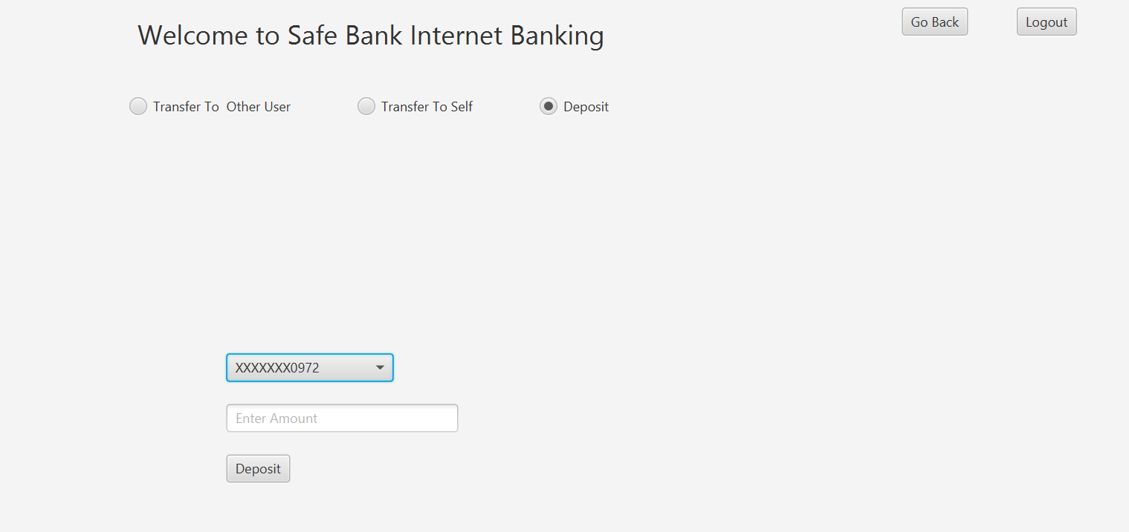
SafeBank
Transfers:
The TransfersSceneController is a JavaFX controller class that controls the behavior of a scene for a banking application.
It uses FXML to define the scene layout and handle user events such as button clicks and radio button selections.
The initialize method sets up the scene with an Anchor Pane containing different options for transfers (to other account, to self, or deposit), while other methods handle logout and navigation to other scenes.

Slide 20
SafeBank
Individual Contribution:
Sri Harsha Peri: Transfers(beneficiary transfer, self transfer, deposit)
Varun: Transaction(Filtering Card and account transactions data)
Rajesh Kaireddy: User Authentication(passwords, emailverifications, Resetpassword from inside and outside the application and validations)
Group Contribution:-
payments (payment by credit-Rajesh, paymentbysavings-Varun, creditcardbillpayments-Harsha)

Slide 21

SafeBank
Conclusion:
Functional:
Prioritized the safety and security of users' financial information
Created a platform that adheres to industry standards and regulations
Fostered trust and confidence among customers by ensuring the privacy and security of their data
Leveraged technology to deliver a seamless banking experience
Technical:
Developed a secure and user-friendly banking application using JavaFx
Designed robust layered application architecture using JavaFx with separation of concern
Used Java collection framework as the data structure to store retrieve and manipulate the data from the database.
Continuously improved and updated the application to meet the evolving needs of the banking industry and its customers.
Optimized all the queries and improved the query performance by 10%
Followed loose coupling of front end and backend services throughout the application development process

