Slide 1
DevOps Project
Group 8
- Sri Harsha Peri

Slide 2
Overview
Execute the application on the cloud such the number of backend service containers/pods gets scaled as per scheduled.

Slide 3
Approaches
Running with local servers on Plain VM's
( Amazon Linux 2, Ubuntu)
Running Dockerized applications on plain VM's
Executing on AWS ECS

Slide 4
Workflow on AWS ECS
Code is pushed onto Github repo
Build gets triggered on AWS Code build
A prod image of fe and be services gets created on AWS ECR
Containers associated with the Task Definitions for fe and be are instantiated
Services run the tasks within the EC2 instances launched by the ECS cluster

Slide 5
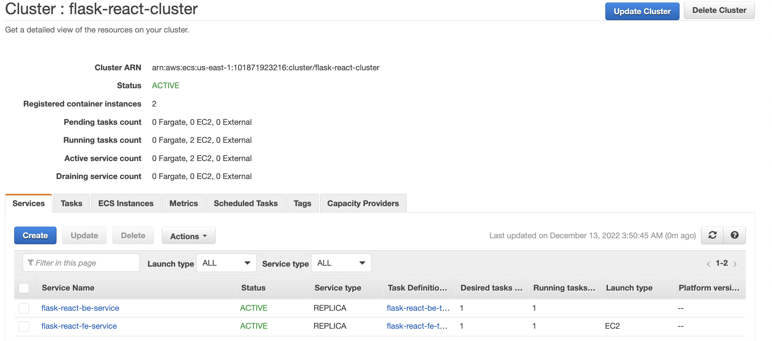
Execution using AWS ECR

Slide 6
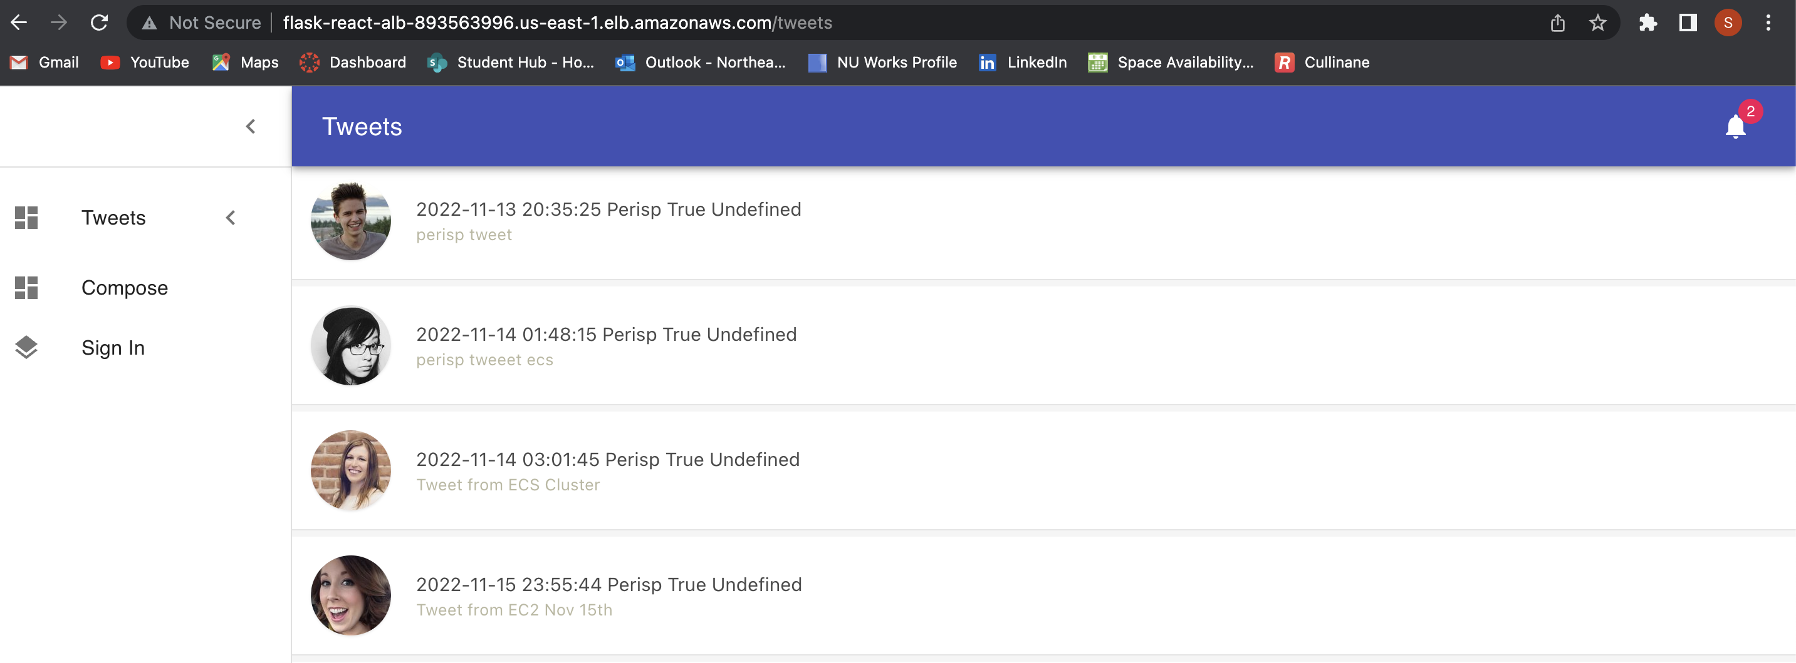

Slide 7
Outcomes
Succesfully executed the application using AWS ECS
Performed Scheduled Scaling of EC2 instances
Performed Scheduled Scaling of tasks under services
Estimated cost analysis of using Spot Instances vs On Demand Instances and used On Demand Instances in the project

