Slide 1

GOOGLE BUILD WITH AI HACKATHON 2.0
KisanSathi
AI-Powered Agricultural Market Intelligence & Farmer Support Platform
Full-Stack AI Agricultural Platform · Google Cloud Hack2skill
APMC Mandi Intelligence
Gemini 2.0 Agronomy
Sentinel-2 Geospatial
10 Regional Languages

Slide 2



THE PROBLEM
Small Farmers Lack Unified Decision Support
Fragmented Agricultural Information
Market prices, weather forecasts, and soil advisory scattered across disconnected government portals.
Severe Price Asymmetry & Middlemen Opacity
Price opacity forces distress sales to intermediaries without modal, min, and max mandi price transparency.
Zero Pre-Harvest Value Estimation
Farmers struggle to calculate net returns after factoring in packaging, transport logistics, and mandi fees.
Delayed Field Crop Disease Diagnosis
Preventable crop failures spread rapidly with no accessible, on-field AI visual diagnosis tool for leaves.
Language & Digital Literacy Barriers
Scientific advisories and market analytics are locked behind complex English-only dashboards.

Slide 3













OUR SOLUTION
KisanSathi — One Platform, All Decisions
A unified farmer intelligence ecosystem combining real-time APMC mandi analytics, Gemini 2.0 multimodal agronomy, Sentinel-2 geospatial indices, and official cadastre.
Mandi Market Intelligence
AI Explanation & Advisory
Real-time modal rates across 3,000+ mandis
Gemini 2.0 market insights & seasonal crop guide
10 Languages & IVR Support
Satellite & NDVI Telemetry
Multilingual UI + 1800-180-1551 Kisan Call Centre
Sentinel-2 & GEE crop vigor & water stress
Plant Disease Diagnosis
Hyperlocal Ag Weather
Gemini Vision leaf pathology & organic remedies
7-day microclimate data & spray window alerts

Slide 4











KEY FEATURES
10 Production Feature Modules
Mandi / Market Intelligence
Price Trend Analysis
AI Market Explanation
Real-time APMC price lookup across 3,000+ mandis with modal spread analysis
30-day price trends, volatility metrics & arrival volume tracking
Gemini 2.0 grounded market context in simple regional dialects
Contextual Crop Advisory
Plant Disease Diagnosis
Satellite & NDVI Telemetry
Agro-climatic crop guidance, sowing windows & nutrient schedules
Upload leaf photo → Gemini Vision diagnoses disease & organic remedies
Google Earth Engine + Sentinel-2 multispectral field vigor mapping
Hyperlocal Ag Weather
Government Cadastre & Schemes
Field Polygon Sculpting
Open-Meteo 7-day agricultural forecasts with optimal spray windows
AgriStack GID, ISRO Bhuvan, PM-KISAN, PMFBY & State RoR integrations
Trace parcel boundaries with real-time geodesic area calculation (ha/ac)
10 Languages & Offline Sync
10 Indian languages, low-bandwidth caching & recent-search resilience

Slide 5

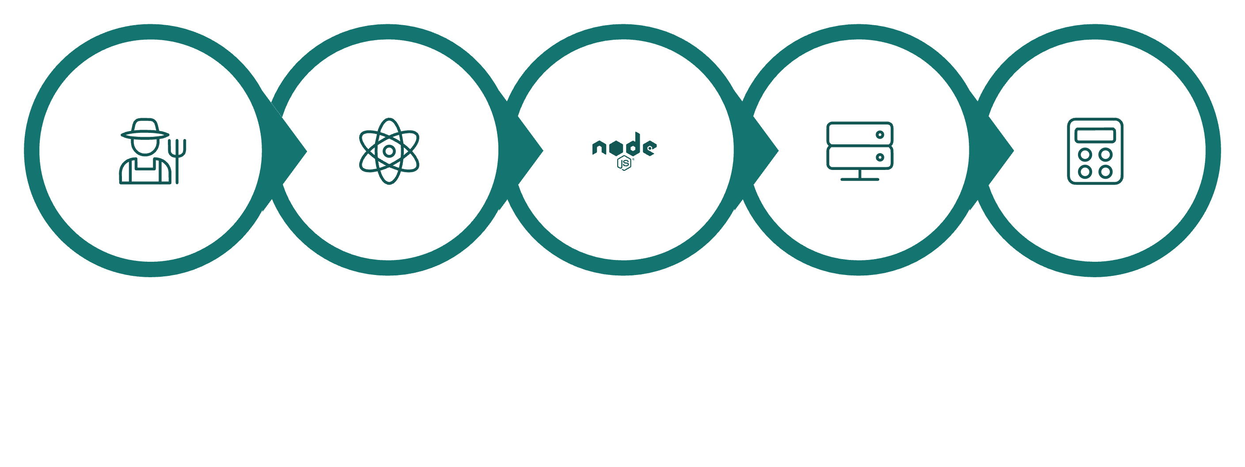
HOW IT WORKS
End-to-End Processing Workflow
Farmer Input
React Frontend
Node.js API
Domain Services
Data Processing
✅ Verified Structured Data
🔢 Deterministic Calculations
🤖 Grounded Gemini 2.0 AI
Official mandi prices from data.gov.in / Agmarknet, Open-Meteo & Sentinel-2
Gross value, net return, transport deductions & trend stats — zero AI hallucination
Translates, explains & diagnoses — strictly bounded by verified calculations

Slide 6


SYSTEM ARCHITECTURE
Multi-Tier Cloud, AI & Data Architecture
Complete structural separation between verified deterministic engines, Gemini 2.0 AI, and agricultural data mesh.
TIER 1: CLIENT PRESENTATION LAYER (React 19 SPA)
Farmer Responsive Web App
React 19, TypeScript, Vite & Tailwind CSS with high-contrast UI
Interactive Geospatial GIS
Leaflet maps with real-time geodesic polygon sculpting (ha/ac)
10 Regional Indian Languages
Hindi, Kannada, Telugu, Tamil, Marathi, Bengali, Gujarati, etc.
Voice & Offline Resilience
Speech synthesis, Kisan Call Centre IVR scripts & cached queries
▼
TIER 2: API GATEWAY & APPLICATION SERVER (Node.js 20+ Express)
RESTful Microservices Gateway
30+ secured modular endpoints routing farmer analytics requests
Security & Rate Limiting
Input sanitization, origin verification & DDOS request throttling
In-Memory Hot Caching
Sub-second TTL caching for mandi commodity price records
Cadastre Query Orchestration
AgriStack GID, ISRO Bhuvan & State land record RoR dispatch
▼
TIER 3: CORE PROCESSING & DUAL INTELLIGENCE ENGINES
Deterministic Engine (Zero AI Math)
Exact modal price spreads, gross revenue & net farmer returns
Google Gemini 2.0 AI Core
Multimodal Vision leaf diagnosis & grounded regional narratives
Geospatial & Telemetry Core
Google Earth Engine + Sentinel-2 multispectral NDVI/NDWI indices
Zero-Hallucination Guardrail
Strict boundary isolating financial arithmetic from LLM text
▼
TIER 4: FEDERATED DATA MESH & PERSISTENCE LAYER
data.gov.in / Agmarknet
Daily verified modal, min & max prices across 3,000+ mandis
Open-Meteo & IMD Ag-Weather
Hyperlocal 7-day temperature, rainfall, wind & spray windows
AgriStack & ISRO Bhuvan
Official national land parcel boundaries & soil health cards
Cloud Firestore & ETSI NGSI-LD
Secure persistence store & federated Digital Public Good exchange

Slide 7





TECHNOLOGY STACK
Built With Modern Technologies
Frontend Application
Backend & API Gateway
Satellite & Geospatial
React 19 · TypeScript · Vite · Tailwind CSS · Framer Motion · Leaflet GIS
Node.js 20+ · Express.js · RESTful Gateway · 30+ endpoints · In-Memory Cache
Google Earth Engine · Sentinel-2 Multispectral · Geodesic Polygon Tools
Database & Storage
Google Cloud Firestore · In-Memory Hot Store · Local Storage Resilience
Artificial Intelligence
Deployment & Cloud
Google Gemini 2.0 Flash · Gemini Multimodal Vision · Grounded Prompts
Vercel Serverless · Google Cloud Run · Docker Containerization
Government & Open Standards
data.gov.in (Agmarknet) · Open-Meteo · AgriStack · ISRO Bhuvan · ETSI NGSI-LD

Slide 8

RESPONSIBLE AI ARCHITECTURE
The Zero-Hallucination Triad: AI + Deterministic Rigor
AI explains and assists — it never invents market prices or financial calculations.
✅ Verified Data Layer
🔢 Deterministic Processing
Real mandi / APMC prices across 3,000+ mandis
Modal, minimum & maximum price benchmarks
Arrival volumes & seasonal historical records
Official open data: data.gov.in / Agmarknet
Hyperlocal weather via Open-Meteo & IMD
Yield & quantity normalization (Quintals/Kg)
Gross harvest value & net-return calculations
Transport, packaging & commission deductions
Trend statistics & volatility index computation
Zero-LLM math guarantee prevents price fabrication
🤖 Grounded Gemini 2.0 AI
Natural-language market price explanation
10 Indian languages (Hindi, Kannada, Telugu, etc.)
Agro-climatic crop & irrigation guidance
Leaf disease diagnosis via Gemini Vision
Kisan Call Centre 1800-180-1551 IVR scripts

Slide 9







USER JOURNEY
End-to-End 6-Step Farmer Flow
Select Language & Crop
Choose from 10 Indian languages (English, Hindi, Kannada, Telugu, etc.)
Search APMC Mandi Rates
KisanSathi retrieves structured live modal prices from official Agmarknet data
Net-Return & Value Calculation
Deterministic calculation of gross yield value and net returns after transport
Grounded AI Market Insights
Gemini translates complex market spreads into clear regional-language advice
Field Health & Disease Diagnosis
Trace parcel polygon on Sentinel-2 satellite map & photo leaf for Gemini diagnosis
Checklist, Decision & IVR Support
Review pre-sale checklist or trigger 1-tap Kisan Call Centre (1800-180-1551) escalation

Slide 10

TECHNICAL HIGHLIGHTS
FUTURE SCOPE
What Makes KisanSathi Different
Roadmap & Expansion
Dual-Engine Hybrid Rigor
AgriStack Farmer ID Locker
Verified government data + deterministic math + AI synthesis — 0% hallucinated numbers
Secure farmer digital identity & personalized soil health record vault
Full-Spectrum Satellite GIS
WhatsApp & IVR Voice Bot
Google Earth Engine + Sentinel-2 multispectral NDVI/NDWI crop health mapping
Voice-based market inquiries on feature phones via IVR & WhatsApp bot
Interactive Polygon Sculpting
Cooperative Mandi Logistics
Real-time geodesic field area calculation (ha/ac) with multi-cadastre overlays
Collective transport pooling for smallholders to slash freight costs
Production Cloud-Ready
Soil Carbon Credit Verification
Vercel + Google Cloud Run + Docker with 30+ secured REST endpoints
Satellite-verified regenerative practices for farmer carbon credit monetization
KisanSathi — From Agricultural Data to Better Farmer Decisions
📊 Data-Driven
🤖 Responsible AI
🌾 Farmer-First
Verified market, satellite and cadastre data across 3,000+ mandis
Gemini 2.0 explains, advises and diagnoses with zero hallucination
10 Indian languages, accessible UI & 1800-180-1551 Kisan Call Centre
Thank You · Questions & Demonstration

