Slide 1
IE 551: ADV TOPICS: STATISTICS FOR MACHINE LEARNING PROJECT 2: RECIPE RECOMMENDATION SYSTEM
Group Members: NAME: SRI HARSHA SAMAYAMANTHULA NETID: ss4305
NAME: SAI RAM BALU NETID: sb2310

Slide 2
ABSTRACT
Many people worldwide are becoming more worried about their health and how they live in today's world. Just avoiding junk food and exercising isn't enough. It's also important to eat a balanced diet. A balanced diet depends on your height, weight, and age. Eating right can help you stay at a healthy weight, reduce the risk of diseases like cancer and heart disease, and improve overall health when combined with exercise.
However, there aren't many advanced projects for recommending recipes. So, We thought of making a recipe recommendation system using machine learning for this purpose.

Slide 3
RECIPE recommendation system
Recipe recommendation system plays a crucial role in encouraging healthier eating habits. This engine analyses the nutritional details and ingredient lists of different foods to suggest personalized choices to users. What makes this approach beneficial is its capacity to consider each person's unique dietary needs and tastes, including allergies and food aversions. By offering users customized suggestions, a content-based recommendation system can guide them toward healthier eating decisions, ultimately contributing to improved health.
Furthermore, by suggesting a wide range of nutritious foods, this type of engine can inspire users to explore new food options, reducing the monotony often associated with restrictive diets. This variety helps individuals maintain a balanced diet, which is likely to have a favorable impact on their long-term health and well-being.

Slide 4


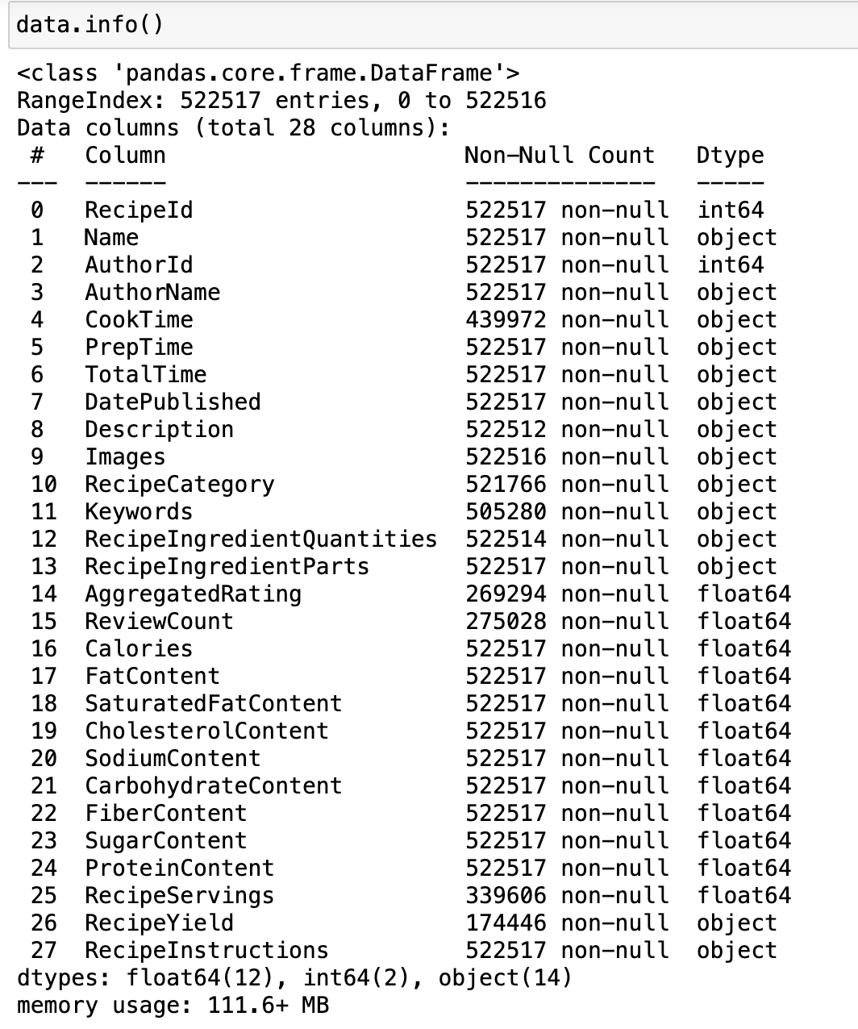
Data description
The dataset used in this project is scraped from Food.com, featuring over 500,000 recipes and 1,400,000 reviews. It provides a comprehensive overview of various recipes, complete with details such as cooking and preparation times, ingredients, and nutritional content. The primary focus is on nutritional information, which includes attributes like calories, fat content, saturated fat, cholesterol, sodium, carbohydrates, fiber, sugar, and protein. Given the size of the dataset, it offers a rich source of information for analysis and model building.

Slide 5
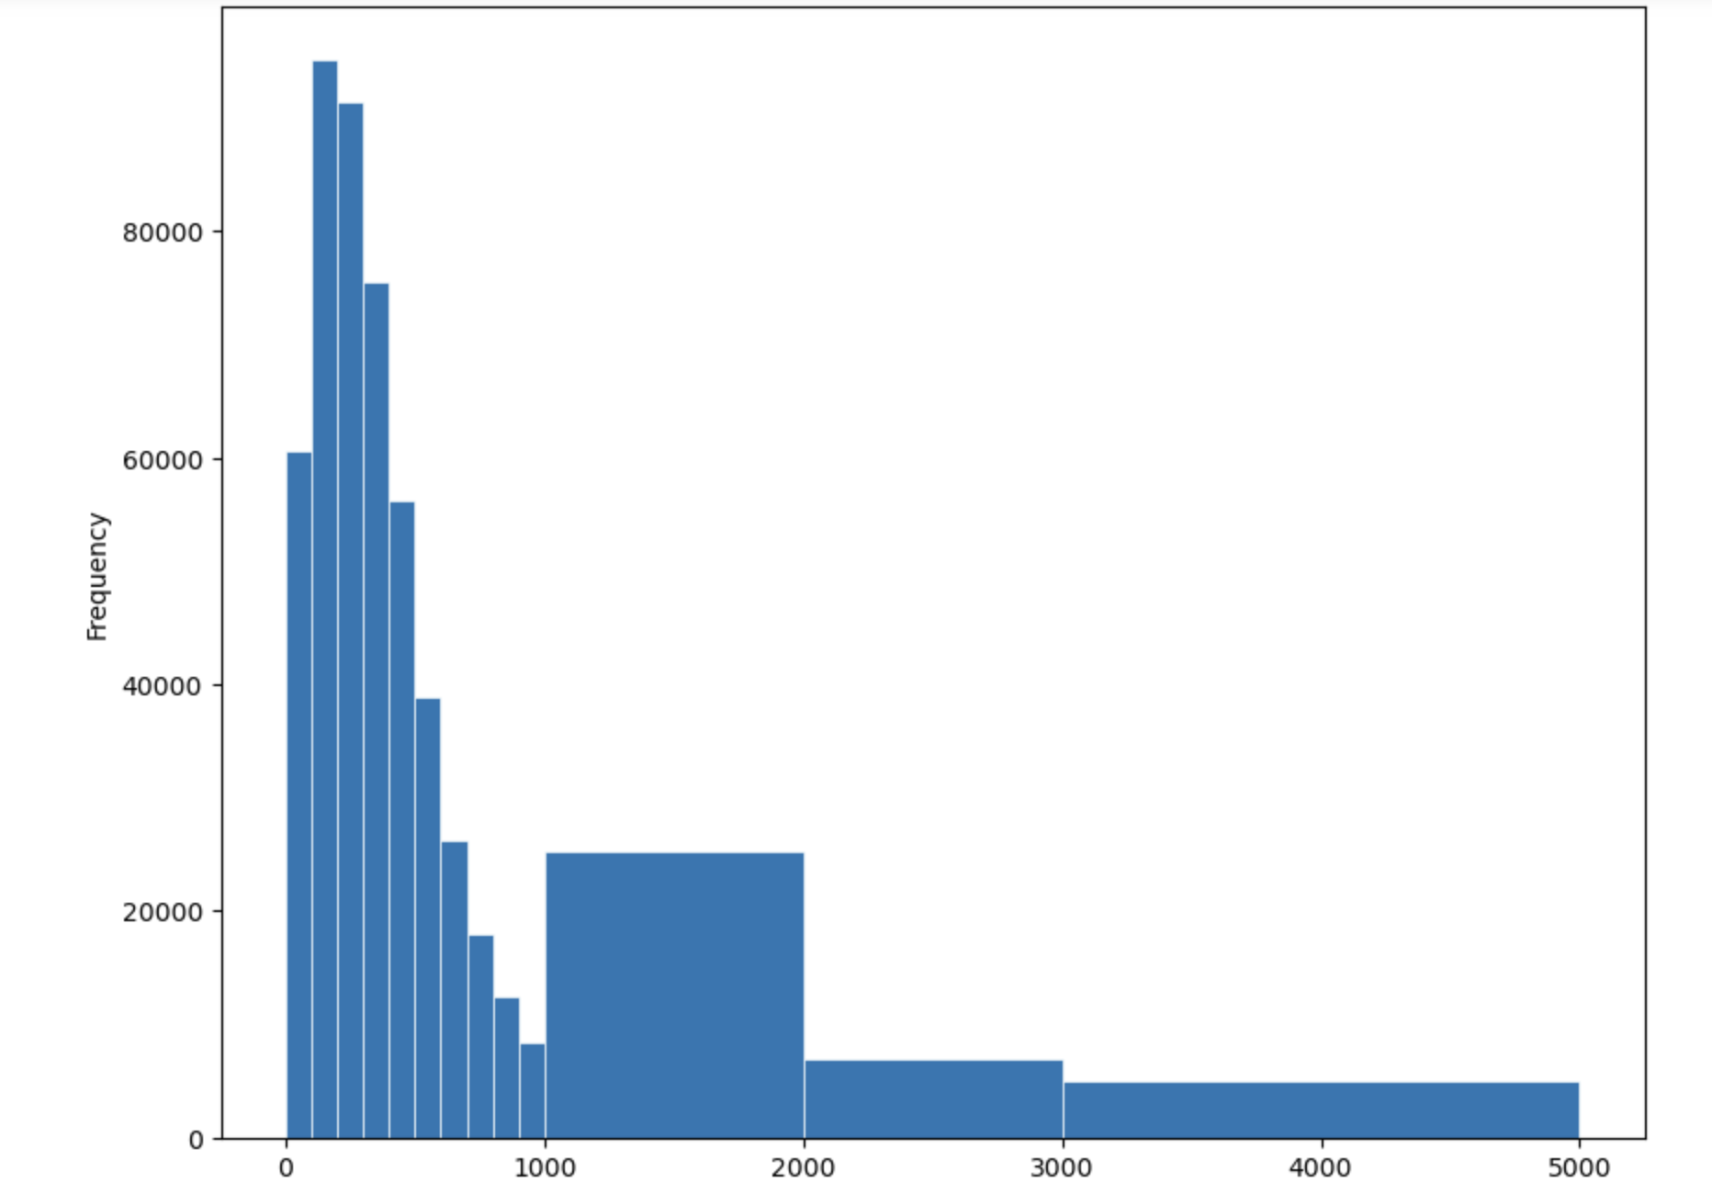
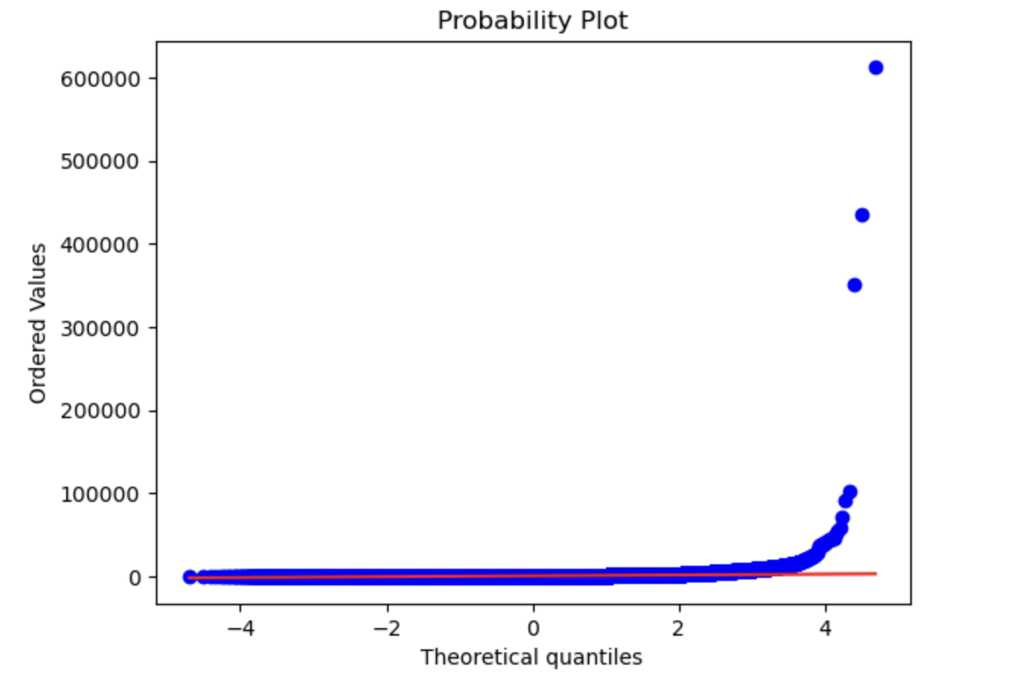
Data Analysis and Visualization
To understand the distribution of key nutritional attributes in the dataset, we have created a histogram to visualize the frequency of calories across the recipes. This visualization uses bins to categorize the calorie content, allowing us to see where most recipes fall in terms of calorie count. Additionally, we generated a probability plot (also known as a Q-Q plot) to examine how the distribution of calorie content compares with a normal distribution. This provides insights into the skewness or outliers in the data, indicating that some recipes contain significantly higher calorie content than others.

Slide 6
Data Transformation
Given the large number of recipes and varying nutritional content, it was necessary to apply some transformations to the dataset. We filtered the data based on specific nutritional limits to focus on recipes that align with general dietary guidelines. The applied limits were:
Calories: less than 2000, Fat content: less than 100, Saturated fat content: less than 13
Cholesterol content: less than 300, Sodium content: less than 2300, Carbohydrates: less than 325
Fiber content: less than 40, Sugar content: less than 40, Protein content: less than 200
By applying these filters, we reduced the dataset to a more manageable subset for further analysis. The filtered data was then standardized using the StandardScaler to ensure consistent scaling across all attributes.

Slide 7
methodology
The recommendation engine for this project is built using the Nearest Neighbors algorithm, a type of unsupervised learning used for neighbour searches. Given the dataset size and desired simplicity, I used the brute-force approach with cosine similarity as the metric for measuring distances between recipes. This method is computationally efficient for smaller datasets and provides a straightforward way to identify similar recipes based on their nutritional content.
To build the recommendation model, I used a pipeline that included the StandardScaler for data normalization and the NearestNeighbors algorithm with cosine similarity. The parameters used for this model included a neighbor count of 5 and no distance information returned. This setup allows for a straightforward computation of the nearest neighbors for any given input

Slide 8
ONLINE accessibility
Once the model was developed, we focused on making our work user-friendly by designing a user interface. To achieve this, we used Streamlit, an open-source platform that allows for rapid prototyping and interactive data-driven applications on the frontend.
For the backend, we opted for FASTAPI, a modern framework known for its speed and simplicity. In the backend, we imported the model, and whenever a user requests a recipe recommendation, FASTAPI processes the request, communicates with the model, and generates suggestions based on the user’s input.

Slide 9
Recipe recommendation based on bmr
Our website offers two distinct sections for recipes: the Recipe Recommendation page and the Custom Recipe Recommendation page. On the Recipe Recommendation page, users receive recipe suggestions tailored to their age, gender, height, and weight.
To do this, we calculate their Basal Metabolic Rate (BMR) and account for their physical activity levels to estimate daily caloric requirements. Recipes are then recommended based on this calorie estimate and divided according to the preferred number of meals.

Slide 10
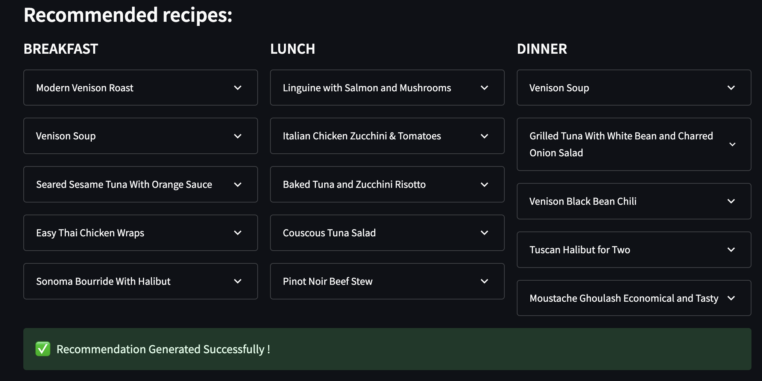
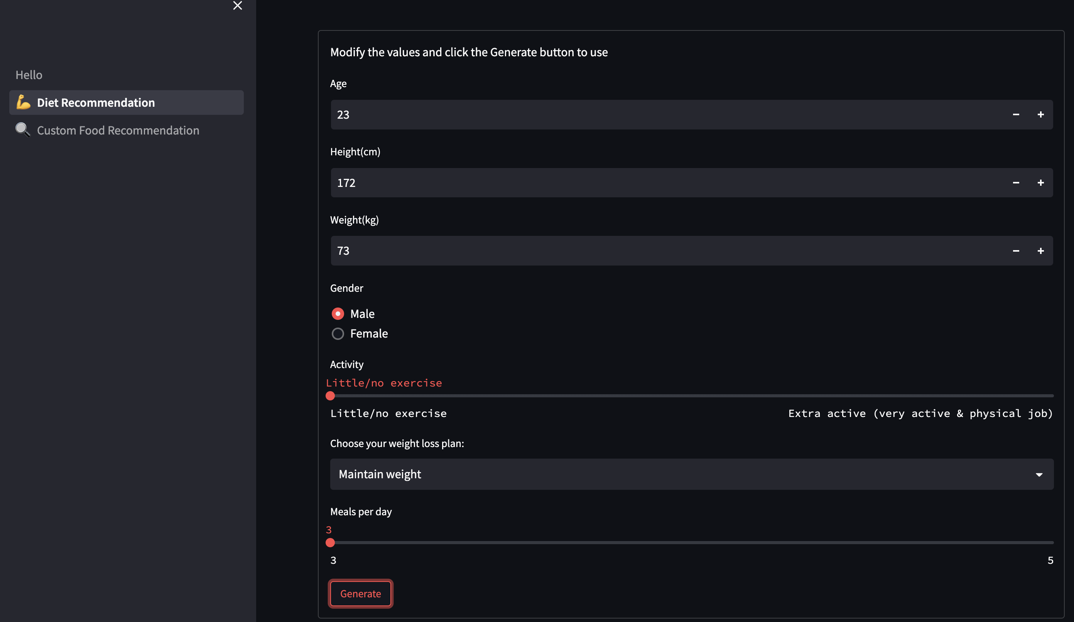
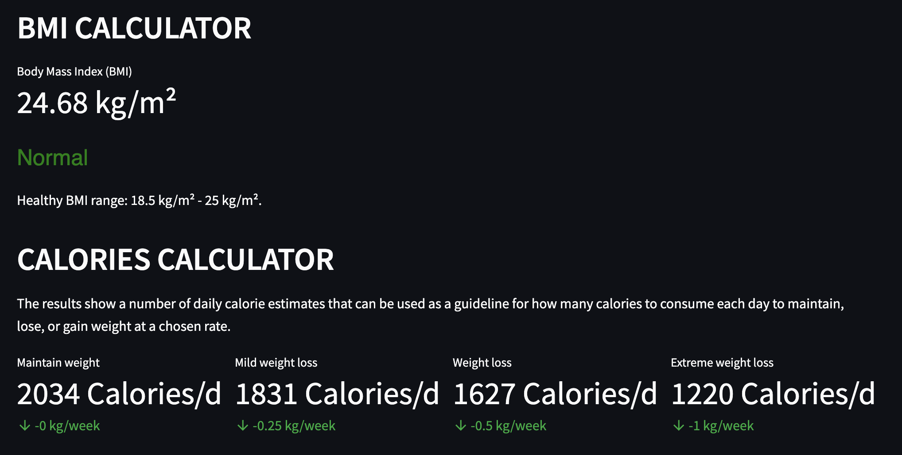

Slide 11
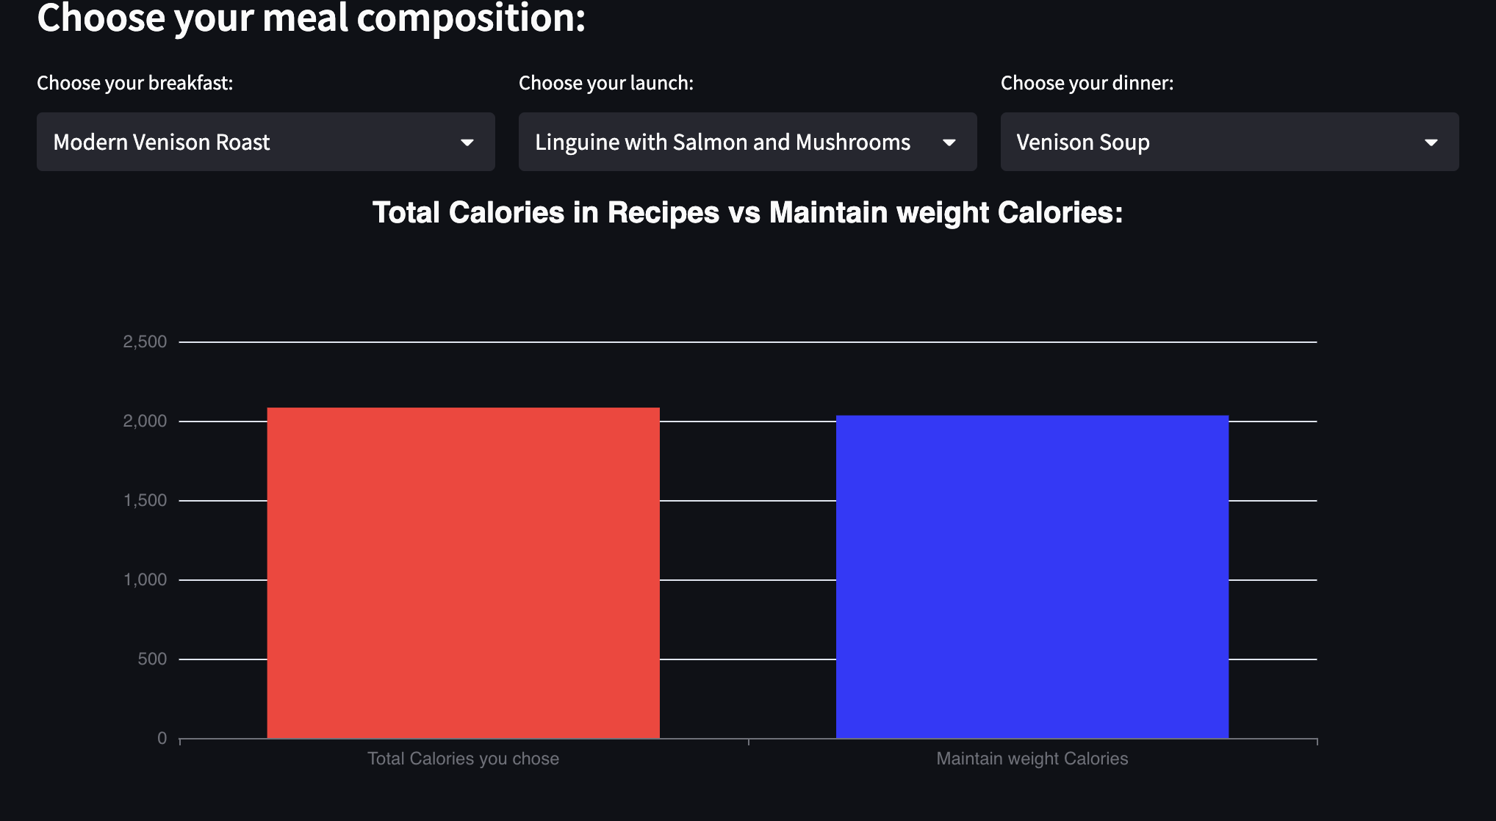
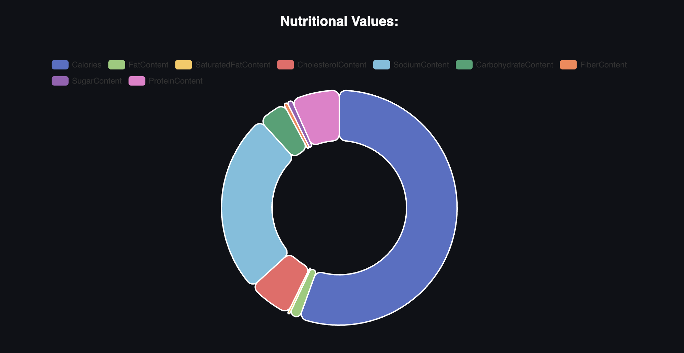

Slide 12
CUSTomised recipe recommendation
This page offers personalized recipes based on user-specified nutrient values. A frontend slider allows users to adjust nutrient amounts such as fats, sodium, proteins, and more. As users set their desired nutrient levels, the system recommends suitable recipes.
Additionally, users can enter specific ingredients, ensuring the recommendations align with their preferences while meeting the nutrient criteria. A chart library is utilized to visualize the nutrient content of each recommended recipe through pie charts.

Slide 13
