Slide 1

Title: ResearchGraph AI: A Semantic Academic Research Intelligence Platform Using Large Language Models and Knowledge Graphs
Major Project – Stage-I Review-1 Presentation
by
Name: B.Sriharsha, B.Prany Kumar, B. Rajyavardhan
Roll No: 23B81A0551, 23B81A0538, 23B81A05541
Section:A
Batch No:8
Dept:CSE
CVR College of Engineering
Under the Esteemed guidance of
Supervisor name: Ms.S.Sathya sudha
Designation:Assistant Professor

Slide 2
Abstract
AIM : ResearchGraph AI: A Semantic AcademicResearch Intelligence Platform Using Large Language Models and Knowledge Graphs
The rapid growth of scientific publications has made it increasingly difficult for researchers and students to efficiently explore academic literature. Traditional academic search platforms primarily rely on keyword-based retrieval and citation indexing, requiring users to manually analyze numerous research papers to identify relevant methodologies, datasets, and research gaps. This process is time-consuming and often fails to reveal meaningful relationships among research entities.
ResearchGraph AI: A Semantic Academic Research Intelligence Platform Using Large Language Models and Knowledge Graphs is proposed to address these challenges by integrating semantic search, Knowledge Graphs, and Large Language Models into a unified research assistance platform. The system automatically retrieves research papers from scholarly repositories such as OpenAlex and arXiv, extracts textual content from PDF documents, and converts the information into semantic embeddings for efficient retrieval using a vector database. Simultaneously, entities such as authors, research papers, algorithms, datasets, and research domains are extracted and organized into a Neo4j Knowledge Graph to represent their relationships.
When a user submits a natural language query, the system retrieves relevant document chunks from the vector database and related entities from the Knowledge Graph. This combined contextual information is provided to a Large Language Model through a GraphRAG pipeline to generate accurate, citation-supported responses. The proposed platform assists researchers by simplifying literature reviews, comparing research papers, identifying research gaps, and visualizing relationships among research concepts, thereby improving the efficiency and quality of academic research.

Slide 3
Agenda
Aim, Motivation & Novelty
Problem Statement, Objectives & Scope
Literature Review
Research Gap & Proposed Solution
Software & Hardware Requirements
Project Milestones
System Design & Overall Architecture
Proposed System Architecture
GraphRAG Workflow
System Modules
Technology Stack

Slide 4
1.Aim, motivation, novelty
Aim
Develop an intelligent academic research platform that combines Large Language Models (LLMs), Knowledge Graphs, and semantic search to simplify literature review and improve research paper exploration.
Motivation
Researchers spend significant time searching and reading research papers.
Existing academic search engines mainly depend on keyword matching.
Understanding relationships among papers, authors, and methodologies is difficult.
AI can automate literature review and provide intelligent research assistance.
Novelty
Integrates GraphRAG instead of traditional RAG.
Combines Vector Search with Knowledge Graph reasoning.
Generates citation-supported answers using Large Language Models.
Visualizes relationships among research entities.

Slide 5
2.Problem statement, objectives, and scope
Problem Statement
The rapid increase in research publications has made literature review more challenging. Existing academic search platforms return relevant papers but do not explain the relationships among research papers, methodologies, datasets, and authors. Researchers must manually analyze multiple papers to understand research trends and identify research gaps.
Objectives
Collect research papers from scholarly repositories.
Generate semantic embeddings for efficient retrieval.
Construct a Knowledge Graph representing research relationships.
Integrate GraphRAG for intelligent question answering.
Generate citation-supported responses using LLMs.
Scope
The proposed system focuses on Computer Science research papers and assists students, researchers, and faculty members in literature review, research paper comparison, and research gap identification.

Slide 6
3. Literature review
Several academic search platforms and AI-based retrieval systems have been developed to simplify research paper discovery. Google Scholar, IEEE Xplore, and Semantic Scholar provide access to a large number of research papers but primarily rely on keyword-based search and citation indexing.
.
Author(s) / Year | Title / Focus of Study | Methodology | Key Findings | Research Gap / Limitation
XGraphRAG Authors (2025) | XGraphRAG: Interactive Visual Analysis for Graph-based Retrieval-Augmented Generation | The framework provides interactive visual analysis of GraphRAG pipelines, allowing retrieval results to be traced through graph construction and query processing. | The study demonstrates that visual analysis can help users understand GraphRAG retrieval behavior, identify critical retrieval cases, and analyze opportunities for improvement. | The work focuses on GraphRAG analysis and visualization rather than an end-to-end academic research intelligence platform for paper discovery, comparison, and research-gap identification.
IEEE ICTBAI Authors (2025) | A Survey of Retrieval-Augmented Generation (RAG) for Large Language Models | The study reviews RAG architectures and discusses retrieval, augmentation, and generation mechanisms used to provide external knowledge to Large Language Models. | The survey highlights the importance of retrieval quality and external knowledge in improving grounded LLM responses and reducing hallucination-related problems. | The study is a general RAG survey and does not specifically address Knowledge Graph integration for academic research exploration.
S. Pan et al. (2024) | Unifying Large Language Models and Knowledge Graphs: A Roadmap | The authors review approaches for integrating LLMs and Knowledge Graphs and categorize them according to how LLMs and KGs support and enhance each other. | The study shows that combining LLMs with Knowledge Graphs can support factual grounding, reasoning, knowledge construction, and question answering. | It provides a broad roadmap and conceptual framework rather than a complete academic research platform evaluated on scholarly datasets.
T. T. Procko and O. Ochoa (2024) | Graph Retrieval-Augmented Generation for Large Language Models: A Survey | The authors analyze GraphRAG approaches that combine graph structures with Retrieval-Augmented Generation to improve retrieval and reasoning. Different graph retrieval and reasoning strategies are discussed. | The survey indicates that graph-based retrieval can provide structured context and support complex or multi-hop reasoning beyond conventional vector retrieval. | The reviewed approaches are general-purpose and do not specifically provide a complete platform for academic paper relationships, literature review, and research-gap analysis.

Slide 7
4.Research gaps and proposed solution
Research Gap
Although several academic search platforms and AI-based retrieval systems have been developed, they still have several limitations that affect efficient academic research.
Existing systems mainly rely on keyword-based or semantic retrieval techniques.
Relationships among research papers, authors, datasets, algorithms, and research domains are not explicitly represented.
Most platforms do not automatically identify research gaps or provide comprehensive literature review generation.
Existing RAG systems retrieve relevant documents but lack graph-based reasoning for understanding complex relationships.
Researchers still spend significant time manually comparing papers and identifying future research directions.

Slide 8
4.Research gaps and proposed solution
Proposed Solution
To overcome these limitations, ResearchGraph AI integrates Knowledge Graphs, Vector Databases, GraphRAG, and Large Language Models into a unified academic research platform.
Key Features
Automatic collection of research papers from OpenAlex and arXiv.
Semantic retrieval using ChromaDB vector database.
Knowledge Graph construction using Neo4j.
Hybrid retrieval using GraphRAG.
AI-powered, citation-supported responses using Gemini / Llama 3.
Interactive visualization of relationships among research entities.
Automatic literature review generation and research gap identification.

Slide 9
5.Software requirements ( Software and Hardware requirements)
Software Requirements
Hardware Requirements
Software | Purpose
Operating System | Windows 10/11 or Linux
Programming Language | Python, TypeScript
Frontend | React + Tailwind CSS
Backend | FastAPI
Graph Database | Neo4j
Vector Database | ChromaDB
Database | PostgreSQL
Embedding Model | BAAI/BGE-large-en-v1.5
Large Language Model | Gemini / Llama 3
Version Control | Git & GitHub
IDE | Visual Studio Code
Component | Specification
Processor | Intel Core i5 (8th Generation or above)
RAM | Minimum 8 GB (16 GB Recommended)
Storage | 20 GB Free SSD Space
Internet | Broadband Internet Connection
Graphics | Integrated Graphics or Better

Slide 10
6.Plan project milestones.
Phase | Activity | Status
1 | Problem Identification & Topic Selection | Completed
2 | Literature Survey & Requirement Analysis | Completed
3 | System Design & Architecture | Completed
4 | Frontend Development | In progress
5 | Backend API Development | Planned
6 | Knowledge Graph (Neo4j) Integration | Planned
7 | Vector Database (ChromaDB) Integration | Planned
8 | LLM & GraphRAG Integration | Planned
9 | Testing & Evaluation | Planned
10 | Documentation & Final Deployment | Planned

Slide 11
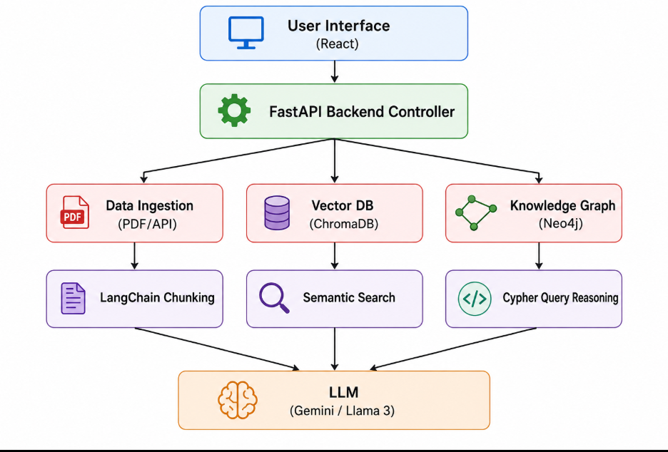
7.Design and overall system architecture.

Slide 12
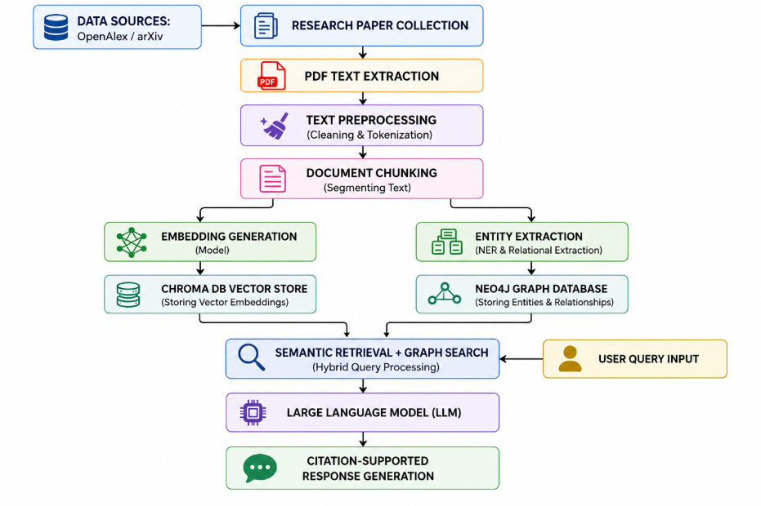
7.Design and overall system architecture.

Slide 13
References
[1]. S. Pan, L. Luo, Y. Wang, C. Chen, J. Wang and X. Wu, "Unifying Large Language Models and Knowledge Graphs: A Roadmap," in IEEE Transactions on Knowledge and Data Engineering, vol. 36, no. 7, pp. 3580-3599, July 2024, doi: 10.1109/TKDE.2024.3352100 .
https://doi.org/10.1109/TKDE.2024.3352100
[2].T. T. Procko and O. Ochoa, "Graph Retrieval-Augmented Generation for Large Language Models: A Survey," 2024 Conference on AI, Science, Engineering, and Technology (AIxSET), Laguna Hills, CA, USA, 2024, pp. 166-169, doi: 10.1109/AIxSET62544.2024.00030.
https://ieeexplore.ieee.org/document/10771030
[3]. Y. Ma et al., "A Survey of Retrieval-Augmented Generation (RAG) for Large Language Models," 2025 International Conference on Trustworthy Big Data and Artificial Intelligence (ICTBAI), Tokyo, Japan, 2025, pp. 7-13, doi: 10.1109/ICTBAI68361.2025.00008.
https://doi.org/10.1109/ICTBAI68361.2025.00008
[4].Q. Wang, Z. Mao, B. Wang and L. Guo, "Knowledge Graph Embedding: A Survey of Approaches and Applications," in IEEE Transactions on Knowledge and Data Engineering, vol. 29, no. 12, pp. 2724-2743, 1 Dec. 2017, doi: 10.1109/TKDE.2017.2754499.
https://ieeexplore.ieee.org/document/8047276
LangChain Documentation. https://python.langchain.com/
Neo4j Documentation. https://neo4j.com/docs/
ChromaDB Documentation. https://docs.trychroma.com/
OpenAlex API Documentation. https://docs.openalex.org/
arXiv API Documentation. https://info.arxiv.org/help/api/
Google Scholar. https://scholar.google.com/
IEEE Xplore Digital Library. https://ieeexplore.ieee.org/
Semantic Scholar. https://www.semanticscholar.org/

Slide 14


