Slide 1
Doctor.Online: Online Healthcare Consultation Portal
Group Members:
Tejeswi Devi Priya Pillarisetty – N01654962
SriHarshini Jilloju – N01649103
Linga Sai Srilaxmi – N01653528

Slide 2
Agenda
Problem Statement
Target Audience
Proposed Solution
Project Scope
Class Diagram
Sequence Diagram
Screenshots (Placeholder)

Slide 3
Problem Statement
Challenges in Healthcare Access:
• Limited access to quality virtual consultation services.
• Patients struggle with scheduling and managing appointments.
• Doctors face issues with virtual consultation workflows and medical record management.
• Lack of integrated, secure, and scalable platforms for real-time healthcare interactions.
Objective:
Develop a robust platform to streamline virtual consultations with secure data handling and role-based operations.

Slide 4
Target Audience
Who Benefits?
Patients:
• Book, manage, and attend virtual consultations seamlessly.
Doctors:
• Manage availability, conduct consultations, and record diagnoses/prescriptions.
Administrators:
• Oversee platform operations, user management, and ensure compliance/security.

Slide 5
Proposed Solution
Doctor.Online: A Scalable Healthcare Portal
• Built with Spring Boot Microservices for modularity and scalability.
• Key Features:
- Role-based authentication/authorization (Admin, Doctor, Patient)
- Appointment management (booking, updating, canceling)
- Prescription and diagnosis management
- Live consultation queue using Spring for reactive data handling
- Docker container-based deployment for cloud-readiness

Slide 6
Project Scope
Mandatory Core Functionalities:
• Secure user registration and login (Spring Security)
• CRUD operations for appointments
• Prescription and diagnosis module
• Microservices architecture:
- User Management
- Appointment Management
- Prescription Handling
• Docker containerized deployment
Optional Features:
• Email/SMS notifications
• Feedback system for doctors
• Admin analytics dashboard

Slide 7
Justification
Why Doctor.Online?
Relevance: Meets the growing demand for virtual healthcare services.
Expected Outcomes:
• Reduced operational friction for doctors and patients
• Enhanced accessibility to healthcare services
• Streamlined scheduling and consultation processes
Feasibility:
• Microservices allow incremental development
• Leverages Spring Boot and Podman for scalability and deployment

Slide 8
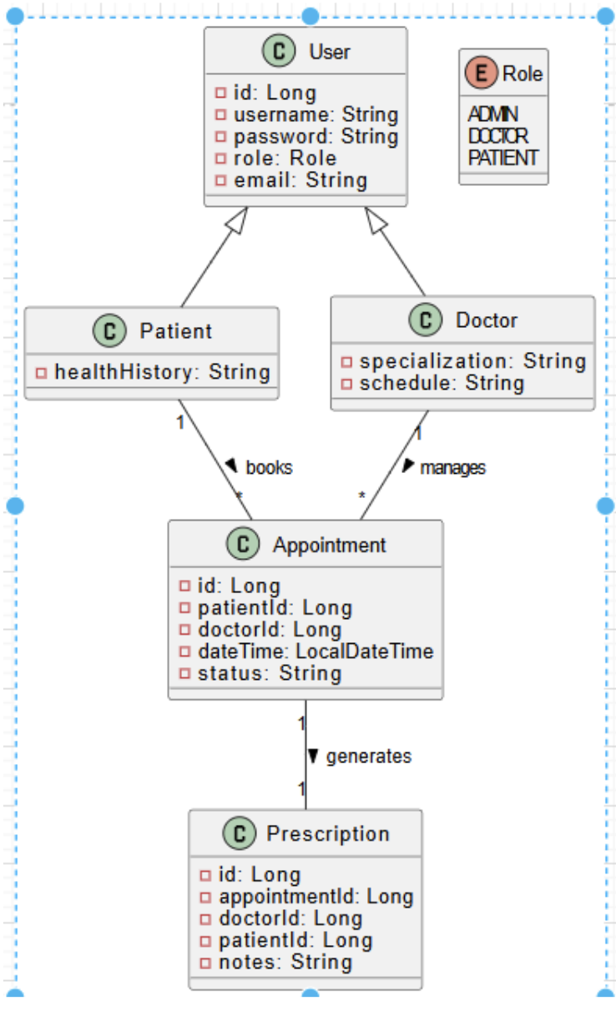
Class Diagram

Slide 9
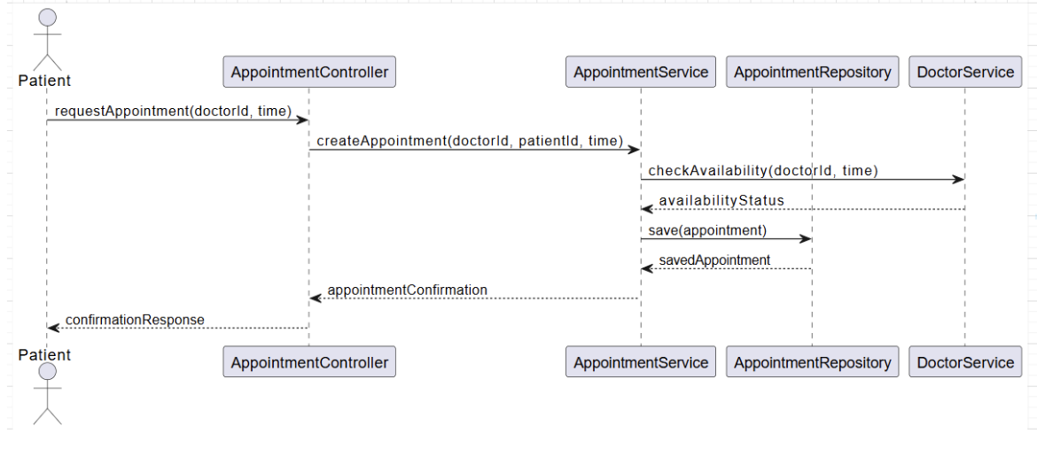
Sequence Diagram

Slide 10
Technical Architecture
Technology Stack:
• Backend: Spring Boot Microservices, Spring Security, Spring Reactive
• Deployment: Docker containers,
• Database: (MySQL/)
• Optional Integrations: Email/SMS APIs, Analytics tools
Architecture Benefits:
• Modular and scalable
• Secure and cloud-ready
• Supports real-time data handling

Slide 11
Screenshots
Screenshots of Doctor.Online (Placeholder for UI/Implementation Screenshots)
• User Login Interface
• Appointment Booking Screen
• Doctor Dashboard
• Prescription Management

Slide 12
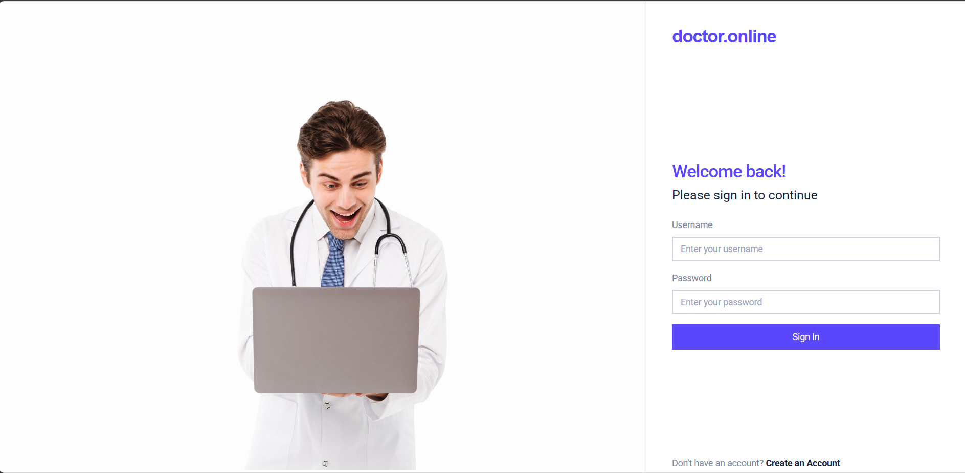
Screenshots

Slide 13
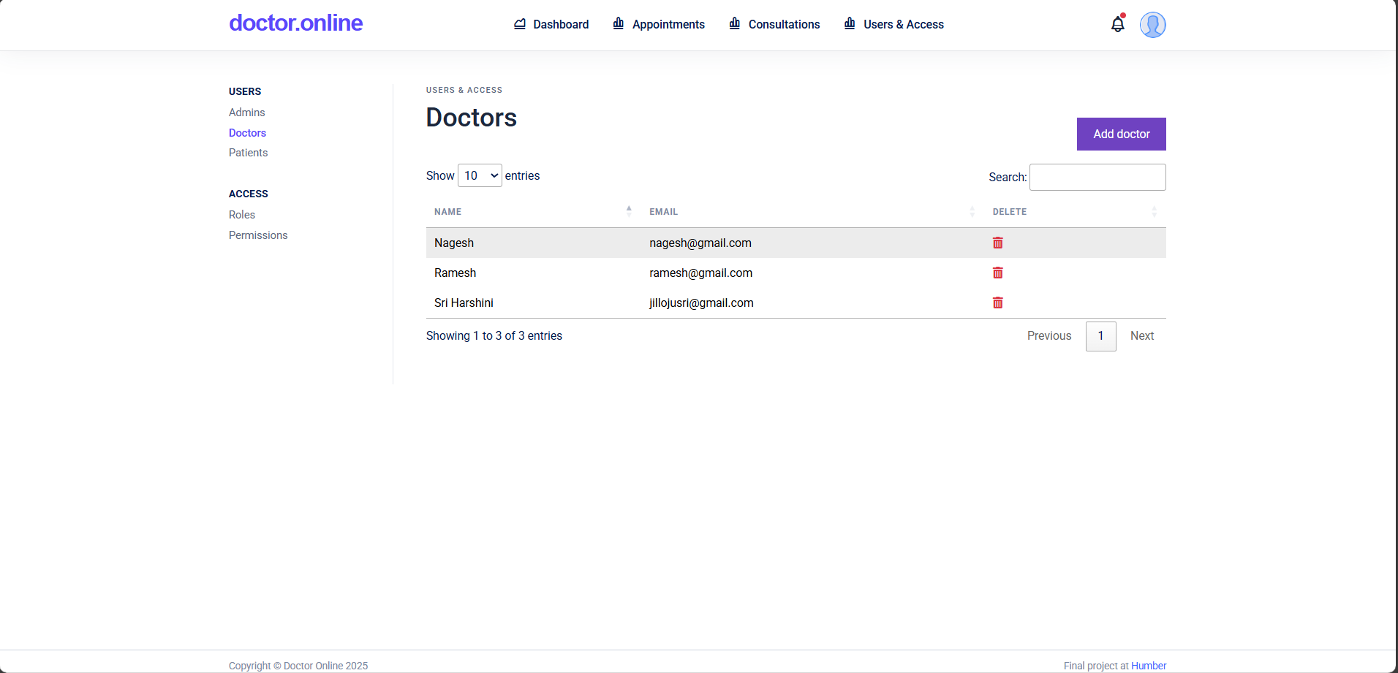
Screenshots

Slide 14
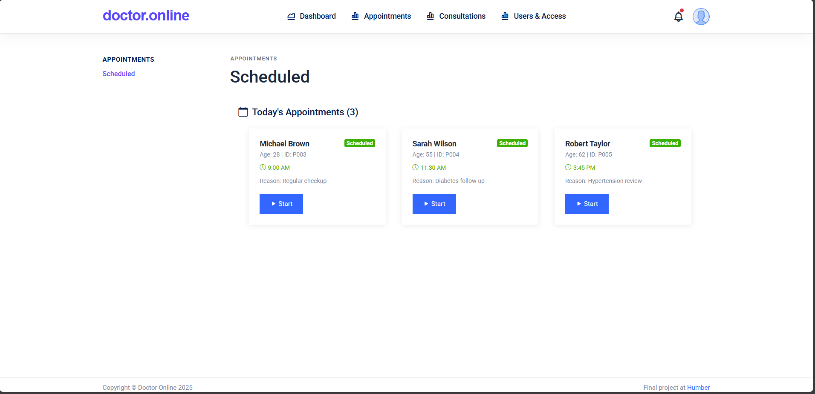
Screenshots

Slide 15
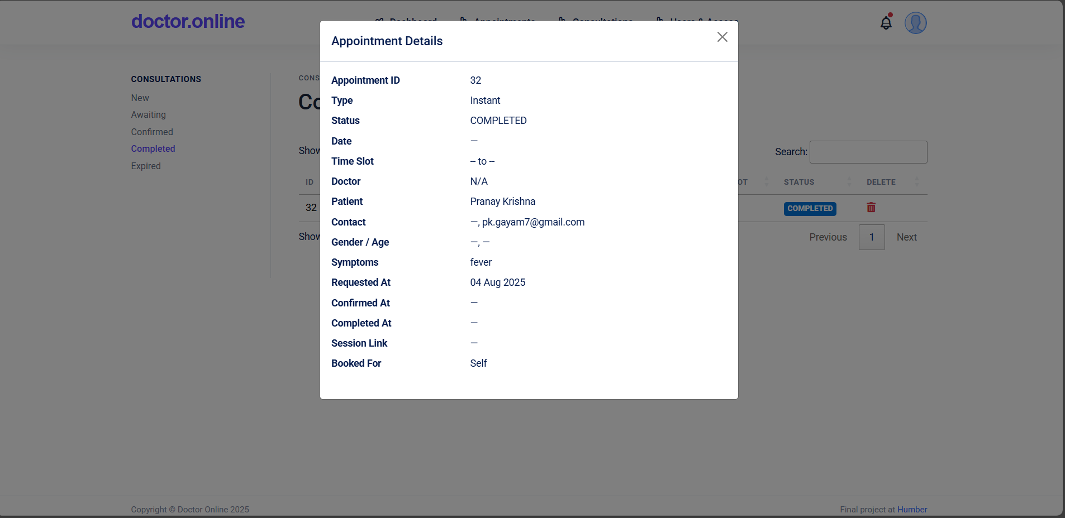
Screenshots

Slide 16
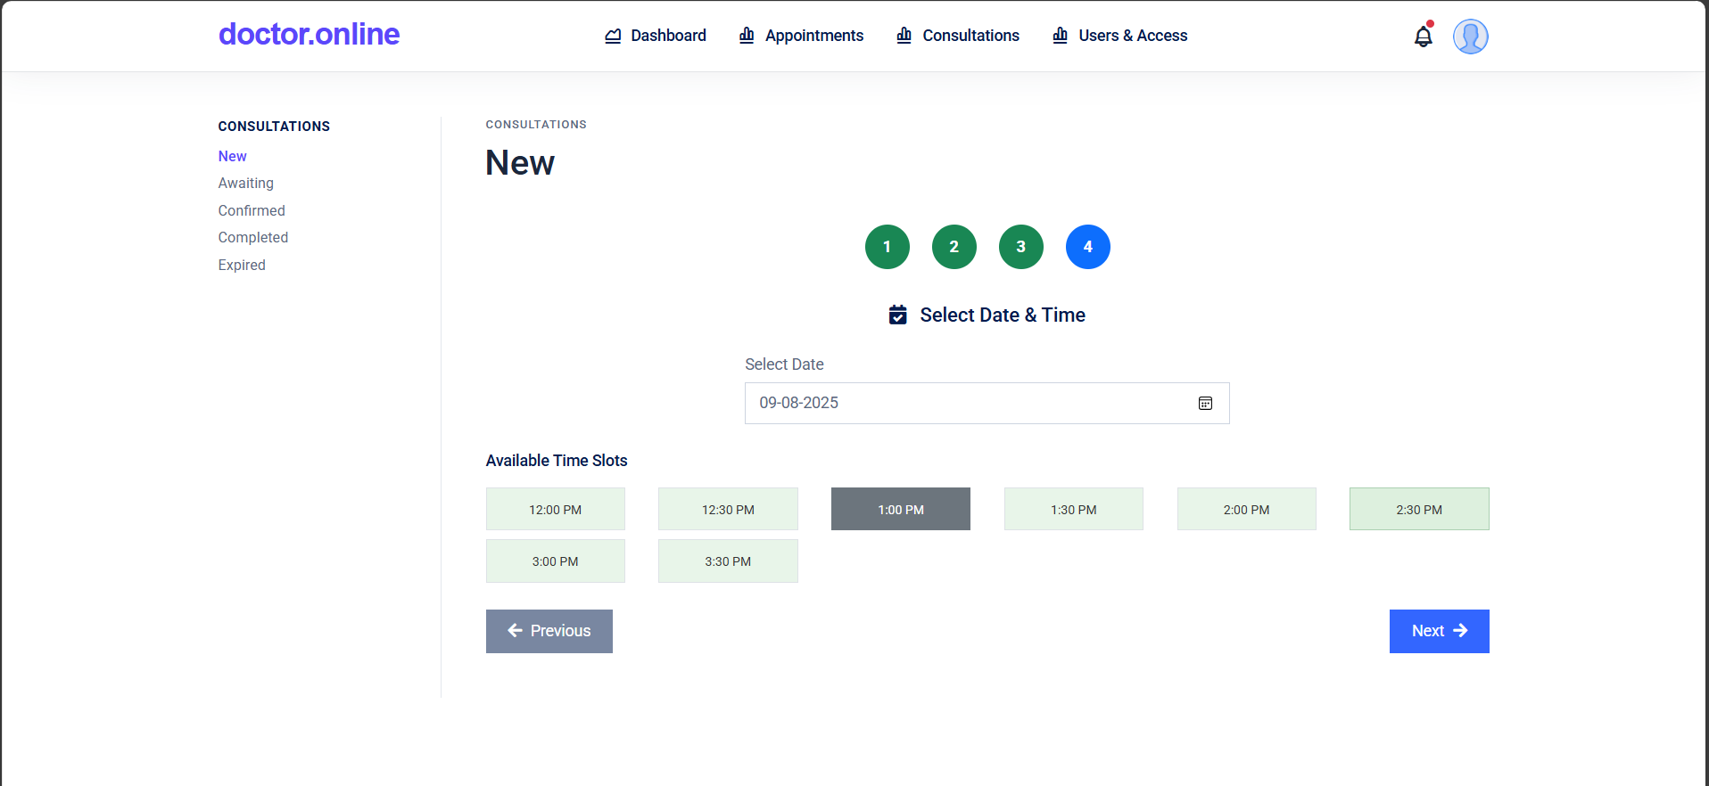
Screenshots

Slide 17
Conclusion
Doctor.Online: Transforming Virtual Healthcare
• Addresses critical gaps in healthcare accessibility
• Provides a secure, scalable, and user-friendly platform
• Future-ready with microservices and containerized deployment
Next Steps:
• Complete development of core functionalities
• Test and deploy using Docker and Podman
• Explore optional features for enhanced user experience

Slide 18
Q&A
Questions and Answers
Thank you for your attention!
We’re happy to answer any questions about Doctor.Online.

