Slide 1
blinkit Sales and Outlet Performance Analysis
Power BI • SQL • Excel • Python
A Data-Driven Approach to Business Optimization
By Srihas Guttula

Slide 2
Project Objective & Dataset Overview :
🧠 Objective:
To analyze Blinkit’s outlet-level sales, customer behavior, and item category performance across India using Power BI, Excel, SQL, and Python.
This analysis aimed to uncover actionable insights to:
• Improve category management
• Optimize outlet performance
• Support Tier-based expansion strategies
• Enhance user experience and monetization
📂 Dataset Summary:
• Time Period: 2010–2022
• Total Sales: ₹1.20M
• Total Items Sold: 8,523
• Avg Rating: 3.92
• Fields:
- Outlet Size, Type, Tier
- Product Category, Fat Content
- Ratings, Sales, Visibility
🔍 Dashboard Filters Used:
• Outlet Location Tier
• Outlet Size
• Item Type

Slide 3
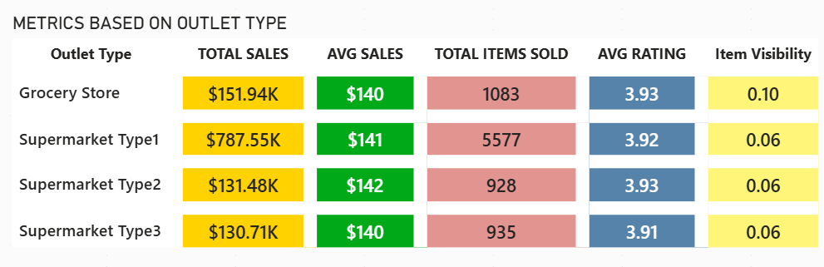
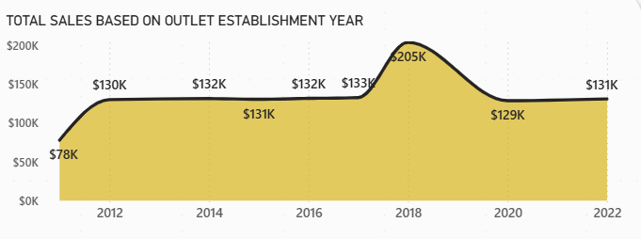
Key Metrics & Dashboard Highlights
📊 Key Metrics Tracked:
• Total Sales: ₹1.20 Million
• Total Items Sold: 8,523
• Avg Rating: 3.92 / 5
• Avg Sales per Outlet: ₹141K
• Most Profitable Outlet Size: High
• Best Performing Tier: Tier 3
• Top Outlet Type: Supermarket Type 1
• Top Categories: Fruits & Vegetables, Snacks
🔄 All metrics and charts are filterable via slicers for Tier, Size, and Item Type — allowing dynamic business exploration.

Slide 4
Business Insights & Recommendations
Insights | Recommendations
🔍 Insight 1: Tier 3 cities lead sales (₹472K) | ✅ Recommendation: Expand Tier 3 delivery hubs
🛒 Insight 2: Fruits & Snacks dominate; Breakfast lags | ✅ Promote weak items via bundle offers
🏪 Insight 3: Supermarket Type 1 = 65% revenue | ✅ Replicate this outlet format in more regions
🧭 Insight 4: High-sized outlets earn more revenue | ✅ Use as quick-delivery hubs (10–15 min)
📉 Insight 5: Sales dipped post-2018 | ✅ Win-back campaigns with loyalty perks

Slide 5
Conclusion & Key Takeaways
Summary of the Project :
Analyzed Blinkit’s sales, outlet formats, and category trends using Power BI, SQL, Excel, and Python to derive data-driven insights.
The aim was to convert raw data into actionable business insights that could guide growth, efficiency, and customer experience.
Key Business Takeaways:
📍 Tier 3 cities show revenue potential
🏪 Supermarket Type 1 leads in sales
🥣 Breakfast category underperforms
🚚 Delivery optimization possible
📈 Reactivation via loyalty campaigns
Closing Thought:
This project highlights the value of combining analytics with business-first thinking — turning data into strategies that can scale and adapt in fast-moving environments.

