Slide 1


TEEGALA KRISHNA REDDY ENGINEERING COLLEGE
Department of Computer Science & Engineering
HEAD OF THE DEPARTMENT
Dr.CH.V.PHANI KRISHNA
Professor
PROJECT COORDINATORS
A DIVYA SREE
Assistant Professor
Y SHIVA SREE
Assistant Professor

Slide 2
Chirography Documentation using OCR in CNN
INTERNAL GUIDE
A DIVYA SREE
Assistant Professor
TEAM MEMBERS
18R91A0570 - B VIJAY KUMAR
20R95A0502 A SAI SRI CHAITANAYA
20R95A0529 – V SRIHITHA REDDY

Slide 3
CONTENTS
Abstract
Existing system
Proposed system
Hardware & Software Requirements
System Architecture
Flow chart
Use case diagram
UML diagrams
Algorithm
Outputs
Conclusion
Reference

Slide 4
ABSTRACT
Chirography documentation is the capacity of a computer to accept and analyze legible handwriting input from sources such as paper documents, touch screens, pictures, and so on. One kind of pattern recognition is chirography text recognition. or categories. It is difficult to train an optical character recognition (OCR) system based on these conditions. Deep learning algorithms have produced breakthrough results in the area of handwriting recognition research in recent years Convolutional neural networks (CNNs) are particularly excellent in perceiving the structure of handwritten characters/words in ways that aid in the automated extraction of distinguishing characteristics, making CNN the best solution for solving handwriting recognition difficulties.

Slide 5
EXISTING SYSTEM
Chirography has huge variability and ambiguity of strokes from person to person.
Disadvantages:
Chirography style of an individual person also varies time to time and is inconsistent.
Cursive chirography makes separation and recognition of documentation is challenging.

Slide 6
PROPOSED SYSTEM
In the proposed system, after training and saving the model, the model contains four main stages in order to classify and detect the chirography.
Advantages:
Preprocessing,Segmentation, Feature Extraction, Classification and Recognition.
It we are looking to deploy the model in the form of an API, or by using any kind of deploying service into the web.
Then we will create an interface with the model where the user will be able to access it and then it will be saved to text document then use it accordingly.

Slide 7
Hardware & software Requirements
Software requirements:
Operating system: windows 10
Python
IDE: Notebook
Hardware requirements:
Processor: Intel Pentium 4 or equivalent
RAM: Minimum of 256 MB or higher HDD: 10 GB or higher
Monitor: 15” or 17: color monitor
Mouse: Scroll or optical mouse
Keyboard: Standard 110 keys keyboard

Slide 8
System Architecture
Training & Recognition
Input Image
Pre- Processing
Segmentation & Clipping
Output Generation
Feature Extraction
Figure: Architecture of the proposed System

Slide 9
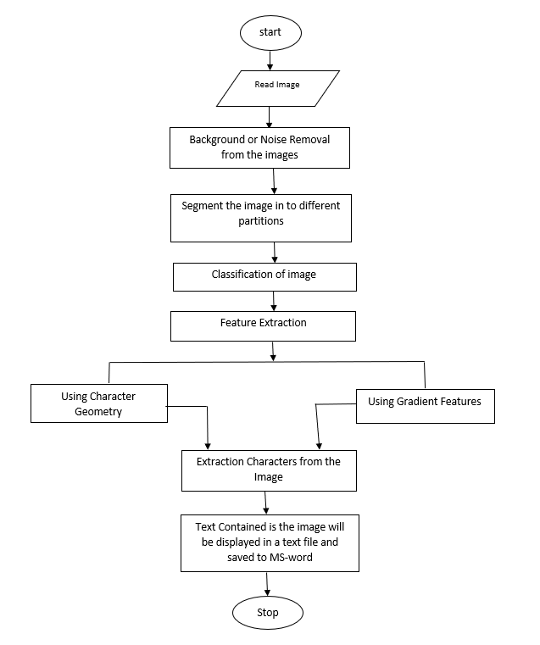
Flow Chart

Slide 10
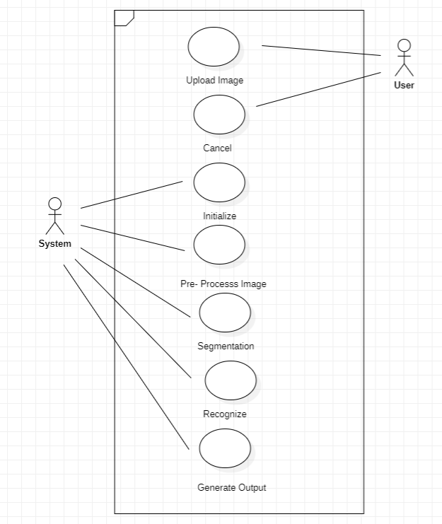
Use case Diagram

Slide 11
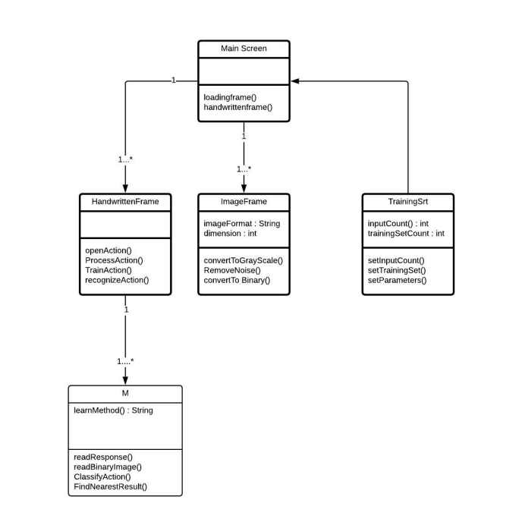
Class Diagram

Slide 12
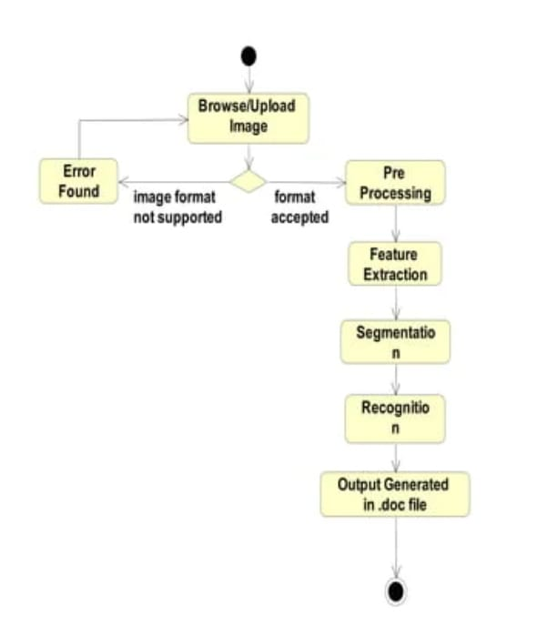
Activity Diagram

Slide 13
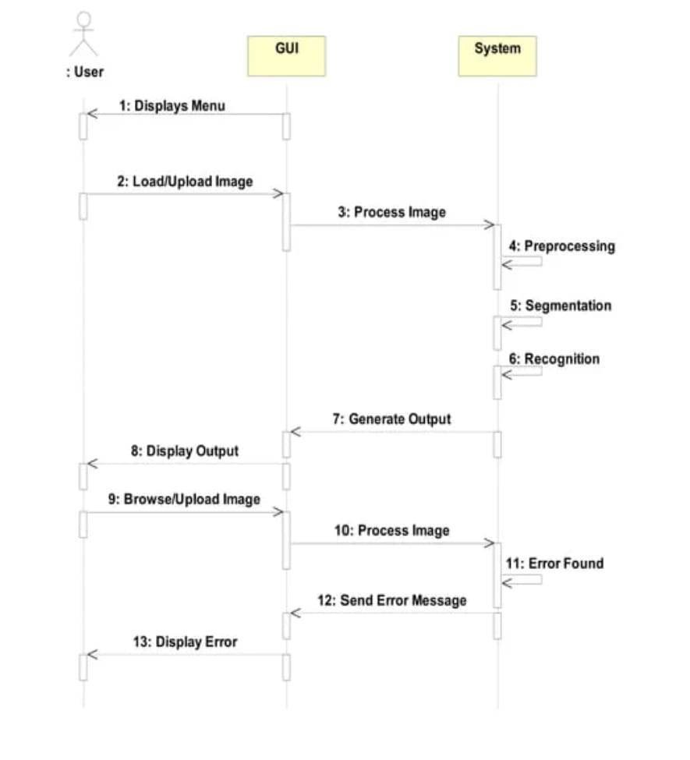
Sequence Diagram

Slide 14
Algorithm
OCR(Optical Character Recognition):
Optical Character Recognition (OCR) is the type of annotation that allows the transcription of images of typed or handwritten messages into machine-recognizable text.

Slide 15
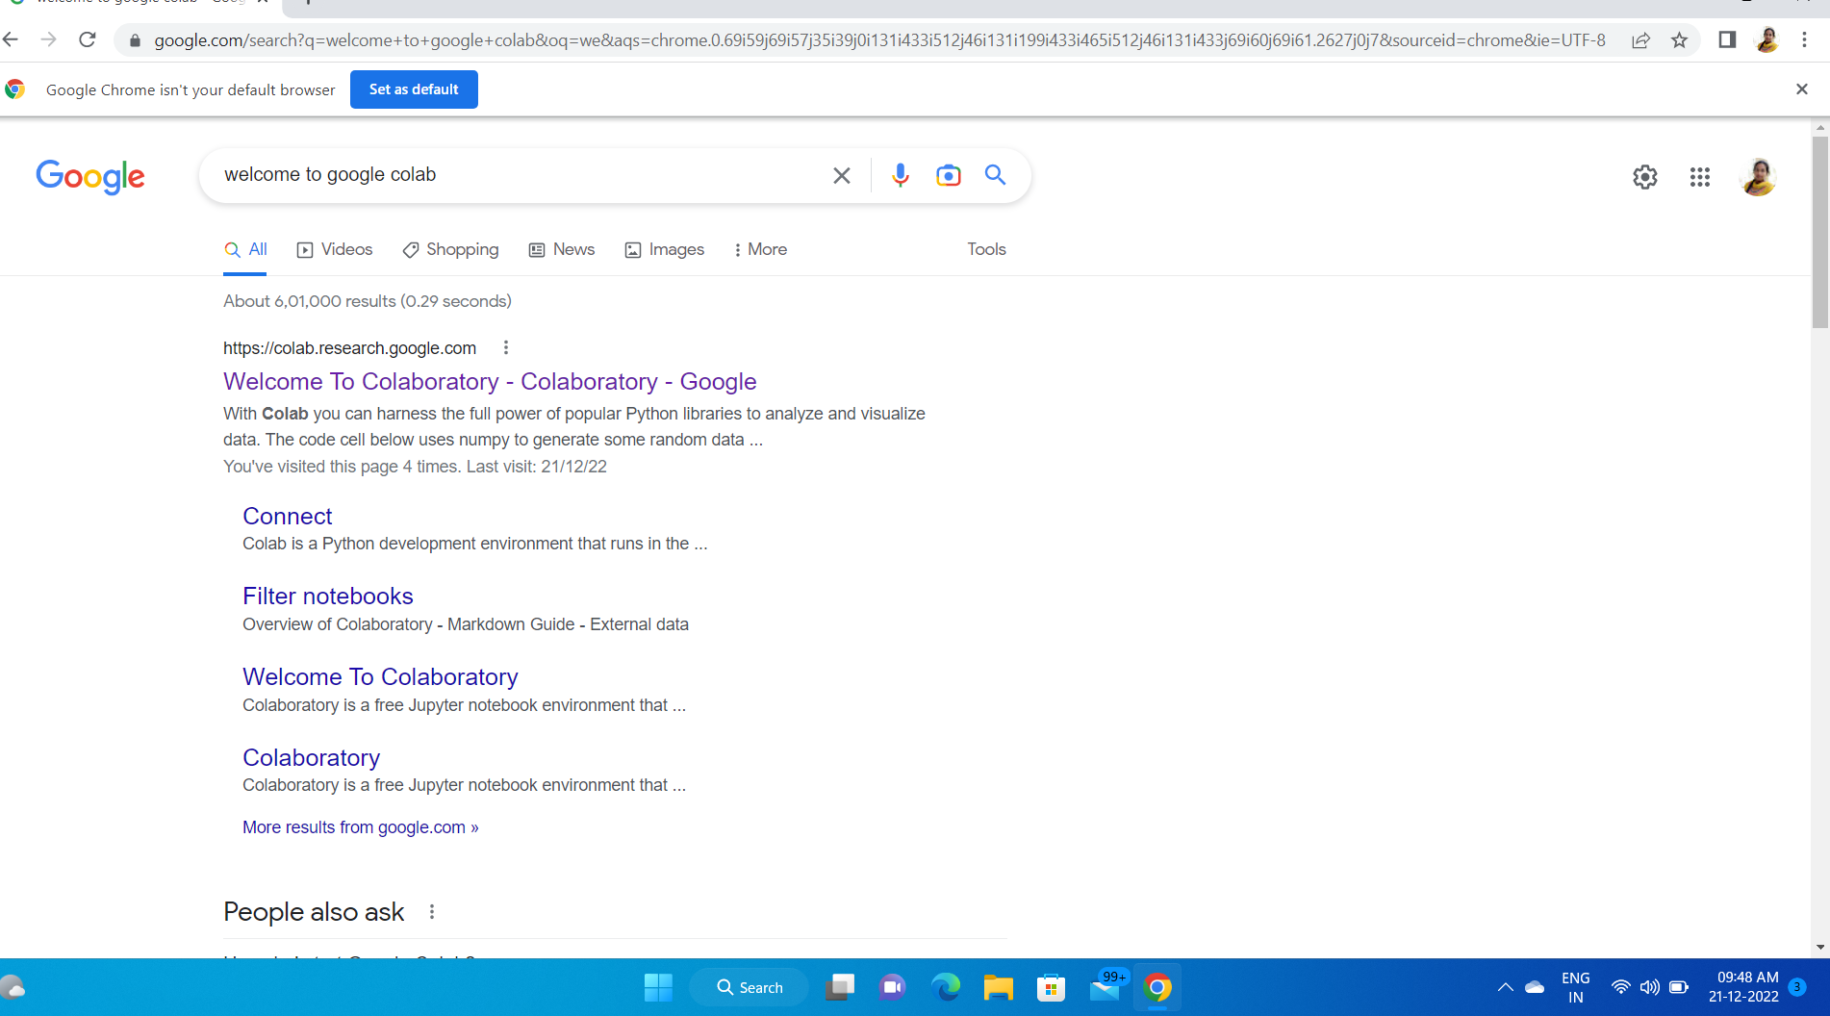

Slide 16
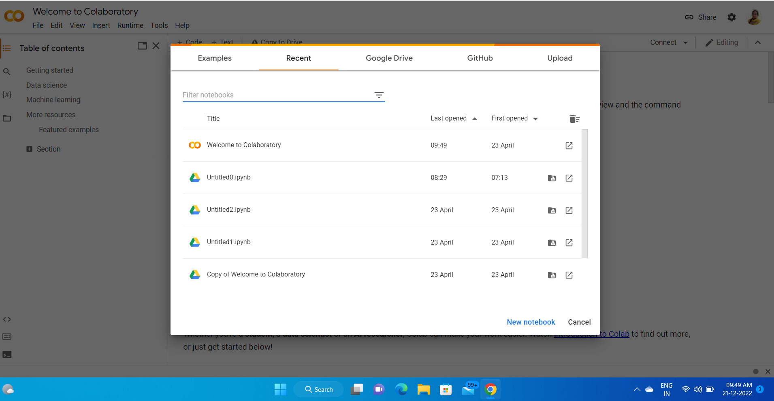

Slide 17
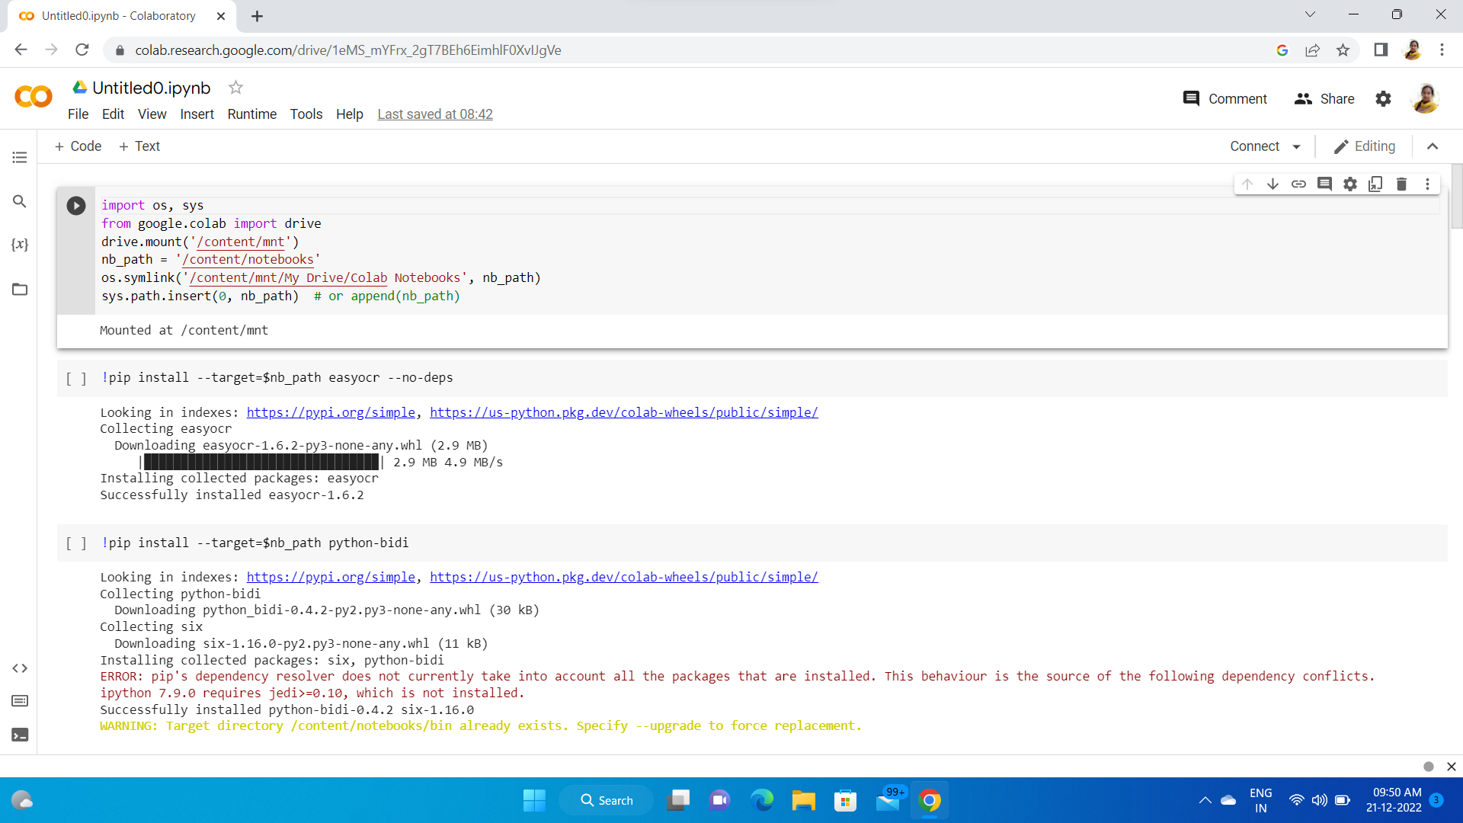

Slide 18
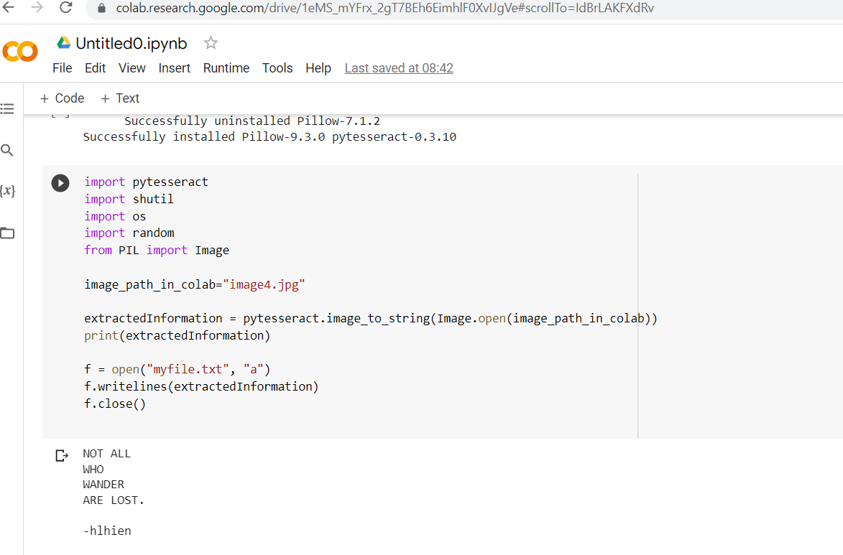

Slide 19
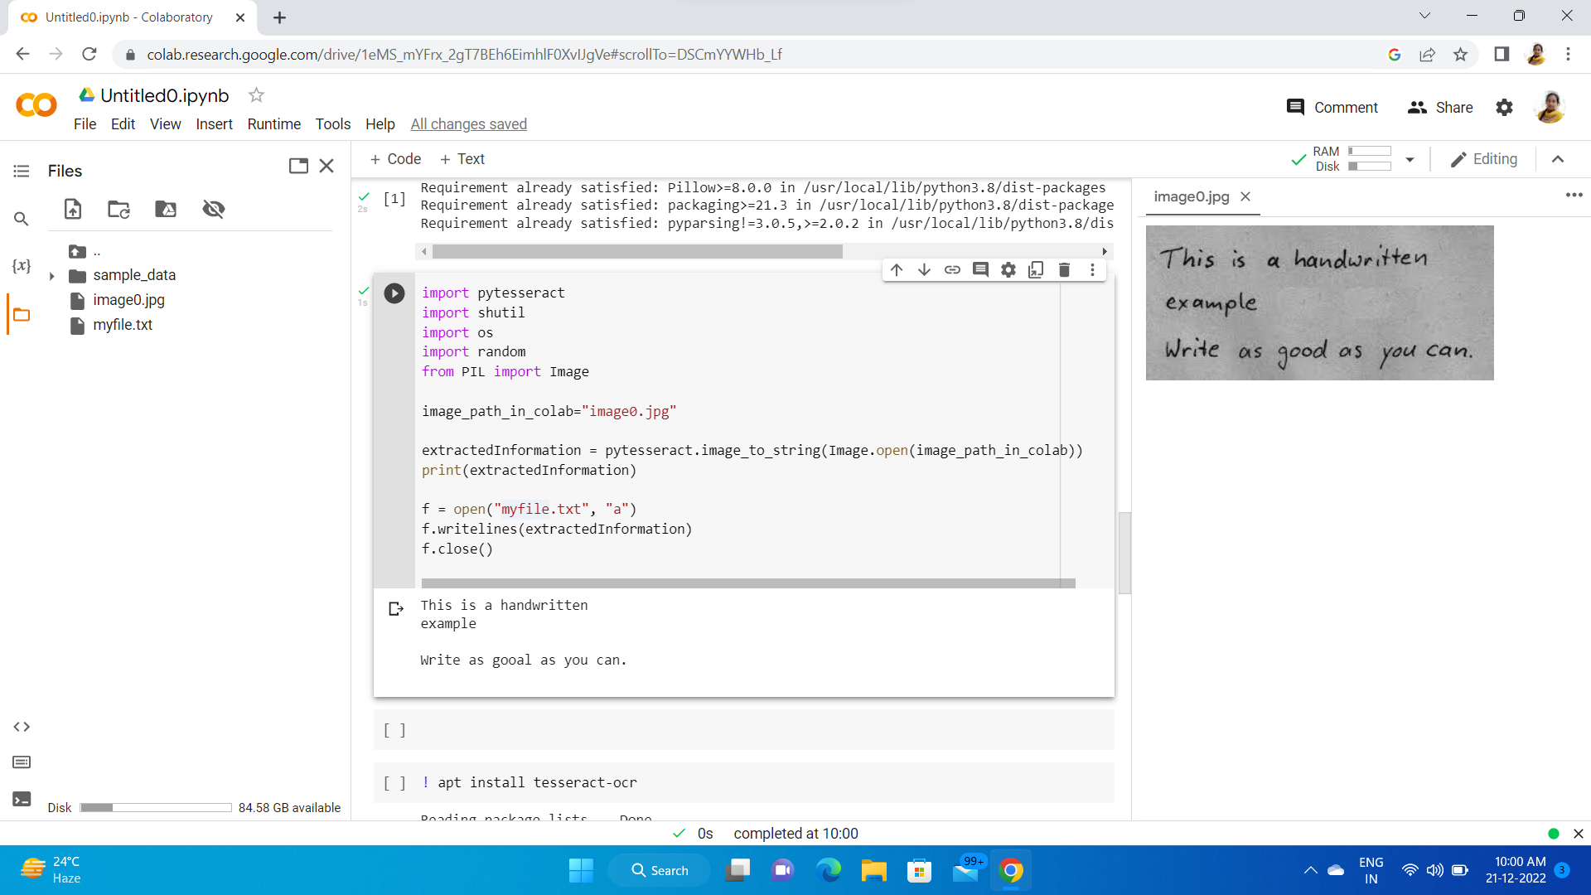

Slide 20
Conclusion
We aim to achieve highest level of accuracy that is possible for a lightweight easy to train model, with the help of freely available GPU resources and Compute time. We will be using and finalizing the best performing CRNN architecture for our model. But with the help of modern-day techniques like convolution neural networks we are able to scan and understand words with an accuracy never seen before in history.

Slide 21
References
Plamondon R and Srihari S N 2000 IEEE Trans. on Patt. Anal. and Mach. Intelligence 22 63
Kato N, Suzuki M, Omachi S I, Aso H and Nemoto Y 1999 IEEE Trans. on Patt. Anal. and Mach. Intelligence 21 258
Islam M M, Tayan O, Islam M R, Islam M S, Nooruddin S, Kabir M N and Islam M R 2020 IEEE Access 8 166117
Chaudhuri B B and Adak C 2017 Patt. Recognition 61 282
Fardous A and Afroge S 2019 Proc. Int. Conf. on Elect. Comp. and Comm. Engineering 4 1

Slide 22
THANK YOU.

